Slide 1
Place Report Title Here

Slide 2
Part 1: Critical Infrastructure Assessment
Vulnerability analysis team assignments
Participant Name | Role/Area of Expertise

Slide 3
Location Assessed

Slide 4
Analysis of Critical Infrastructure (1 of 2)
Assess Component | Information Received from Site Survey Report
Physical Conditions
Facility Operations
Facility Policies and Procedures

Slide 5
Analysis of Critical Infrastructure (2 of 2)
Assess Component | Information Received from Site Survey Report
Regulatory Requirements
Safety Considerations
Legal Considerations

Slide 6
Part 2: Critical Infrastructure Assets
Critical Infrastructure Facility Assets
People
Information
Processes
Equipment

Slide 7
Critical Asset Loss Analysis
Critical Asset | Undesirable Consequences of Critical Asset Loss | Levels of Undesirable Consequences of Critical Asset Loss | Probability of Occurrence of Undesirable Events
People
Information
Processes
Equipment

Slide 8
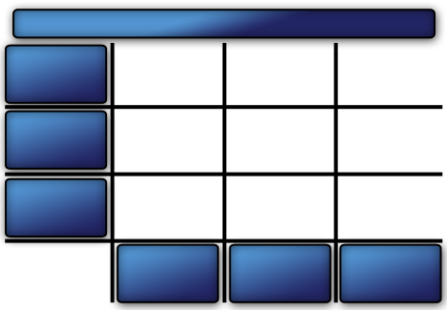
Threat Spectrum Matrix
Facility:
High
Consequence
Medium Consequence
Low
Consequence
Low
Probability
Medium Probability
High Probability

Slide 9
Part 3: Threats Estimation:
Insider Threat Information
Threat Opportunity Insider Categories | Access to Asset | Access to Physical Protection System | Knowledge of Security | Theft Opportunity | Sabotage Opportunity | Collusion Opportunity

Slide 10
Outsider Threat Information (1 of 2)
Threat Type | Threat 1
Potential Action (High, Medium, Low)
Theft
Sabotage
Other
Motivation (High, Medium, Low)
Political
Religious
Social
Economic
Personal
Other

Slide 11
Outsider Threat Information (2 of 2)
Tactics
S=Stealth, F=Force, and /or D=Deceit
Capabilities
Number
Technical expertise
Insider assistance
Weapons
Equipment/ Tools
Transportation
Other

Slide 12
Estimating Likelihood of Attack
Estimating Likelihood of Attack (L_{A}) Worksheet
Date: |  | Recorded by:
Facility identifier:
Threat type:
History/Intent | Score
Historical Interest
Historical Attacks
Current Interest In Facility
Current Surveillance
Documented Threats
Relative Attractiveness of Target | Score
Consequence
Ideology
Ease of Attack
Total Score for Threat Type |  |  |  | Sum
Sum all above scores➔
Likelihood of this Threat Type Attacking this Facility |  |  |  | L_{A}
Write threat level based on L_{A} score➔

Slide 13
Threat Analysis Statement

Slide 14
Part 4: Security Inspection and Validation and Site Visit
Deficiencies observed (include pictures, as needed):

Slide 15
On-Site Measurements
Distance from the nearest point a vehicle can approach outside of security to the facility:
Distance from parking area to the building:
Distance from parking area to the asset(s):
Distance to other critical infrastructure:
Distance to other open areas:
Distance between asset(s):
Distance to other significant threat(s) (such as hazardous material, train tracks):

Slide 16
Part 5: Standoff Distances (1 of 2)
Vehicle:
  Lethal air blast:
  Minimum evacuation distance:
  Falling glass hazard:
  Building evacuation distance:

Slide 17
Part 5: Standoff Distances (2 of 2)
Suicide Bomber:
  Minimum evacuation distance:
  Building evacuation distance:

Slide 18
Part 6: Security Countermeasure Recommendation (1 of 2)
Recommended upgrades to mitigate threat from large vehicle bomb:

Slide 19
Part 6: Security Countermeasure Recommendation (2 of 2)
Recommended upgrades to mitigate threat from suicide bomber:

Slide 20
Part 6: Operational Resilience Plan
Additional recommendations and operational resilience plan statement:

Slide 21
Conclusion

