Slide 1
Course Introduction
Module 1

Slide 2
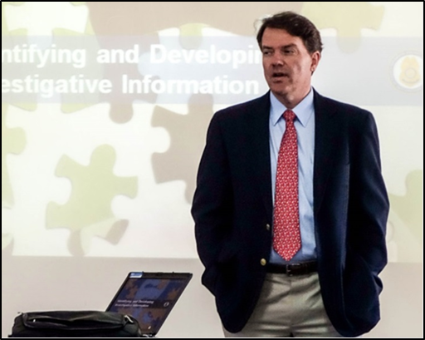
Facilitator Introductions
Name
Position
Professional experience
Course expectations
Source: DS/T/ATA
Facilitator Introductions
Name
Position
Professional experience
Course expectations

Slide 3

Participant Introductions
Please provide:
  Name
  Position
  Professional experience
  Course expectations
Source: Getty Images
Participant Introductions
Please provide:
  Name
  Position
  Professional experience
  Course expectations

Slide 4

Introduction to Course Materials
Participant Workbook
Course materials
  Compact disc
Source: Getty Images
Introduction to Course Materials
Participant Workbook
Course materials
  Compact disc

Slide 5
Office of Antiterrorism Assistance (ATA)
Created by US Congress in 1983
Formed as a major initiative against international terrorism
Provides training and related assistance to law enforcement and security services worldwide
Office of Antiterrorism Assistance (ATA)
Created by US Congress in 1983
Formed as a major initiative against international terrorism
Provides training and related assistance to law enforcement and security services worldwide

Slide 6
Course Purpose
To provide the skills and techniques needed to develop a process to assess and mitigate vulnerabilities of critical infrastructure and plan for resilience
Course Purpose
To provide the skills and techniques needed to develop a process to assess and mitigate vulnerabilities of critical infrastructure and plan for resilience

Slide 7
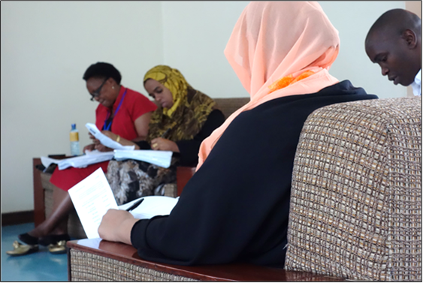
Instructional Strategies
Lecture
Case studies
Large-group discussion
Small-group activities
Demonstration
TeachBack moment
Source: DS/T/ATA
Instructional Strategies
Lecture
Case studies
Large-group discussion
Small-group activities
Demonstration
TeachBack moment

Slide 8

Classroom Etiquette
Share ideas
Ask questions
Silence cell phones
Report to class on time
Source: Getty Images
Classroom Etiquette
Share ideas
Ask questions
Silence cell phones
Report to class on time

Slide 9
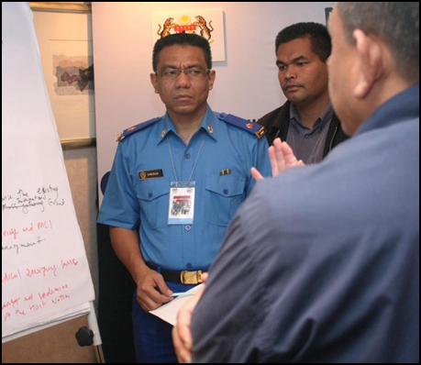
Course Logistics
Class representative
Facilities
Daily schedule
Class photo
Source: DS/T/ATA
Course Logistics
Class representative
Facilities
Daily schedule
Class photo

Slide 10

Course Schedule (1 of 2)
Refer To:
Workbook 1.1
Day(s) | Milestones
1 | Introduction to Critical Infrastructure Security and Resilience
2 | Community Engagement and Human Rights; Building Community Partnerships; Components of Critical Infrastructure
3 | Critical Infrastructure Assets; Cybersecurity; Surveillance Detection Overview
4–5 | Explosives and Critical Infrastructure; Analyzing the Threat
Course Schedule (1 of 2)
Refer To:
Workbook 1.1
Day(s) | Milestones
1 | Introduction to Critical Infrastructure Security and Resilience
2 | Community Engagement and Human Rights; Building Community Partnerships; Components of Critical Infrastructure
3 | Critical Infrastructure Assets; Cybersecurity; Surveillance Detection Overview
4–5 | Explosives and Critical Infrastructure; Analyzing the Threat

Slide 11
Course Schedule (2 of 2)
Refer To:
Workbook 1.1
Day(s) | Milestones
5 | Policies and Procedures
6 | Security Force Operations; Security Technology
7–9 | Security Inspection and Validation; Operational Resilience; Capstone Exercise
10 | Summary, Evaluation, and Commencement
Course Schedule (2 of 2)
Refer To:
Workbook 1.1
Day(s) | Milestones
5 | Policies and Procedures
6 | Security Force Operations; Security Technology
7–9 | Security Inspection and Validation; Operational Resilience; Capstone Exercise
10 | Summary, Evaluation, and Commencement

Slide 12


Knowledge Survey
Refer To:
Handout 1.1
Measures course effectiveness
Is not graded
Does not require your name
Source: Getty Images
Knowledge Survey
Refer To:
Handout 1.1
Measures course effectiveness
Is not graded
Does not require your name

