Slide 1
Introduction to Critical Infrastructure Security and Resilience
Module 2

Slide 2
Module Objective
By the end of this module, you will be able to describe the importance of implementing a well-designed physical protection system for the security of critical infrastructure
Module Objective
By the end of this module, you will be able to describe the importance of implementing a well-designed physical protection system for the security of critical infrastructure

Slide 3
Critical Infrastructure
Systems and assets, whether physical or virtual, so vital to the nation that the incapacity or destruction of such systems and assets would have a debilitating impact on:
  Security
  National economic security
  National public health or safety
  Any combination of those matters
Critical Infrastructure
Systems and assets, whether physical or virtual, so vital to the nation that the incapacity or destruction of such systems and assets would have a debilitating impact on:
  Security
  National economic security
  National public health or safety
  Any combination of those matters

Slide 4
Security
The implementation of a set of procedures and processes that when taken as a whole have the effect of altering the ratio of undesirable events to total event based on:
  Identified risks
  Threats
  Vulnerabilities
  Probability of an undesirable occurrence
Security
The implementation of a set of procedures and processes that when taken as a whole have the effect of altering the ratio of undesirable events to total event based on:
  Identified risks
  Threats
  Vulnerabilities
  Probability of an undesirable occurrence

Slide 5
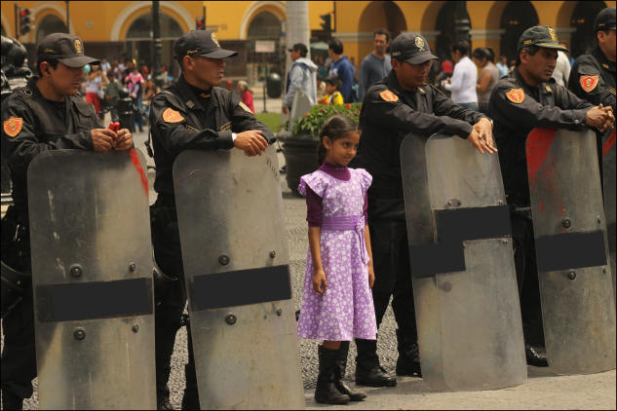
Need for Security
Protect lives and property
Sustain critical assets
Maintain political and economic stability
Need for Security
Protect lives and property
Sustain critical assets
Maintain political and economic stability
Source: Creative Commons

Slide 6
Building Community Partnerships
Protecting and ensuring the resilience of critical infrastructure requires partnerships with multiple entities:
  Government
  Private sector
  Academic and professional
  Certain not-for-profit and private volunteer organizations
Building Community Partnerships
Protecting and ensuring the resilience of critical infrastructure requires partnerships with multiple entities:
  Government
  Private sector
  Academic and professional
  Certain not-for-profit and private volunteer organizations

Slide 7

Surveillance Awareness Overview
A defensive security operation
Observe, detect, and report hostile surveillance
Crucial to protection of critical infrastructures
Used in cyber security operations
Surveillance Awareness Overview
A defensive security operation
Observe, detect, and report hostile surveillance
Crucial to protection of critical infrastructures
Used in cyber security operations
Source: Getty Images

Slide 8
Vulnerability
A physical feature or operational attribute that renders an entity open to exploitation or susceptible to given threat
Vulnerability
A physical feature or operational attribute that renders an entity open to exploitation or susceptible to given threat

Slide 9
Vulnerability Analysis
A product or process of identifying physical features or operational attributes that renders an entity, asset, system, network, or geographic area susceptible or exposed to threats
Vulnerability Analysis
A product or process of identifying physical features or operational attributes that renders an entity, asset, system, network, or geographic area susceptible or exposed to threats

Slide 10
Discussion Question
What are some examples of critical infrastructure security problems you may need to address?
Discussion Question
What are some examples of critical infrastructure security problems you may need to address?

Slide 11
Vulnerability Analysis Purpose
Evaluate the effectiveness of implemented security countermeasures
Preserve limited resources
Provide security managers with accurate information in support of security decision making
Vulnerability Analysis Purpose
Evaluate the effectiveness of implemented security countermeasures
Preserve limited resources
Provide security managers with accurate information in support of security decision making

Slide 12

TeachBack Moment
What is the purpose of conducting a critical infrastructure vulnerability analysis?
TeachBack Moment
What is the purpose of conducting a critical infrastructure vulnerability analysis?

Slide 13
Physical Protection System Definition
An integration of people, policies and procedures, and equipment for the protection of assets or facilities against all threats
Physical Protection System Definition
An integration of people, policies and procedures, and equipment for the protection of assets or facilities against all threats

Slide 14

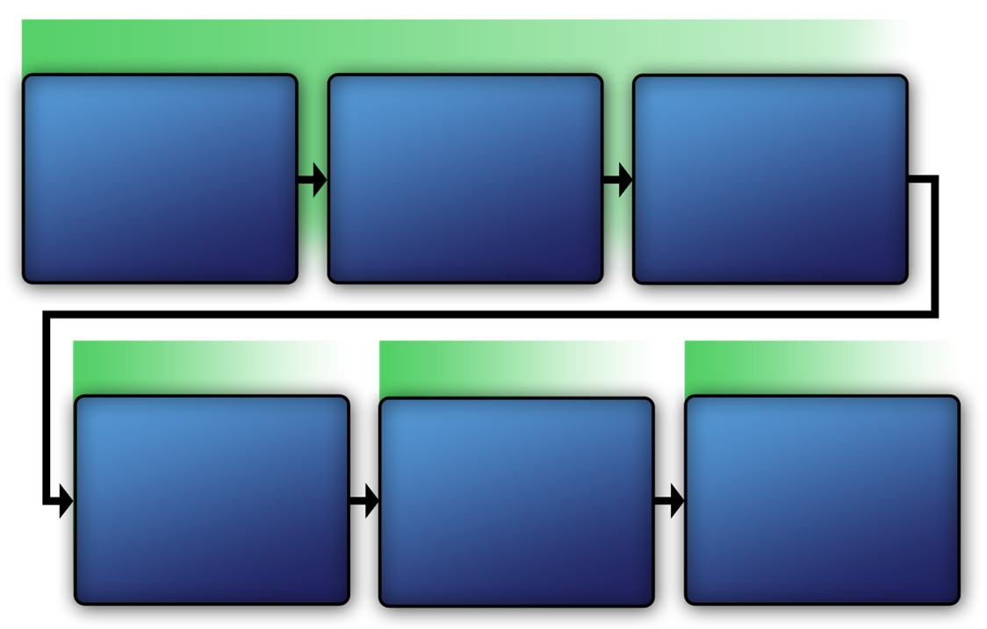
Physical Protection
System Diagram
Refer To:
Workbook 2.1
Identify Critical Infrastructure
Assess Critical Infrastructure Components
Identify Critical Infrastructure Assets
Analyze
the
Threat
Identify
Security Counter-
measures
Develop
Operational
Resilience
Physical Protection
System Diagram
Refer To:
Workbook 2.1
Identify Critical Infrastructure
Assess Critical Infrastructure Components
Identify Critical Infrastructure Assets
Analyze
the
Threat
Identify
Security Counter-
measures
Develop
Operational
Resilience
Physical Protection
System Diagram
Refer to
Addendum 2.1

Slide 15
Physical Protection
System Components
Refer To:
Workbook 2.1
Design and implementation of an effective physical protection system begins with vulnerability analysis
Physical Protection
System Components
Refer To:
Workbook 2.1
Design and implementation of an effective physical protection system begins with vulnerability analysis

Slide 16

Step 1: Identify
Critical Infrastructure
Refer To:
Workbook 2.1
Identify critical infrastructure to assess any associated security countermeasures
Step 1: Identify
Critical Infrastructure
Refer To:
Workbook 2.1
Identify critical infrastructure to assess any associated security countermeasures

Slide 17
Critical Infrastructure Categories
Refer To:
Workbook 2.1
What are some categories of critical infrastructure?
Critical Infrastructure Categories
Refer To:
Workbook 2.1
What are some categories of critical infrastructure?

Slide 18
Step 2: Assess Critical Infrastructure Components
Refer To:
Workbook 2.1
Environmental conditions
Physical conditions
Facility operations
Facility policies and procedures
Regulatory requirements
Safety considerations
Step 2: Assess Critical Infrastructure Components
Refer To:
Workbook 2.1
Environmental conditions
Physical conditions
Facility operations
Facility policies and procedures
Regulatory requirements
Safety considerations

Slide 19
Purpose of Critical Infrastructure Component Assessment
Prioritize efforts
Use limited resources more efficiently
Implement security countermeasures on the most important facilities
Purpose of Critical Infrastructure
Component Assessment
Prioritize efforts
Use limited resources more efficiently
Implement security countermeasures on the most important facilities

Slide 20
Step 3: Identify Critical Infrastructure Assets
Refer To:
Workbook 2.1
Critical assets typically are in one of four categories:
  People
  Information
  Processes
  Equipment (technology)
Step 3: Identify Critical Infrastructure Assets
Refer To:
Workbook 2.1
Critical assets typically are in one of four categories:
  People
  Information
  Processes
  Equipment (technology)

Slide 21
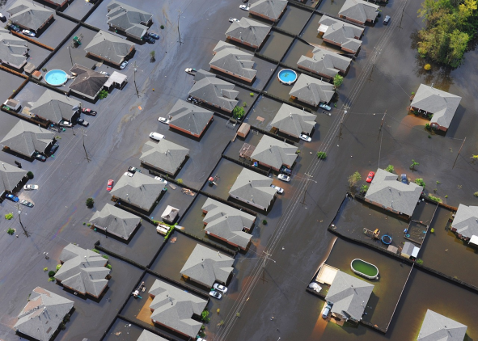
Prioritize
Critical Infrastructure Assets
Identify threats
Specify undesirable consequences of loss
Determine the probability of occurrence
Prioritize
Critical Infrastructure Assets
Identify threats
Specify undesirable consequences of loss
Determine the probability of occurrence
Source: Creative Commons Public Domain

Slide 22
Identify Threats
Nonavailability
Loss or theft
Compromise
Destruction
Sabotage
Assault
Impaired operations
Cyberattack
Identify Threats
Nonavailability
Loss or theft
Compromise
Destruction
Sabotage
Assault
Impaired operations
Cyberattack

Slide 23
Undesirable Consequences of Loss
For every asset specify all undesirable consequences of loss
Assign values to each of the consequences specified:
  Low
  Medium
  High
Undesirable Consequences of Loss
For every asset specify all undesirable consequences of loss
Assign values to each of the consequences specified:
  Low
  Medium
  High

Slide 24
Probability of Occurrence
Evaluate the probability of attack by analyzing:
  Intelligence information
  The effectiveness of existing security countermeasures
Assign value of low, medium, or high to the probability
Probability of Occurrence
Evaluate the probability of attack by analyzing:
  Intelligence information
  The effectiveness of existing security countermeasures
Assign value of low, medium, or high to the probability

Slide 25

Critical Infrastructure
Assets Activity
Refer To:
Handout 2.1
Purpose: to identify critical assets for a standard government facility that houses the Head of State or other dignitaries
  Duration: 20 minutes (15-activity; 5-debrief)
  Group composition: table groups
  Debrief: large-group discussion
Critical Infrastructure
Assets Activity
Refer To:
Handout 2.1
Purpose: to identify critical assets for a standard government facility that houses the Head of State or other dignitaries
  Duration: 20 minutes (15-activity; 5-debrief)
  Group composition: table groups
  Debrief: large-group discussion

Slide 26
Step 4: Analyze the Threat
Refer To:
Workbook 2.1
Examine the characteristics of the threat
Formalize the information in the threat analysis statement to:
  Summarize gathered information
  Identify facility threats
  Evaluate an infrastructure’s physical protection system
Step 4: Analyze the Threat
Refer To:
Workbook 2.1
Examine the characteristics of the threat
Formalize the information in the threat analysis statement to:
  Summarize gathered information
  Identify facility threats
  Evaluate an infrastructure’s physical protection system

Slide 27
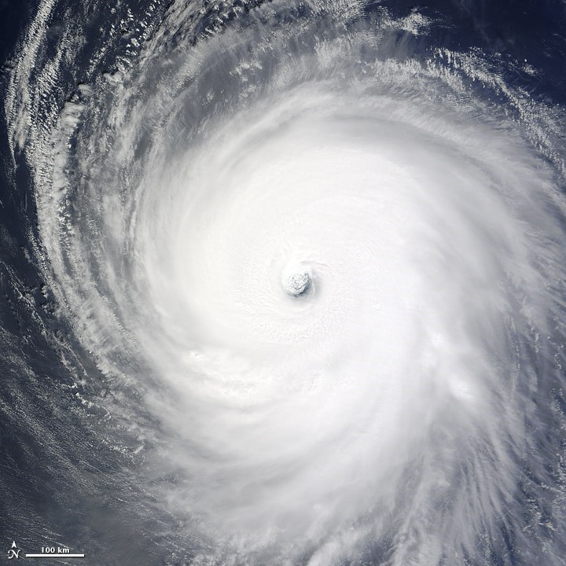
Natural Disaster Threat
Characteristics to Consider
Before drafting the threat analysis statement, consider the following:
  Type of disaster
  Potential effects
  Areas affected
Source: NASA
Natural Disaster Threat
Characteristics to Consider
Before drafting the threat analysis statement, consider the following:
  Type of disaster
  Potential effects
  Areas affected

Slide 28
Discussion Questions
What are some natural disaster threats in your area?
What are the potential effects?
Discussion Questions
What are some natural disaster threats in your area?
What are the potential effects?

Slide 29

Terrorist Threat
Characteristics to Consider
Before drafting the threat analysis statement, consider the terrorists’:
  Motivations
  Types of threats
  Equipment and weapons
  Tactics
Terrorist Threat
Characteristics to Consider
Before drafting the threat analysis statement, consider the terrorists’:
  Motivations
  Types of threats
  Equipment and weapons
  Tactics
Source: Getty Images

Slide 30
Discussion Question
Which types of terrorist threats are most likely in your region?
Discussion Question
Which types of terrorist threats are most likely in your region?

Slide 31
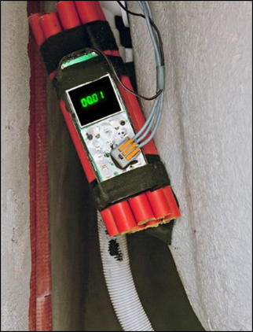
Equipment and Weapons
Knowing the range of possible weapons allows for implementation of appropriate security measures
Terrorists typically use improvised explosive devices
Equipment and Weapons
Knowing the range of possible weapons allows for implementation of appropriate security measures
Terrorists typically use improvised explosive devices
Source: Getty Images

Slide 32
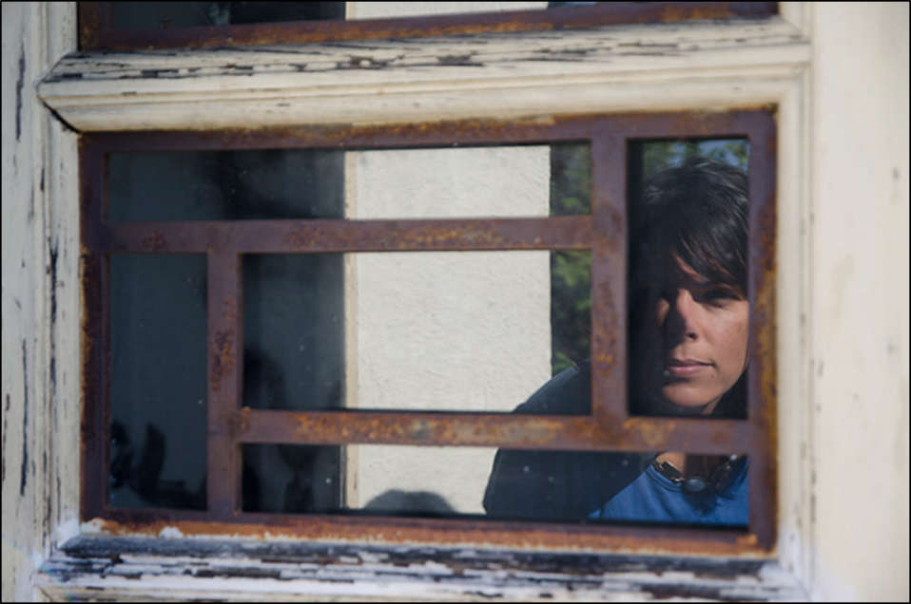
Terrorist Tactics
Force
Stealth
Deceit
Source: Getty Images
Terrorist Tactics
Force
Stealth
Deceit

Slide 33
Step 5: Security
Inspection and Validation
Refer To:
Workbook 2.1
Identify and evaluate security countermeasures:
  Effectiveness
  Recommendations for improvement
Provide evaluation criteria:
  Validate each security countermeasure
  Determine overall effectiveness of existing physical protection system
Step 5: Security
Inspection and Validation
Refer To:
Workbook 2.1
Identify and evaluate security countermeasures:
  Effectiveness
  Recommendations for improvement
Provide evaluation criteria:
  Validate each security countermeasure
  Determine overall effectiveness of existing physical protection system

Slide 34
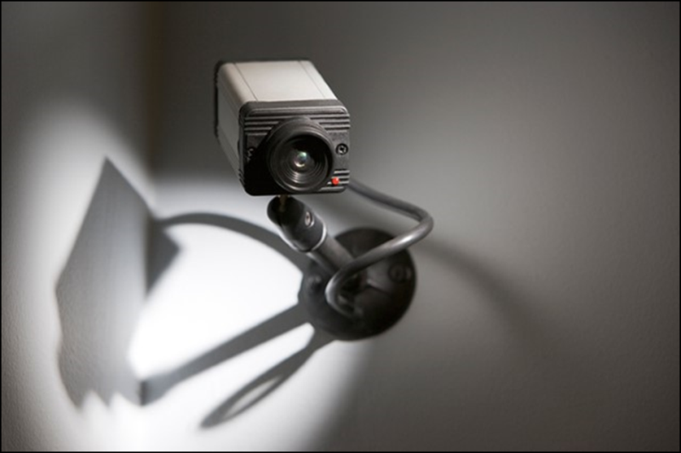
Effective Security Countermeasures
Should be designed to protect against the types and level of threats identified during the threat analysis
Source: Getty Images
Effective Security Countermeasures
Should be designed to protect against the types and level of threats identified during the threat analysis

Slide 35

Evaluate Security Countermeasures
To determine effectiveness, assess the following elements:
  Policies and procedures
    Security force
    Technology
Source: Getty Images
Evaluate Security Countermeasures
To determine effectiveness, assess the following elements:
  Policies and procedures
    Security force
    Technology

Slide 36
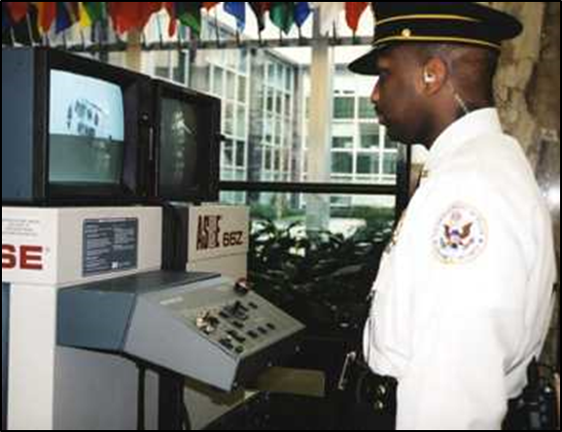
Policies and Procedures
Should focus on:
  Security force
  Technology
Source: DS/T/ATA
Policies and Procedures
Should focus on:
  Security force
  Technology

Slide 37
Policies and Procedures for
Security Countermeasures (1 of 2)
Should include:
  Perimeter barriers
  Lighting
  Intruder detection systems
  Closed-circuit television
  Automated access control system
Policies and Procedures for
Security Countermeasures (1 of 2)
Should include:
  Perimeter barriers
  Lighting
  Intruder detection systems
  Closed-circuit television
  Automated access control system

Slide 38
Policies and Procedures for
Security Countermeasures (2 of 2)
  Security officers and patrols (security force)
  Lock and key controls
  Entry control areas
  Secure asset locations
  Bomb threat management
  Information technology
Policies and Procedures for
Security Countermeasures (2 of 2)
  Security officers and patrols (security force)
  Lock and key controls
  Entry control areas
  Secure asset locations
  Bomb threat management
  Information technology

Slide 39
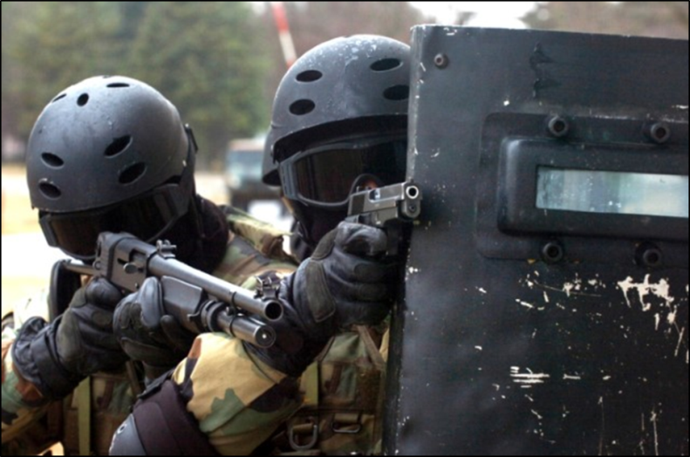
Security Force Purpose
Effectively interrupt actions and neutralize terrorists or threats before they achieve their goal
Source: DS/T/ATA
Security Force Purpose
Effectively interrupt actions and neutralize terrorists or threats before they achieve their goal

Slide 40
Security Force Elements
Elements that contribute to the effectiveness of a security force include:
  Selection of security force members
  Initial and continuous training
  Deployment of adequate equipment
  Appropriate supervision from command and control
Security Force Elements
Elements that contribute to the effectiveness of a security force include:
  Selection of security force members
  Initial and continuous training
  Deployment of adequate equipment
  Appropriate supervision from command and control

Slide 41
Security Force Effectiveness
Depends on the:
  Ability to operate within established policies and procedures
  Capability of the technology to detect, assess, and provide adequate delay
Security Force Effectiveness
Depends on the:
  Ability to operate within established policies and procedures
  Capability of the technology to detect, assess, and provide adequate delay

Slide 42
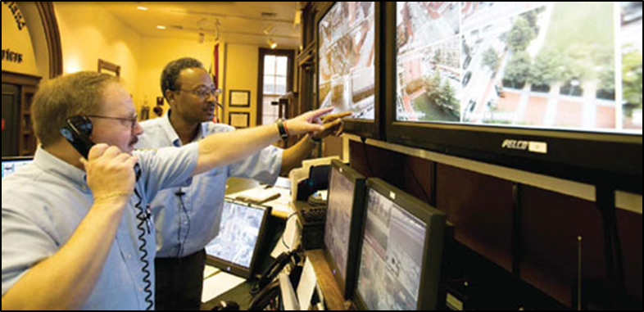
Technology Purpose
Security managers must consider technical and nontechnical solutions that will:
  Detect terrorists or intruders (intrusion detection systems)
  Delay terrorists from progressing towards the target (barriers)
Technology Purpose
Security managers must consider technical and nontechnical solutions that will:
  Detect terrorists or intruders (intrusion detection systems)
  Delay terrorists from progressing towards the target (barriers)
Source: FBI

Slide 43
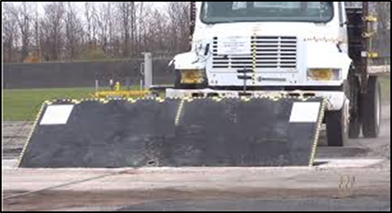
Technology Elements
Intrusion detection systems
Barriers
Technology Elements
Intrusion detection systems
Barriers
Source: General Services Administration

Slide 44
Technology Supports
Physical Protection System Effectiveness
Protection-in-depth
Minimum consequences of component failure
Balanced protection
Technology Supports
Physical Protection System Effectiveness
Protection-in-depth
Minimum consequences of component failure
Balanced protection

Slide 45
Step 6: Develop
Operational Resilience
Refer To:
Workbook 2.1
Refine and clarify functional relationships across agencies
Enable effective information exchange
Implement an integration and analysis function to inform planning
Step 6: Develop
Operational Resilience
Refer To:
Workbook 2.1
Refine and clarify functional relationships across agencies
Enable effective information exchange
Implement an integration and analysis function to inform planning

Slide 46

TeachBack Moment
What are the components of a physical protection system?
TeachBack Moment
What are the components of a physical protection system?

Slide 47
Security System
Recommendations (1 of 3)
Developed as a result from:
  Limited scope performance testing: conducting tests on specific elements of a physical protection system
  Gap analysis: identifying the gap between existing and required countermeasures
Security System
Recommendations (1 of 3)
Developed as a result from:
  Limited scope performance testing: conducting tests on specific elements of a physical protection system
  Gap analysis: identifying the gap between existing and required countermeasures

Slide 48
Security System
Recommendations (2 of 3)
  Feasibility: determining whether a solution is suitable or logical
  Resilience: the ability to prepare for and adapt to changing conditions and withstand and recover rapidly from disruptions such as deliberate attacks, accidents, or naturally occurring threats or incidents
Security System
Recommendations (2 of 3)
  Feasibility: determining whether a solution is suitable or logical
  Resilience: the ability to prepare for and adapt to changing conditions and withstand and recover rapidly from disruptions such as deliberate attacks, accidents, or naturally occurring threats or incidents

Slide 49
Security System
Recommendations (3 of 3)
  Acceptability: determining whether the recommended security countermeasure provides the required protection and falls within scope of available resources
Security System
Recommendations (3 of 3)
  Acceptability: determining whether the recommended security countermeasure provides the required protection and falls within scope of available resources

Slide 50
Physical Protection
System Functions
Refer To:
Workbook 2.2
Detection and assessment
Delay
Response
Physical Protection
System Functions
Refer To:
Workbook 2.2
Detection and assessment
Delay
Response

Slide 51
Physical Protection
System Functions Activity
Refer To:
Workbook 2.2
Purpose: to indicate which function of a physical protection system a specified action describes
  Duration: 10 minutes (5-activity; 5-debrief)
  Group composition: table groups
  Debrief: large-group discussion
Physical Protection
System Functions Activity
Refer To:
Workbook 2.2
Purpose: to indicate which function of a physical protection system a specified action describes
  Duration: 10 minutes (5-activity; 5-debrief)
  Group composition: table groups
  Debrief: large-group discussion

Slide 52
Critical Infrastructure Interdependence
Critical infrastructure is no longer limited to public works systems
Redefined to increase security and awareness to deter attacks
Critical Infrastructure Interdependence
Critical infrastructure is no longer limited to public works systems
Redefined to increase security and awareness to deter attacks

Slide 53
Examples, Threats, and Vulnerabilities
Necessary knowledge:
  Which critical elements to protect
  How to protect each critical element
Must understand the threats and vulnerabilities facing the managers of critical infrastructure, in each category or sector
Examples, Threats, and Vulnerabilities
Necessary knowledge:
  Which critical elements to protect
  How to protect each critical element
Must understand the threats and vulnerabilities facing the managers of critical infrastructure, in each category or sector

Slide 54

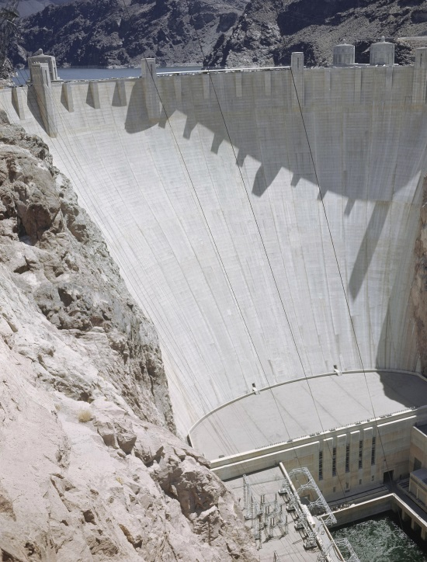
Critical Infrastructure
Categories (1 of 3)
Refer To:
Handout 2.2
Chemical
Commercial facilities
Communications
Critical manufacturing
Dams
Source: AP Images
Critical Infrastructure
Categories (1 of 3)
Refer To:
Handout 2.2
Chemical
Commercial facilities
Communications
Critical manufacturing
Dams

Slide 55
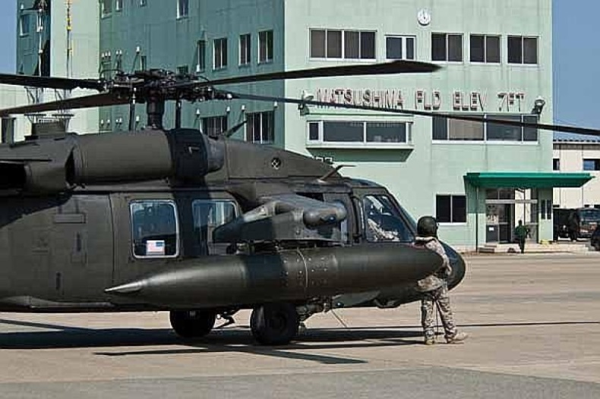
Critical Infrastructure
Categories (2 of 3)
Refer To:
Handout 2.2
Defense industrial base
Emergency services
Energy
Financial services
Food and agriculture
Government facilities
Source: Stars and Stripes
Critical Infrastructure
Categories (2 of 3)
Refer To:
Handout 2.2
Defense industrial base
Emergency services
Energy
Financial services
Food and agriculture
Government facilities

Slide 56

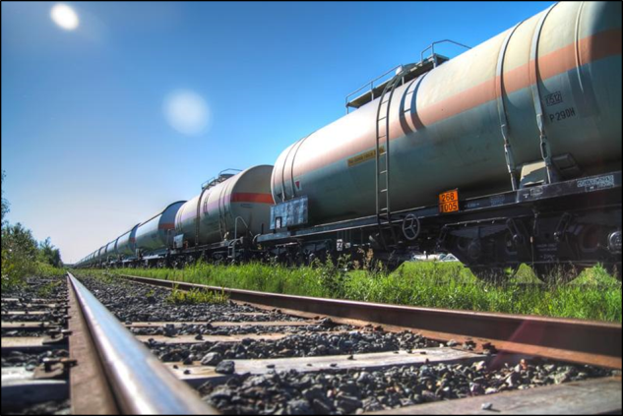
Critical Infrastructure
Categories (3 of 3)
Refer To:
Handout 2.2
Healthcare and public health
Information technology
Nuclear reactors, materials, and waste
Transportation systems
Water and wastewater systems
Critical Infrastructure
Categories (3 of 3)
Refer To:
Handout 2.2
Healthcare and public health
Information technology
Nuclear reactors, materials, and waste
Transportation systems
Water and wastewater systems
Source: US Dept. of Transportation

Slide 57
Discussion Questions
How do the earlier flip-chart responses compare with the list of categories shown?
What are some examples of critical infrastructure that are not on this list?
Discussion Questions
How do the earlier flip-chart responses compare with the list of categories shown?
What are some examples of critical infrastructure that are not on this list?

Slide 58
Critical Infrastructure
Categories Activity
Refer To:
Handout 2.3
Purpose: to identify specific examples of each of the 16 critical infrastructure categories
  Duration: 20 minutes (10-activity; 10-debrief)
  Group composition: table groups
  Debrief: large-group discussion
Critical Infrastructure
Categories Activity
Refer To:
Handout 2.3
Purpose: to identify specific examples of each of the 16 critical infrastructure categories
  Duration: 20 minutes (10-activity; 10-debrief)
  Group composition: table groups
  Debrief: large-group discussion

Slide 59
Discussion Questions
What are some examples of recent terrorist attacks on transportation infrastructure?
What recent cyberattacks have disrupted critical infrastructure?
Discussion Questions
What are some examples of recent terrorist attacks on transportation infrastructure?
What recent cyberattacks have disrupted critical infrastructure?

Slide 60
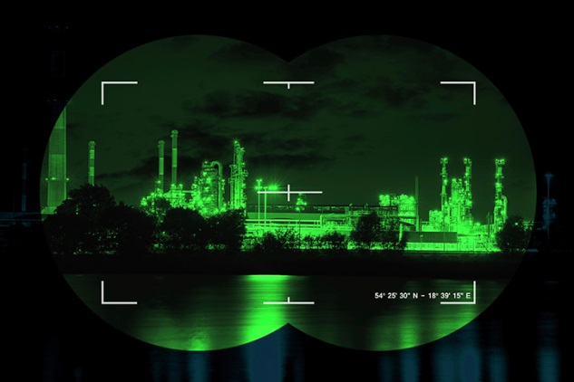
Vulnerability Analysis
Methodology Definition
A proven approach used to identify and mitigate security weaknesses and vulnerabilities in an infrastructure
Vulnerability Analysis Methodology Definition
A proven approach used to identify and mitigate security weaknesses and vulnerabilities in an infrastructure
Source: Getty Images

Slide 61
Vulnerability Analysis Methodology Use
Provides the information necessary to:
  Develop countermeasures for potential weaknesses
  Evaluate the effectiveness of the countermeasures implemented
  Make necessary changes for improvement
Vulnerability Analysis Methodology Use
Provides the information necessary to:
  Develop countermeasures for potential weaknesses
  Evaluate the effectiveness of the countermeasures implemented
  Make necessary changes for improvement

Slide 62
Four Phases of Vulnerability Analysis Methodology (1 of 2)
Refer To:
Workbook 2.3
Phase 1:
  Identify critical infrastructure
  Assess critical infrastructure components
  Identify critical infrastructure assets
Phase 2: analyze the threat by conducting a threat analysis and providing written documentation of threat types
Four Phases of Vulnerability Analysis Methodology (1 of 2)
Refer To:
Workbook 2.3
Phase 1:
  Identify critical infrastructure
  Assess critical infrastructure components
  Identify critical infrastructure assets
Phase 2: analyze the threat by conducting a threat analysis and providing written documentation of threat types

Slide 63
Four Phases of Vulnerability Analysis Methodology (2 of 2)
Refer To:
Workbook 2.3
Phase 3: identify security countermeasures:
  Policies and procedures
  Security force
  Technology
Phase 4: develop operational resilience:
  Conduct a gap analysis
  Determine actions to manage potential threats
Four Phases of Vulnerability Analysis Methodology (2 of 2)
Refer To:
Workbook 2.3
Phase 3: identify security countermeasures:
  Policies and procedures
  Security force
  Technology
Phase 4: develop operational resilience:
  Conduct a gap analysis
  Determine actions to manage potential threats

Slide 64

TeachBack Moment
What is the importance of the information collected during the vulnerability analysis?
TeachBack Moment
What is the importance of the information collected during the vulnerability analysis?

Slide 65
Physical Protection System Report
Information collected in a vulnerability analysis is documented in a report that:
  Identifies weaknesses
  Provides a better understanding of security vulnerabilities
  Provides recommendations for improvement
  Assists with planning and implementation of security countermeasures
Physical Protection System Report
Information collected in a vulnerability analysis is documented in a report that:
  Identifies weaknesses
  Provides a better understanding of security vulnerabilities
  Provides recommendations for improvement
  Assists with planning and implementation of security countermeasures

Slide 66

Elements of a Physical
Protection System Report (1 of 2)
Executive summary
Introduction
Vulnerability analysis methodology
Critical infrastructure identification
Critical infrastructure component analysis
Elements of a Physical
Protection System Report (1 of 2)
Executive summary
Introduction
Vulnerability analysis methodology
Critical infrastructure identification
Critical infrastructure component analysis
Source: Getty Images

Slide 67
Elements of a Physical
Protection System Report (2 of 2)
Threat definition
Physical protection system evaluation
Performance testing requirements
Recommendations for improvements
Conclusions
References
Elements of a Physical
Protection System Report (2 of 2)
Threat definition
Physical protection system evaluation
Performance testing requirements
Recommendations for improvements
Conclusions
References

Slide 68
Physical Protection System Report Discussion (1 of 3)
Refer To:
Workbook 2.4
Which section of the physical protection system report:
  Identifies the critical infrastructure being described in the report?
  Outlines the information used to locate, identify, describe, and prioritize critical infrastructure sites?
Physical Protection System Report Discussion (1 of 3)
Refer To:
Workbook 2.4
Which section of the physical protection system report:
  Identifies the critical infrastructure being described in the report?
  Outlines the information used to locate, identify, describe, and prioritize critical infrastructure sites?

Slide 69
Physical Protection System Report Discussion (2 of 3)
Refer To:
Workbook 2.4
Which section of the physical protection system report describes:
  How physical protection system elements will be tested?
  Recommendations for improving the physical protection system?
Physical Protection System Report Discussion (2 of 3)
Refer To:
Workbook 2.4
Which section of the physical protection system report describes:
  How physical protection system elements will be tested?
  Recommendations for improving the physical protection system?

Slide 70
Physical Protection System Report Discussion (3 of 3)
Refer To:
Workbook 2.4
Which section of the physical protection system report:
  Will contain the results of the threat analysis?
  Describes the processes and approaches used in the analysis?
Physical Protection System Report Discussion (3 of 3)
Refer To:
Workbook 2.4
Which section of the physical protection system report:
  Will contain the results of the threat analysis?
  Describes the processes and approaches used in the analysis?

Slide 71
TeachBack Moment
What are the four phases of the vulnerability analysis methodology?
What information is included in each of the sections of the physical protection system report?
TeachBack Moment
What are the four phases of the vulnerability analysis methodology?
What information is included in each of the sections of the physical protection system report?

Slide 72
Module Summary (1 of 2)
Critical infrastructure
Security
Vulnerability analysis
Components, elements, and functions of a physical protection system
Module Summary (1 of 2)
Critical infrastructure
Security
Vulnerability analysis
Components, elements, and functions of a physical protection system

Slide 73
Module Summary (2 of 2)
Critical infrastructure categories
Four phases of vulnerability analysis methodology
Elements of a physical protection system report
Module Summary (2 of 2)
Critical infrastructure categories
Four phases of vulnerability analysis methodology
Elements of a physical protection system report

