Slide 1
Critical Infrastructure Components
Module 5

Slide 2
Module Objective
By the end of this module, you will be able to determine the functional components of critical infrastructure to establish the basis of a vulnerability analysis
Module Objective
By the end of this module, you will be able to determine the functional components of critical infrastructure to establish the basis of a vulnerability analysis

Slide 3
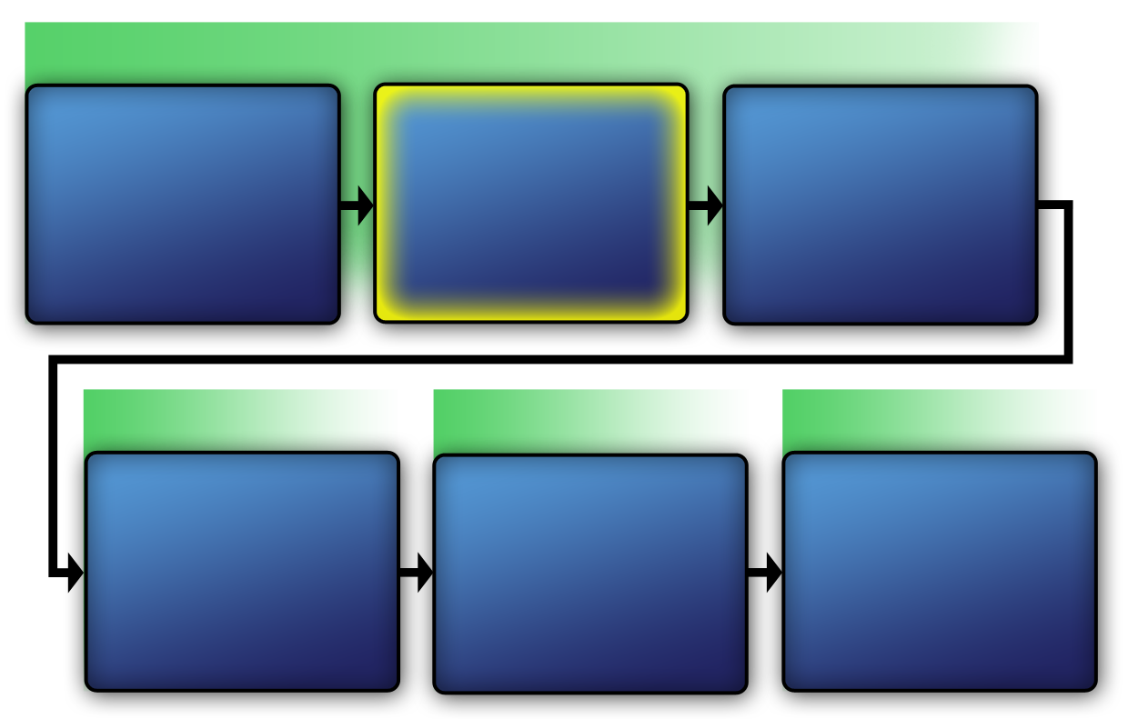
Course Map with VAM Phases
VAM Phase 1
Assess Critical Infrastructure Components
Module 5
Identify Critical Infrastructure Assets
Module 6
Identify Critical Infrastructure
Module 2
VAM Phase 2
VAM Phase 3
VAM Phase 4
Identify
Security
Counter-
Measures
Modules 11-14
Develop Operational Resilience
Module 15
Analyze the
Threat
Modules 7-10
Course Map with VAM Phases
VAM Phase 1
Identify Critical Infrastructure
Module 2
Assess Critical Infrastructure Components
Module 5
Identify Critical Infrastructure Assets
Module 6
VAM Phase 2
VAM Phase 2
VAM Phase 3
VAM Phase 4
Analyze the Threat
Modules 7-10
Identify
Security
Counter-
Measures
Modules 11-14
Develop Operational Resilience
Module 15

Slide 4
Critical Infrastructure
Components Defined
The physical conditions, facility operations, policies, and procedures, regulatory requirements, and the safety and legal considerations of the identified asset
Critical Infrastructure Components Defined
The physical conditions, facility operations, policies, and procedures, regulatory requirements, and the safety and legal considerations of the identified asset

Slide 5

Critical Infrastructure
Assessments Defined
A comprehensive evaluation of the components of a given critical infrastructure
Source: Getty Images
Critical Infrastructure Assessments Defined
A comprehensive evaluation of the components of a given critical infrastructure

Slide 6
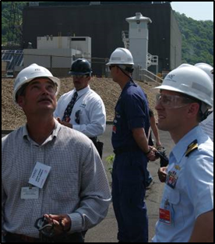
Purpose of Critical
Infrastructure Assessments
Provide a comprehensive evaluation of a critical infrastructure’s components
Assess and mitigate vulnerabilities
Identify and establish security countermeasures
Purpose of Critical Infrastructure Assessments
Provide a comprehensive evaluation of a critical infrastructure’s components
Assess and mitigate vulnerabilities
Identify and establish security countermeasures
Source: Dept. of Homeland Security

Slide 7
Evaluation of Critical
Infrastructure Components
Is part of the process of securing facilities against all threats including terrorist attack and natural disasters
Requires a methodical approach
Involves gathering data such as:
  Physical description of the facility
  Known vulnerabilities and weaknesses
Evaluation of Critical Infrastructure Components
Is part of the process of securing facilities against all threats including terrorist attack and natural disasters
Requires a methodical approach
Involves gathering data such as:
  Physical description of the facility
  Known vulnerabilities and weaknesses

Slide 8
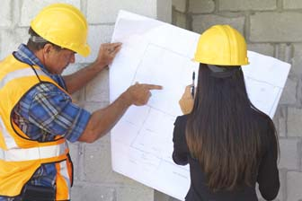
Accurate Data
Gathering accurate information is critical
Accurate data allows for the development of appropriate security countermeasure recommendations
Accurate Data
Gathering accurate information is critical
Accurate data allows for the development of appropriate security countermeasure recommendations
Source: Bureau of Labor Statistics

Slide 9

Inaccurate Data
Results in:
  Wasted resources
  Damage or destruction of critical assets
  Injury or death
Inaccurate Data
Results in:
  Wasted resources
  Damage or destruction of critical assets
  Injury or death
Source: Microsoft

Slide 10
Critical Infrastructure Components
This section will cover:
  Physical conditions
  Facility operations, policies, and procedures
  Regulatory requirements
  Safety considerations
  Legal considerations
Critical Infrastructure Components
This section will cover:
  Physical conditions
  Facility operations, policies, and procedures
  Regulatory requirements
  Safety considerations
  Legal considerations

Slide 11
Physical Conditions Component (1 of 2)
Site boundaries
Number and location of buildings
Room locations within buildings
Access points
Physical Conditions Component (1 of 2)
Site boundaries
Number and location of buildings
Room locations within buildings
Access points

Slide 12
Physical Conditions Component (2 of 2)
Existing physical protection system
Building construction details
Environmental aspects
Physical Conditions Component (2 of 2)
Existing physical protection system
Building construction details
Environmental aspects

Slide 13
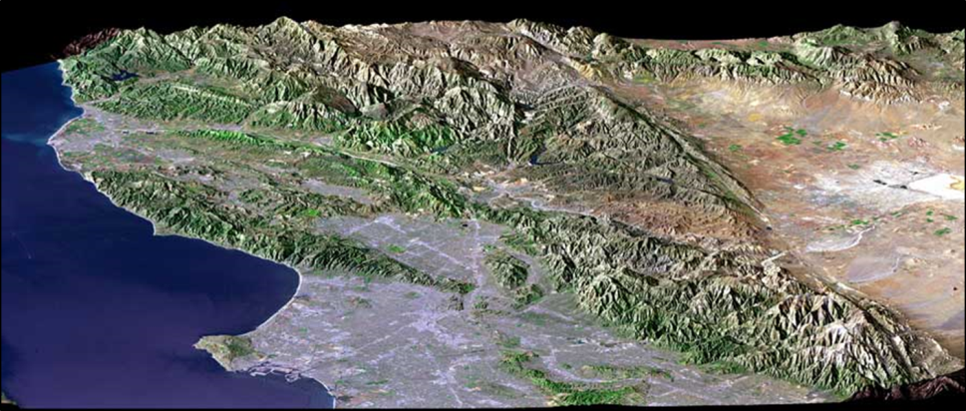
Environmental Aspects
Topography
Vegetation
Wildlife
Background noise
Climate and weather conditions
Environmental Aspects
Topography
Vegetation
Wildlife
Background noise
Climate and weather conditions
Source: NASA

Slide 14
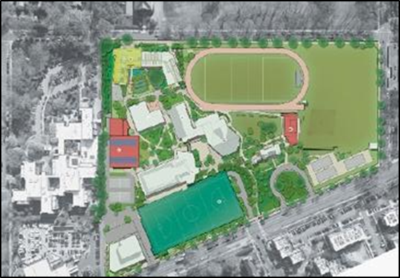
Knowledge of Physical Conditions
Helps to identify conditions that may limit site access:
  Vegetation
  Isolation
Used to predict terrorist routes into the facility and best routes for security force and first responders
Knowledge of Physical Conditions
Helps to identify conditions that may limit site access:
  Vegetation
  Isolation
Used to predict terrorist routes into the facility and best routes for security force and first responders
Source: Department of Energy

Slide 15
Discussion Question
Can you provide examples of physical conditions that have influenced the design of a physical protection system?
Discussion Question
Can you provide examples of physical conditions that have influenced the design of a physical protection system?

Slide 16
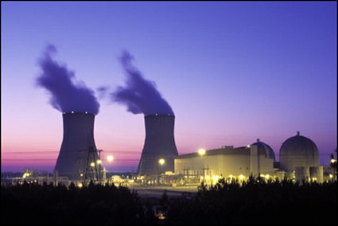
Facility Operations Component
Process and products — facility assets
Operating conditions:
  Hours of operation
  Number of employees
  Staff and visitors’ movement
  Traffic patterns and specialized equipment
Facility Operations Component
Process and products — facility assets
Operating conditions:
  Hours of operation
  Number of employees
  Staff and visitors’ movement
  Traffic patterns and specialized equipment
Source: NRC

Slide 17
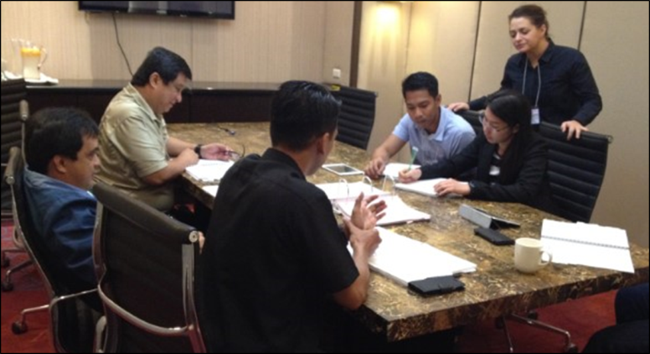
Facility Polices and Procedures Component
Documented policies and procedures
Employee training
Disciplinary action procedures for policy violations
Proper supervision and management
Facility Polices and Procedures Component
Documented policies and procedures
Employee training
Disciplinary action procedures for policy violations
Proper supervision and management
Source: DS/T/ATA

Slide 18
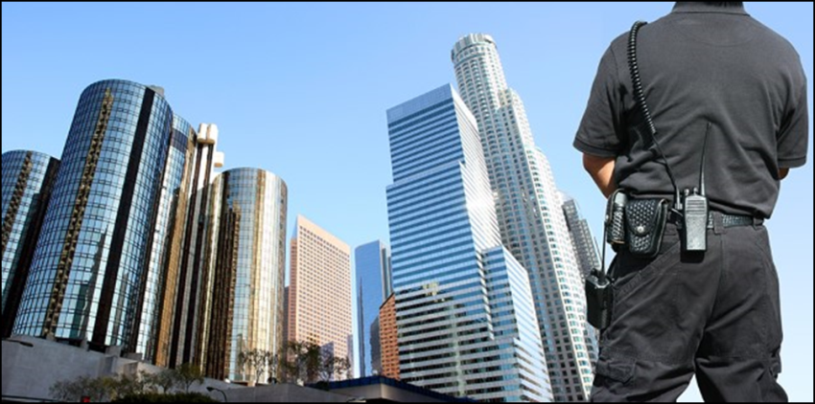
Regulatory Requirements Component
Collect data on regulatory requirements and standards that apply to the facility
Ensure that the physical protection system design does not conflict with regulations
Regulatory Requirements Component
Collect data on regulatory requirements and standards that apply to the facility
Ensure that the physical protection system design does not conflict with regulations
Source: Getty Images

Slide 19
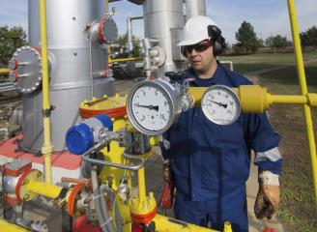
Safety Considerations Component
Before implementing security measures:
  Consult the safety authority at the critical infrastructure
  Ensure compliance with safety regulations and policies
The vulnerability analysis team may not include a safety expert
Safety Considerations Component
Before implementing security measures:
  Consult the safety authority at the critical infrastructure
  Ensure compliance with safety regulations and policies
The vulnerability analysis team may not include a safety expert
Source: Bureau of Labor Statistics

Slide 20
Discussion Question
What are some examples of other safety considerations for critical infrastructure in your country?
Discussion Question
What are some examples of other safety considerations for critical infrastructure in your country?

Slide 21

Legal Considerations Component (1 of 3)
Collect data on legal information to ensure the physical protection system does not create legal problems for the facility
Legal Considerations Component (1 of 3)
Collect data on legal information to ensure the physical protection system does not create legal problems for the facility
Source: Creative Commons Public Domain

Slide 22
Legal Considerations Component (2 of 3)
May include:
  Use-of-force policy
  Employee rights and privacy concerns when conducting searches of employees and visitors
  Training requirements for security forces
Legal Considerations Component (2 of 3)
May include:
  Use-of-force policy
  Employee rights and privacy concerns when conducting searches of employees and visitors
  Training requirements for security forces

Slide 23
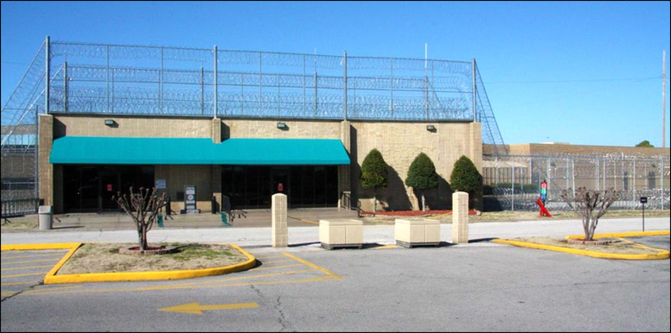
Legal Considerations Component (3 of 3)
Failure to comply with legal requirements could result in:
  Financial penalties for the facility
  Prison time for senior executives
  Litigation (civil lawsuits)
Legal Considerations Component (3 of 3)
Failure to comply with legal requirements could result in:
  Financial penalties for the facility
  Prison time for senior executives
  Litigation (civil lawsuits)
Source: Federal Bureau of Prisons

Slide 24

TeachBack Moment
What are some examples of the components used to assess critical infrastructure?
TeachBack Moment
What are some examples of the components used to assess critical infrastructure?

Slide 25
Critical Infrastructure Components
This section will cover:
  Critical infrastructure component evaluation
  Methodology for gathering information on facilities
Critical Infrastructure Components
This section will cover:
  Critical infrastructure component evaluation
  Methodology for gathering information on facilities

Slide 26
Critical Infrastructure
Component Evaluation
Allows security managers to:
  Protect critical assets
  Prioritize efforts
  Use limited resources more efficiently
Critical Infrastructure Component Evaluation
Allows security managers to:
  Protect critical assets
  Prioritize efforts
  Use limited resources more efficiently

Slide 27
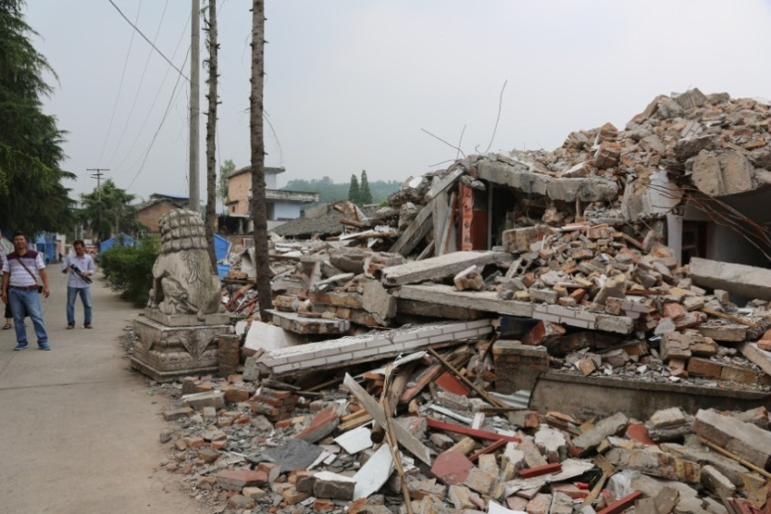
Prioritize Vulnerability Analysis Efforts
Identify:
  Critical assets
  Common vulnerabilities and protection solutions
  Interdependencies between infrastructures
Prioritize Vulnerability Analysis Efforts
Identify:
  Critical assets
  Common vulnerabilities and protection solutions
  Interdependencies between infrastructures
Source: USGS

Slide 28
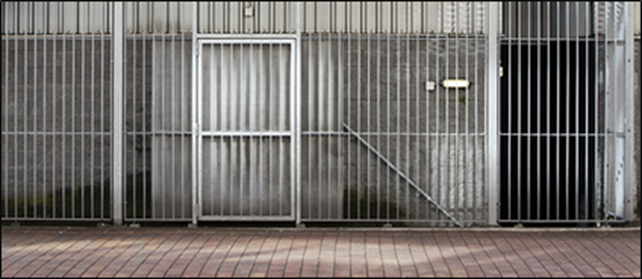
Identify Critical Assets
Focus on identifying the truly critical assets
Harden critical assets against attack
If possible, reduce the effect of asset loss through:
  Redundancy
  Relocation
  Redesign
Identify Critical Assets
Source: Getty Images
Focus on identifying the truly critical assets
Harden critical assets against attack
If possible, reduce the effect of asset loss through:
  Redundancy
  Relocation
  Redesign

Slide 29
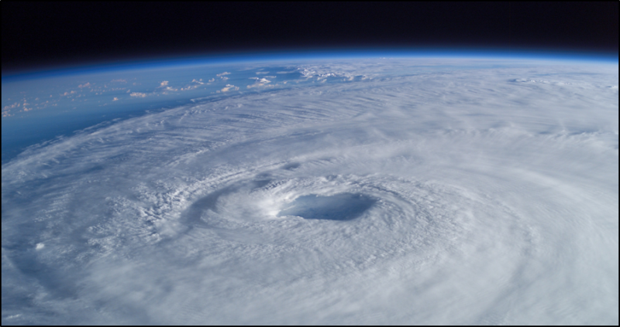
Identify Common Vulnerabilities and Protection Solutions
Establish and implement best practices:
  Methods that show consistent superior results
  Benchmarks
  Variable to each asset
Identify Common Vulnerabilities
and Protection Solutions
Source: NASA
Establish and implement best practices:
  Methods that show consistent superior results
  Benchmarks
  Variable to each asset

Slide 30
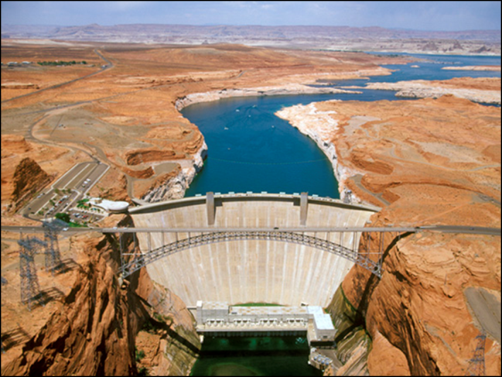
Identify Interdependencies between Infrastructures
Relationship between infrastructures
Geographic proximity
Feasibility
Source: Bureau of Reclamation
Identify Interdependencies
between Infrastructures
Relationship between infrastructures
Geographic proximity
Feasibility

Slide 31
Discussion Question
Why is the evaluation of a critical infrastructure's components an important part of the vulnerability analysis?
Discussion Question
Why is the evaluation of a critical infrastructure's components an important part of the vulnerability analysis?

Slide 32
Methodology for Gathering
Information for Facilities
This section will cover:
  Stage 1: Planning
  Stage 2: Data review
  Stage 3: Site visit
  Stage 4: Information evaluation
Methodology for Gathering
Information for Facilities
This section will cover:
  Stage 1: Planning
  Stage 2: Data review
  Stage 3: Site visit
  Stage 4: Information evaluation

Slide 33

Gathering Component
Data —Stage 1: Planning
Refer To:
Workbook 5.1
Form a vulnerability analysis team:
  Project manager
  Security system technologist
  Subject matter experts
Make a data call:
  Before site visit
  Request information about site
Schedule site visit — time and permission
Gathering Component
Data —Stage 1: Planning
Refer To:
Workbook 5.1
Form a vulnerability analysis team:
  Project manager
  Security system technologist
  Subject matter experts
Make a data call:
  Before site visit
  Request information about site
Schedule site visit — time and permission

Slide 34
Discussion Question
What other kinds of information would you want to obtain from the data call?
Discussion Question
What other kinds of information would you want to obtain from the data call?

Slide 35

Gathering Component Data — Stage 2: Data Review
Refer To:
Workbook 5.1
Review data call information
Prepare questions for site visit
Plan site visit
Gathering Component Data — Stage 2: Data Review
Refer To:
Source: Getty Images
Workbook 5.1
Review data call information
Prepare questions for site visit
Plan site visit

Slide 36
Discussion Question
Are there any other sample questions you would include in the list?
Discussion Question
Are there any other sample questions you would include in the list?

Slide 37
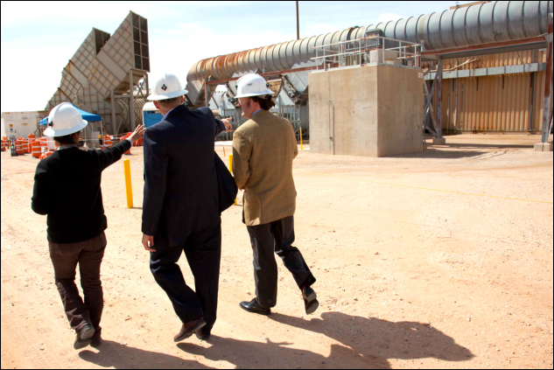
Gathering Component Data —
Stage 3: Site Visit
Briefing to facility point of contact
Tour, including:
  All critical assets
  Secondary critical assets
  Security control center
  Other specified areas
Interviews to answer remaining questions
Gathering Component Data — Stage 3: Site Visit
Briefing to facility point of contact
Tour, including:
  All critical assets
  Secondary critical assets
  Security control center
  Other specified areas
Interviews to answer remaining questions
Source: Department of Energy

Slide 38

Gathering Component Data —
Stage 4: Information Evaluation
Determine data relevance
Record in report
Source: Getty Images
Gathering Component Data —
Stage 4: Information Evaluation
Determine data relevance
Record in report

Slide 39

TeachBack Moment
How are critical infrastructure components used in a critical infrastructure assessment?
TeachBack Moment
How are critical infrastructure components used in a critical infrastructure assessment?

Slide 40

Threaded Exercise
Introduction and Part 1
Refer To:
Workbook Introduction
and Part 1
Purpose: to evaluate the critical infrastructure components of the National Ministries Building
  Duration: 90 minutes (70-exercise; 20-debrief)
  Group composition: table groups
  Debrief: presentations and discussion
Threaded Exercise
Introduction and Part 1
Refer To:
Workbook Introduction and Part 1
Purpose: to evaluate the critical infrastructure components of the National Ministries Building
  Duration: 90 minutes (70-exercise; 20-debrief)
  Group composition: table groups
  Debrief: presentations and discussion

Slide 41
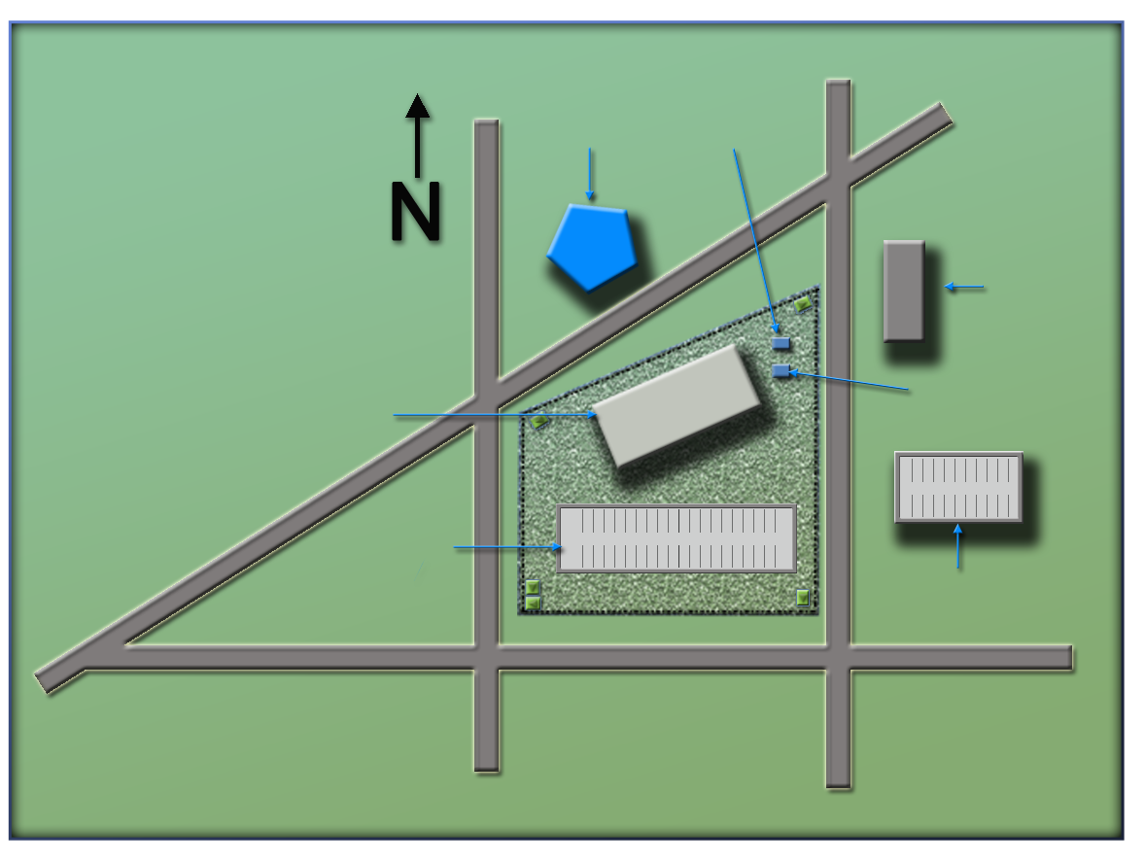
National Ministries
Building Complex Map
Refer To:
National Ministries Building Complex Map
(Ministry of Defense)
Ministry
of Defense
Security office
(Security office)
(Foreign embassy)
Foreign embassy
National Ministries
Building
Building generator
(National Ministries
Building)
National Avenue
(Building generator)
(National Avenue)
Parking lot
(Parking garage)
Parking garage
(Parking lot)
Judiciary Lane
(First Street)
(Judiciary Lane)
First Street
(Second Street)
Second Street
National Ministries
Building Complex Map
Refer To:
National Ministries Building Complex Map
(Ministry of Defense)
Ministry
of Defense
Security office
(Security office)
National Ministries
Building
(Foreign embassy)
Foreign embassy
(National Ministries
Building)
Building generator
National Avenue
Parking lot
(Building generator)
(National Avenue)
Parking garage
Judiciary Lane
(Parking lot)
(Parking garage)
(Judiciary Lane)
First Street
Second Street
(Second Street)
(First Street)

Slide 42
Module Summary
Critical infrastructure assessments
Critical infrastructure components
Module Summary
Critical infrastructure assessments
Critical infrastructure components

