Slide 1
Surveillance Awareness: What You Can Do
Module 8

Slide 2
Module Objective
By the end of this module, you will be able to explain the actions necessary to detect and report suspicious activities associated with hostile surveillance
Module Objective
Module Objective
By the end of this module, you will be able to explain the actions necessary to detect and report suspicious activities associated with hostile surveillance
By the end of this module, you will be able to explain the actions necessary to detect and report suspicious activities associated with hostile surveillance

Slide 3
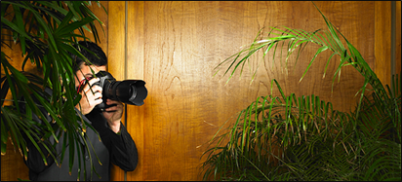
What Is Surveillance?
The monitoring of a person, facility, or area with the intent of gathering information, generally through discreet observation
Law enforcement and security personnel actions
What Is Surveillance?
What Is Surveillance?
The monitoring of a person, facility, or area with the intent of gathering information, generally through discreet observation
Law enforcement and security personnel actions
The monitoring of a person, facility, or area with the intent of gathering information, generally through discreet observation
Law enforcement and security personnel actions
Source: Getty Images

Slide 4

Important Surveillance-Related Terms
Surveillant
Hostile surveillance
Surveillance detection
Countersurveillance
Source: Getty Images
Important Surveillance-Related Terms
Important Surveillance-Related Terms
Surveillant
Hostile surveillance
Surveillance detection
Countersurveillance
Surveillant
Hostile surveillance
Surveillance detection
Countersurveillance

Slide 5
Who Can Detect Hostile Surveillance?
Everyone working together serves as a force multiplier in protecting critical infrastructure and the community as a whole
  Members of the community
  Critical infrastructure employees
  Critical infrastructure security personnel
  Law enforcement
Who Can Detect Hostile Surveillance?
Who Can Detect Hostile Surveillance?
Everyone working together serves as a force multiplier in protecting critical infrastructure and the community as a whole
  Members of the community
  Critical infrastructure employees
  Critical infrastructure security personnel
  Law enforcement
Everyone working together serves as a force multiplier in protecting critical infrastructure and the community as a whole
  Members of the community
  Critical infrastructure employees
  Critical infrastructure security personnel
  Law enforcement

Slide 6
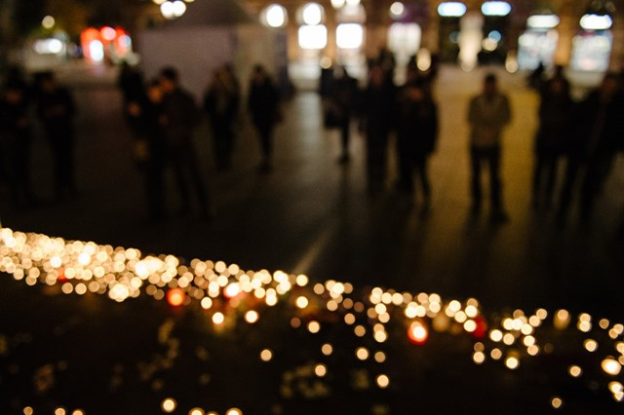
Information Collected through Hostile Surveillance
Depends on type of target and attack
Information about facilities, personnel, and procedures
Information about special events
Information Collected
through Hostile Surveillance
Information Collected
through Hostile Surveillance
Depends on type of target and attack
Information about facilities, personnel, and procedures
Information about special events
Depends on type of target and attack
Information about facilities, personnel, and procedures
Information about special events
Source: Getty Images

Slide 7

Categories of Critical Infrastructure as Targets (1 of 2)
Refer To:
Workbook 8.1
Banking and finance
Chemical sector
Commercial facilities
Communications
Critical manufacturing
Dams
Defense industrial base
Emergency services
Categories of Critical
Infrastructure as Targets (1 of 2)
Refer To:
Workbook 8.1
Banking and finance
Chemical sector
Commercial facilities
Communications
Critical manufacturing
Dams
Defense industrial base
Emergency services
Banking and finance
Chemical sector
Commercial facilities
Communications
Critical manufacturing
Dams
Defense industrial base
Emergency services

Slide 8
Categories of Critical Infrastructure as Targets (2 of 2)
Refer To:
Workbook 8.1
Energy
Food and agriculture
Government facilities and national monuments
Health care and public health facilities
Information technology
Nuclear reactors, materials, and waste
Transportation, postal, and shipping systems
Water
Categories of Critical
Infrastructure as Targets (2 of 2)
Refer To:
Workbook 8.1
Energy
Food and agriculture
Government facilities and national monuments
Health care and public health facilities
Information technology
Nuclear reactors, materials, and waste
Transportation, postal, and shipping systems
Water
Energy
Food and agriculture
Government facilities and national monuments
Health care and public health facilities
Information technology
Nuclear reactors, materials, and waste
Transportation, postal, and shipping systems
Water

Slide 9
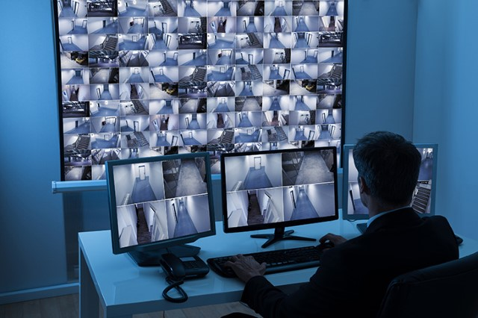
Target Selection Surveillance
Location and surroundings
Access, egress, or vulnerabilities
Usual activities
Security systems
Other relevant information
Target Selection Surveillance
Target Selection Surveillance
Location and surroundings
Access, egress, or vulnerabilities
Usual activities
Security systems
Other relevant information
Location and surroundings
Access, egress, or vulnerabilities
Usual activities
Security systems
Other relevant information
Source: Getty Images

Slide 10
Pre-Attack Preparation
Scope determines length of preparation
Hostile surveillance
Security system tests
Repeated visits — most vulnerability for operative
Acquisition of supplies and materials
Practice or rehearsals
Detection and halting attack most likely
Pre-Attack Preparation
Pre-Attack Preparation
Scope determines length of preparation
Hostile surveillance
Security system tests
Repeated visits — most vulnerability for operative
Acquisition of supplies and materials
Practice or rehearsals
Detection and halting attack most likely
Scope determines length of preparation
Hostile surveillance
Security system tests
Repeated visits — most vulnerability for operative
Acquisition of supplies and materials
Practice or rehearsals
Detection and halting attack most likely

Slide 11
Indicators of Hostile Surveillance Activities (1 of 2)
Refer To:
Workbook 8.2
Making observations with vision-enhancing devices
Drawing maps or diagrams
Asking for more than routine information
Taking notes about observable security
Indicators of Hostile Surveillance Activities (1 of 2)
Refer To:
Workbook 8.2
Making observations with vision-enhancing devices
Drawing maps or diagrams
Asking for more than routine information
Taking notes about observable security
Making observations with vision-enhancing devices
Drawing maps or diagrams
Asking for more than routine information
Taking notes about observable security

Slide 12

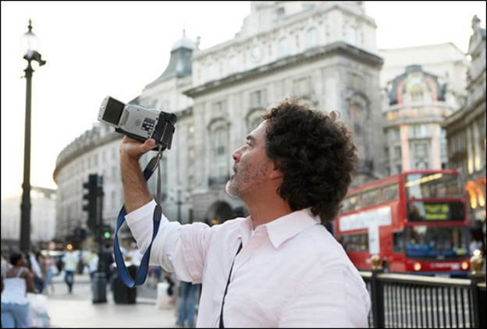
Indicators of Hostile Surveillance Activities (2 of 2)
Refer To:
Workbook 8.2
Charting crowd patterns
Putting documents in a pocket
Photographing anything related to security
Observing or taking notes about responses to a security breach
Indicators of Hostile Surveillance Activities (2 of 2)
Refer To:
Workbook 8.2
Charting crowd patterns
Putting documents in a pocket
Photographing anything related to security
Observing or taking notes about responses to a security breach
Charting crowd patterns
Putting documents in a pocket
Photographing anything related to security
Observing or taking notes about responses to a security breach
Source: Getty Images

Slide 13
Unusual Hostile
Surveillant Behavior (1 of 2)
Attempting to hide when observed
Reacting visibly to security events of interest
Making sudden turns or stops
Making visible hand or other signals
Running immediately when detected
Hiding, averting the face, or bending down to avoid detection
Unusual Hostile
Surveillant Behavior (1 of 2)
Unusual Hostile
Surveillant Behavior (1 of 2)
Attempting to hide when observed
Reacting visibly to security events of interest
Making sudden turns or stops
Making visible hand or other signals
Running immediately when detected
Hiding, averting the face, or bending down to avoid detection
Attempting to hide when observed
Reacting visibly to security events of interest
Making sudden turns or stops
Making visible hand or other signals
Running immediately when detected
Hiding, averting the face, or bending down to avoid detection

Slide 14
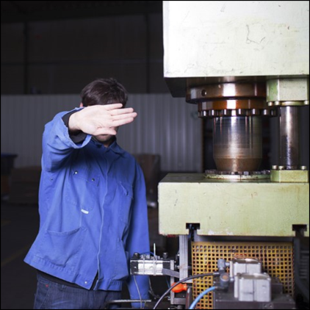
Unusual Hostile
Surveillant Behavior (2 of 2)
Failing to have a valid reason to be in a location
Engaging in activities not normally conducted in a location
Dressing inappropriately for the environment
Unusual Hostile
Surveillant Behavior (2 of 2)
Unusual Hostile
Surveillant Behavior (2 of 2)
Failing to have a valid reason to be in a location
Engaging in activities not normally conducted in a location
Dressing inappropriately for the environment
Failing to have a valid reason to be in a location
Engaging in activities not normally conducted in a location
Dressing inappropriately for the environment
Source: Getty Images

Slide 15
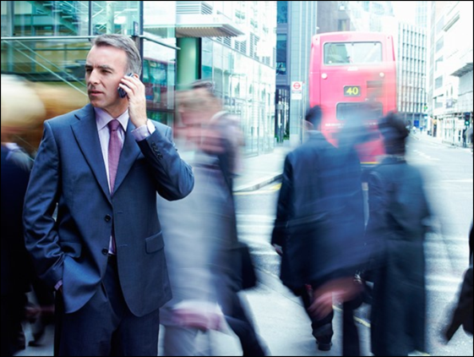
Surveillance Can Be Detected
Weak link in the preparations for an attack
Surveillants are vulnerable due to:
  The time needed for surveillance
  The likelihood of repeated visits to the same site
Surveillance Can Be Detected
Surveillance Can Be Detected
Weak link in the preparations for an attack
Surveillants are vulnerable due to:
  The time needed for surveillance
  The likelihood of repeated visits to the same site
Weak link in the preparations for an attack
Surveillants are vulnerable due to:
  The time needed for surveillance
  The likelihood of repeated visits to the same site
Source: Getty Images

Slide 16
Trained and Untrained Surveillants
Highly trained individuals or teams may use:
  Sophisticated observation equipment
  Multiple forms of transportation
  The cover of posing as families or tourists
Untrained surveillants are:
  Not well equipped
  Vulnerable to detection due to their inexperience
Trained and Untrained Surveillants
Trained and Untrained Surveillants
Highly trained individuals or teams may use:
  Sophisticated observation equipment
  Multiple forms of transportation
  The cover of posing as families or tourists
Untrained surveillants are:
  Not well equipped
  Vulnerable to detection due to their inexperience
Highly trained individuals or teams may use:
  Sophisticated observation equipment
  Multiple forms of transportation
  The cover of posing as families or tourists
Untrained surveillants are:
  Not well equipped
  Vulnerable to detection due to their inexperience

Slide 17
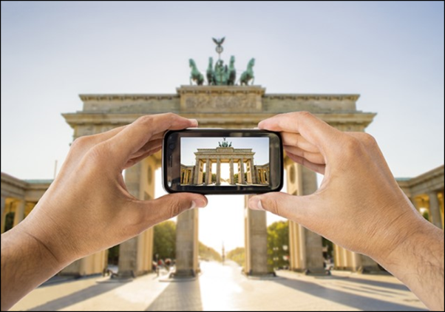
How to Detect Hostile Surveillance
Know what is normal in order to detect what is abnormal
  Notice the indicators of surveillance
  Evaluate surveillance-related activities
Determine whether they seem unusual or out of place
How to Detect Hostile Surveillance
How to Detect Hostile Surveillance
Know what is normal in order to detect what is abnormal
  Notice the indicators of surveillance
  Evaluate surveillance-related activities
Determine whether they seem unusual or out of place
Know what is normal in order to detect what is abnormal
  Notice the indicators of surveillance
  Evaluate surveillance-related activities
Determine whether they seem unusual or out of place
Source: Getty Images

Slide 18
Look for Unusual Activities
— Examples 1 and 2
An individual is observed one time with a tripod-mounted camera and is openly taking photographs of a critical infrastructure
A person is observed on repeated occasions taking several quick secretive photos of a critical infrastructure with a cell phone from several locations
Look for Unusual Activities
— Examples 1 and 2
Look for Unusual Activities
— Examples 1 and 2
An individual is observed one time with a tripod-mounted camera and is openly taking photographs of a critical infrastructure
A person is observed on repeated occasions taking several quick secretive photos of a critical infrastructure with a cell phone from several locations
An individual is observed one time with a tripod-mounted camera and is openly taking photographs of a critical infrastructure
A person is observed on repeated occasions taking several quick secretive photos of a critical infrastructure with a cell phone from several locations

Slide 19
Look for Unusual Activities
— Examples 3 and 4
An individual is taking photographs of everything notable in a popular tourist area and includes companions in the photographs
An individual is photographing building entrances, windows, or security personnel or features and does not include companions in the photos or video
Look for Unusual Activities
— Examples 3 and 4
Look for Unusual Activities
— Examples 3 and 4
An individual is taking photographs of everything notable in a popular tourist area and includes companions in the photographs
An individual is photographing building entrances, windows, or security personnel or features and does not include companions in the photos or video
An individual is taking photographs of everything notable in a popular tourist area and includes companions in the photographs
An individual is photographing building entrances, windows, or security personnel or features and does not include companions in the photos or video

Slide 20
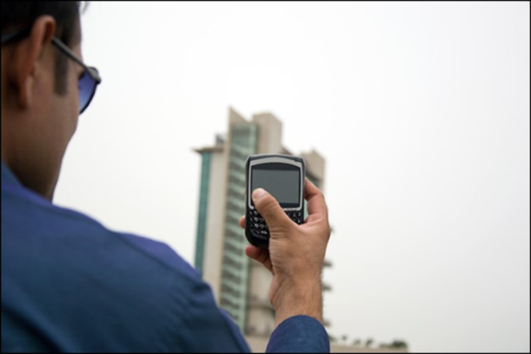
Evaluating Unusual Activities (1 of 2)
Isolated unusual activity may not necessarily indicate hostile surveillance
Evaluate all observed actions and behaviors in context
Evaluating Unusual Activities (1 of 2)
Evaluating Unusual Activities (1 of 2)
Isolated unusual activity may not necessarily indicate hostile surveillance
Evaluate all observed actions and behaviors in context
Isolated unusual activity may not necessarily indicate hostile surveillance
Evaluate all observed actions and behaviors in context
Source: Getty Images

Slide 21
Evaluating Unusual Activities (2 of 2)
Consider behaviors to be suspicious if there are additional unusual behaviors observed:
  Repeated visits to same location
  Disguised interest in location
  Focused interest in alarms, security features or personnel, or restricted areas
Evaluating Unusual Activities (2 of 2)
Evaluating Unusual Activities (2 of 2)
Consider behaviors to be suspicious if there are additional unusual behaviors observed:
  Repeated visits to same location
  Disguised interest in location
  Focused interest in alarms, security features or personnel, or restricted areas
Consider behaviors to be suspicious if there are additional unusual behaviors observed:
  Repeated visits to same location
  Disguised interest in location
  Focused interest in alarms, security features or personnel, or restricted areas

Slide 22
Discussion — Scenario 1
Ray is crossing the street toward the Law Enforcement Training Academy and sees someone taking photos of the building entrance with a camera
The person taking the photos is sitting inside a car parked across the street from the building
The car window is closed and the person is hunched over inside the car
Discussion — Scenario 1
Discussion — Scenario 1
Ray is crossing the street toward the Law Enforcement Training Academy and sees someone taking photos of the building entrance with a camera
The person taking the photos is sitting inside a car parked across the street from the building
The car window is closed and the person is hunched over inside the car
Ray is crossing the street toward the Law Enforcement Training Academy and sees someone taking photos of the building entrance with a camera
The person taking the photos is sitting inside a car parked across the street from the building
The car window is closed and the person is hunched over inside the car

Slide 23
Discussion — Scenario 2 (1 of 3)
People gather across the street from Law Enforcement Headquarters near a bus stop every day
  The bus comes at the same time every hour
  People who are waiting check often for an approaching bus and look at their watches or cell phones frequently
  They typically wait less than 20 minutes
Discussion — Scenario 2 (1 of 3)
Discussion — Scenario 2 (1 of 3)
People gather across the street from Law Enforcement Headquarters near a bus stop every day
  The bus comes at the same time every hour
  People who are waiting check often for an approaching bus and look at their watches or cell phones frequently
  They typically wait less than 20 minutes
People gather across the street from Law Enforcement Headquarters near a bus stop every day
  The bus comes at the same time every hour
  People who are waiting check often for an approaching bus and look at their watches or cell phones frequently
  They typically wait less than 20 minutes

Slide 24
Discussion — Scenario 2 (2 of 3)
One day, you notice a man sitting at the bus stop and writing in a notebook
  When you look up again almost an hour later, the man is in the same location
  He does not look up as a bus approaches
Discussion — Scenario 2 (2 of 3)
Discussion — Scenario 2 (2 of 3)
One day, you notice a man sitting at the bus stop and writing in a notebook
  When you look up again almost an hour later, the man is in the same location
  He does not look up as a bus approaches
One day, you notice a man sitting at the bus stop and writing in a notebook
  When you look up again almost an hour later, the man is in the same location
  He does not look up as a bus approaches

Slide 25
Discussion — Scenario 2 (3 of 3)
You see him several more times in the following week at different times of the day
  He waits for an hour or more each time, writing in his notebook
  He looks up often, but only toward the building
Discussion — Scenario 2 (3 of 3)
Discussion — Scenario 2 (3 of 3)
You see him several more times in the following week at different times of the day
  He waits for an hour or more each time, writing in his notebook
  He looks up often, but only toward the building
You see him several more times in the following week at different times of the day
  He waits for an hour or more each time, writing in his notebook
  He looks up often, but only toward the building

Slide 26
Discussion — Scenario 3 (1 of 2)
Ella is walking from her car in the employee parking lot of the Water Department
  There is a young man in front of her taking long strides
  When he reaches the parking lot gate, he stops and writes something in a small notebook
Discussion — Scenario 3 (1 of 2)
Discussion — Scenario 3 (1 of 2)
Ella is walking from her car in the employee parking lot of the Water Department
  There is a young man in front of her taking long strides
  When he reaches the parking lot gate, he stops and writes something in a small notebook
Ella is walking from her car in the employee parking lot of the Water Department
  There is a young man in front of her taking long strides
  When he reaches the parking lot gate, he stops and writes something in a small notebook

Slide 27
Discussion — Scenario 3 (2 of 2)
  The young man walks alongside the parking lot fence from one end to the other, stopping again at the end to write in his notebook
When he turns around and sees Ella watching, he quickly puts the notebook in his pocket and rapidly walks away
Discussion — Scenario 3 (2 of 2)
Discussion — Scenario 3 (2 of 2)
  The young man walks alongside the parking lot fence from one end to the other, stopping again at the end to write in his notebook
When he turns around and sees Ella watching, he quickly puts the notebook in his pocket and rapidly walks away
  The young man walks alongside the parking lot fence from one end to the other, stopping again at the end to write in his notebook
When he turns around and sees Ella watching, he quickly puts the notebook in his pocket and rapidly walks away

Slide 28
Reporting Observed Activities (1 of 2)
Reporting suspicious activities is invaluable to protecting critical infrastructure
Law enforcement, employees, and the community are in the best position to observe and report unusual activities in the area of critical infrastructure
Reporting Observed Activities (1 of 2)
Reporting Observed Activities (1 of 2)
Reporting suspicious activities is invaluable to protecting critical infrastructure
Law enforcement, employees, and the community are in the best position to observe and report unusual activities in the area of critical infrastructure
Reporting suspicious activities is invaluable to protecting critical infrastructure
Law enforcement, employees, and the community are in the best position to observe and report unusual activities in the area of critical infrastructure

Slide 29
Reporting Observed Activities (2 of 2)
Reports may be the significant factor in disrupting a terrorist attack
Business, public, and private organizations should encourage employees to report suspicious activities
Reporting Observed Activities (2 of 2)
Reporting Observed Activities (2 of 2)
Reports may be the significant factor in disrupting a terrorist attack
Business, public, and private organizations should encourage employees to report suspicious activities
Reports may be the significant factor in disrupting a terrorist attack
Business, public, and private organizations should encourage employees to report suspicious activities

Slide 30
What Should You Report?
Immediately write down as much detailed information about the person or vehicle as you remember, including:
  Actions, behaviors, and descriptions of people and vehicles
  Descriptions of what made the actions or behaviors suspicious or unusual
Report using form or worksheet if available
What Should You Report?
What Should You Report?
Immediately write down as much detailed information about the person or vehicle as you remember, including:
  Actions, behaviors, and descriptions of people and vehicles
  Descriptions of what made the actions or behaviors suspicious or unusual
Report using form or worksheet if available
Immediately write down as much detailed information about the person or vehicle as you remember, including:
  Actions, behaviors, and descriptions of people and vehicles
  Descriptions of what made the actions or behaviors suspicious or unusual
Report using form or worksheet if available

Slide 31
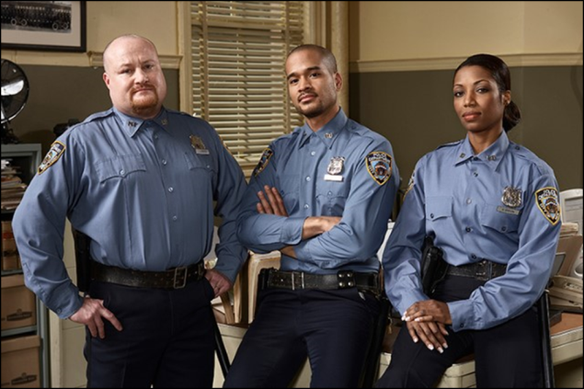
To Whom Do You Report?
Community relationships help establish reporting procedures with local law enforcement
Employers may establish reporting procedures
Local law enforcement may supply reporting forms or worksheets
To Whom Do You Report?
To Whom Do You Report?
Community relationships help establish reporting procedures with local law enforcement
Employers may establish reporting procedures
Local law enforcement may supply reporting forms or worksheets
Community relationships help establish reporting procedures with local law enforcement
Employers may establish reporting procedures
Local law enforcement may supply reporting forms or worksheets
Source: Getty Images

Slide 32

Community Awareness and Reporting Programs
If You See Something, Say Something
Txt-a-Tip Campaign
Programs in your own countries
Community Awareness
and Reporting Programs
Community Awareness
and Reporting Programs
If You See Something, Say Something
Txt-a-Tip Campaign
Programs in your own countries
If You See Something, Say Something
Txt-a-Tip Campaign
Programs in your own countries

Slide 33

TeachBack Moment
What actions you can take to detect potential hostile surveillance incidents?
Why is it important to identify and report suspicious activities associated with hostile surveillance?
TeachBack Moment
TeachBack Moment
What actions you can take to detect potential hostile surveillance incidents?
Why is it important to identify and report suspicious activities associated with hostile surveillance?
What actions you can take to detect potential hostile surveillance incidents?
Why is it important to identify and report suspicious activities associated with hostile surveillance?

Slide 34
Module Summary
Understanding surveillance
Potential targets of surveillance
Hostile surveillance
Detecting surveillance
Reporting suspicious activities
Module Summary
Module Summary
Refer to
Addendum 8.3
Understanding surveillance
Potential targets of surveillance
Hostile surveillance
Detecting surveillance
Reporting suspicious activities
Understanding surveillance
Potential targets of surveillance
Hostile surveillance
Detecting surveillance
Reporting suspicious activities

