Slide 1
Analyzing the Threat
Module 10

Slide 2
Module Objective
By the end of this module, you will be able to create a threat analysis statement for critical infrastructure
Module Objective
By the end of this module, you will be able to create a threat analysis statement for critical infrastructure

Slide 3
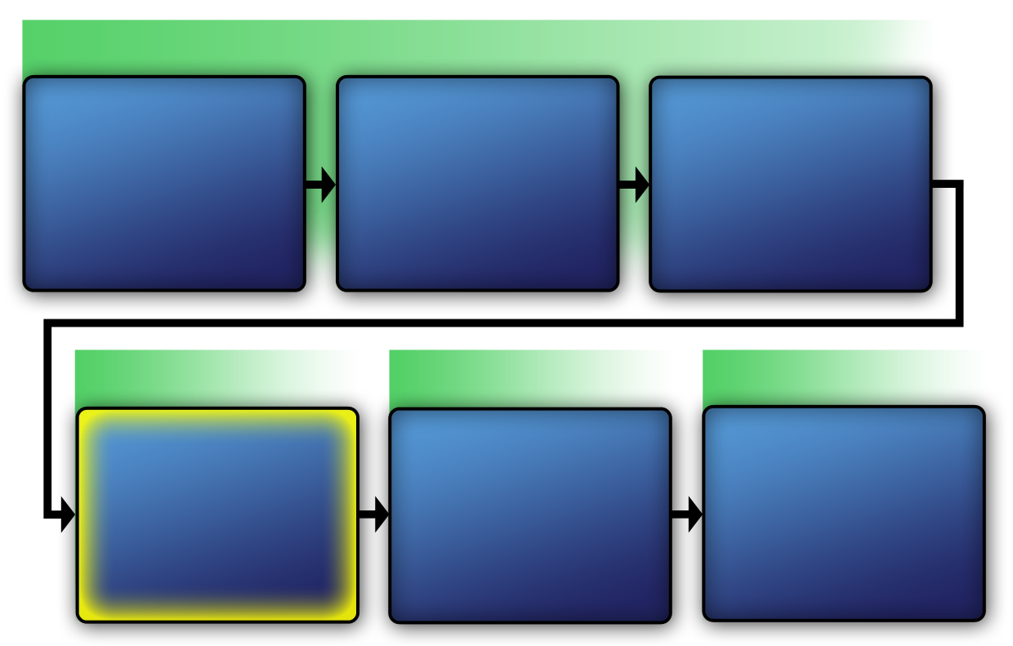
Physical Protection System
VAM Phase 1
Identify
Critical Infrastructure
Module 2
Assess Critical Infrastructure Components
Module 5
Identify Critical Infrastructure Assets
Module 6
VAM Phase 2
VAM Phase 3
VAM Phase 4
Analyze the Threat
Modules 7-10
Identify
Security
Counter-
Measures
Modules 11-14
Develop Operational Resilience
Module 15
Physical Protection System
VAM Phase 1
Identify Critical Infrastructure
Module 2
Assess Critical Infrastructure Components
Module 5
Identify Critical Infrastructure Assets
Module 6
VAM Phase 2
VAM Phase 2
VAM Phase 3
VAM Phase 4
Analyze the Threat
Modules 7-10
Identify
Security
Counter-
Measures
Modules 11-14
Develop Operational Resilience
Module 15

Slide 4
Purpose of the Threat Analysis
Gather threat data
Identify data sources
Prepare threat analysis statement
Establish physical protection system design requirements
Purpose of the Threat Analysis
Gather threat data
Identify data sources
Prepare threat analysis statement
Establish physical protection system design requirements

Slide 5
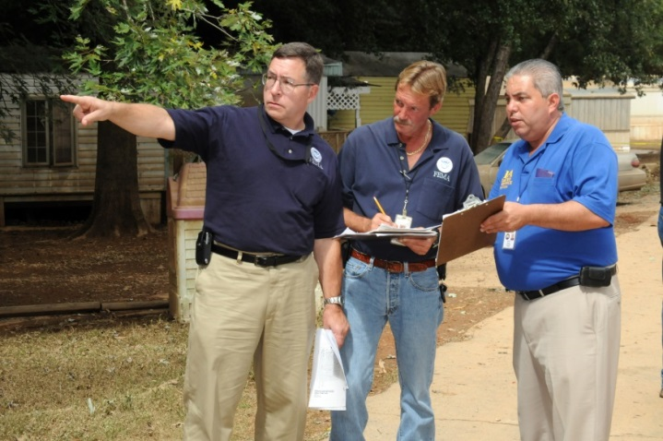
Threat Analysis Statement (1 of 2)
Identifies potential or credible threat capabilities
Represents an assessment by informed and qualified people using available information
Threat Analysis Statement (1 of 2)
Identifies potential or credible threat capabilities
Represents an assessment by informed and qualified people using available information
Source: FEMA.GOV

Slide 6
Threat Analysis Statement (2 of 2)
Helps determine the basic requirements of a critical infrastructure’s physical protection system
Review and update as necessary
Threat Analysis Statement (2 of 2)
Helps determine the basic requirements of a critical infrastructure’s physical protection system
Review and update as necessary

Slide 7

Sample Threat Analysis Statement Case Study (1 of 3)
Refer To:
Handout 10.1
Purpose: to examine and discuss a sample threat analysis statement from a given case study
  Duration: 30 minutes (20-reading; 10-discussion)
  Group composition: table groups
  Debrief: large-group discussion
Sample Threat Analysis Statement Case Study (1 of 3)
Refer To:
Handout 10.1
Purpose: to examine and discuss a sample threat analysis statement from a given case study
  Duration: 30 minutes (20-reading; 10-discussion)
  Group composition: table groups
  Debrief: large-group discussion

Slide 8

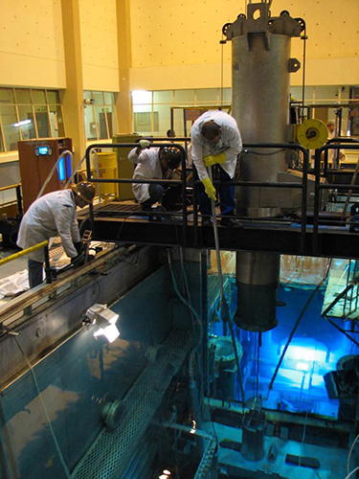
Sample Threat Analysis Statement Case Study (2 of 3)
Refer To:
Handout 10.1
Facility: nuclear power plant in Pelindaba, South Africa
Specific threat: terrorist, radiological sabotage
Credible threat: terrorist, theft, or diversion of special nuclear material
Sample Threat Analysis Statement Case Study (2 of 3)
Refer To:
Handout 10.1
Facility: nuclear power plant in Pelindaba, South Africa
Specific threat: terrorist, radiological sabotage
Credible threat: terrorist, theft, or diversion of special nuclear material
Source: ENERGY.GOV

Slide 9
Sample Threat Analysis Statement Case Study (3 of 3)
Refer To:
Handout 10.1
What critical information was not included in the sample threat analysis?
What were some of the significant points of the threat analysis statement?
What were some of the security countermeasure failures?
Sample Threat Analysis Statement Case Study (3 of 3)
Refer To:
Handout 10.1
What critical information was not included in the sample threat analysis?
What were some of the significant points of the threat analysis statement?
What were some of the security countermeasure failures?

Slide 10
Potential Adversary Threats
This section will cover:
  Adversary categories
  Potential actions of an adversary
  Adversary motivations
  Adversary tactics
  Adversary capabilities and limitations
Potential Adversary Threats
This section will cover:
  Adversary categories
  Potential actions of an adversary
  Adversary motivations
  Adversary tactics
  Adversary capabilities and limitations

Slide 11
Adversary Categories (1 of 2)
Insiders — individuals with authorized access
Outsiders — individuals without authorized access
Insiders working together with an outsider
Adversary Categories (1 of 2)
Insiders — individuals with authorized access
Outsiders — individuals without authorized access
Insiders working together with an outsider

Slide 12
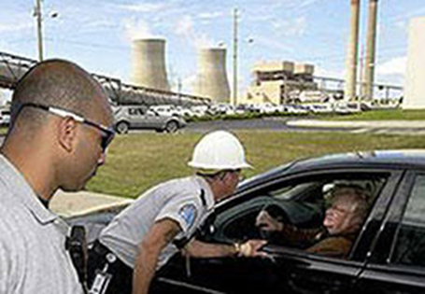
Adversary Categories (2 of 2)
Terrorists
Criminals
Discontented employees
Activists
Mentally ill persons
Source: NRC.GOV
Adversary Categories (2 of 2)
Terrorists
Criminals
Discontented employees
Activists
Mentally ill persons

Slide 13
Insiders
Most dangerous adversary because of:
  Knowledge
  Access
  Opportunity
  Motivation
Includes:
  Employees and contractors
  Vendors and visitors
Insiders
Most dangerous adversary because of:
  Knowledge
  Access
  Opportunity
  Motivation
Includes:
  Employees and contractors
  Vendors and visitors

Slide 14
Washington Navy Yard
Shooting Case Study (1 of 2)
Refer To:
Handout 10.2
Purpose: to identify the threat involved in the case study
  Duration: 10 minutes (5-case study; 5-discussion)
  Group composition: table groups
  Debrief: large-group discussion
Washington Navy Yard
Shooting Case Study (1 of 2)
Refer To:
Handout 10.2
Purpose: to identify the threat involved in the case study
  Duration: 10 minutes (5-case study; 5-discussion)
  Group composition: table groups
  Debrief: large-group discussion

Slide 15

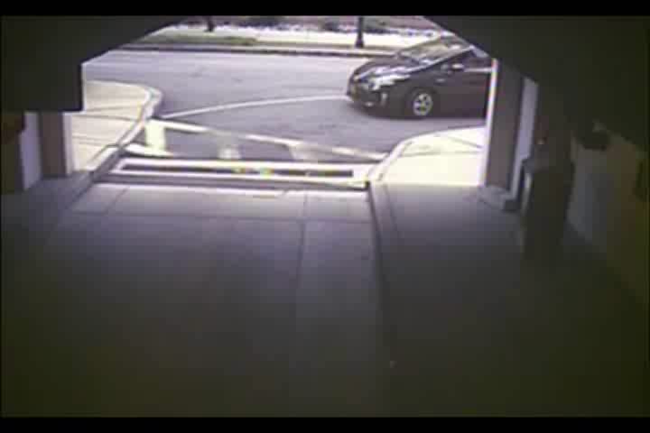
Washington Navy Yard
Shooting Case Study (2 of 2)
Washington Navy Yard
Shooting Case Study (2 of 2)

Slide 16

Terrorists
Characteristics:
  Are motivated by political or social objectives
  Conduct hostile surveillance
  Plan to kill to achieve goals
  Use explosives, automatic weapons, or both
  Will risk capture, injury, or death
  Target critical infrastructure
Terrorists
Characteristics:
  Are motivated by political or social objectives
  Conduct hostile surveillance
  Plan to kill to achieve goals
  Use explosives, automatic weapons, or both
  Will risk capture, injury, or death
  Target critical infrastructure
Source: NCTC.GOV

Slide 17

Criminals
Often motivated by financial gain
Develop financial networks to fund terrorist activity
Seek to avoid either capture or detection
Criminals
Often motivated by financial gain
Develop financial networks to fund terrorist activity
Seek to avoid either capture or detection
Source: NCDOJ.GOV

Slide 18
Discontented Employees (1 of 2)
Perceived mistreatment by boss or disagreements with coworkers
May disrupt known routines with aggressive behavior, theft, sabotage, or force
May risk capture or detection
Discontented Employees (1 of 2)
Perceived mistreatment by boss or disagreements with coworkers
May disrupt known routines with aggressive behavior, theft, sabotage, or force
May risk capture or detection
May use fear and intimidation
May be an insider or an outsider with insider information

Slide 19
Discontented Employees (2 of 2)
May use fear and intimidation
May be an insider or an outsider with insider information
Discontented Employees (2 of 2)
May use fear and intimidation
May be an insider or an outsider with insider information

Slide 20
Activists
Oppose ecological, political, and economic programs
May use violent or nonviolent tactics for direct confrontation
May attempt to defeat barriers (fences and walls)
May be insider or outsider
Activists
Oppose ecological, political, and economic programs
May use violent or nonviolent tactics for direct confrontation
May attempt to defeat barriers (fences and walls)
May be insider or outsider

Slide 21
Mentally Ill Persons (1 of 2)
Known criminal with mental illness history or family history of violence
Known member of a terrorist organization
Appearance of being under the influence of alcohol or other drugs
Mentally Ill Persons (1 of 2)
Known criminal with mental illness history or family history of violence
Known member of a terrorist organization
Appearance of being under the influence of alcohol or other drugs

Slide 22
Mentally Ill Persons (2 of 2)
Undiagnosed mental illness with no outward signs
May be insider or outsider
Mentally Ill Persons (2 of 2)
Undiagnosed mental illness with no outward signs
May be insider or outsider

Slide 23
Discussion Question
What are some examples of damage to critical infrastructure assets caused by terrorists, criminals, discontented employees, or mentally ill persons in your country?
Discussion Question
What are some examples of damage to critical infrastructure assets caused by terrorists, criminals, discontented employees, or mentally ill persons in your country?

Slide 24
Potential Actions of an Adversary (1 of 2)
Consider the types of crimes and terrorist attacks these various adversaries are interested in and capable of carrying out
Determine which of these acts pose a credible threat to the specific site
Study historical examples and trends
Potential Actions of an Adversary (1 of 2)
Consider the types of crimes and terrorist attacks these various adversaries are interested in and capable of carrying out
Determine which of these acts pose a credible threat to the specific site
Study historical examples and trends

Slide 25
Potential Actions of an Adversary (2 of 2)
Sabotage — deliberate and malicious destruction or intrusion
Theft — unlawful possession of property, equipment, or information
Diversion of materials — unlawful movement or transfer
Other violent acts — against critical people assets
Potential Actions of an Adversary (2 of 2)
Sabotage — deliberate and malicious destruction or intrusion
Theft — unlawful possession of property, equipment, or information
Diversion of materials — unlawful movement or transfer
Other violent acts — against critical people assets

Slide 26
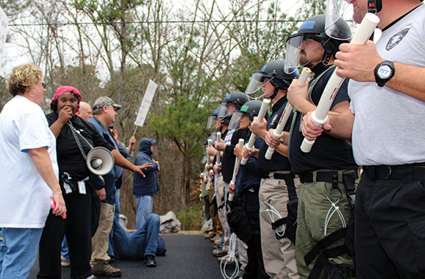
Adversary Motivations
Political
Philosophical
Social
Economic
Personal
Source: DHS.GOV
Adversary Motivations
Political
Philosophical
Social
Economic
Personal

Slide 27
Terrorist Tactics (1 of 2)
Part of the threat analysis involves examining the tactics of each potential adversary
Tactics may include or be a combination of:
  Stealth — perform a task undetected
Terrorist Tactics (1 of 2)
Part of the threat analysis involves examining the tactics of each potential adversary
Tactics may include or be a combination of:
  Stealth — perform a task undetected

Slide 28
Terrorist Tactics (2 of 2)
  Force — gain access through the use of violence
  Deceit — provide false information to gain access
Help enhance the design of the physical protection system
Terrorist Tactics (2 of 2)
  Force — gain access through the use of violence
  Deceit — provide false information to gain access
Help enhance the design of the physical protection system

Slide 29
Adversary Capabilities and Limitations
Determine system performance requirements
Define threat more clearly
Include specific considerations of:
  Personnel
  Knowledge, skills, and experience
  Types and quantity of weapons
  Tools and equipment
  Transportation
Adversary Capabilities and Limitations
Determine system performance requirements
Define threat more clearly
Include specific considerations of:
  Personnel
  Knowledge, skills, and experience
  Types and quantity of weapons
  Tools and equipment
  Transportation

Slide 30

TeachBack Moment
Why is it important to analyze the threat?
What are the different types of adversary threats?
TeachBack Moment
Why is it important to analyze the threat?
What are the different types of adversary threats?

Slide 31
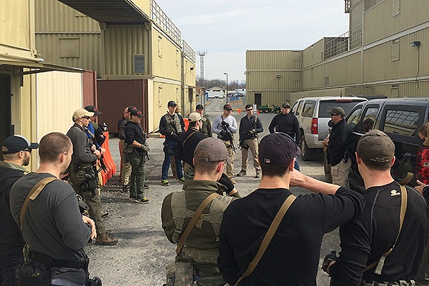
Information Sources on
Potential Threat (1 of 4)
Threat information helps define the threat:
  The targeted critical infrastructure asset
  Adversary’s objective
Source: STATE.GOV
Information Sources on
Potential Threat (1 of 4)
Threat information helps define the threat:
  The targeted critical infrastructure asset
  Adversary’s objective

Slide 32
Information Sources on
Potential Threat (2 of 4)
Communication with organizations that can provide information
Sources of threat information include:
  Law enforcement reports
  In-country intelligence reports
  National threat data reports
Information Sources on
Potential Threat (2 of 4)
Communication with organizations that can provide information
Sources of threat information include:
  Law enforcement reports
  In-country intelligence reports
  National threat data reports

Slide 33
Information Sources on
Potential Threat (3 of 4)
  Military and law enforcement agencies
  International intelligence agencies
Site incident reports
Reports of criminal or terrorist activities in the area
Information Sources on
Potential Threat (3 of 4)
  Military and law enforcement agencies
  International intelligence agencies
Site incident reports
Reports of criminal or terrorist activities in the area

Slide 34
Information Sources on
Potential Threat (4 of 4)
Contact lists for law enforcement activities
Number and types of personnel at the facility
Any available threat information
Information Sources on
Potential Threat (4 of 4)
Contact lists for law enforcement activities
Number and types of personnel at the facility
Any available threat information

Slide 35
Discussion Questions
What are other suggestions for sources of information about potential threats in your country?
What types of similar sources of statistics on terrorist activities does your government have?
Discussion Questions
What are other suggestions for sources of information about potential threats in your country?
What types of similar sources of statistics on terrorist activities does your government have?

Slide 36
Organizing Threat Information
Formats information to help facilitate the critical decision-making process:
  Which threats should be included in the threat spectrum?
  What is the effectiveness of the existing physical protection system?
Includes both types of adversaries, insider and outsider, in the threat analysis statement
Organizing Threat Information
Formats information to help facilitate the critical decision-making process:
  Which threats should be included in the threat spectrum?
  What is the effectiveness of the existing physical protection system?
Includes both types of adversaries, insider and outsider, in the threat analysis statement

Slide 37

Barriers to Analytical Thinking
(1 of 2)
Refer To:
Workbook 10.1
An awareness of common barriers will help:
  Avoid critical mistakes that could negatively affect critical infrastructure protection
  Facilitate the analytical thought process relating to the physical protection system
Barriers to Analytical Thinking
(1 of 2)
Refer To:
Workbook 10.1
An awareness of common barriers will help:
  Avoid critical mistakes that could negatively affect critical infrastructure protection
  Facilitate the analytical thought process relating to the physical protection system

Slide 38
Barriers to Analytical Thinking
(2 of 2)
Refer To:
Workbook 10.1
  Focus on facts not personal opinions
  Use analytical thinking processes to overcome barriers
Barriers to Analytical Thinking
(2 of 2)
Refer To:
Workbook 10.1
  Focus on facts not personal opinions
  Use analytical thinking processes to overcome barriers

Slide 39
Discussion Questions
In your experience, which types of barriers to analytical thinking have you encountered?
What actions could you take to prevent or avoid these barriers?
Discussion Questions
In your experience, which types of barriers to analytical thinking have you encountered?
What actions could you take to prevent or avoid these barriers?

Slide 40

Alternative Outcome
Thinking Techniques
Refer To:
Workbook 10.1
Advocating the opposite view
Team A or Team B analysis
Other team analysis
“What if?” analysis
High consequence and low probability analysis
Outside-in-thinking
Gaming and simulation
Alternative Outcome
Thinking Techniques
Refer To:
Workbook 10.1
Advocating the opposite view
Team A or Team B analysis
Other team analysis
“What if?” analysis
High consequence and low probability analysis
Outside-in-thinking
Gaming and simulation

Slide 41
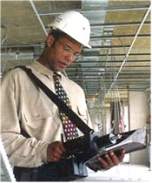
Insider Threat Information Worksheet
Begin threat analysis by considering unique potential insider threats posed by insiders at the critical infrastructure facility
Rate and organize the insider threat information on a worksheet
Insider Threat Information Worksheet
Begin threat analysis by considering unique potential insider threats posed by insiders at the critical infrastructure facility
Rate and organize the insider threat information on a worksheet
Source: DOL.GOV

Slide 42
Insider Threat Information Worksheet Activity
Refer To:
Workbook 10.2
Purpose: to help organize gathered information about insider threats
  Duration: 15 minutes ( 5-reading; 10-discussion)
  Group composition: table groups
  Debrief: large-group discussion
Insider Threat Information Worksheet Activity
Refer To:
Workbook 10.2
Purpose: to help organize gathered information about insider threats
  Duration: 15 minutes ( 5-reading; 10-discussion)
  Group composition: table groups
  Debrief: large-group discussion

Slide 43
Outsider Threat
Information Worksheet
Refer To:
Workbook 10.3
Organized by an assessment of potential threat:
  Actions
  Motivations
  Tactics
  Capabilities
Outsider Threat
Information Worksheet
Refer To:
Workbook 10.3
Organized by an assessment of potential threat:
  Actions
  Motivations
  Tactics
  Capabilities

Slide 44
Outsider Threat
Worksheet Activity
Refer To:
Workbook 10.3
Purpose: to help organize gathered information about outsider threats
  Duration: 15 minutes (5-reading; 10-debrief)
  Group composition: table groups
  Debrief: large-group discussion
Outsider Threat
Worksheet Activity
Refer To:
Workbook 10.3
Purpose: to help organize gathered information about outsider threats
  Duration: 15 minutes (5-reading; 10-debrief)
  Group composition: table groups
  Debrief: large-group discussion

Slide 45
Estimating Likelihood of Attack (1 of 2)
Refer To:
Workbook 10.4
Determine information about each terrorist:
  Threat type
  Capability
  History and intent
  Target appeal (attractiveness)
Estimating Likelihood
of Attack (1 of 2)
Refer To:
Workbook 10.4
Determine information about each terrorist:
  Threat type
  Capability
  History and intent
  Target appeal (attractiveness)

Slide 46
Estimating Likelihood of Attack (2 of 2)
Refer To:
Workbook 10.4
Rating scale:
  Very Low
  Low
  Medium
  High
  Very High
Numerical scale to rate threat type: 1–10, with 10 being highest
Estimating Likelihood
of Attack (2 of 2)
Refer To:
Workbook 10.4
Rating scale:
  Very Low
  Low
  Medium
  High
  Very High
Numerical scale to rate threat type: 1–10, with 10 being highest

Slide 47
Estimating Likelihood of
Attack Worksheet Activity
Refer To:
Workbook 10.4
Purpose: to provide an example to help you estimate the likelihood of attack of an identified threat
  Duration: 25 minutes (20-activity; 5-debrief)
  Group composition: table groups
  Debrief: large-group discussion
Estimating Likelihood of
Attack Worksheet Activity
Refer To:
Workbook 10.4
Purpose: to provide an example to help you estimate the likelihood of attack of an identified threat
  Duration: 25 minutes (20-activity; 5-debrief)
  Group composition: table groups
  Debrief: large-group discussion

Slide 48
Steps to Prepare
Threat Analysis Statement
Refer To:
Workbook 10.5
Compare the likelihood of attack for all threat types
Identify the most likely threat type
Prepare threat analysis statement
Steps to Prepare
Threat Analysis Statement
Refer To:
Workbook 10.5
Compare the likelihood of attack for all threat types
Identify the most likely threat type
Prepare threat analysis statement

Slide 49
Preparing a Threat
Analysis Statement Activity
Refer To:
Workbook 10.5
Purpose: to prepare a threat analysis statement using a given scenario
  Duration: 15 minutes (10-activity; 5-debrief)
  Group composition: table groups
  Debrief: large-group discussion
Preparing a Threat
Analysis Statement Activity
Refer To:
Workbook 10.5
Purpose: to prepare a threat analysis statement using a given scenario
  Duration: 15 minutes (10-activity; 5-debrief)
  Group composition: table groups
  Debrief: large-group discussion

Slide 50

Community Engagement and Human Rights Discussion
Why is it important to engage the community in determining the types of threats that may exist?
Community Engagement
and Human Rights Discussion
Why is it important to engage the community in determining the types of threats that may exist?

Slide 51

Threaded Exercise Part 3 — National Ministries Building
Refer to
Workbook Part 3
Purpose: to prepare a threat analysis statement
  Duration: 60 minutes (45-exercise; 15-debrief)
  Group composition: table groups
  Debrief: presentation and discussion
Threaded Exercise Part 3 — National Ministries Building
Refer To:
Workbook Part 3
Purpose: to prepare a threat analysis statement
  Duration: 60 minutes (45-exercise; 15-debrief)
  Group composition: table groups
  Debrief: presentation and discussion

Slide 52
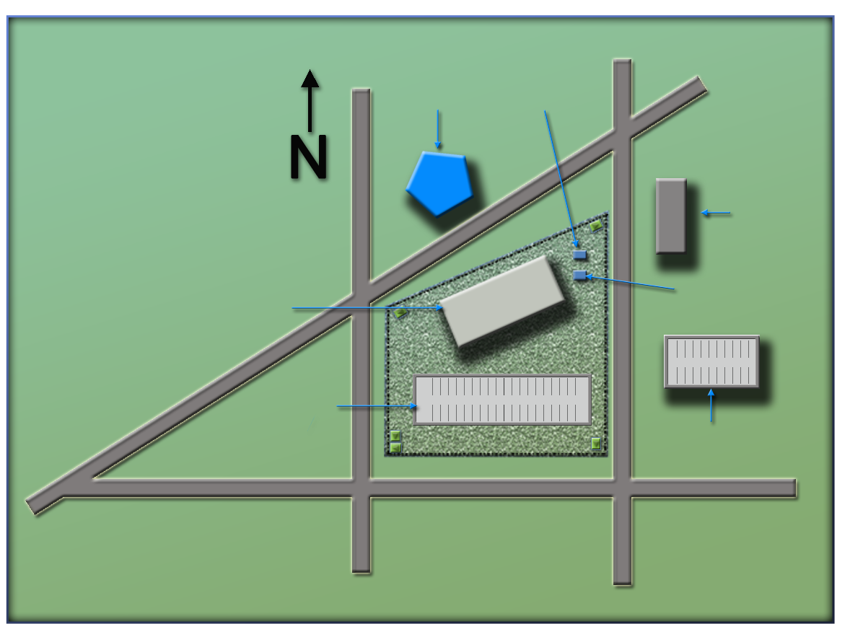
National Ministries
Building Complex Map
Refer to
Workbook Part 3
(Ministry of Defense)
Ministry
of Defense
Security Office
(Security office)
(Foreign embassy)
Foreign Embassy
(National Ministries
Building)
National Ministries
Building
Building Generator
National Avenue
(Building generator)
Parking Lot
Parking Garage
(National Avenue)
(Parking lot)
(Parking garage)
Judiciary Lane
National Ministries
Building Complex Map
Refer To:
First Street
Second Street
(Judiciary Lane)
(Second Street)
Workbook Part 3
Ministry
of Defense
Security office
(First Street)
National Ministries
Building
Foreign embassy
Parking lot
Building generator
National Avenue
Parking garage
Judiciary Lane
First Street
Second Street

Slide 53
Module Summary
Purpose of the threat analysis
Potential adversary threats
Information sources on potential threat
Module Summary
Purpose of the threat analysis
Potential adversary threats
Information sources on potential threat

