Slide 1
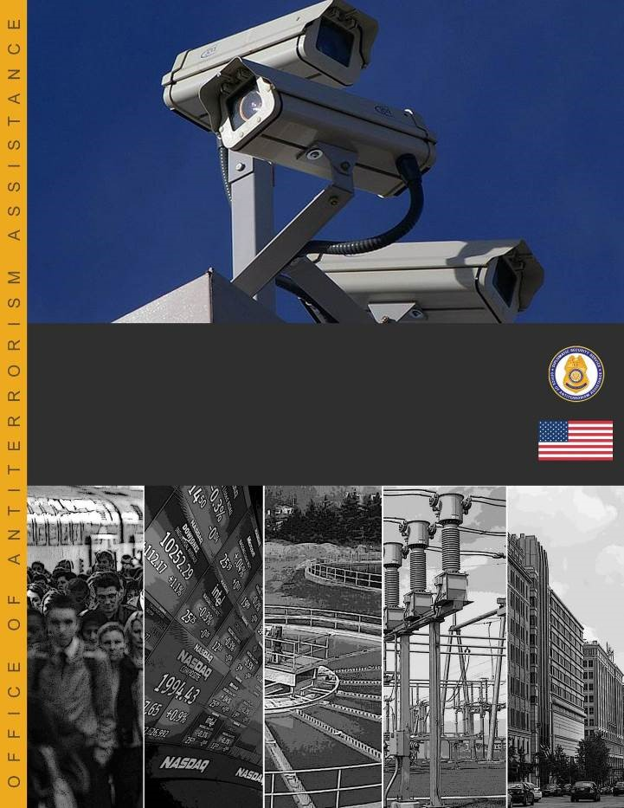
Participant Workbook
July 2016—v4.00
Critical Infrastructure and Security Resilience
Workbook

