Slide 1
Community Engagement and Human Rights
Module 3

Slide 2
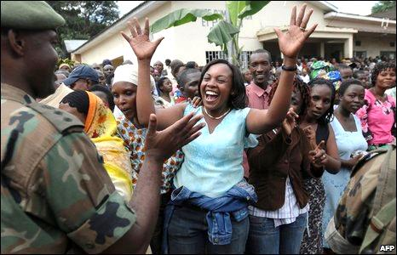
Terminal Learning Objective
By the end of this module, you will be able to explain the importance of community engagement and human rights in deterring terrorism
Terminal Learning Objective
By the end of this module, you will be able to explain the importance of community engagement and human rights in deterring terrorism
Source: AFP

Slide 3
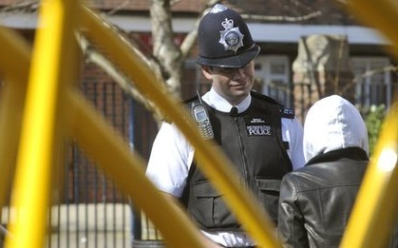
Value of Community Engagement
It is not the police and the intelligence services who will defeat terrorism; it is communities who defeat terrorism.
London Metropolitan Police Commissioner
Sir Ian Blair
Value of Community Engagement
It is not the police and the intelligence services who will defeat terrorism; it is communities who defeat terrorism.
London Metropolitan Police Commissioner
Sir Ian Blair
Source: BBC

Slide 4
Discussion Questions
Think about the quote. How does it apply to your job responsibilities?
What are some examples of successful community engagement?
Discussion Questions
Think about the quote. How does it apply to your job responsibilities?
What are some examples of successful community engagement?

Slide 5


Scenario (1 of 3)
Refer To:
Handout 3.1
Pre-Event
  City planned an event expected to attract large crowds
  Officials developed joint plans for traffic and security
Scenario (1 of 3)
Refer To:
Handout 3.1
Pre-Event
  City planned an event expected to attract large crowds
  Officials developed joint plans for traffic and security
Source: Getty Images

Slide 6

Scenario (2 of 3)
Refer To:
Handout 3.1
Few Days Before the Event
  Community members announced plans for a peaceful protest against a controversial government policy
  A radical group from outside the community posted materials on social media sites encouraging violence and threating to disrupt the event
Scenario (2 of 3)
Refer To:
Handout 3.1
Few Days Before the Event
  Community members announced plans for a peaceful protest against a controversial government policy
  A radical group from outside the community posted materials on social media sites encouraging violence and threating to disrupt the event
Source: Getty Images

Slide 7

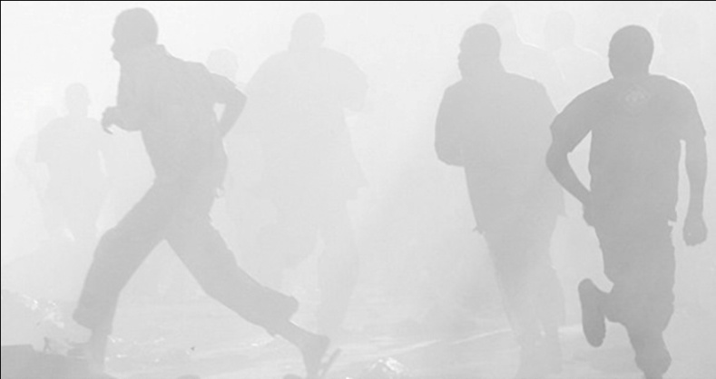
Scenario (3 of 3)
Refer To:
Handout 3.1
Day of the Event
  Crowds were larger than anticipated and transportation systems were overwhelmed
  Protesters were initially orderly, until an unruly group appeared and started antigovernment chanting
  Crowd began throwing rocks and bottles at law enforcement personnel
Scenario (3 of 3)
Refer To:
Handout 3.1
Day of the Event
  Crowds were larger than anticipated and transportation systems were overwhelmed
  Protesters were initially orderly, until an unruly group appeared and started antigovernment chanting
  Crowd began throwing rocks and bottles at law enforcement personnel
Source: DS/T/ATA

Slide 8
Discussion Questions
Refer To:
Handout 3.1
How could officials engage with the community to de-escalate the situation?
What could officials do to prevent future conflicts?
How do these strategies relate to countering terrorism?
Discussion Questions
Refer To:
Handout 3.1
How could officials engage with the community to de-escalate the situation?
What could officials do to prevent future conflicts?
How do these strategies relate to countering terrorism?

Slide 9
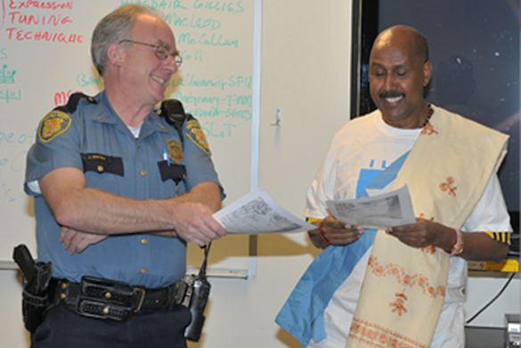
Successful Community
Engagement (1 of 2)
Law enforcement and government officials:
  Provide a needed public service and protect the community
  Remain visible and accessible to all community members
  Are accountable to the law and the public
Successful Community
Engagement (1 of 2)
Law enforcement and government officials:
  Provide a needed public service and protect the community
  Remain visible and accessible to all community members
  Are accountable to the law and the public
Source: Seattle, Washington Government

Slide 10
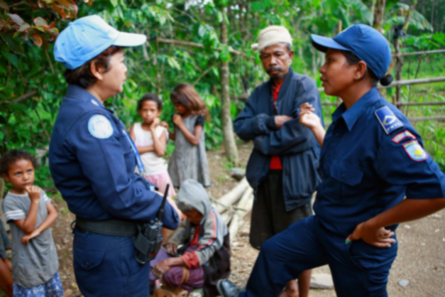
Successful Community
Engagement (2 of 2)
Law enforcement and government officials:
  Offer easy ways for the community to provide input
  Respect and value all community members
  Are fair and protect human rights
Successful Community
Engagement (2 of 2)
Law enforcement and government officials:
  Offer easy ways for the community to provide input
  Respect and value all community members
  Are fair and protect human rights
Source: UN

Slide 11

Universal Declaration of Human Rights
Recognition of the inherent dignity and of the equal and inalienable rights of all members of the human family is the foundation of freedom, justice, and peace in the world
Source: Penn State University
Universal Declaration of Human Rights
Recognition of the inherent dignity and of the equal and inalienable rights of all members of the human family is the foundation of freedom, justice, and peace in the world

Slide 12

Regional Human Rights Treaties (1 of 2)
African Charter on Human and Peoples’ Rights
American Convention on Human Rights
Arab Charter on Human Rights
Association of Southeast Asian Nations Human Rights Declaration
Regional Human Rights Treaties (1 of 2)
African Charter on Human and Peoples’ Rights
American Convention on Human Rights
Arab Charter on Human Rights
Association of Southeast Asian Nations Human Rights Declaration
Source: Getty Images

Slide 13
Regional Human Rights Treaties (2 of 2)
European Convention on Human Rights and Fundamental Freedoms
Pacific Plan Initiative 12.5
Regional Human Rights Treaties (2 of 2)
European Convention on Human Rights and Fundamental Freedoms
Pacific Plan Initiative 12.5
Source: Getty Images

Slide 14
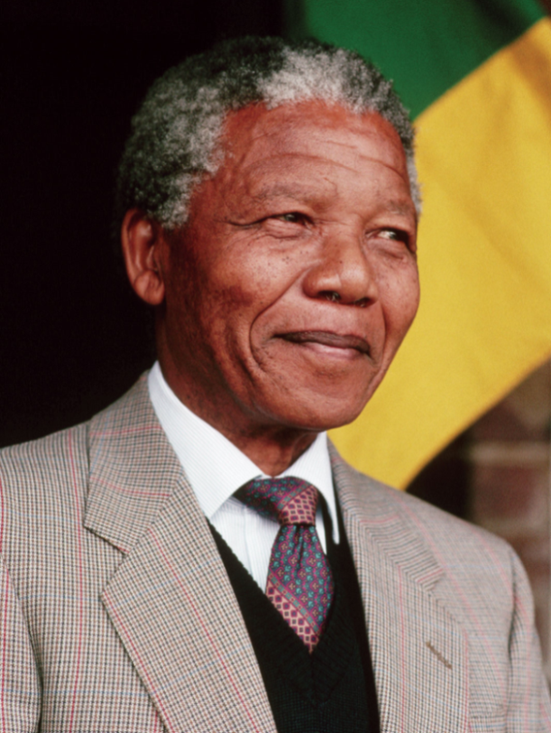
Why Are Human Rights Important?
To deny people their human rights is to challenge their very humanity.
Nelson Mandela
Source: Costa Rican Times
Why Are Human Rights Important?
To deny people their human rights is to challenge their very humanity.
Nelson Mandela

Slide 15

Protecting Human Rights
Refer To:
Workbook 3.1
Review the human rights in Workbook 3.1
Select one human right you feel is most significant
Describe one action you can take in your work to protect this right
Protecting Human Rights
Refer To:
Workbook 3.1
Review the human rights in Workbook 3.1
Select one human right you feel is most significant
Describe one action you can take in your work to protect this right

Slide 16
Module Summary
Countering Terrorism
Human Rights
Community Engagement
Module Summary
Countering Terrorism
Human Rights
Community Engagement

