Slide 1
Building Community Partnerships
Module 4

Slide 2
Module Objective
By the end of this module, you will be able to explain how to build partnerships with the community to better protect critical infrastructure
Module Objective
By the end of this module, you will be able to explain how to build partnerships with the community to better protect critical infrastructure

Slide 3

Community Awareness Program
An interactive program designed to provide citizens with the basic tools needed to recognize and help prevent terrorism and criminal activity within our communities
https://www.ready.gov/community-preparedness
Community Awareness Program
An interactive program designed to provide citizens with the basic tools needed to recognize and help prevent terrorism and criminal activity within our communities
https://www.ready.gov/community-preparedness
Source: DS/T/ATA

Slide 4
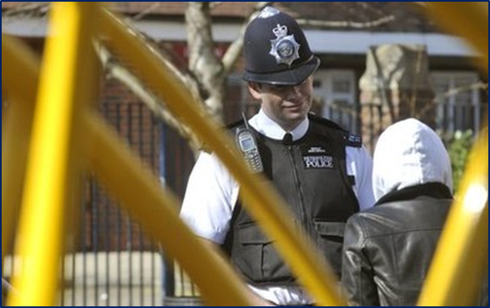
Benefits of Community Awareness
Communication increases between the community and law enforcement
The community becomes part of the solution
Protection becomes everyone’s responsibility
Trust increases and fear decreases
Benefits of Community Awareness
Communication increases between the community and law enforcement
The community becomes part of the solution
Protection becomes everyone’s responsibility
Trust increases and fear decreases
Source: BBC

Slide 5
Discussion Question
What types of community awareness programs exist in your nation?
Discussion Question
What types of community awareness programs exist in your nation?

Slide 6
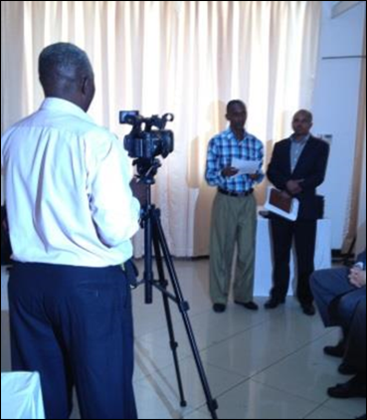
Elements of a Community
Awareness Program (1 of 3)
Partnerships:
  Governments, industry, and communities
  Open, mutual, and practical
  Includes all levels of government
Public service announcements
Source: DS/T/ATA
Elements of a Community
Awareness Program (1 of 3)
Partnerships:
  Governments, industry, and communities
  Open, mutual, and practical
  Includes all levels of government
Public service announcements

Slide 7
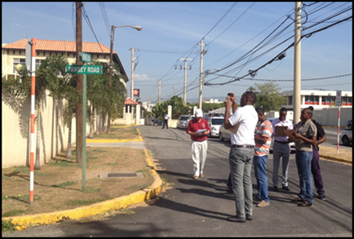
Elements of a Community
Awareness Program (2 of 3)
Information for the public and partners about suspicious activity or behavior if observed:
  Unusual items or situations
  Observation of surveillance
  Requests for information about military, security, business capabilities, or people
Elements of a Community
Awareness Program (2 of 3)
Information for the public and partners about suspicious activity or behavior if observed:
  Unusual items or situations
  Observation of surveillance
  Requests for information about military, security, business capabilities, or people
Source: DS/T/ATA

Slide 8
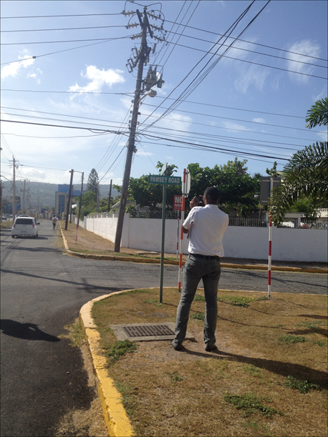
Elements of a Community
Awareness Program (3 of 3)
Protection of citizens’ privacy and civil liberties
The process for reporting observations of suspicious activity
Source: DS/T/ATA
Elements of a Community
Awareness Program (3 of 3)
Protection of citizens’ privacy and civil liberties
The process for reporting observations of suspicious activity

Slide 9

Example — “If You See
Something, Say Something”
“It takes a community to protect a community. Informed, alert communities play a critical role in keeping our nation safe.”
  https://www.dhs.gov/see-something-say-something
Example — “If You See
Something, Say Something”
“It takes a community to protect a community. Informed, alert communities play a critical role in keeping our nation safe.”
  https://www.dhs.gov/see-something-say-something
Source: US Dept. of Homeland Security

Slide 10

Example — Amtrak and
Amtrak Police Department
Txt-a-Tip Campaign
Partners for Amtrak Safety and Security Program
Source: National Railroad
Passenger Corporation (Amtrak)
Example — Amtrak and
Amtrak Police Department
Txt-a-Tip Campaign
Partners for Amtrak Safety and Security Program

Slide 11
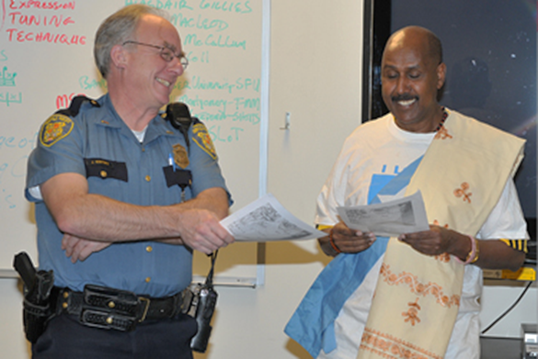
Partnering with Private
Security Agencies (1 of 2)
Community partnerships — law enforcement agencies and the community and organizations they serve working together for the purpose of developing solutions to problems and increasing trust in law enforcement
Partnering with Private
Security Agencies (1 of 2)
Community partnerships — law enforcement agencies and the community and organizations they serve working together for the purpose of developing solutions to problems and increasing trust in law enforcement
Source: Seattle, Washington, Government

Slide 12
Partnering with Private
Security Agencies (2 of 2)
Protection of critical infrastructure
Contribution to homeland security efforts
Discussion question: What are some ways to add value to partnering with private security?
Partnering with Private
Security Agencies (2 of 2)
Protection of critical infrastructure
Contribution to homeland security efforts
Discussion question: What are some ways to add value to partnering with private security?

Slide 13
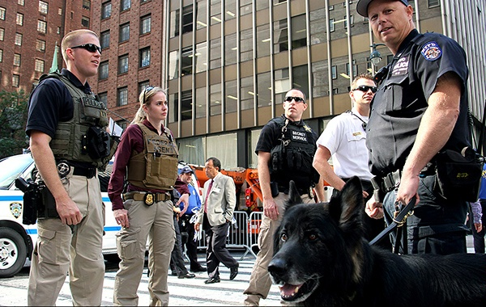
Benefits of Partnerships (1 of 3)
For law enforcement agencies:
  Assistance during emergencies
  Combined effort to protect critical infrastructure
  Additional personnel and skills
  Evidence and incident knowledge
  Decrease in calls for service
Benefits of Partnerships (1 of 3)
For law enforcement agencies:
  Assistance during emergencies
  Combined effort to protect critical infrastructure
  Additional personnel and skills
  Evidence and incident knowledge
  Decrease in calls for service
Source: US Department of State

Slide 14
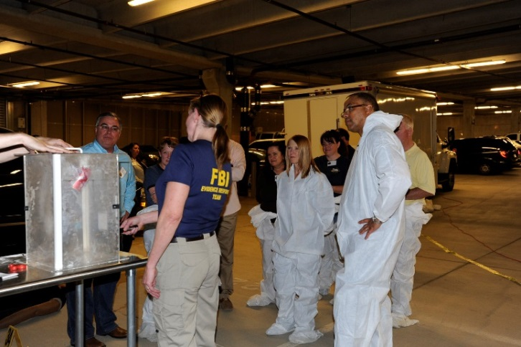
Benefits of Partnerships (2 of 3)
For private sector security agencies:
  Coordinating disaster planning
  Obtaining training and services
  Developing relationships to explain reporting processes
  Increasing understanding of corporate needs
Benefits of Partnerships (2 of 3)
For private sector security agencies:
  Coordinating disaster planning
  Obtaining training and services
  Developing relationships to explain reporting processes
  Increasing understanding of corporate needs
Source: FBI

Slide 15
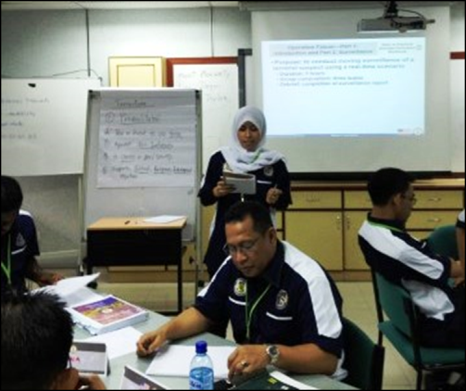
Benefits of Partnerships (3 of 3)
Joint benefits for both types of agencies
  Creative problem solving
  Increased training opportunities
  Information, data, and intelligence sharing
  Force multiplier opportunities
  Reduced recovery time following disasters
  Access to the community through private sector communications technology
Benefits of Partnerships (3 of 3)
Joint benefits for both types of agencies
  Creative problem solving
  Increased training opportunities
  Information, data, and intelligence sharing
  Force multiplier opportunities
  Reduced recovery time following disasters
  Access to the community through private sector communications technology
Source: DS/T/ATA

Slide 16


Elements of Successful Partnerships
Shared mission
Communication
Leadership
Adequate resources
Mutual trust and respect
Source: Getty Images
Elements of Successful Partnerships
Source: Getty Images
Shared mission
Communication
Leadership
Adequate resources
Mutual trust and respect

Slide 17

Building Community Partnerships Discussion
Refer To:
Workbook 4.1
Purpose: to discuss community partnerships, their importance, and strategies for development
  Duration: 15 minutes (5-complete table; 10-discussion)
  Group composition: participant pairs
  Debrief: large-group discussion
Building Community Partnerships Discussion
Refer To:
Workbook 4.1
Purpose: to discuss community partnerships, their importance, and strategies for development
  Duration: 15 minutes (5-complete table; 10-discussion)
  Group composition: participant pairs
  Debrief: large-group discussion

Slide 18

TeachBack Moment
What are the benefits of increasing community awareness to better protect critical infrastructure?
What are some of the benefits of partnering with private security to better protect critical infrastructure?
TeachBack Moment
What are the benefits of increasing community awareness to better protect critical infrastructure?
What are some of the benefits of partnering with private security to better protect critical infrastructure?

Slide 19
Module Summary
Community awareness programs
Partnering with private security agencies
Module Summary
Community awareness programs
Partnering with private security agencies

