Slide 1
Critical Infrastructure Assets
Module 6

Slide 2
Module Objective
By the end of this module, you will be able to analyze critical infrastructure assets in order to prioritize them for protection
Module Objective
By the end of this module, you will be able to analyze critical infrastructure assets in order to prioritize them for protection

Slide 3
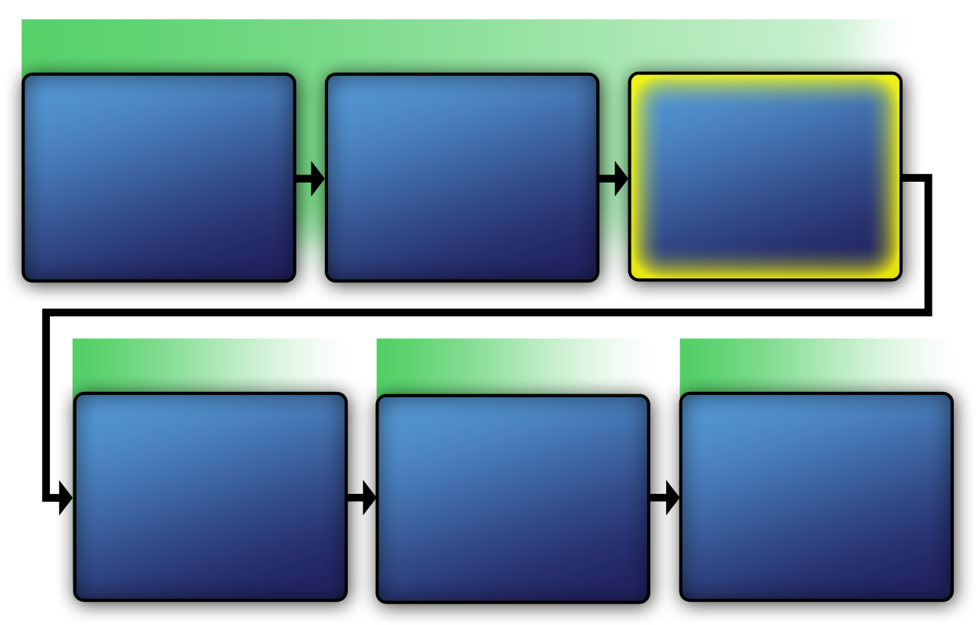
PPS Diagram
VAM Phase 1
Identify Critical Infrastructure
Module 2
Assess Critical Infrastructure Components
Module 5
Identify Critical Infrastructure Assets
Module 6
VAM Phase 2
VAM Phase 3
VAM Phase 4
Analyze the Threat
Modules 7-10
Identify
Security
Counter-
Measures
Modules 11-14
Develop Operational Resilience
Module 15
PPS Diagram
VAM Phase 1
Identify Critical Infrastructure
Module 2
Assess Critical Infrastructure Components
Module 5
Identify Critical Infrastructure Assets
Module 6
VAM Phase 2
VAM Phase 2
VAM Phase 3
VAM Phase 4
Analyze the Threat
Modules 7-10
Identify
Security
Counter-
Measures
Modules 11-14
Develop Operational Resilience
Module 15

Slide 4
Critical Assets
Any people, information, processes, and equipment that must be protected to prevent an undesired consequence from occurring
Critical Assets
Any people, information, processes, and equipment that must be protected to prevent an undesired consequence from occurring

Slide 5

Categories of Critical Assets (1 of 2)
People — dignitaries, government leaders, and officials or individuals in critical mission-specific positions
Information — classified documents, reports, or other proprietary data
Categories of Critical Assets (1 of 2)
People — dignitaries, government leaders, and officials or individuals in critical mission-specific positions
Information — classified documents, reports, or other proprietary data
Source: Getty Images

Slide 6

Categories of Critical Assets (2 of 2)
Processes — backup and storage of data processing materials and special analytical programs
Equipment — data processing equipment, military weapons, computers, and vehicles
Categories of Critical Assets (2 of 2)
Processes — backup and storage of data processing materials and special analytical programs
Equipment — data processing equipment, military weapons, computers, and vehicles
Source: Getty Images

Slide 7
Discussion Question
Thinking back to the facilities listed in Module 5: Critical Infrastructure Components, what types of critical assets might belong to those facilities?
Discussion Question
Thinking back to the facilities listed in Module 5: Critical Infrastructure Components, what types of critical assets might belong to those facilities?

Slide 8
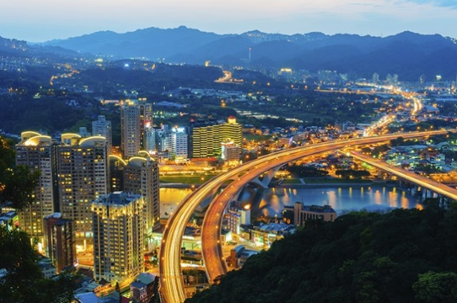
Critical Asset Identification
Identify all critical assets to prepare for asset analysis
Identification must occur before prioritizing critical assets for protection
Critical Asset Identification
Identify all critical assets to prepare for asset analysis
Identification must occur before prioritizing critical assets for protection
Source: Getty Images

Slide 9

Critical Asset
Identification Activity
Refer To:
Handout 6.1
Purpose: to identify critical assets for assigned facilities
  Duration: 30 minutes (20-activity; 10-debrief)
  Group composition: table groups
  Debrief: large-group discussion
Critical Asset
Identification Activity
Refer To:
Handout 6.1
Purpose: to identify critical assets for assigned facilities
  Duration: 30 minutes (20-activity; 10-debrief)
  Group composition: table groups
  Debrief: large-group discussion

Slide 10
Protecting Critical Assets
Cannot protect all critical infrastructure assets
Prioritize all critical assets according to their importance
Analyze critical assets to determine which to protect
Protecting Critical Assets
Cannot protect all critical infrastructure assets
Prioritize all critical assets according to their importance
Analyze critical assets to determine which to protect

Slide 11

Undesirable Consequences of Critical Asset Loss Analysis
Refer To:
Workbook 6.1
The steps are:
  Specify the undesirable consequences of loss for each critical asset
  Determine the levels (high, medium, low) of the undesirable consequences of loss for each asset
  Determine the probability of occurrence of undesirable events
Undesirable Consequences of Critical Asset Loss Analysis
Refer To:
Workbook 6.1
The steps are:
  Specify the undesirable consequences of loss for each critical asset
  Determine the levels (high, medium, low) of the undesirable consequences of loss for each asset
  Determine the probability of occurrence of undesirable events

Slide 12
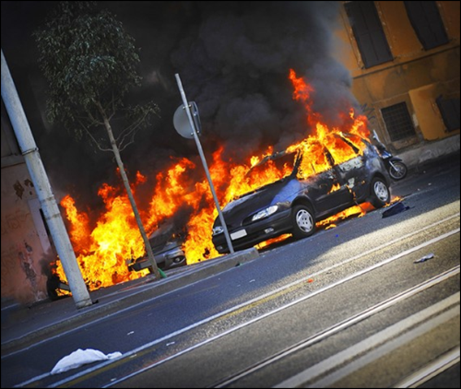
Specify the Undesirable Consequences of Loss for each Critical Asset (1 of 2)
Define the anticipated negative effects resulting from a specific type of threat:
  Terrorist attack
  Natural disaster
  Biochemical attack
  Other threat
Specify the Undesirable Consequences
of Loss for each Critical Asset (1 of 2)
Source: Getty Images
Define the anticipated negative effects resulting from a specific type of threat:
  Terrorist attack
  Natural disaster
  Biochemical attack
  Other threat

Slide 13
Specify the Undesirable Consequences of Loss for each Critical Asset (2 of 2)
Consequence measure may be classified as a:
  Loss of tangibles (revenue, life, or property)
  Loss of intangibles (reputation)
  Combination of tangibles and intangibles
Identify sets of critical assets
Consequence measure establishes consistency among assets
Specify the Undesirable Consequences
of Loss for each Critical Asset (2 of 2)
Consequence measure may be classified as a:
  Loss of tangibles (revenue, life, or property)
  Loss of intangibles (reputation)
  Combination of tangibles and intangibles
Identify sets of critical assets
Consequence measure establishes consistency among assets

Slide 14
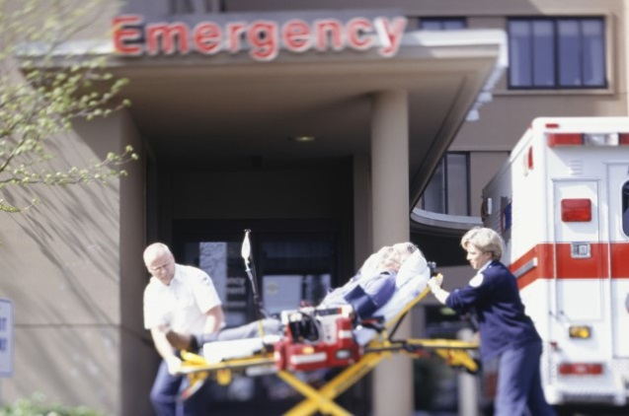
Undesirable Consequences of Loss Examples (1 of 2)
Loss of life
Theft of material or information
Environmental damage
Interruption of critical utilities
Degraded business operations
Workplace violence
Undesirable Consequences
of Loss Examples (1 of 2)
Loss of life
Theft of material or information
Environmental damage
Interruption of critical utilities
Degraded business operations
Workplace violence
Source: Getty Images

Slide 15
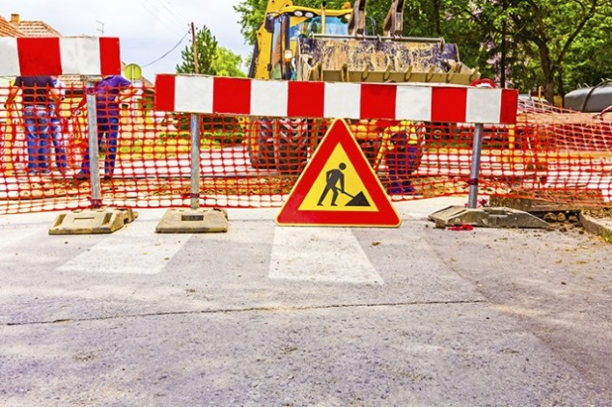
Undesirable Consequences of Loss Examples (2 of 2)
Building damage or collapse
Equipment damage or destruction
Damage to reputation
Damage to national security
Legal liability
Disruption to economy
Undesirable Consequences
of Loss Examples (2 of 2)
Building damage or collapse
Equipment damage or destruction
Damage to reputation
Damage to national security
Legal liability
Disruption to economy
Source: Getty Images

Slide 16
Determine Levels of Undesirable Consequences (1 of 5)
A decision-making process that relies on knowledge about the importance of each critical asset
When evaluating:
  People assets: know the number of people and their expertise and skills
Determine Levels of
Undesirable Consequences (1 of 5)
A decision-making process that relies on knowledge about the importance of each critical asset
When evaluating:
  People assets: know the number of people and their expertise and skills

Slide 17

Determine Levels of Undesirable Consequences (2 of 5)
  Equipment and process assets:
    Know criticality of specific pieces of equipment and processes
    Know about availability of backup equipment, processes, and systems
Determine Levels of
Undesirable Consequences (2 of 5)
Source: Getty Images
  Equipment and process assets:
    Know criticality of specific pieces of equipment and processes
    Know about availability of backup equipment, processes, and systems

Slide 18
Determine Levels of Undesirable Consequences (3 of 5)
To make decisions about consequences:
  Define all the negative effects of a specific threat’s occurrence
  Compare negative effects with all identified consequences of loss
  Assign levels to the undesirable consequences of loss
  Compare all loss levels to each other
Determine Levels of
Undesirable Consequences (3 of 5)
To make decisions about consequences:
  Define all the negative effects of a specific threat’s occurrence
  Compare negative effects with all identified consequences of loss
  Assign levels to the undesirable consequences of loss
  Compare all loss levels to each other

Slide 19
Determine Levels of Undesirable Consequences (4 of 5)
Establish consequence levels by using a qualitative scale to determine undesirable consequences of loss as:
  High — example: loss of life
  Medium — example: moderate financial loss due to industrial espionage
  Low — example: damage to a critical asset’s reputation
Determine Levels of
Undesirable Consequences (4 of 5)
Establish consequence levels by using a qualitative scale to determine undesirable consequences of loss as:
  High — example: loss of life
  Medium — example: moderate financial loss due to industrial espionage
  Low — example: damage to a critical asset’s reputation

Slide 20
Discussion Questions
What are examples of high consequences of loss?
What are examples of medium consequences of loss?
What are some examples of low consequences of loss?
Discussion Questions
What are examples of high consequences of loss?
What are examples of medium consequences of loss?
What are some examples of low consequences of loss?

Slide 21

Determine Levels of Undesirable Consequences (5 of 5)
Refer To:
Workbook 6.1
Assigning levels:
  Helps determine overall effects
  Requires communication between analysts
  Provides rationale for levels
Comparing all consequences of loss levels helps prioritize:
  Critical infrastructure
  Security upgrades
Determine Levels of Undesirable Consequences (5 of 5)
Refer To:
Workbook 6.1
Assigning levels:
  Helps determine overall effects
  Requires communication between analysts
  Provides rationale for levels
Comparing all consequences of loss levels helps prioritize:
  Critical infrastructure
  Security upgrades

Slide 22
Determine Probability of Occurrence (1 of 2)
The likelihood that a terrorist will attack or an undesirable event will happen
A complex process that must be conducted in coordination with a complete threat analysis
Determine Probability of Occurrence (1 of 2)
The likelihood that a terrorist will attack or an undesirable event will happen
A complex process that must be conducted in coordination with a complete threat analysis

Slide 23
Determine Probability of Occurrence (2 of 2)
Refer To:
Workbook 6.1
Examine historical records and information obtained during threat analysis:
  Review previous reports regarding attacks against the facility
  Consult terrorist trend experts to gather information about current terrorist attack operations
Determine the level of probability using the scale of high, medium, and low
Determine Probability of Occurrence (2 of 2)
Refer To:
Workbook 6.1
Examine historical records and information obtained during threat analysis:
  Review previous reports regarding attacks against the facility
  Consult terrorist trend experts to gather information about current terrorist attack operations
Determine the level of probability using the scale of high, medium, and low

Slide 24
Discussion Question
Based on Table 4, and what you currently know about the probability of occurrence in your nation today for each undesirable consequence listed in column 2, what probability level determinations can you make?
Discussion Question
Based on Table 4, and what you currently know about the probability of occurrence in your nation today for each undesirable consequence listed in column 2, what probability level determinations can you make?

Slide 25
Threat Spectrum Matrix (1 of 6)
A table that visually illustrates the relationships between consequence, level of consequence, and probability of occurrence
A clear format to analyze and quickly see the relationships between collected information
Threat Spectrum Matrix (1 of 6)
A table that visually illustrates the relationships between consequence, level of consequence, and probability of occurrence
A clear format to analyze and quickly see the relationships between collected information

Slide 26
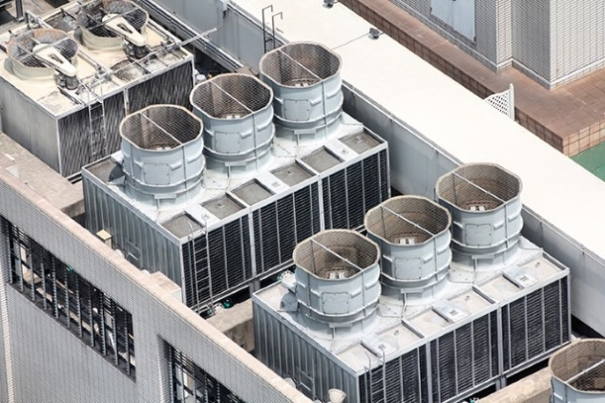
Threat Spectrum Matrix (2 of 6)
Presents risks to a facility across a threat spectrum at various consequence levels
A completed matrix helps asset selection for protection
Any asset with a high consequence and high probability level requires the highest priority for protection
Threat Spectrum Matrix (2 of 6)
Presents risks to a facility across a threat spectrum at various consequence levels
A completed matrix helps asset selection for protection
Any asset with a high consequence and high probability level requires the highest priority for protection
Source: Getty Images

Slide 27
Threat Spectrum Matrix (3 of 6)
Any asset with a low consequence and low probability level requires the lowest priority for protection
The completed matrix may be used later in physical protection system design, when determining the allocation of resources
Threat Spectrum Matrix (3 of 6)
Any asset with a low consequence and low probability level requires the lowest priority for protection
The completed matrix may be used later in physical protection system design, when determining the allocation of resources

Slide 28
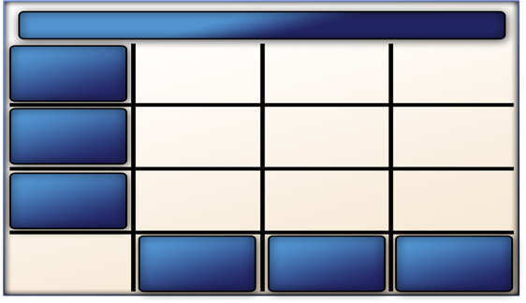
Threat Spectrum Matrix (4 of 6)
Refer To:
Workbook 6.2
Facility: Water Treatment Plant
High
consequence
Medium consequence
Low
consequence
Vertical
Horizontal
Low
probability
Medium
probability
High
probability
Threat Spectrum
Matrix (4 of 6)
Refer To:
Workbook 6.2
Facility: Water Treatment Plant
High
consequence
Medium consequence
Low
consequence
Vertical Horizontal
Low
probability
Medium
probability
High
probability

Slide 29
Threat Spectrum Matrix (5 of 6)
Refer To:
Workbook 6.2
Consequences level scale — vertical axis
Probability of occurrence scale — horizontal axis
Parameters remain fixed for critical assets within a specific facility
Qualitative scale must also remain fixed
Threat Spectrum
Matrix (5 of 6)
Refer To:
Workbook 6.2
Consequences level scale — vertical axis
Probability of occurrence scale — horizontal axis
Parameters remain fixed for critical assets within a specific facility
Qualitative scale must also remain fixed

Slide 30
Threat Spectrum Matrix (6 of 6)
Refer To:
Workbook 6.2
Facility: Water Treatment Plant
High
consequence
Environmental damage
Loss of life
Medium consequence
Damage to national security
Low
consequence
Interruption of critical utility services
Vertical
Horizontal
Low
probability
Medium
probability
High
probability
Threat Spectrum
Matrix (6 of 6)
Refer To:
Workbook 6.2
Facility: Water Treatment Plant
High
consequence
Environmental damage
Loss of life
Medium consequence
Damage to national security
Interruption of critical utility services
Low
consequence
Vertical Horizontal
Low
probability
Medium
probability
High
probability

Slide 31
Discussion Questions
Refer To:
Workbook 6.2
Where in the threat spectrum matrix would you expect to see the assets that require the highest priority for protection?
Where in the threat spectrum matrix would you expect to see the assets with the lowest priority for protection?
Discussion Questions
Refer To:
Workbook 6.2
Where in the threat spectrum matrix would you expect to see the assets that require the highest priority for protection?
Where in the threat spectrum matrix would you expect to see the assets with the lowest priority for protection?

Slide 32

Community Engagement and
Human Rights Discussion
When determining the undesirable consequences, why is it important to engage with community representatives?
Community Engagement and
Human Rights Discussion
When determining the undesirable consequences, why is it important to engage with community representatives?

Slide 33

TeachBack Moment
What are the four categories of critical infrastructure assets?
What are the steps to determine undesirable consequences of critical asset loss?
What are some of the negative consequences of a terrorist attack on a critical infrastructure asset?
TeachBack Moment
What are the four categories of critical infrastructure assets?
What are the steps to determine undesirable consequences of critical asset loss?
What are some of the negative consequences of a terrorist attack on a critical infrastructure asset?

Slide 34
Threaded Exercise Part 2 — National Ministries Building
Refer To:
Workbook Part 2
Purpose: to prioritize consequences for a given critical infrastructure
  Duration: 110 minutes (90-exercise; 20-debrief)
  Group composition: table groups
  Debrief: presentation and discussion
Threaded Exercise Part 2 — National Ministries Building
Refer To:
Workbook Part 2
Purpose: to prioritize consequences for a given critical infrastructure
  Duration: 110 minutes (90-exercise; 20-debrief)
  Group composition: table groups
  Debrief: presentation and discussion

Slide 35
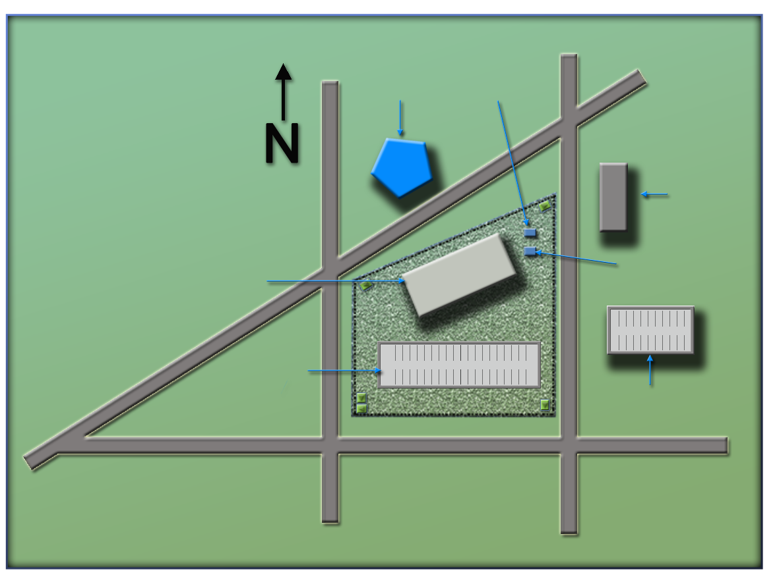
National Ministries
Building Complex Map
Refer To:
National Ministries Building Complex Map
(Ministry of Defense)
Ministry
of Defense
Security Office
(Security office)
(Foreign Embassy)
Foreign Embassy
(National Ministries
Building)
National Ministries
Building
Building Generator
(Building generator)
National Avenue
(National Avenue)
Parking Lot
Parking Garage
(Parking lot)
(Parking garage)
Judiciary Lane
(Judiciary Lane)
(Second Street)
(First Street)
First Street
Second Street
National Ministries
Building Complex Map
Refer To:
National Ministries Building Complex Map
(Ministry of Defense)
Ministry
of Defense
Security office
(Security office)
National Ministries
Building
(Foreign embassy)
Foreign embassy
(National Ministries
Building)
Building generator
National Avenue
Parking lot
(Building generator)
(National Avenue)
Parking garage
Judiciary Lane
(Parking lot)
(Parking garage)
(Judiciary Lane)
First Street
Second Street
(Second Street)
(First Street)

Slide 36
Threaded Exercise Part 2 — Discussion Questions
Refer To:
Workbook Part 2
What influenced your decision regarding probability of occurrence levels?
What additional information would you need to make more accurate decisions about probability of occurrence?
Threaded Exercise Part 2 — Discussion Questions
Refer To:
Workbook Part 2
What influenced your decision regarding probability of occurrence levels?
What additional information would you need to make more accurate decisions about probability of occurrence?

Slide 37
Module Summary
Critical assets
Undesirable consequences of critical asset loss analysis
Module Summary
Critical assets
Undesirable consequences of critical asset loss analysis

