Slide 1
Cybersecurity
Module 7

Slide 2
Module Objective
By the end of this module, you will be able to explain cyberthreats to your organization
Module Objective
Module Objective
By the end of this module, you will be able to explain cyberthreats to your organization
By the end of this module, you will be able to explain cyberthreats to your organization

Slide 3

Cybersecurity Overview — Important Definitions
Information system
Cyberspace
Cyberinfrastructure
Cyberthreat
Cyberattack
Cybersecurity
Source: Getty Images
Cybersecurity Overview — Important Definitions
Cybersecurity Overview — Important Definitions
Information system
Cyberspace
Cyberinfrastructure
Cyberthreat
Cyberattack
Cybersecurity
Information system
Cyberspace
Cyberinfrastructure
Cyberthreat
Cyberattack
Cybersecurity

Slide 4
Discussion Question
What types of critical infrastructure in your nation require cybersecurity?
Discussion Question
Discussion Question
What types of critical infrastructure in your nation require cybersecurity?
What types of critical infrastructure in your nation require cybersecurity?

Slide 5
Cybersecurity Trends (1 of 3)
Repeated cyberattacks on critical infrastructure
Cyberthreat to critical infrastructure continues to grow
Cyberinterdependency
Cybersecurity Trends (1 of 3)
Cybersecurity Trends (1 of 3)
Repeated cyberattacks on critical infrastructure
Cyberthreat to critical infrastructure continues to grow
Cyberinterdependency
Repeated cyberattacks on critical infrastructure
Cyberthreat to critical infrastructure continues to grow
Cyberinterdependency

Slide 6
Cybersecurity Trends (2 of 3)
Insider threats to computer systems
Foreign ownership of infrastructure
Serious national security challenges for a nation to confront
Cybersecurity Trends (2 of 3)
Cybersecurity Trends (2 of 3)
Insider threats to computer systems
Foreign ownership of infrastructure
Serious national security challenges for a nation to confront
Insider threats to computer systems
Foreign ownership of infrastructure
Serious national security challenges for a nation to confront

Slide 7

Cybersecurity Trends (3 of 3)
Goals to address trends:
Enhance security and resilience of a nation’s critical infrastructure
Maintain an efficient cyberenvironment that promotes safety and privacy
Partner with infrastructure owners and operators to improve information sharing
Cybersecurity Trends (3 of 3)
Cybersecurity Trends (3 of 3)
Goals to address trends:
Enhance security and resilience of a nation’s critical infrastructure
Maintain an efficient cyberenvironment that promotes safety and privacy
Partner with infrastructure owners and operators to improve information sharing
Goals to address trends:
Enhance security and resilience of a nation’s critical infrastructure
Maintain an efficient cyberenvironment that promotes safety and privacy
Partner with infrastructure owners and operators to improve information sharing
Source: Getty Images

Slide 8
Discussion Question
If any of your critical infrastructure experienced a successful cyberattack and stopped operations, what would be the consequences for your nation?
Discussion Question
Discussion Question
If any of your critical infrastructure experienced a successful cyberattack and stopped operations, what would be the consequences for your nation?
If any of your critical infrastructure experienced a successful cyberattack and stopped operations, what would be the consequences for your nation?

Slide 9
Protecting against Cyberthreats (1 of 2)
Using information technology
Checking backgrounds of all personnel and contractors
Involving the entire agency — senior leadership, mid-level leaders, front-line officers, and analysts
Protecting against Cyberthreats (1 of 2)
Protecting against Cyberthreats (1 of 2)
Using information technology
Checking backgrounds of all personnel and contractors
Involving the entire agency — senior leadership, mid-level leaders, front-line officers, and analysts
Using information technology
Checking backgrounds of all personnel and contractors
Involving the entire agency — senior leadership, mid-level leaders, front-line officers, and analysts

Slide 10

Protecting against Cyberthreats (2 of 2)
Building community partnerships
Determining critical and cyberinfrastructure
Decentralizing critical and cyberinfrastructure
Incorporating technology to protect technology
Protecting against Cyberthreats (2 of 2)
Protecting against Cyberthreats (2 of 2)
Building community partnerships
Determining critical and cyberinfrastructure
Decentralizing critical and cyberinfrastructure
Incorporating technology to protect technology
Building community partnerships
Determining critical and cyberinfrastructure
Decentralizing critical and cyberinfrastructure
Incorporating technology to protect technology
Source: Getty Images

Slide 11
Intrusion Detection and Prevention (1 of 2)
The process of monitoring the events occurring in a computer system or network, analyzing them for signs of possible incidents, and attempting to stop detected possible incidents
Intrusion Detection and Prevention (1 of 2)
Intrusion Detection and Prevention (1 of 2)
The process of monitoring the events occurring in a computer system or network, analyzing them for signs of possible incidents, and attempting to stop detected possible incidents
The process of monitoring the events occurring in a computer system or network, analyzing them for signs of possible incidents, and attempting to stop detected possible incidents

Slide 12
Intrusion Detection and Prevention (2 of 2)
Advantages | Disadvantages
Monitors traffic and alerts on what is unusual about an aspect of the traffic Alerts on a computer signature that is listed in a database of threats | Provides information about a suspected intrusion after it has occurred Contains information that becomes outdated quickly Tends to generate a greater number of false alarms than real attacks — resulting in real attacks being missed or ignored
Intrusion Detection and Prevention (2 of 2)
Intrusion Detection and Prevention (2 of 2)
Advantages | Disadvantages
Monitors traffic and alerts on what is unusual about an aspect of the traffic Alerts on a computer signature that is listed in a database of threats | Provides information about a suspected intrusion after it has occurred Contains information that becomes outdated quickly Tends to generate a greater number of false alarms than real attacks — resulting in real attacks being missed or ignored
Advantages | Disadvantages
Monitors traffic and alerts on what is unusual about an aspect of the traffic Alerts on a computer signature that is listed in a database of threats | Provides information about a suspected intrusion after it has occurred Contains information that becomes outdated quickly Tends to generate a greater number of false alarms than real attacks — resulting in real attacks being missed or ignored

Slide 13
Intrusion Detection and Resilience
Preventing an intrusion avoids the need to rebuild systems and reconstruct data
Separating systems makes incident cleanup significantly less costly
Maintaining a resiliency plan of response
Executing prepared responses quickly
Broadcasting advance public awareness in case of total shutdown response
Intrusion Detection and Resilience
Intrusion Detection and Resilience
Preventing an intrusion avoids the need to rebuild systems and reconstruct data
Separating systems makes incident cleanup significantly less costly
Maintaining a resiliency plan of response
Executing prepared responses quickly
Broadcasting advance public awareness in case of total shutdown response
Preventing an intrusion avoids the need to rebuild systems and reconstruct data
Separating systems makes incident cleanup significantly less costly
Maintaining a resiliency plan of response
Executing prepared responses quickly
Broadcasting advance public awareness in case of total shutdown response

Slide 14
Firewall (1 of 3)
A network security system designed to provide protection against outside attackers by shielding your computer or network from malicious or unnecessary network traffic and preventing malicious software from accessing the network
Firewall (1 of 3)
Firewall (1 of 3)
A network security system designed to provide protection against outside attackers by shielding your computer or network from malicious or unnecessary network traffic and preventing malicious software from accessing the network
A network security system designed to provide protection against outside attackers by shielding your computer or network from malicious or unnecessary network traffic and preventing malicious software from accessing the network

Slide 15
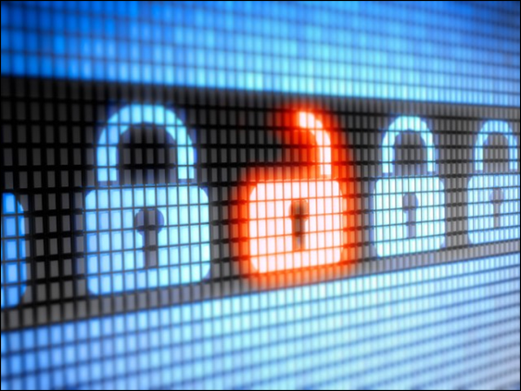
Firewall (2 of 3)
Characteristics:
May be hardware or software type
Must be properly configured for desired level of security
Limits traffic between networks
Firewall (2 of 3)
Firewall (2 of 3)
Characteristics:
May be hardware or software type
Must be properly configured for desired level of security
Limits traffic between networks
Characteristics:
May be hardware or software type
Must be properly configured for desired level of security
Limits traffic between networks
Source: Getty Images

Slide 16
Firewall (3 of 3)
Stops intrusive traffic from entering
Does not protect against installed malicious programs
Does not signal an intrusion
Use with anti-virus software and safe computing practices
Firewall (3 of 3)
Firewall (3 of 3)
Stops intrusive traffic from entering
Does not protect against installed malicious programs
Does not signal an intrusion
Use with anti-virus software and safe computing practices
Stops intrusive traffic from entering
Does not protect against installed malicious programs
Does not signal an intrusion
Use with anti-virus software and safe computing practices

Slide 17

Response — Cybersecurity Engineer
A personnel role in the information technology department that aids in cybersecurity by determining who requires access to which information; plans, coordinates, and implements information security programs; and helps protect against Internet threats that facilitate cybercrime
Response — Cybersecurity Engineer
Response — Cybersecurity Engineer
A personnel role in the information technology department that aids in cybersecurity by determining who requires access to which information; plans, coordinates, and implements information security programs; and helps protect against Internet threats that facilitate cybercrime
A personnel role in the information technology department that aids in cybersecurity by determining who requires access to which information; plans, coordinates, and implements information security programs; and helps protect against Internet threats that facilitate cybercrime
Source: Getty Images

Slide 18
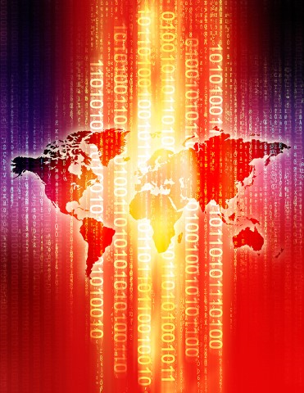
Cybercrime Sources
Primary sources of critical infrastructure cybercrime:
National governments
Terrorists
Industrial spies and organized crime groups
Source: Getty Images
Cybercrime Sources
Cybercrime Sources
Primary sources of critical infrastructure cybercrime:
National governments
Terrorists
Industrial spies and organized crime groups
Primary sources of critical infrastructure cybercrime:
National governments
Terrorists
Industrial spies and organized crime groups

Slide 19

Stop.Think.Connect
Public awareness campaign to increase the understanding of cyberthreats and empower the public to be safer and more secure online
Website includes tips and tools, videos, blog, and promotional materials
More information at www.dhs.gov/about-stopthinkconnect
Stop.Think.Connect
Stop.Think.Connect
Public awareness campaign to increase the understanding of cyberthreats and empower the public to be safer and more secure online
Website includes tips and tools, videos, blog, and promotional materials
More information at www.dhs.gov/about-stopthinkconnect
Public awareness campaign to increase the understanding of cyberthreats and empower the public to be safer and more secure online
Website includes tips and tools, videos, blog, and promotional materials
More information at www.dhs.gov/about-stopthinkconnect

Slide 20

Evaluating Cybersecurity for Resilience (1 of 3)
Refer To:
Workbook 7.1
Does the agency or organization:
Use a security technique that limits what programs can run at one time?
Ensure that all program downloads and upgrades come from verified sources?
Isolate networks from any untrusted networks, especially the Internet?
Evaluating Cybersecurity for Resilience (1 of 3)
Evaluating Cybersecurity for Resilience (1 of 3)
Refer to
Addendum 7.1
Refer To:
Workbook 7.1
Does the agency or organization:
Use a security technique that limits what programs can run at one time?
Ensure that all program downloads and upgrades come from verified sources?
Isolate networks from any untrusted networks, especially the Internet?
Does the agency or organization:
Use a security technique that limits what programs can run at one time?
Ensure that all program downloads and upgrades come from verified sources?
Isolate networks from any untrusted networks, especially the Internet?

Slide 21
Evaluating Cybersecurity for Resilience (2 of 3)
Refer To:
Workbook 7.1
Separate its computer system into distinct parts?
Have a strict policy for issuing and authenticating access credentials to the system?
Control remote access with strong credentials and time limits?
Evaluating Cybersecurity for Resilience (2 of 3)
Evaluating Cybersecurity for Resilience (2 of 3)
Refer to
Addendum 7.1
Refer To:
Workbook 7.1
Separate its computer system into distinct parts?
Have a strict policy for issuing and authenticating access credentials to the system?
Control remote access with strong credentials and time limits?
Separate its computer system into distinct parts?
Have a strict policy for issuing and authenticating access credentials to the system?
Control remote access with strong credentials and time limits?

Slide 22

Evaluating Cybersecurity for Resilience (3 of 3)
Refer To:
Workbook 7.1
Monitor the system continuously and respond immediately to intrusion incidents?
Ongoing and evolving challenge
Resilience is part of our defense
Evaluating Cybersecurity for Resilience (3 of 3)
Evaluating Cybersecurity for Resilience (3 of 3)
Refer to
Addendum 7.1
Refer To:
Workbook 7.1
Monitor the system continuously and respond immediately to intrusion incidents?
Ongoing and evolving challenge
Resilience is part of our defense
Monitor the system continuously and respond immediately to intrusion incidents?
Ongoing and evolving challenge
Resilience is part of our defense

Slide 23
Large-Group Discussion: Insider Threats
The most predominant threats that exist to an agency are insider threats
What cybersecurity issues could involve an insider?
What do you think are some of the personal motivations of an insider?
What could an agency or organization do to reduce the possibility of insider threats?
Large-Group Discussion: Insider Threats
Large-Group Discussion: Insider Threats
The most predominant threats that exist to an agency are insider threats
What cybersecurity issues could involve an insider?
What do you think are some of the personal motivations of an insider?
What could an agency or organization do to reduce the possibility of insider threats?
The most predominant threats that exist to an agency are insider threats
What cybersecurity issues could involve an insider?
What do you think are some of the personal motivations of an insider?
What could an agency or organization do to reduce the possibility of insider threats?

Slide 24
Cybersecurity Policies and Procedures (1 of 3)
Specific to cybersecurity of agency information systems
Protocols to select and work with community partners
Collaboration with community partners to write policies and procedures
Limitations of information sharing
Cybersecurity Policies and Procedures (1 of 3)
Cybersecurity Policies and Procedures (1 of 3)
Specific to cybersecurity of agency information systems
Protocols to select and work with community partners
Collaboration with community partners to write policies and procedures
Limitations of information sharing
Specific to cybersecurity of agency information systems
Protocols to select and work with community partners
Collaboration with community partners to write policies and procedures
Limitations of information sharing

Slide 25

Cybersecurity Policies and Procedures (2 of 3)
Policies to address three elements of resilience planning:
Robustness
Resourcefulness
Rapid recovery
Source: Getty Images
Cybersecurity Policies and Procedures (2 of 3)
Cybersecurity Policies and Procedures (2 of 3)
Policies to address three elements of resilience planning:
Robustness
Resourcefulness
Rapid recovery
Policies to address three elements of resilience planning:
Robustness
Resourcefulness
Rapid recovery

Slide 26
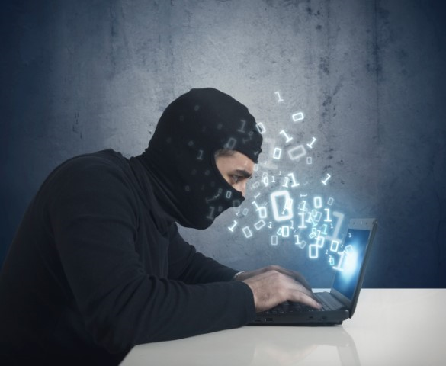
Cybersecurity Policies and Procedures (3 of 3)
Policies and procedures for incident reporting:
Internal incidents
Cross-border infrastructure incidents
Reporting points-of-contact
Personnel training
Source: Getty Images
Cybersecurity Policies and Procedures (3 of 3)
Cybersecurity Policies and Procedures (3 of 3)
Policies and procedures for incident reporting:
Internal incidents
Cross-border infrastructure incidents
Reporting points-of-contact
Personnel training
Policies and procedures for incident reporting:
Internal incidents
Cross-border infrastructure incidents
Reporting points-of-contact
Personnel training

Slide 27
Discussion Questions
What cybersecurity reporting requirements are already in place in your agency or nation?
What cybersecurity reporting requirements would you consider adding?
Discussion Questions
Discussion Questions
What cybersecurity reporting requirements are already in place in your agency or nation?
What cybersecurity reporting requirements would you consider adding?
What cybersecurity reporting requirements are already in place in your agency or nation?
What cybersecurity reporting requirements would you consider adding?

Slide 28
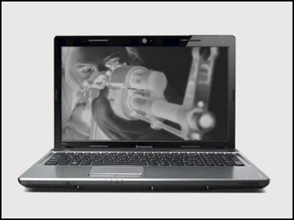
ATA Terrorist Tactics and Trends Handbook
Refer To:
Terrorist Tactics and Trends Handbook
Definition
Growing threats and weapons
Terrorist tactics and trends
Terrorist use of the Internet
Terrorist publications
References to stay informed
ATA Terrorist Tactics and Trends Handbook
ATA Terrorist Tactics and Trends Handbook
Refer to Terrorist Tactics and Trends Handbook
Refer To:
Terrorist Tactics and Trends Handbook
Definition
Growing threats and weapons
Terrorist tactics and trends
Terrorist use of the Internet
Terrorist publications
References to stay informed
Definition
Growing threats and weapons
Terrorist tactics and trends
Terrorist use of the Internet
Terrorist publications
References to stay informed
Source: ATA Library

Slide 29

TeachBack Moment
What is the definition of cybersecurity?
How is cybersecurity used to respond to ongoing cyberthreats?
What are some examples of cybersecurity policies and procedures?
TeachBack Moment
TeachBack Moment
What is the definition of cybersecurity?
How is cybersecurity used to respond to ongoing cyberthreats?
What are some examples of cybersecurity policies and procedures?
What is the definition of cybersecurity?
How is cybersecurity used to respond to ongoing cyberthreats?
What are some examples of cybersecurity policies and procedures?

Slide 30
Module Summary
Cybersecurity overview
Protecting against cyberthreats
Cybersecurity policies and procedures
Module Summary
Module Summary
Refer to
Addendum 7.2
Cybersecurity overview
Protecting against cyberthreats
Cybersecurity policies and procedures
Cybersecurity overview
Protecting against cyberthreats
Cybersecurity policies and procedures

