Slide 1
Explosives and Critical Infrastructure
Module 9

Slide 2
Module Objective
At the end of this module, you will be able to explain the effects of explosives on critical infrastructure
Module Objective
Module Objective
At the end of this module, you will be able to explain the effects of explosives on critical infrastructure
At the end of this module, you will be able to explain the effects of explosives on critical infrastructure

Slide 3
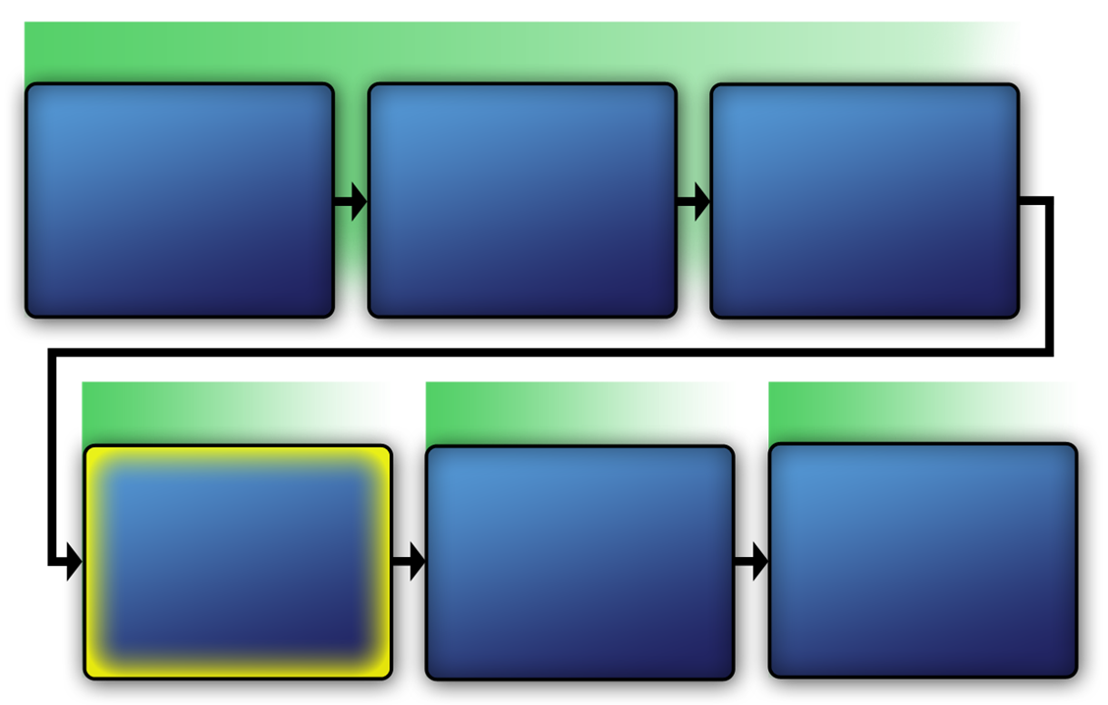
Course Map with VAM Phases
VAM Phase 1
Assess Critical Infrastructure Components
Module 5
Identify Critical Infrastructure Assets
Module 6
Identify Critical Infrastructure
Module 2
VAM Phase 2
VAM Phase 3
VAM Phase 4
Analyze the Threat
Modules 7-10
Identify
Security
Counter-
Measures
Modules 11-14
Develop Operational Resilience
Module 15
Course Map
with VAM Phases
Course Map with VAM Phases
Refer to
Addendum 5.1
VAM Phase 1
Identify Critical Infrastructure
Module 2
VAM Phase 1
Identify Critical Infrastructure Assets
Module 6
Identify Critical Infrastructure
Module 2
Assess Critical Infrastructure Components
Module 5
Assess Critical Infrastructure Components
Module 5
Identify Critical Infrastructure Assets
Module 6
VAM Phase 2
VAM Phase 3
VAM Phase 4
VAM Phase 2
VAM Phase 2
VAM Phase 3
VAM Phase 4
Analyze the Threat
Modules 7-10
Identify
Security
Counter-
Measures
Modules 11-14
Develop Operational Resilience
Module 15
Analyze the Threat
Modules 7-10
Identify
Security
Counter-
Measures
Modules 11-14
Develop Operational Resilience
Module 15

Slide 4
Definition of an Explosion
An extremely rapid release of energy (gases) in the observed physical forms of light, heat, sound, and a shock wave
Definition of an Explosion
Definition of an Explosion
An extremely rapid release of energy (gases) in the observed physical forms of light, heat, sound, and a shock wave
An extremely rapid release of energy (gases) in the observed physical forms of light, heat, sound, and a shock wave

Slide 5
Characteristics of an Explosion
A sudden escape of gases from a confined space
High temperatures, a violent shock, and a loud noise
Characteristics of an Explosion
Characteristics of an Explosion
A sudden escape of gases from a confined space
High temperatures, a violent shock, and a loud noise
A sudden escape of gases from a confined space
High temperatures, a violent shock, and a loud noise

Slide 6

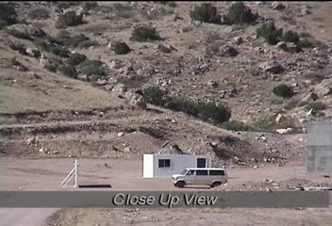
Explosion Video
Explosion Video
Explosion Video
Click on image
to play video

Slide 7
Discussion Questions
What would be your greatest protection against a van filled with explosives, located at a critical infrastructure?
What experience or training do you have with explosives?
Discussion Questions
Discussion Questions
What would be your greatest protection against a van filled with explosives, located at a critical infrastructure?
What experience or training do you have with explosives?
What would be your greatest protection against a van filled with explosives, located at a critical infrastructure?
What experience or training do you have with explosives?

Slide 8
Definition of Explosives
Substances that have the potential to release a very large amount of energy in a very short period of time
All manufactured explosives are chemical explosives
Definition of Explosives
Definition of Explosives
Substances that have the potential to release a very large amount of energy in a very short period of time
All manufactured explosives are chemical explosives
Substances that have the potential to release a very large amount of energy in a very short period of time
All manufactured explosives are chemical explosives

Slide 9
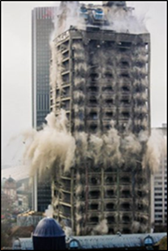
Beneficial Use of Explosives
Mining
Agriculture
Road construction
Demolition
Oil exploration
Source: US Army
Beneficial Use of Explosives
Beneficial Use of Explosives
Mining
Agriculture
Road construction
Demolition
Oil exploration
Mining
Agriculture
Road construction
Demolition
Oil exploration

Slide 10
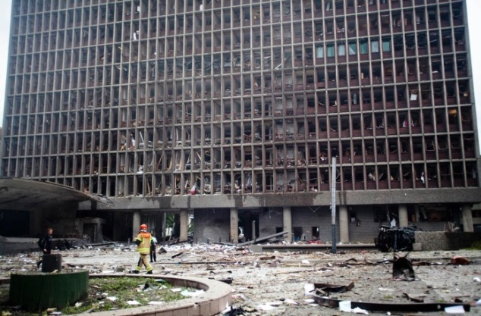
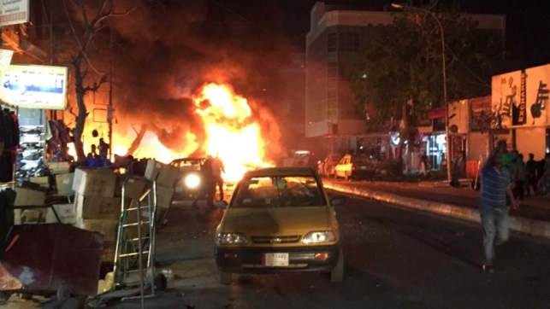
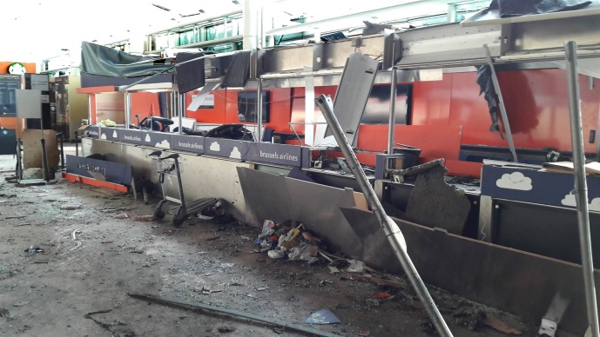
Types of Explosives
Military
Commercial
Homemade
Source: AP
Oslo, Norway — Commercial Explosives
Source: Aljazeera
Ramadi, Iraq — Military Explosives
Types of Explosives
Types of Explosives
Source: Reuters
Military
Commercial
Homemade
Military
Commercial
Homemade
Oslo, Norway — Commercial Explosives
Brussels, Belgium — Homemade Explosives
Ramadi, Iraq — Military Explosives
Oslo, Norway — Commercial Explosives
Ramadi, Iraq — Military Explosives
Brussels, Belgium — Homemade Explosives
Ramadi, Iraq — Military Explosives

Slide 11
Improvised Explosive Device (IED) Definition
A device placed or fabricated in an improvised manner
Incorporating destructive, lethal, noxious, pyrotechnic, or incendiary chemicals
Designed to destroy, incapacitate, harass, or distract
Improvised Explosive Device (IED) Definition
Improvised Explosive Device (IED) Definition
A device placed or fabricated in an improvised manner
Incorporating destructive, lethal, noxious, pyrotechnic, or incendiary chemicals
Designed to destroy, incapacitate, harass, or distract
A device placed or fabricated in an improvised manner
Incorporating destructive, lethal, noxious, pyrotechnic, or incendiary chemicals
Designed to destroy, incapacitate, harass, or distract

Slide 12
Improvised Explosive Devices
This section will cover:
Characteristics
Components
Activation methods
Tactical design
Delivery methods
Improvised Explosive Devices
Improvised Explosive Devices
This section will cover:
Characteristics
Components
Activation methods
Tactical design
Delivery methods
This section will cover:
Characteristics
Components
Activation methods
Tactical design
Delivery methods

Slide 13
IED Characteristics
Normally nonmilitary components
Constructed from various materials
May be concealed in a package or container
Can take any form
Designed to deceive and compromise a facility’s physical protection system
IED Characteristics
IED Characteristics
Normally nonmilitary components
Constructed from various materials
May be concealed in a package or container
Can take any form
Designed to deceive and compromise a facility’s physical protection system
Normally nonmilitary components
Constructed from various materials
May be concealed in a package or container
Can take any form
Designed to deceive and compromise a facility’s physical protection system

Slide 14
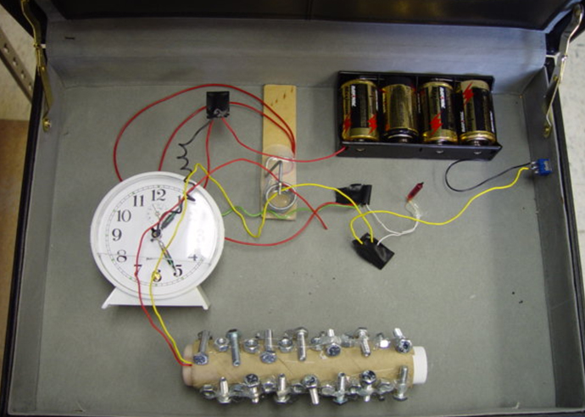
IED Components
This section will cover:
Main charge
Initiator
Power source
Switches
Container
Switch 3
Power source
Container
Switch 2
Switch 1
Main charge
Initiator
Source: ATF
IED Components
IED Components
This section will cover:
Main charge
Initiator
Power source
Switches
Container
This section will cover:
Main charge
Initiator
Power source
Switches
Container
Power source
Switch 3
Switch 3
Power source
Container
Switch 2
Container
Switch 1
Switch 2
Switch 1
Main charge
Main charge
Initiator
Initiator

Slide 15
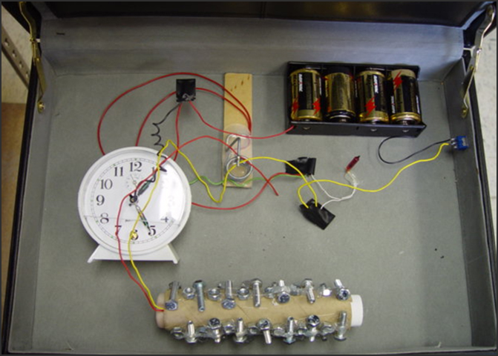
Main Charge
Primary explosive substance of an IED
Capable of providing an explosion by its own energy
Main Charge
Source: ATF
Main Charge
Main Charge
Primary explosive substance of an IED
Capable of providing an explosion by its own energy
Primary explosive substance of an IED
Capable of providing an explosion by its own energy
Main Charge
Main Charge

Slide 16
Initiator
Primary component
Activates the detonation of the explosive device
Initiator
Source: ATF
Initiator
Initiator
Primary component
Activates the detonation of the explosive device
Primary component
Activates the detonation of the explosive device
Initiator
Initiator

Slide 17
Power Source
Creates electrical energy for an electrically initiated IED
Power source
Source: ATF
Power Source
Power Source
Creates electrical energy for an electrically initiated IED
Creates electrical energy for an electrically initiated IED
Power source
Power source

Slide 18
Switches (1 of 2)
Make, break, or change a connection between the power source, initiator, and main charge
Arming — breaks the connection between the power source, initiator and main charge
Firing — makes the connection between the power source, initiator and main
Switches (1 of 2)
Switches (1 of 2)
Make, break, or change a connection between the power source, initiator, and main charge
Arming — breaks the connection between the power source, initiator and main charge
Firing — makes the connection between the power source, initiator and main
Make, break, or change a connection between the power source, initiator, and main charge
Arming — breaks the connection between the power source, initiator and main charge
Firing — makes the connection between the power source, initiator and main

Slide 19
Switches (2 of 2)
Some switches perform both functions
There may be multiple switches in the circuit
Switch 3
Switch 2
Switch 1
Source: ATF
Switches (2 of 2)
Switches (2 of 2)
Some switches perform both functions
There may be multiple switches in the circuit
Some switches perform both functions
There may be multiple switches in the circuit
Switch 3
Switch 3
Switch 1
Switch 2
Switch 1
Switch 2

Slide 20

IED Activation Methods
Refer To:
Workbook 9.1
This section will cover:
Time-activated switches
Victim-activated switches
Command-activated switches
IED Activation Methods
IED Activation Methods
Refer to
Addendum 9.1
Refer To:
Workbook 9.1
This section will cover:
Time-activated switches
Victim-activated switches
Command-activated switches
This section will cover:
Time-activated switches
Victim-activated switches
Command-activated switches
This section will cover:
Time-activated switches
Victim-activated switches
Command-activated switches

Slide 21
Time-Activated Method
Refer To:
Workbook 9.1
Function: initiation occurs after a set time is reached
Discussion questions:
What is an advantage for the terrorist in using a time-activated switch?
What is the disadvantage?
Time-Activated Method
Time-Activated Method
Refer to
Addendum 9.1
Refer To:
Workbook 9.1
Function: initiation occurs after a set time is reached
Discussion questions:
What is an advantage for the terrorist in using a time-activated switch?
What is the disadvantage?
Function: initiation occurs after a set time is reached
Discussion questions:
What is an advantage for the terrorist in using a time-activated switch?
What is the disadvantage?

Slide 22
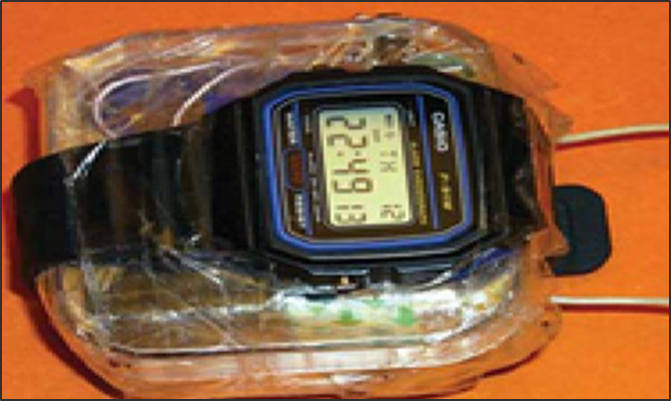
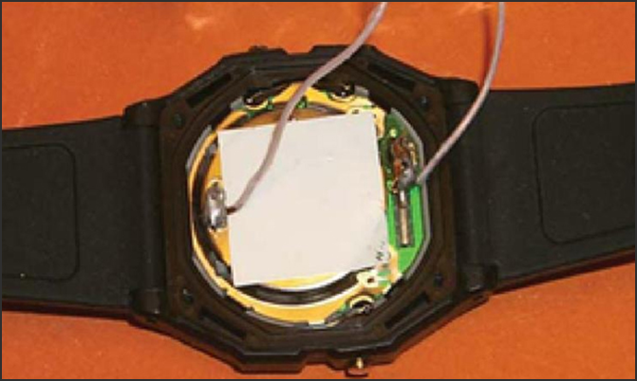
Time-Activated Digital Example
Refer To:
Workbook 9.1
Source: ATF
Source: ATF
Front
Back
Time-Activated Digital Example
Refer To:
Workbook 9.1
Front
Back
Time-Activated
Digital Example
Refer to
Addendum 9.1

Slide 23
Victim-Activated Method
Refer To:
Workbook 9.1
Function: initiation occurs as a result of the victim’s actions
Advantage: terrorist does not need to be present because the device is activated by the victim
Disadvantage: the victim of the device may not always be the intended target
Victim-Activated Method
Victim-Activated Method
Refer to
Addendum 9.1
Refer To:
Workbook 9.1
Function: initiation occurs as a result of the victim’s actions
Advantage: terrorist does not need to be present because the device is activated by the victim
Disadvantage: the victim of the device may not always be the intended target
Function: initiation occurs as a result of the victim’s actions
Advantage: terrorist does not need to be present because the device is activated by the victim
Disadvantage: the victim of the device may not always be the intended target

Slide 24

Victim-Activated Method Discussion
Refer To:
Workbook 9.1
What is an example of a light-sensitive switch used to activate an IED?
What examples of a victim-activated switch could be present in the classroom?
Victim-Activated Method Discussion
Victim-Activated Method Discussion
Refer to
Addendum 9.1
Refer To:
Workbook 9.1
What is an example of a light-sensitive switch used to activate an IED?
What examples of a victim-activated switch could be present in the classroom?
What is an example of a light-sensitive switch used to activate an IED?
What examples of a victim-activated switch could be present in the classroom?

Slide 25
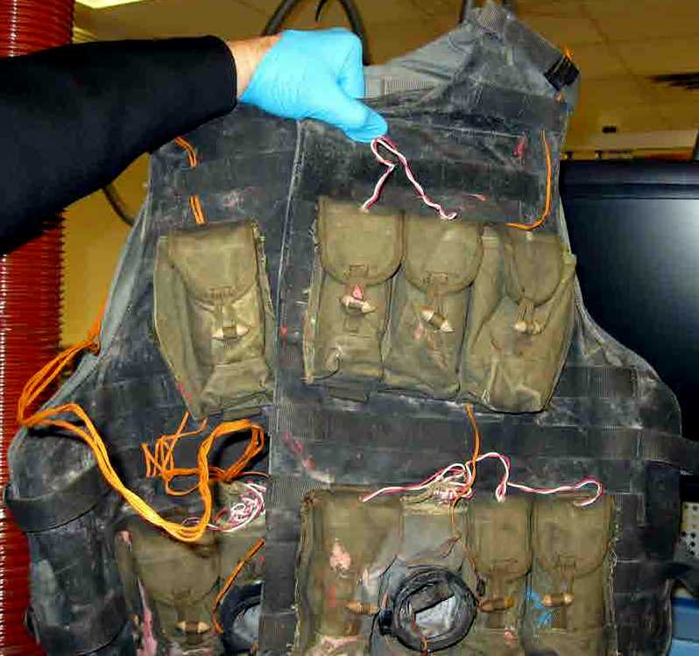
Command-Activated Method (1 of 2)
Refer To:
Workbook 9.1
Function: initiated by the bomber remote control device or command detonation
Terrorist may touch wire to battery terminals or have an ON or OFF switch
Suicide bomber may have a firing switch in hand
Command-Activated Method (1 of 2)
Command-Activated Method (1 of 2)
Refer to
Addendum 9.1
Refer To:
Workbook 9.1
Function: initiated by the bomber remote control device or command detonation
Terrorist may touch wire to battery terminals or have an ON or OFF switch
Suicide bomber may have a firing switch in hand
Function: initiated by the bomber remote control device or command detonation
Terrorist may touch wire to battery terminals or have an ON or OFF switch
Suicide bomber may have a firing switch in hand
Source: TSA

Slide 26
Command-Activated Method (2 of 2)
Refer To:
Workbook 9.1
Advantage: allows terrorist to choose the optimum moment of initiation
Disadvantage: the terrorist must be within the frequency range of the receiver and transmitter and generally be able to see the target in order to know when to detonate the explosive
Command-Activated Method (2 of 2)
Command-Activated Method (2 of 2)
Refer to
Addendum 9.1
Refer To:
Workbook 9.1
Advantage: allows terrorist to choose the optimum moment of initiation
Disadvantage: the terrorist must be within the frequency range of the receiver and transmitter and generally be able to see the target in order to know when to detonate the explosive
Advantage: allows terrorist to choose the optimum moment of initiation
Disadvantage: the terrorist must be within the frequency range of the receiver and transmitter and generally be able to see the target in order to know when to detonate the explosive

Slide 27
Container
An item or vessel that commonly houses the complete IED or principle components of the IED
Container
Source: ATF
Container
Container
An item or vessel that commonly houses the complete IED or principle components of the IED
An item or vessel that commonly houses the complete IED or principle components of the IED
Container
Container

Slide 28
Container Selection
Terrorists choose based on:
Best way to reach target
Security and accessibility
Ability to conceal
Container Selection
Container Selection
Terrorists choose based on:
Best way to reach target
Security and accessibility
Ability to conceal
Terrorists choose based on:
Best way to reach target
Security and accessibility
Ability to conceal

Slide 29
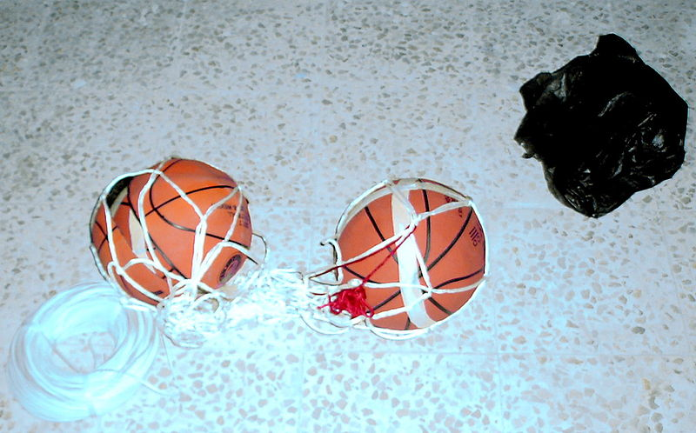
Container Characteristics
Containers vary in size
Original containers may be altered
Size helps to determine amount of explosives
Source: Creative Commons Public Domain
Container Characteristics
Container Characteristics
Containers vary in size
Original containers may be altered
Size helps to determine amount of explosives
Containers vary in size
Original containers may be altered
Size helps to determine amount of explosives

Slide 30
Security Awareness
Be observant and suspicious of containers with alterations
Determine what size vehicles and packages will be permitted at access points
Be aware that checkpoints can be targets
Security Awareness
Security Awareness
Be observant and suspicious of containers with alterations
Determine what size vehicles and packages will be permitted at access points
Be aware that checkpoints can be targets
Be observant and suspicious of containers with alterations
Determine what size vehicles and packages will be permitted at access points
Be aware that checkpoints can be targets

Slide 31

IED Components Activity (1 of 2)
Refer To:
Handout 9.1
Purpose: to identify components of an IED
Duration: 10 minutes (5-activity; 5-debrief)
Group composition: table groups
Debrief: large-group discussion
IED Components
Activity (1 of 2)
IED Components Activity
(1 of 2)
Refer to
Addendum 9.2
Refer To:
Handout 9.1
Purpose: to identify components of an IED
Duration: 10 minutes (5-activity; 5-debrief)
Group composition: table groups
Debrief: large-group discussion
Purpose: to identify components of an IED
Duration: 10 minutes (5-activity; 5-debrief)
Group composition: table groups
Debrief: large-group discussion
Purpose: to identify components of an IED
Duration: 10 minutes (5-activity; 5-debrief)
Group composition: table groups
Debrief: large-group discussion

Slide 32
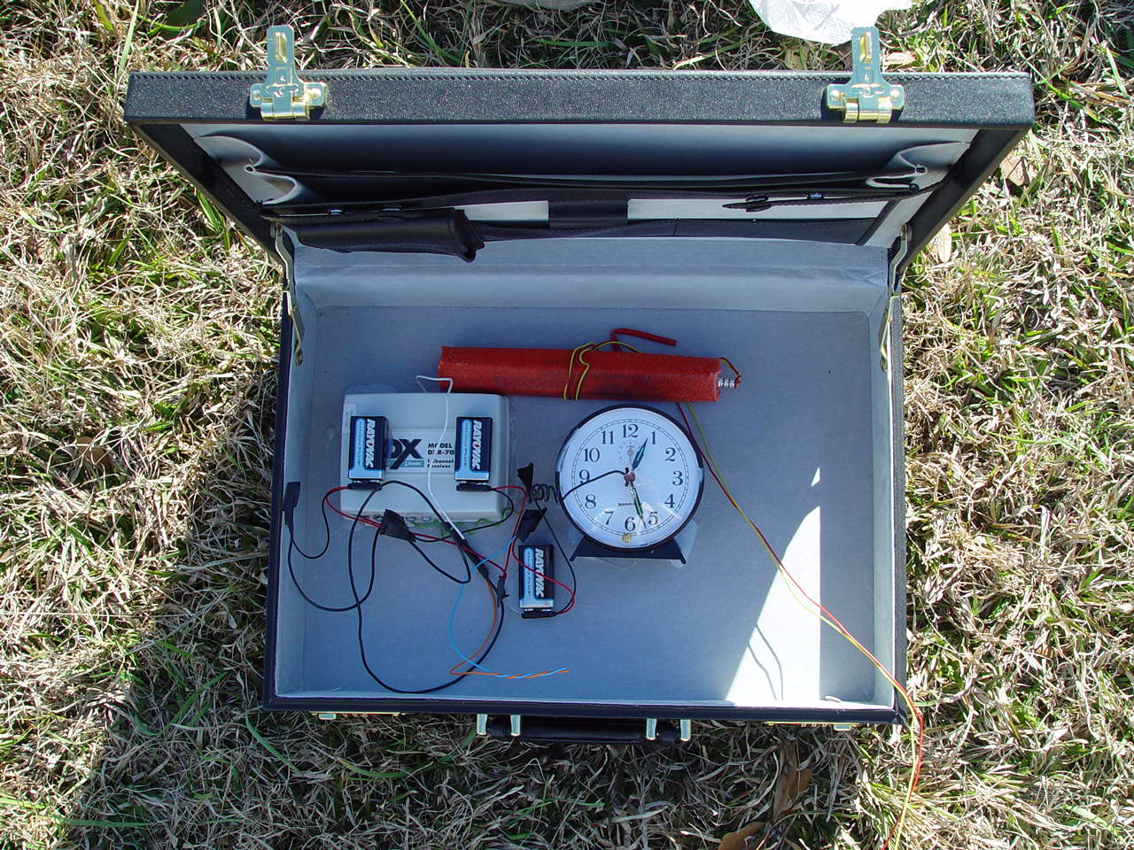
IED Components Activity (2 of 2)
Refer To:
Handout 9.1
3.
2.
4.
1.
5.
6.
Source: ATF
IED Components Activity
(2 of 2)
Refer To:
Handout 9.1
IED Components
Activity (2 of 2)
Refer to
Addendum 9.2

Slide 33

TeachBack Moment
What are the three methods of activating an IED?
TeachBack Moment
TeachBack Moment
What are the three methods of activating an IED?
What are the three methods of activating an IED?

Slide 34
IED Tactical Design Considerations (1 of 2)
Ineffective security measures lead to terrorists’ undetected access
Tactics chosen to achieve goal of getting past security and reach the target
Terrorists look to exploit critical infrastructures’ vulnerabilities
IED Tactical Design Considerations (1 of 2)
IED Tactical Design Considerations (1 of 2)
Ineffective security measures lead to terrorists’ undetected access
Tactics chosen to achieve goal of getting past security and reach the target
Terrorists look to exploit critical infrastructures’ vulnerabilities
Ineffective security measures lead to terrorists’ undetected access
Tactics chosen to achieve goal of getting past security and reach the target
Terrorists look to exploit critical infrastructures’ vulnerabilities

Slide 35

IED Tactical Design Considerations (2 of 2)
Geographical area of the target
Position or placement of the IED
Method of delivery and activation of the IED
Concealment techniques
Security barriers and checkpoints
Escape routes and time of day
IED Tactical Design Considerations (2 of 2)
IED Tactical Design Considerations (2 of 2)
Geographical area of the target
Position or placement of the IED
Method of delivery and activation of the IED
Concealment techniques
Security barriers and checkpoints
Escape routes and time of day
Geographical area of the target
Position or placement of the IED
Method of delivery and activation of the IED
Concealment techniques
Security barriers and checkpoints
Escape routes and time of day
Source: FEMA

Slide 36
IED Tactical Delivery Methods
This section will cover:
Vehicle-borne IEDs (VBIEDs) and large vehicle-borne IEDs (LVBIEDs)
Letter or package bombs
Suicide bombs
Launched IEDs
IED Tactical Delivery Methods
IED Tactical Delivery Methods
This section will cover:
Vehicle-borne IEDs (VBIEDs) and large vehicle-borne IEDs (LVBIEDs)
Letter or package bombs
Suicide bombs
Launched IEDs
This section will cover:
Vehicle-borne IEDs (VBIEDs) and large vehicle-borne IEDs (LVBIEDs)
Letter or package bombs
Suicide bombs
Launched IEDs

Slide 37
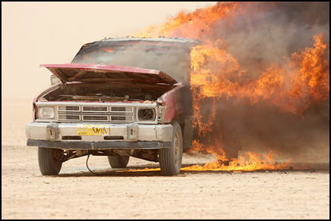
VBIED and LVBIED
Are the preferred method of delivery
Pose the most destructive threat to critical infrastructure
Result in massive destruction and high numbers of casualties
Most effective security measure — distance and separation
VBIED and LVBIED
VBIED and LVBIED
Are the preferred method of delivery
Pose the most destructive threat to critical infrastructure
Result in massive destruction and high numbers of casualties
Most effective security measure — distance and separation
Are the preferred method of delivery
Pose the most destructive threat to critical infrastructure
Result in massive destruction and high numbers of casualties
Most effective security measure — distance and separation
Source: US Marines

Slide 38
Characteristics of VBIEDs and LVBIEDs (1 of 2)
Refer To:
Workbook 9.2
Classified based on the size of the vehicle, not the quantity of explosives
Characteristics of VBIEDs and LVBIEDs (1 of 2)
Characteristics of VBIEDs and LVBIEDs (1 of 2)
Refer to
Addendum 9.3
Refer To:
Workbook 9.2
Classified based on the size of the vehicle, not the quantity of explosives
Classified based on the size of the vehicle, not the quantity of explosives

Slide 39
Characteristics of VBIEDs and LVBIEDs (2 of 2)
Refer To:
Workbook 9.2
Advantages for terrorists | Disadvantages for terrorists
High mobility | Vehicle acquisition
Mass devastation and casualties | Explosives acquisition
Cost | Driving experience
Characteristics of VBIEDs and LVBIEDs (2 of 2)
Characteristics of VBIEDs and LVBIEDs (2 of 2)
Refer To:
Refer to
Addendum 9.3
Workbook 9.2
Advantages for terrorists | Disadvantages for terrorists
High mobility | Vehicle acquisition
Mass devastation and casualties | Explosives acquisition
Cost | Driving experience
Advantages for terrorists | Disadvantages for terrorists
High mobility | Vehicle acquisition
Mass devastation and casualties | Explosives acquisition
Cost | Driving experience

Slide 40
Discussion Questions
What are some examples of VBIED attacks?
What makes a VBIED attractive to terrorists?
What difficulties could a terrorist encounter when attempting to use a VBIED?
Discussion Questions
Discussion Questions
What are some examples of VBIED attacks?
What makes a VBIED attractive to terrorists?
What difficulties could a terrorist encounter when attempting to use a VBIED?
What are some examples of VBIED attacks?
What makes a VBIED attractive to terrorists?
What difficulties could a terrorist encounter when attempting to use a VBIED?

Slide 41
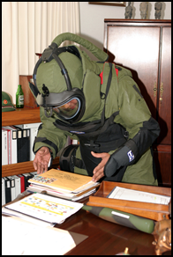
Delivered IED — Letter or Package
Constructed of a flexible or moldable explosive
Firing switch could be a pull switch, loop switch, or photosynthesis cell
Delivered IED — Letter or Package
Delivered IED — Letter or Package
Constructed of a flexible or moldable explosive
Firing switch could be a pull switch, loop switch, or photosynthesis cell
Constructed of a flexible or moldable explosive
Firing switch could be a pull switch, loop switch, or photosynthesis cell
Source: US National Archives

Slide 42
Indicators of Delivered IED — Letter or Package (1 of 3)
Foreign mail or special delivery markings
Restrictive markings, such as confidential or personal
Excessive postage
Handwritten or poorly typed address
Indicators of Delivered IED — Letter or Package (1 of 2)
Indicators of Delivered IED — Letter or Package (1 of 3)
Foreign mail or special delivery markings
Restrictive markings, such as confidential or personal
Excessive postage
Handwritten or poorly typed address
Incorrect titles
Titles but no names
Foreign mail or special delivery markings
Restrictive markings, such as confidential or personal
Excessive postage
Handwritten or poorly typed address

Slide 43
Indicators of Delivered IED — Letter or Package (2 of 3)
Incorrect titles
Titles but no names
Misspelling of common words
Missing or suspicious return address
Indicators of Delivered IED — Letter or Package (2 of 2)
Indicators of Delivered IED — Letter or Package (2 of 3)
Misspelling of common words
Missing or suspicious return address
Stains, strange odors, or excessive weight
Thick, bulky, or rigid envelope
Protruding wires or tin foil
Excessive tape or string
Incorrect titles
Titles but no names
Misspelling of common words
Missing or suspicious return address

Slide 44
Indicators of Delivered IED — Letter or Package (3 of 3)
Stains, strange odors, or excessive weight
Thick, bulky, or rigid envelope
Protruding wires or tin foil
Excessive tape or string
Indicators of Delivered IED — Letter or Package (2 of 2)
Indicators of Delivered IED — Letter or Package (3 of 3)
Misspelling of common words
Missing or suspicious return address
Stains, strange odors, or excessive weight
Thick, bulky, or rigid envelope
Protruding wires or tin foil
Excessive tape or string
Stains, strange odors, or excessive weight
Thick, bulky, or rigid envelope
Protruding wires or tin foil
Excessive tape or string

Slide 45
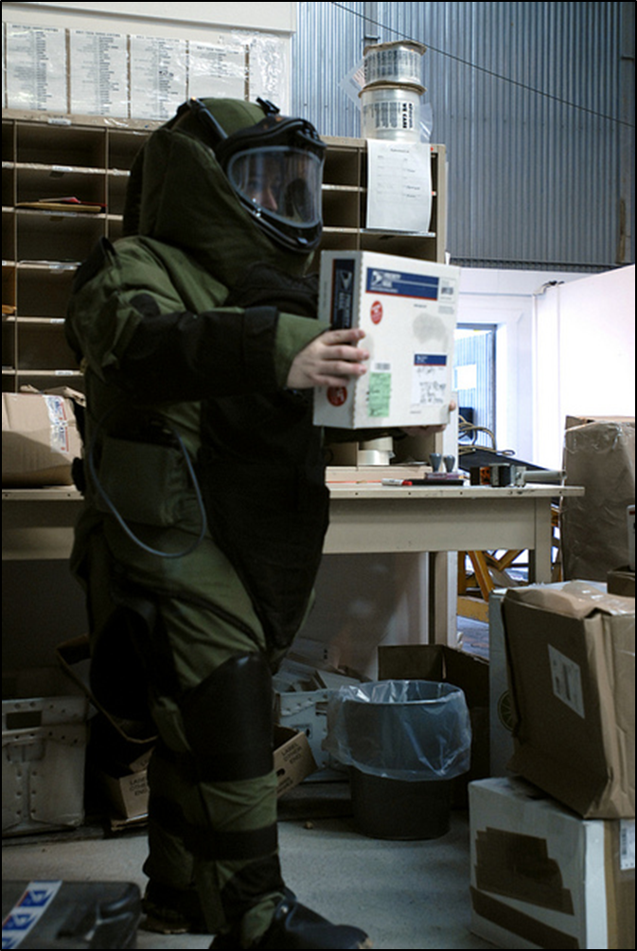
Handling of Delivered IED — Letter or Package
Do not open it
Determine whether it can be moved
Attempt to learn details
Source: USPS
Handling of Delivered IED — Letter or Package
Handling of Delivered IED — Letter or Package
Do not open it
Determine whether it can be moved
Attempt to learn details
Do not open it
Determine whether it can be moved
Attempt to learn details

Slide 46
Suicide Bombers
Extremely motivated
Have control and flexibility
Suicide Bombers
Suicide Bombers
Extremely motivated
Have control and flexibility
Extremely motivated
Have control and flexibility

Slide 47
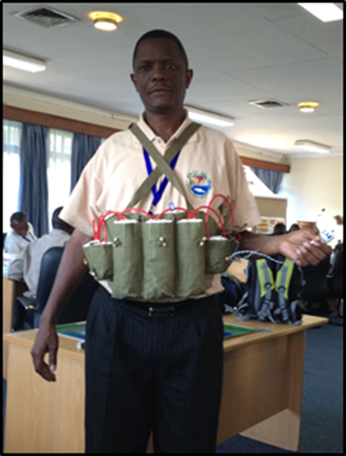
Suicide Bombs Preferred by Terrorists
Require relatively few resources and training
Have a high rate of success
Source: DS/T/ATA
Suicide Bombs Preferred by Terrorists
Suicide Bombs Preferred by Terrorists
Require relatively few resources and training
Have a high rate of success
Require relatively few resources and training
Have a high rate of success

Slide 48
Suicide Bombs — Tactics and Delivery Methods (1 of 3)
Can be person-borne or VBIED
Person-borne has less power but still considered successful
Bomber controls the location, method of delivery, and timing
Can change target as circumstances dictate
Suicide Bombs — Tactics and Delivery Methods (1 of 3)
Suicide Bombs — Tactics and Delivery Methods (1 of 3)
Can be person-borne or VBIED
Person-borne has less power but still considered successful
Bomber controls the location, method of delivery, and timing
Can change target as circumstances dictate
Can be person-borne or VBIED
Person-borne has less power but still considered successful
Bomber controls the location, method of delivery, and timing
Can change target as circumstances dictate

Slide 49

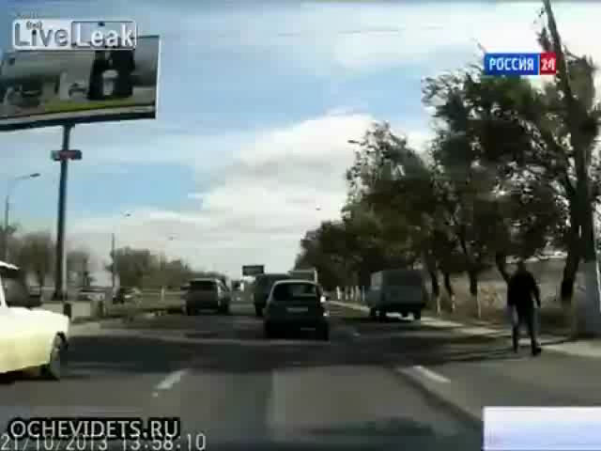
Suicide Bombs — Tactics and Delivery Methods (2 of 3)
Suicide Bombs — Tactics and Delivery Methods (2 of 3)
Suicide Bombs — Tactics and Delivery Methods (2 of 3)
Click the
image to play video

Slide 50
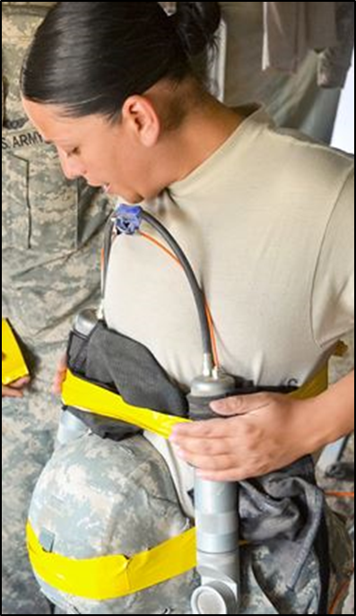
Suicide Bombs — Tactics and Delivery Methods (3 of 3)
Critical elements of a suicide bombing:
Design of the explosive device
Method of delivery
Target selection
Concealment and deception:
Often hidden in clothes or concealed in vehicle
False pregnancy or physical disability
Suicide Bombs — Tactics and Delivery Methods (3 of 3)
Suicide Bombs — Tactics and Delivery Methods (3 of 3)
Critical elements of a suicide bombing:
Design of the explosive device
Method of delivery
Target selection
Concealment and deception:
Often hidden in clothes or concealed in vehicle
False pregnancy or physical disability
Critical elements of a suicide bombing:
Design of the explosive device
Method of delivery
Target selection
Concealment and deception:
Often hidden in clothes or concealed in vehicle
False pregnancy or physical disability
Source: DOD

Slide 51
Female Suicide Bombers
The number of female suicide bombers has increased significantly in recent years
The fact that females bombers do not appear threatening or fit the typical suicide bomber profile provides them with greater access to targets
Female Suicide Bombers
Female Suicide Bombers
The number of female suicide bombers has increased significantly in recent years
The fact that females bombers do not appear threatening or fit the typical suicide bomber profile provides them with greater access to targets
The number of female suicide bombers has increased significantly in recent years
The fact that females bombers do not appear threatening or fit the typical suicide bomber profile provides them with greater access to targets

Slide 52
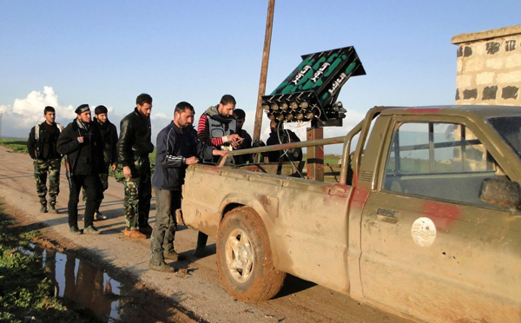
Launched or Thrown IED
Can be military weapons or improvised devices
Designed to be launched over security barriers
Firing mechanisms typically detonate on impact
Launched or Thrown IED
Launched or Thrown IED
Can be military weapons or improvised devices
Designed to be launched over security barriers
Firing mechanisms typically detonate on impact
Can be military weapons or improvised devices
Designed to be launched over security barriers
Firing mechanisms typically detonate on impact
Source: Reuters

Slide 53
TeachBack Moment
What are the delivery methods of an improvised explosive device?
Why are suicide bombs the preferred delivery method of terrorists?
TeachBack Moment
TeachBack Moment
What are the delivery methods of an improvised explosive device?
Why are suicide bombs the preferred delivery method of terrorists?
What are the delivery methods of an improvised explosive device?
Why are suicide bombs the preferred delivery method of terrorists?

Slide 54
Effects of an Explosion
This section will cover:
Thermal effect
Blast pressure effects:
Shock front
Blast wave (blast pressure time phase)
Incident and reflected pressures
Fragmentation
Effects of an Explosion
Effects of an Explosion
This section will cover:
Thermal effect
Blast pressure effects:
Shock front
Blast wave (blast pressure time phase)
Incident and reflected pressures
Fragmentation
This section will cover:
Thermal effect
Blast pressure effects:
Shock front
Blast wave (blast pressure time phase)
Incident and reflected pressures
Fragmentation

Slide 55
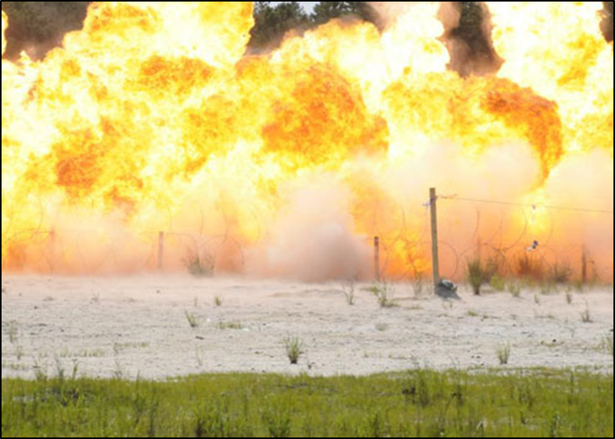
Thermal Effect (1 of 2)
Results from the tremendous quantity of heat produced
Duration and intensity greatly affects the damage and injury potential
Thermal Effect (1 of 2)
Thermal Effect (1 of 2)
Results from the tremendous quantity of heat produced
Duration and intensity greatly affects the damage and injury potential
Results from the tremendous quantity of heat produced
Duration and intensity greatly affects the damage and injury potential
Source: FBI

Slide 56
Thermal Effect (2 of 2)
Commercial explosives do not generally generate enough heat to ignite nearby combustibles
Military explosives are:
Designed for a greater thermal event
Produce secondary fires
Thermal Effect (2 of 2)
Thermal Effect (2 of 2)
Commercial explosives do not generally generate enough heat to ignite nearby combustibles
Military explosives are:
Designed for a greater thermal event
Produce secondary fires
Commercial explosives do not generally generate enough heat to ignite nearby combustibles
Military explosives are:
Designed for a greater thermal event
Produce secondary fires

Slide 57
Blast Pressure Effect
When an explosion occurs, it produces the following effects:
Blast seat
Blast wave
Incident pressure
Reflected pressure
Shock front
Blast Pressure Effect
Blast Pressure Effect
When an explosion occurs, it produces the following effects:
Blast seat
Blast wave
Incident pressure
Reflected pressure
Shock front
When an explosion occurs, it produces the following effects:
Blast seat
Blast wave
Incident pressure
Reflected pressure
Shock front

Slide 58
Shock Front
Moves spherically away from explosion
Drops in pressure rapidly as it moves away
Shock front pressure decay can be affected by:
Reflective barriers
Tunnels
Corners
Other structural features
Shock Front
Shock Front
Moves spherically away from explosion
Drops in pressure rapidly as it moves away
Shock front pressure decay can be affected by:
Reflective barriers
Tunnels
Corners
Other structural features
Moves spherically away from explosion
Drops in pressure rapidly as it moves away
Shock front pressure decay can be affected by:
Reflective barriers
Tunnels
Corners
Other structural features

Slide 59
Blast Wave
Hot expanding gases from an explosion compress the surrounding air to form a blast wave
Formed in 1/10,000 of a second
Travels outward at speeds greater than the speed of sound
Blast Wave
Blast Wave
Hot expanding gases from an explosion compress the surrounding air to form a blast wave
Formed in 1/10,000 of a second
Travels outward at speeds greater than the speed of sound
Hot expanding gases from an explosion compress the surrounding air to form a blast wave
Formed in 1/10,000 of a second
Travels outward at speeds greater than the speed of sound

Slide 60
Incident and Reflected Pressures (1 of 2)
Incident pressure is exerted at a right angle
Reflected pressure occurs when incident pressure is not parallel to the direction the wave is traveling
Reflected pressure may be two to nine times greater than incident pressure
Incident and Reflected Pressures (1 of 2)
Incident and Reflected Pressures (1 of 2)
Incident pressure is exerted at a right angle
Reflected pressure occurs when incident pressure is not parallel to the direction the wave is traveling
Reflected pressure may be two to nine times greater than incident pressure
Incident pressure is exerted at a right angle
Reflected pressure occurs when incident pressure is not parallel to the direction the wave is traveling
Reflected pressure may be two to nine times greater than incident pressure

Slide 61
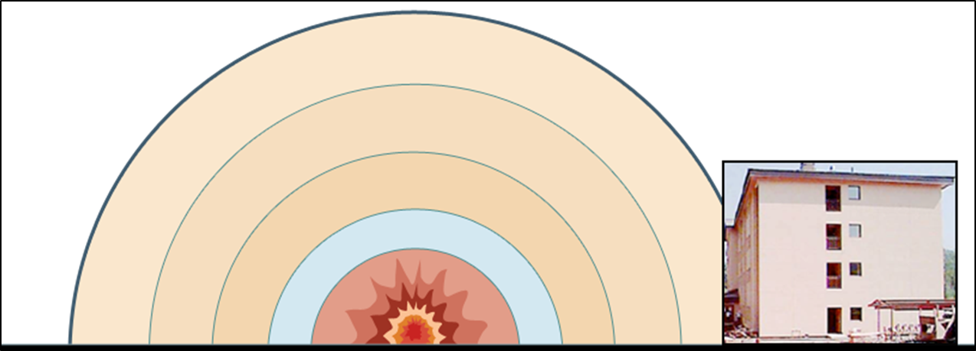
Incident and Reflected Pressures (2 of 2)
Reflected
Pressure
Incident Pressure
Source: FEMA
Incident and Reflected Pressures (2 of 2)
Incident and Reflected Pressures (2 of 2)
Reflected
Pressure
Reflected
Pressure
Incident Pressure
Incident Pressure

Slide 62
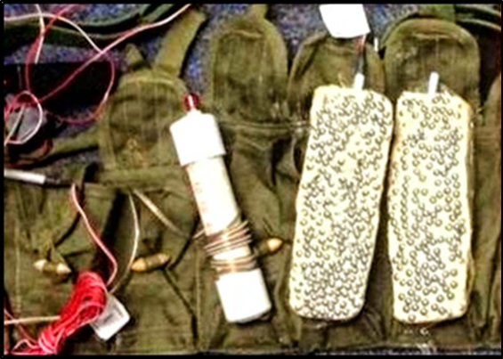
Fragmentation
Occurs when the blast pressure effect of the explosion breaks bomb and nearby objects into pieces
Bombs can be constructed to include shrapnel
Post-blast investigators use flight path and direction of fragments for bomb reconstruction
Fragmentation
Fragmentation
Occurs when the blast pressure effect of the explosion breaks bomb and nearby objects into pieces
Bombs can be constructed to include shrapnel
Post-blast investigators use flight path and direction of fragments for bomb reconstruction
Occurs when the blast pressure effect of the explosion breaks bomb and nearby objects into pieces
Bombs can be constructed to include shrapnel
Post-blast investigators use flight path and direction of fragments for bomb reconstruction
Source: TSA

Slide 63
Effects on Structures
External — outside a structure
Internal — inside a structure
Amplification of pressures will cause greater damage and affect the structural integrity
Effects on Structures
Effects on Structures
External — outside a structure
Internal — inside a structure
Amplification of pressures will cause greater damage and affect the structural integrity
External — outside a structure
Internal — inside a structure
Amplification of pressures will cause greater damage and affect the structural integrity

Slide 64
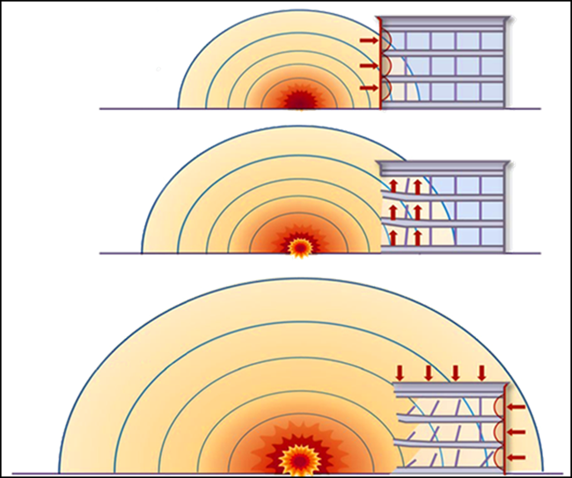
External Explosion Effects Diagram
Breaks windows; exterior walls blown in and columns may be damaged
Forces floors upward
Source: FEMA
External Explosion Effects Diagram
External Explosion Effects Diagram
Breaks windows; exterior walls blown in and columns may be damaged
Forces floors upward
Breaks windows; exterior walls blown in and columns may be damaged
Forces floors upward

Slide 65
External Explosion Effects Diagram
Surrounds structure; downward pressure on roof and inward pressure on all sides
Source: FEMA
External Explosion Effects Diagram
External Explosion Effects Diagram
Surrounds structure; downward pressure on roof and inward pressure on all sides
Surrounds structure; downward pressure on roof and inward pressure on all sides

Slide 66
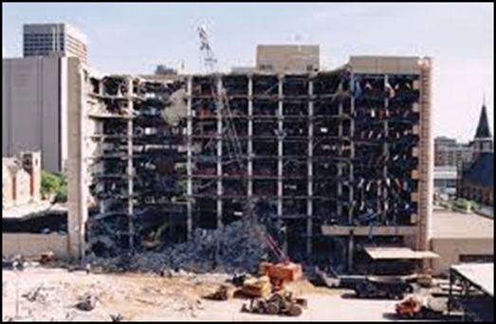
External Explosion Effects Protection
Design buildings for resilience against progressive collapse
External Explosion Effects Protection
External Explosion Effects Protection
Design buildings for resilience against progressive collapse
Design buildings for resilience against progressive collapse
Source: FEMA

Slide 67
Discussion Questions
Have you witnessed or experienced external explosion effects to a building?
If so, how would you describe it?
Discussion Questions
Discussion Questions
Have you witnessed or experienced external explosion effects to a building?
If so, how would you describe it?
Have you witnessed or experienced external explosion effects to a building?
If so, how would you describe it?

Slide 68
Internal Explosion Effects
Reflected pressure is enhanced even more when it collides with other reflected pressures because of the many obstacles, corners, and angles inside a building
This reinforcement increases the strength of the blast wave and produces more damage
Predicting internal damage is highly complex
Internal Explosion Effects
Internal Explosion Effects
Reflected pressure is enhanced even more when it collides with other reflected pressures because of the many obstacles, corners, and angles inside a building
This reinforcement increases the strength of the blast wave and produces more damage
Predicting internal damage is highly complex
Reflected pressure is enhanced even more when it collides with other reflected pressures because of the many obstacles, corners, and angles inside a building
This reinforcement increases the strength of the blast wave and produces more damage
Predicting internal damage is highly complex

Slide 69

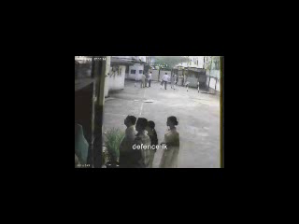
Internal Explosion Effects Video
Internal Explosion Effects Video
Internal Explosion
Effects Video
Click on image
to play video

Slide 70
Effects on Victims
This section will cover:
Primary blast injuries
Secondary blast injuries
Thermal injuries
Others injuries
Effects on Victims
Effects on Victims
This section will cover:
Primary blast injuries
Secondary blast injuries
Thermal injuries
Others injuries
This section will cover:
Primary blast injuries
Secondary blast injuries
Thermal injuries
Others injuries

Slide 71
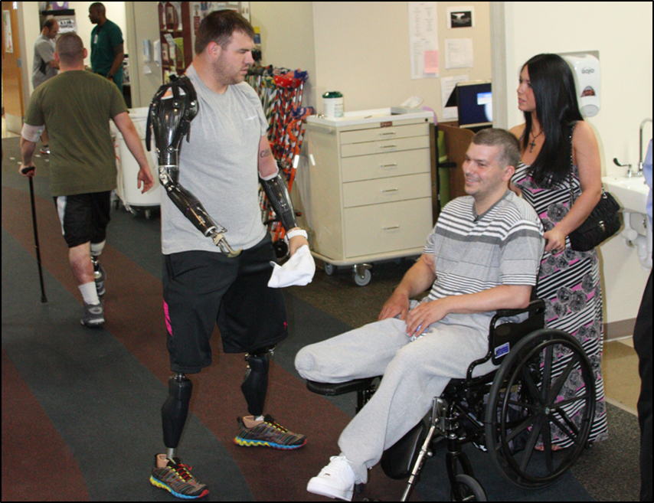
Primary Blast Injuries
Direct effects of close proximity to the blast wave can include significant bodily damage:
Limbs and body parts ripped away or blown off
Damage to ear drums, lungs, and gastrointestinal organs
The large intestines are the abdominal organ most frequently affected
Primary Blast Injuries
Primary Blast Injuries
Direct effects of close proximity to the blast wave can include significant bodily damage:
Limbs and body parts ripped away or blown off
Damage to ear drums, lungs, and gastrointestinal organs
The large intestines are the abdominal organ most frequently affected
Direct effects of close proximity to the blast wave can include significant bodily damage:
Limbs and body parts ripped away or blown off
Damage to ear drums, lungs, and gastrointestinal organs
The large intestines are the abdominal organ most frequently affected
Source: US Army

Slide 72
Secondary Blast Injuries
Occur further from the blast seat
May result from large flying objects but usually from smaller fragments
May be minimal or extensive
Secondary Blast Injuries
Secondary Blast Injuries
Occur further from the blast seat
May result from large flying objects but usually from smaller fragments
May be minimal or extensive
Occur further from the blast seat
May result from large flying objects but usually from smaller fragments
May be minimal or extensive

Slide 73
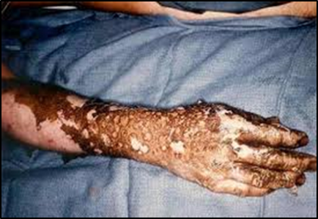
Thermal Injuries
Burns caused when victims are exposed to the intense heat of the thermal effect
Injuries vary depending upon the type of explosives used
Source: OSHA
Thermal Injuries
Thermal Injuries
Burns caused when victims are exposed to the intense heat of the thermal effect
Injuries vary depending upon the type of explosives used
Burns caused when victims are exposed to the intense heat of the thermal effect
Injuries vary depending upon the type of explosives used

Slide 74
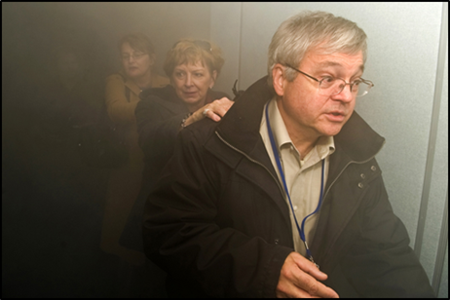
Other Injuries
Commonly occur when victims are attempting to escape:
Falls
Smoke inhalation
Source: FEMA
Other Injuries
Other Injuries
Commonly occur when victims are attempting to escape:
Falls
Smoke inhalation
Commonly occur when victims are attempting to escape:
Falls
Smoke inhalation

Slide 75
Mitigating the Threat of an IED
This section will cover:
Recognizing safe distance
Hardening the potential target
Protecting the potential target
Mitigating the Threat of an IED
Mitigating the Threat of an IED
This section will cover:
Recognizing safe distance
Hardening the potential target
Protecting the potential target
This section will cover:
Recognizing safe distance
Hardening the potential target
Protecting the potential target

Slide 76
Recognizing Safe Distance
Refer To:
Workbook 9.2
Mitigate the effects of the largest credible explosive threat by:
Determining critical locations
Creating distance between critical locations and critical infrastructure assets when possible
Monitoring safe distances
Recognizing Safe Distance
Recognizing Safe Distance
Refer to
Addendum 9.3
Refer To:
Workbook 9.2
Mitigate the effects of the largest credible explosive threat by:
Determining critical locations
Creating distance between critical locations and critical infrastructure assets when possible
Monitoring safe distances
Mitigate the effects of the largest credible explosive threat by:
Determining critical locations
Creating distance between critical locations and critical infrastructure assets when possible
Monitoring safe distances
Mitigate the effects of the largest credible explosive threat by:
Determining critical locations
Creating distance between critical locations and critical infrastructure assets when possible
Monitoring safe distances

Slide 77
Hardening the Potential Target (1 of 3)
Reinforce windows and door openings with laminate or other protective coverings
Modify existing structural supports, if possible
Eliminate underground or street parking next to the structure
Locate large occupancy spaces away from windows, streets, or public access areas
Hardening the Potential Target (1 of 3)
Hardening the Potential Target (1 of 3)
Reinforce windows and door openings with laminate or other protective coverings
Modify existing structural supports, if possible
Eliminate underground or street parking next to the structure
Locate large occupancy spaces away from windows, streets, or public access areas
Reinforce windows and door openings with laminate or other protective coverings
Modify existing structural supports, if possible
Eliminate underground or street parking next to the structure
Locate large occupancy spaces away from windows, streets, or public access areas

Slide 78
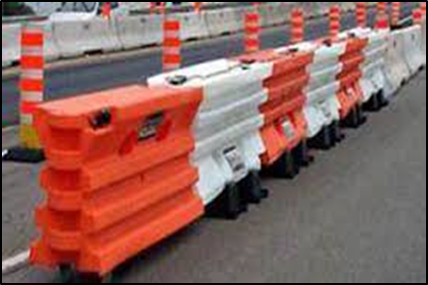
Hardening the Potential Target (2 of 3)
Consider relocating mail or freight receiving areas to a more secure location
Protect utility service areas such as electrical or communication systems
Block off streets with barricades
Hardening the Potential Target (2 of 3)
Hardening the Potential Target (2 of 3)
Consider relocating mail or freight receiving areas to a more secure location
Protect utility service areas such as electrical or communication systems
Block off streets with barricades
Consider relocating mail or freight receiving areas to a more secure location
Protect utility service areas such as electrical or communication systems
Block off streets with barricades
Source: OSHA

Slide 79
Hardening the Potential Target (3 of 3)
Implement all the measures to reduce the effects of a blast
Efforts can only minimize blast effects, not eliminate them
Hardening the Potential Target (3 of 3)
Hardening the Potential Target (3 of 3)
Implement all the measures to reduce the effects of a blast
Efforts can only minimize blast effects, not eliminate them
Implement all the measures to reduce the effects of a blast
Efforts can only minimize blast effects, not eliminate them

Slide 80
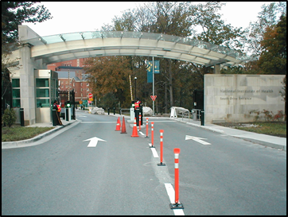
Protecting the Potential Target
Greatest protection is distance but other measures are needed
Increasing facility’s physical security and controlling overall access
Balance the plan by hardening and protecting
Protecting the Potential Target
Protecting the Potential Target
Greatest protection is distance but other measures are needed
Increasing facility’s physical security and controlling overall access
Balance the plan by hardening and protecting
Greatest protection is distance but other measures are needed
Increasing facility’s physical security and controlling overall access
Balance the plan by hardening and protecting
Source: NIH

Slide 81
Case Study — Oklahoma City Bombing (1 of 7)
Refer To:
Handout 9.2
Purpose: to examine the blast effects on the Murrah Federal Building in Oklahoma City and identify ways in which the structural damage and loss of life could have been mitigated
Duration: 15 minutes (5-activity; 10-debrief)
Group composition: table groups
Debrief: large-group discussion
Case Study — Oklahoma City Bombing (1 of 7)
Case Study — Oklahoma City Bombing (1 of 7)
Refer to
Addendum 9.4
Refer To:
Handout 9.2
Purpose: to examine the blast effects on the Murrah Federal Building in Oklahoma City and identify ways in which the structural damage and loss of life could have been mitigated
Duration: 15 minutes (5-activity; 10-debrief)
Group composition: table groups
Debrief: large-group discussion
Purpose: to examine the blast effects on the Murrah Federal Building in Oklahoma City and identify ways in which the structural damage and loss of life could have been mitigated
Duration: 15 minutes (5-activity; 10-debrief)
Group composition: table groups
Debrief: large-group discussion

Slide 82


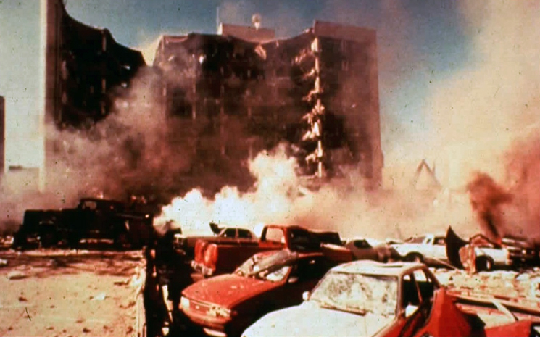
Case Study — Oklahoma City Bombing (2 of 7)
Refer To:
Handout 9.2
Source: ATF
Source: ATF
Timothy McVeigh,
Oklahoma City bomber
Alfred P. Murrah Building,
Oklahoma City
Case Study — Oklahoma City Bombing (2 of 7)
Case Study — Oklahoma City Bombing (2 of 7)
Refer To:
Refer to
Addendum 9.4
Handout 9.2
Timothy McVeigh,
Oklahoma City bomber
Alfred P. Murrah Building,
Oklahoma City
Alfred P. Murrah Building,
Oklahoma City
Timothy McVeigh,
Oklahoma City bomber

Slide 83
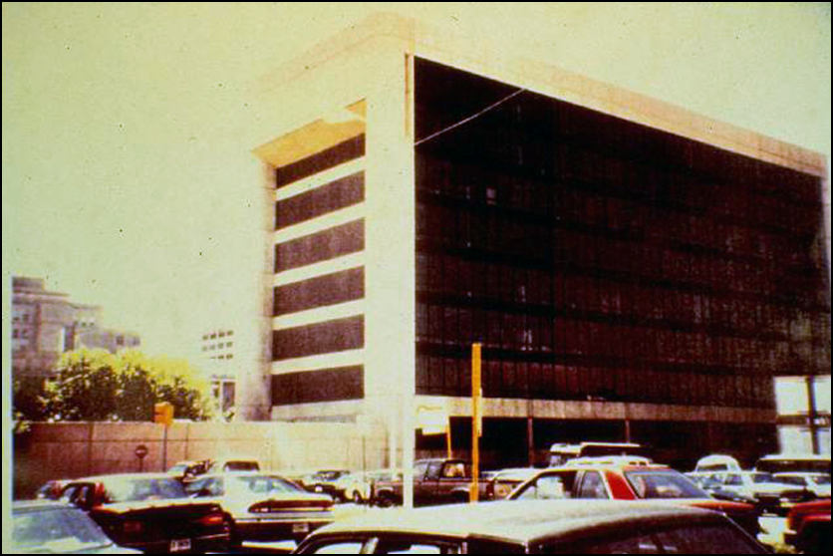
Case Study — Oklahoma City Bombing (3 of 7)
Refer To:
Handout 9.2
Delivery truck
in freight zone
(Delivery truck
in freight zone)
Source: ATF
Case Study — Oklahoma City Bombing (3 of 7)
Refer To:
Handout 9.2
Delivery truck
in freight zone
Case Study — Oklahoma City Bombing (3 of 7)
Refer to
Addendum 9.4

Slide 84
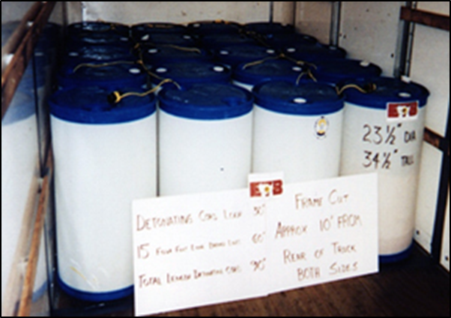
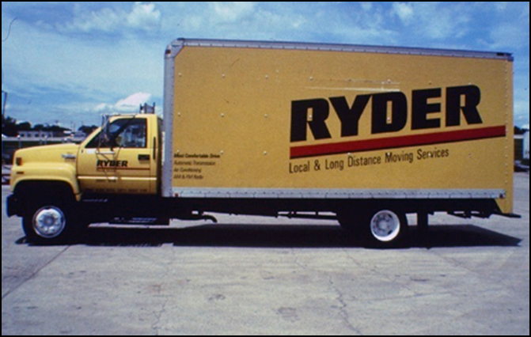
Case Study — Oklahoma City Bombing (4 of 7)
Refer To:
Handout 9.2
Source: ATF
Source: ATF
Explosives in drums, linked by detonator cord
(Explosives in drums, linked by detonator cord)
Case Study — Oklahoma City Bombing (4 of 7)
Refer To:
Handout 9.2
Explosives in drums, linked by detonator cord
Case Study — Oklahoma City Bombing (4 of 7)
Refer to
Addendum 9.4

Slide 85
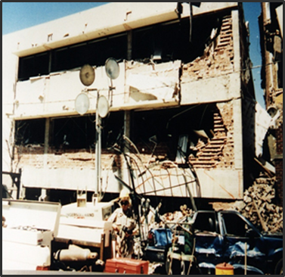
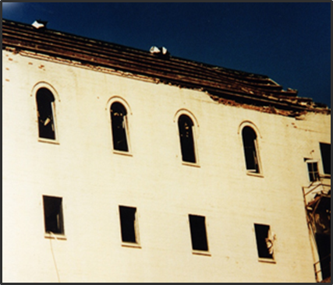
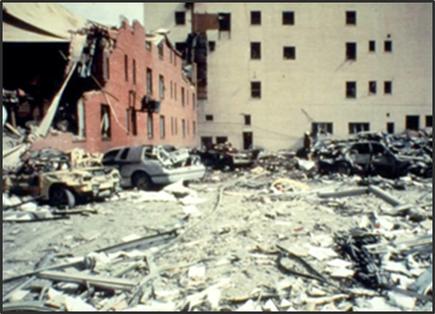
Case Study — Oklahoma City Bombing (5 of 7)
Refer To:
Handout 9.2
Source: ATF
Source: ATF
Source: ATF
Surrounding buildings
Athenian Restaurant
(Surrounding buildings)
(Athenian Restaurant)
Case Study — Oklahoma City Bombing (5 of 7)
Refer To:
Handout 9.2
Surrounding buildings
Athenian Restaurant
Case Study — Oklahoma City Bombing (5 of 7)
Refer to
Addendum 9.4

Slide 86
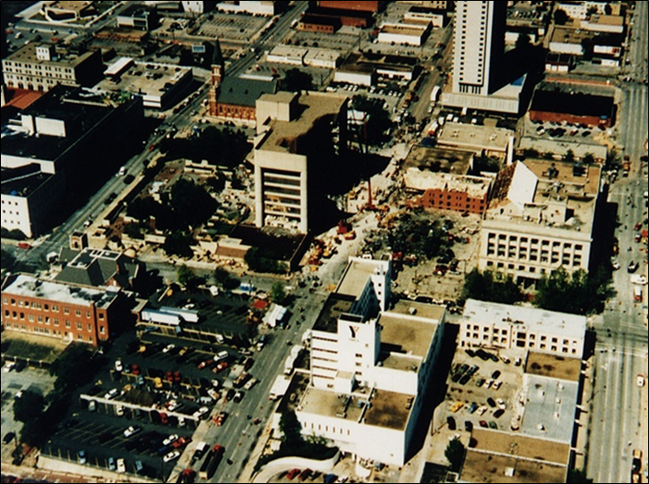
Case Study — Oklahoma City Bombing (6 of 7)
Refer To:
Handout 9.2
(Alfred P. Murrah Building Oklahoma City)
Alfred P. Murrah Building Oklahoma City
Journal Record Building
(Journal Record Building)
Source: ATF
Case Study — Oklahoma City Bombing (6 of 7)
Refer To:
Handout 9.2
Alfred P. Murrah Building Oklahoma City
Journal Record Building
Case Study — Oklahoma City Bombing (6 of 7)
Refer to
Addendum 9.4

Slide 87
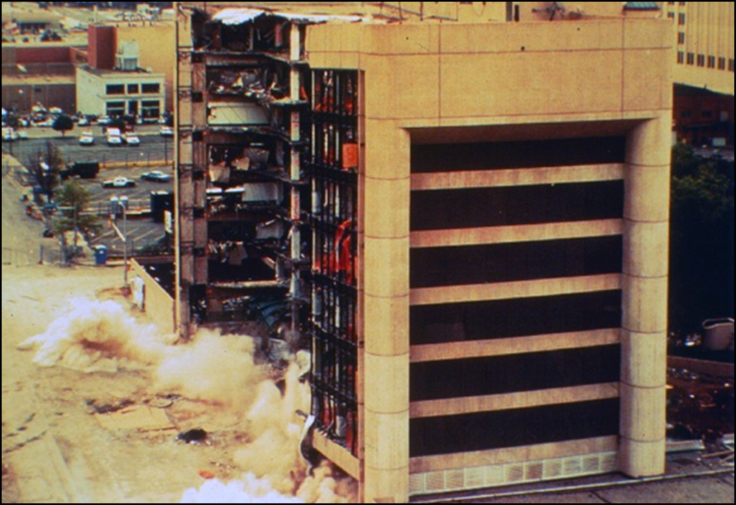
Case Study — Oklahoma City Bombing (7 of 7)
Refer To:
Handout 9.2
Source: ATF
Case Study — Oklahoma City Bombing (7 of 7)
Refer To:
Handout 9.2
Case Study — Oklahoma City Bombing (7 of 7)
Refer to
Addendum 9.4

Slide 88
CBRN — Awareness
Awareness of terrorist threats to use chemical, biological, radiological, and nuclear (CBRN) weapons
A significant threat
Some terrorist organizations are attempting to develop these weapons
CBRN — Awareness
CBRN — Awareness
Awareness of terrorist threats to use chemical, biological, radiological, and nuclear (CBRN) weapons
A significant threat
Some terrorist organizations are attempting to develop these weapons
Awareness of terrorist threats to use chemical, biological, radiological, and nuclear (CBRN) weapons
A significant threat
Some terrorist organizations are attempting to develop these weapons

Slide 89
CBRN — Attacks
Have the potential to indiscriminately kill or injure many thousands of people
Incidents are rare
May not cause a lot of physical damage, but high numbers of casualties, panic, and disruption can severely effect the operational capability of the facility
CBRN — Attacks
CBRN — Attacks
Have the potential to indiscriminately kill or injure many thousands of people
Incidents are rare
May not cause a lot of physical damage, but high numbers of casualties, panic, and disruption can severely effect the operational capability of the facility
Have the potential to indiscriminately kill or injure many thousands of people
Incidents are rare
May not cause a lot of physical damage, but high numbers of casualties, panic, and disruption can severely effect the operational capability of the facility

Slide 90
Attack Scenarios and Safe Distance Exercise
Refer To:
Workbook 9.3
Purpose: to plan a terrorist attack against a facility and determine minimum safe distances
Duration: 65 minutes (45-exercise; 20-debrief)
Group composition: table groups
Debrief: team presentation and large-group discussion
Attack Scenarios and Safe Distance Exercise
Attack Scenarios and Safe Distance Exercise
Refer to
Addendum 9.5
Refer To:
Workbook 9.3
Purpose: to plan a terrorist attack against a facility and determine minimum safe distances
Duration: 65 minutes (45-exercise; 20-debrief)
Group composition: table groups
Debrief: team presentation and large-group discussion
Purpose: to plan a terrorist attack against a facility and determine minimum safe distances
Duration: 65 minutes (45-exercise; 20-debrief)
Group composition: table groups
Debrief: team presentation and large-group discussion

Slide 91
Module Summary
Explosives
Improvised explosive device (IED)
Effects of an explosion
Effects on structures
Effects on victims
Mitigating the threat of an IED
CBRN
Module Summary
Module Summary
Refer to
Addendum 9.6
Explosives
Improvised explosive device (IED)
Effects of an explosion
Effects on structures
Effects on victims
Mitigating the threat of an IED
CBRN
Explosives
Improvised explosive device (IED)
Effects of an explosion
Effects on structures
Effects on victims
Mitigating the threat of an IED
CBRN

