Slide 1
Policies and Procedures
Module 11

Slide 2
Module Objective
By the end of this module, you will be able to describe the types of policies and procedures needed for the protection of critical infrastructure
Module Objective
By the end of this module, you will be able to describe the types of policies and procedures needed for the protection of critical infrastructure

Slide 3
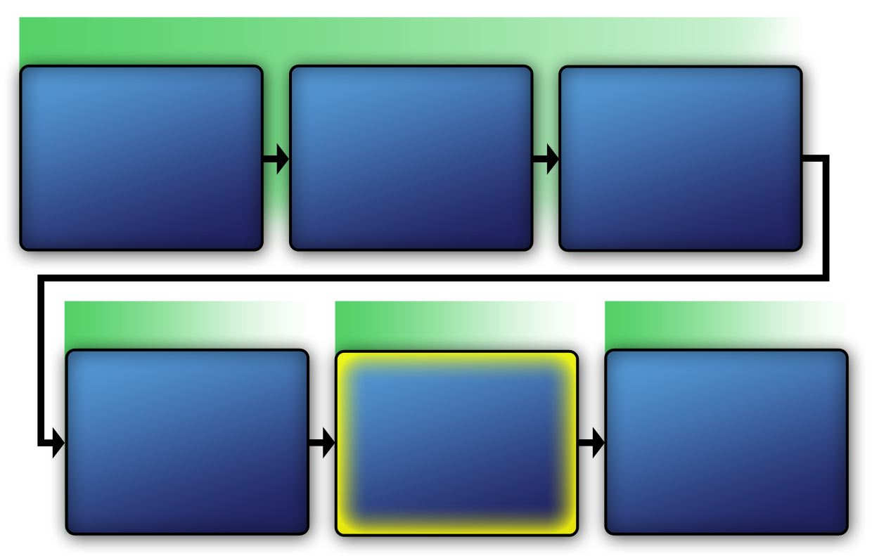
Course Map with VAM Phases
VAM Phase 1
Identify Vital Infrastructure
Module 2
Assess Vital Infrastructure Components
Module 5
Identify Vital Infrastructure Assets
Module 6
VAM Phase 2
VAM Phase 3
VAM Phase 4
Analyze the Threat
Modules 7-10
Identify Security Counter-
Measures
Modules 11-14
Develop Operational Resilience
Module 15
Course Map with VAM Phases
VAM Phase 1
Identify Critical Infrastructure
Module 2
Assess Critical Infrastructure Components
Module 5
Identify Critical Infrastructure Assets
Module 6
VAM Phase 2
VAM Phase 2
VAM Phase 3
VAM Phase 4
Analyze the Threat
Modules 7-10
Develop Operational Resilience
Module 15

Slide 4
Policies and Procedures Relating to a Physical Protection System
This section will cover:
  Definitions
  Purpose of and need for
  Guidelines for writing policies
  Characteristics
  Updating
Policies and Procedures Relating
to a Physical Protection System
This section will cover:
  Definitions
  Purpose of and need for
  Guidelines for writing policies
  Characteristics
  Updating

Slide 5
Definitions
Policy: general guidance regarding an organization’s operational standards
Procedure: a specific series of tasks, steps, and processes necessary to accomplish a particular goal; how the organization intends to carry out operating policies
Definitions
Policy: general guidance regarding an organization’s operational standards
Procedure: a specific series of tasks, steps, and processes necessary to accomplish a particular goal; how the organization intends to carry out operating policies

Slide 6
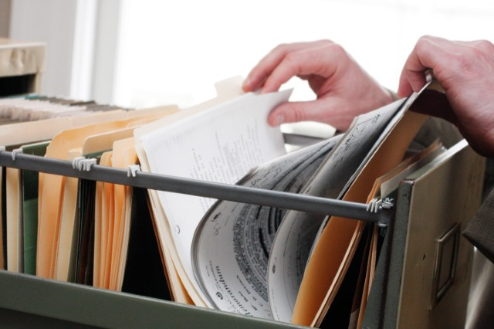
Purposes of Policies and Procedures
Establish guidelines for security management
Resolve security conflicts or incidents
Ensure security of critical infrastructure
Important for everyone:
  Provide guidance about expectations
  Offer a way for settling disputes
Purposes of Policies and Procedures
Establish guidelines for security management
Resolve security conflicts or incidents
Ensure security of critical infrastructure
Important for everyone:
  Provide guidance about expectations
  Offer a way for settling disputes
Source: Getty Images

Slide 7

Need for Policies and Procedures (1 of 2)
Refer To:
Workbook 11.1
If actions of employees indicate confusion about conduct
If guidance is needed about ways to resolve conflict
To comply with governmental policies and laws
Need for Policies and Procedures (1 of 2)
Refer To:
Workbook 11.1
If actions of employees indicate confusion about conduct
If guidance is needed about ways to resolve conflict
To comply with governmental policies and laws

Slide 8

Need for Policies and Procedures (2 of 2)
Refer To:
Workbook 11.1
To establish consistent work standards, rules, and regulations
To provide consistent security force response
To ensure security technologies are functioning properly
Need for Policies and Procedures (2 of 2)
Refer To:
Workbook 11.1
To establish consistent work standards, rules, and regulations
To provide consistent security force response
To ensure security technologies are functioning properly

Slide 9
Discussion Question
What consequences to critical infrastructure security might result without policies and procedures?
Discussion Question
What consequences to critical infrastructure security might result without policies and procedures?

Slide 10
Guidelines for Writing Policies
Determine the goal to accomplish
Tell employees why the policy is being implemented
Provide clear and specific guidelines
Include sufficient detail to effectively communicate the organization’s position
Guidelines for Writing Policies
Determine the goal to accomplish
Tell employees why the policy is being implemented
Provide clear and specific guidelines
Include sufficient detail to effectively communicate the organization’s position

Slide 11

Characteristics of
Policies and Procedures
Refer To:
Workbook 11.1
Policies describe organization’s standards
Procedures describe steps to put the standards into action
Characteristics of
Policies and Procedures
Refer To:
Workbook 11.1
Source: Getty Images
Policies describe organization’s standards
Procedures describe steps to put the standards into action

Slide 12
Use-of-Force Policy Example
A security force officer must not exceed the amount of force required to stop a subject from carrying out an adversarial action
A security force officer must, as appropriate, follow the escalation of force continuum as it applies to the situation
Use-of-Force Policy Example
A security force officer must not exceed the amount of force required to stop a subject from carrying out an adversarial action
A security force officer must, as appropriate, follow the escalation of force continuum as it applies to the situation

Slide 13
Use-of-Force Procedure Example
Security force:
  Physical restraint
    The security force officer, as appropriate, must issue a verbal warning to a subject before taking action.
    If a verbal warning is not complied with, the security force officer can then escalate to the use of physical restraint.
Use-of-Force Procedure Example
Security force:
  Physical restraint
    The security force officer, as appropriate, must issue a verbal warning to a subject before taking action.
    If a verbal warning is not complied with, the security force officer can then escalate to the use of physical restraint.

Slide 14
Importance of Updating
Policies and Procedures
Vulnerability analysis methodology and risk assessment strategies ensure that the policies and procedures are:
  Accurate
  Current
  Regularly reviewed and revised to meet changing threats
Importance of Updating
Policies and Procedures
Vulnerability analysis methodology and risk assessment strategies ensure that the policies and procedures are:
  Accurate
  Current
  Regularly reviewed and revised to meet changing threats

Slide 15
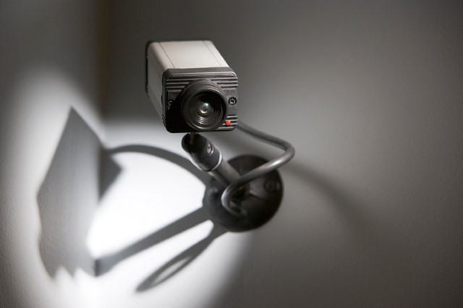
Types of Policies and Procedures to Protect Critical Infrastructure (1 of 2)
Develop for:
  Perimeter barriers
  Lighting
  Intruder detection systems
  Closed-circuit television
  Automated access control systems
  Security officers and patrols
Types of Policies and Procedures to
Protect Critical Infrastructure (1 of 2)
Develop for:
  Perimeter barriers
  Lighting
  Intruder detection systems
  Closed-circuit television
  Automated access control systems
  Security officers and patrols
Source: Getty Images

Slide 16
Types of Policies and Procedures to Protect Critical Infrastructure (2 of 2)
  Electronic access controls
  Lock and key controls
  Entry control areas
  Secure asset locations
  Cybersecurity
Include in a standard operating procedures manual
Types of Policies and Procedures to
Protect Critical Infrastructure (2 of 2)
  Electronic access controls
  Lock and key controls
  Entry control areas
  Secure asset locations
  Cybersecurity
Include in a standard operating procedures manual

Slide 17
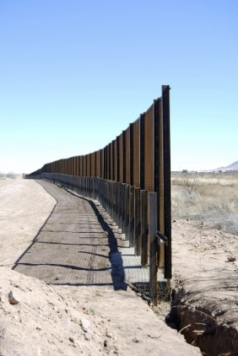
Perimeter Barrier Definition
Natural boundary, such as a river or mountain range
Freestanding fence or wall
Outer walls of a facility or walls or divisions of a building
Source: Getty Images
Perimeter Barrier Definition
Natural boundary, such as a river or mountain range
Freestanding fence or wall
Outer walls of a facility or walls or divisions of a building

Slide 18
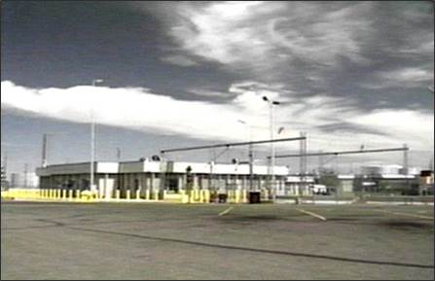
Perimeter Barrier Purpose
Delineate a boundary
Channel visitors to legal points of entry
Deter and delay unlawful intruders
Provide a degree of physical, psychological, or legal deterrence
Perimeter Barrier Purpose
Delineate a boundary
Channel visitors to legal points of entry
Deter and delay unlawful intruders
Provide a degree of physical, psychological, or legal deterrence
Source: DS/T/ATA

Slide 19
Perimeter Barrier Effectiveness (1 of 2)
Perimeter intruder detection systems
Closed-circuit television and security officers
Security lighting
Enclosed fencing
Perimeter Barrier Effectiveness (1 of 2)
Perimeter intruder detection systems
Closed-circuit television and security officers
Security lighting
Enclosed fencing

Slide 20
Perimeter Barrier Effectiveness (2 of 2)
Grouped facilities
Maintained vegetation
Anticlimbing devices on fences
Secure vehicle gates and fences at the same level
Perimeter Barrier Effectiveness (2 of 2)
Grouped facilities
Maintained vegetation
Anticlimbing devices on fences
Secure vehicle gates and fences at the same level

Slide 21
Perimeter Barriers Standards
Refer To:
Workbook 11.2
Doors
Windows
Other areas of the facility
Perimeter Barriers Standards
Refer To:
Workbook 11.2
Doors
Windows
Other areas of the facility

Slide 22
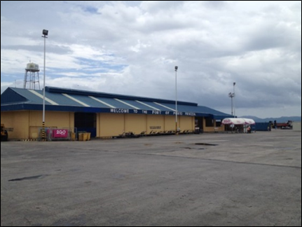
Lighting (1 of 2)
Effective use can minimize the chance that intruders will go undetected
Source: DS/T/ATA
Lighting (1 of 2)
Effective use can minimize the chance that intruders will go undetected

Slide 23
Lighting (2 of 2)
All external areas should be well lit:
  Vehicle parking areas
  Access routes
  Building entrances
  External doors
  Common entrances
Use light-sensitive devices for daytime and nighttime conditions
Lighting (2 of 2)
All external areas should be well lit:
  Vehicle parking areas
  Access routes
  Building entrances
  External doors
  Common entrances
Use light-sensitive devices for daytime and nighttime conditions

Slide 24
Lighting and Closed-Circuit
Television Compatibility
Factors that dramatically reduce quality of image include:
  Excessive shadows
  Glare into the lens
  Back-lighting
  External lighting
Avoid low-pressure sodium vapor lighting
Lighting and Closed-Circuit
Television Compatibility
Factors that dramatically reduce quality of image include:
  Excessive shadows
  Glare into the lens
  Back-lighting
  External lighting
Avoid low-pressure sodium vapor lighting

Slide 25
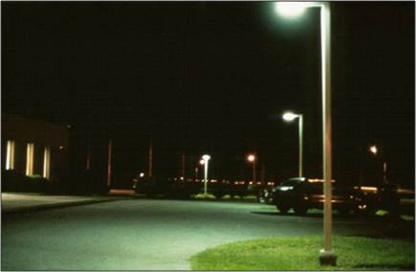
Lighting — Perimeter
Should cast a uniform light over the perimeter
Should create a glare that deters intruders (overhead or low-mounted lamp)
Should not create a nuisance or hazard outside the perimeter
Should not reveal the positions of guards, either inside or outside
Lighting — Perimeter
Should cast a uniform light over the perimeter
Should create a glare that deters intruders (overhead or low-mounted lamp)
Should not create a nuisance or hazard outside the perimeter
Should not reveal the positions of guards, either inside or outside
Source: DS/T/ATA

Slide 26
Lighting — Area
Illuminates areas inside the perimeter that intruders must cross in order to reach their objectives and:
  Increases security officers’ ability to detect intruders
  Acts as a powerful deterrent
  Should be even and without shadows
Lighting — Area
Illuminates areas inside the perimeter that intruders must cross in order to reach their objectives and:
  Increases security officers’ ability to detect intruders
  Acts as a powerful deterrent
  Should be even and without shadows

Slide 27
Intruder Detection Systems
Designed to:
  Detect entry, or attempted entry, of an intruder into a protected area
  Identify location of an intrusion
  Signal an alarm to the security force
Best used to provide early detection of attack
Security force must respond quickly
Intruder Detection Systems
Designed to:
  Detect entry, or attempted entry, of an intruder into a protected area
  Identify location of an intrusion
  Signal an alarm to the security force
Best used to provide early detection of attack
Security force must respond quickly

Slide 28
Intruder Detection System Elements
Perimeter — activate by intrusion or attack upon the perimeter
Trap — activate once the intruder is inside the building
Point — used to protect high-value and portable items
Intruder Detection System Elements
Perimeter — activate by intrusion or attack upon the perimeter
Trap — activate once the intruder is inside the building
Point — used to protect high-value and portable items

Slide 29
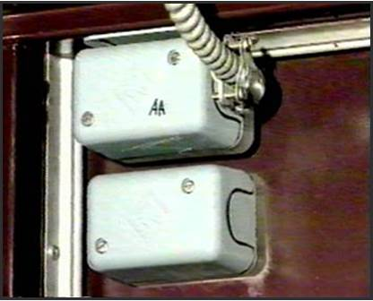
Intruder Detection System for
Unmanned Facilities (1 of 2)
Should be equipped with following features:
  Door contact sensors, as a minimum requirement
  Sensors that report to the security control center
  A security control center that provides access control functions
  A verification feature that clarifies the reason for alarm activation
Intruder Detection System for
Unmanned Facilities (1 of 2)
Should be equipped with following features:
  Door contact sensors, as a minimum requirement
  Sensors that report to the security control center
  A security control center that provides access control functions
  A verification feature that clarifies the reason for alarm activation
Source: DS/T/ATA

Slide 30
Intruder Detection System for
Unmanned Facilities (2 of 2)
The verification feature can be provided by:
  Closed-circuit television at the remote site
  Law enforcement or security force personnel directed to the site to investigate
Provides the ability to view the area
Intruder Detection System for
Unmanned Facilities (2 of 2)
The verification feature can be provided by:
  Closed-circuit television at the remote site
  Law enforcement or security force personnel directed to the site to investigate
Provides the ability to view the area

Slide 31
Closed-Circuit Television (1 of 2)
Refer To:
Workbook 11.2
Benefits include:
  Saves manpower
  Makes an existing security system more effective
  Enhances perimeter security
Closed-Circuit Television
Refer To:
Workbook 11.2
Benefits include:
  Saves manpower
  Makes an existing security system more effective
  Enhances perimeter security

Slide 32
Closed-Circuit Television (2 of 2)
Refer To:
Workbook 11.2
Not a security detection device without video motion detection
Selection of cameras and system based on site requirements
Closed-Circuit Television
Refer To:
Workbook 11.2
Not a security detection device without video motion detection
Selection of cameras and system based on site requirements

Slide 33
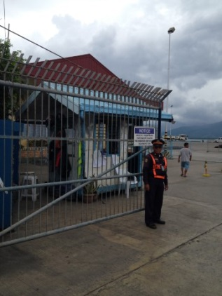
Automated Access Control Systems
Ensure only authorized persons gain access
Minimum requirement: a card-access control system
Follow standard operating procedures manual
Automated Access Control Systems
Ensure only authorized persons gain access
Minimum requirement: a card-access control system
Follow standard operating procedures manual
Source: DS/T/ATA

Slide 34
Automated Access Control Systems —Components
Electronic access control
Alarm reporting
Image capture and badge production
Physical locks and key control
Alarm output triggers to closed-circuit television system
Automated Access Control Systems —Components
Electronic access control
Alarm reporting
Image capture and badge production
Physical locks and key control
Alarm output triggers to closed-circuit television system

Slide 35
Facility Access Control (1 of 2)
Keep number of external access and exit points to a minimum
All regular entry and exit points must be access controlled and include anti-pass backup capability
Facility Access Control (1 of 2)
Keep number of external access and exit points to a minimum
All regular entry and exit points must be access controlled and include anti-pass backup capability

Slide 36
Facility Access Control (2 of 2)
External doors with remote operation installed where entry is viewed:
  Directly
  By closed-circuit
Control internal doors leading to critical areas with electronic access
Facility Access Control (2 of 2)
External doors with remote operation installed where entry is viewed:
  Directly
  By closed-circuit
Control internal doors leading to critical areas with electronic access

Slide 37
Security Officers and Patrols (1 of 2)
Where applicable, lead security officer determines security level policies and procedures based on:
  Informed opinions on threats
  Specific vulnerabilities
  Identified risks
Security Officers and Patrols (1 of 2)
Where applicable, lead security officer determines security level policies and procedures based on:
  Informed opinions on threats
  Specific vulnerabilities
  Identified risks

Slide 38
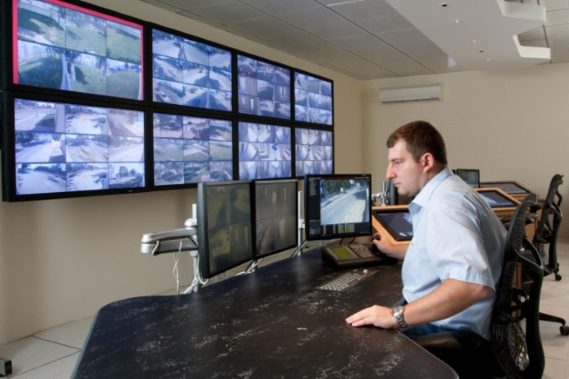
Security Officers and Patrols (2 of 2)
Integrate security measures into one security control center facility protecting:
  Security personnel
  Reception staff
  Systems data
Security Officers and Patrols (2 of 2)
Integrate security measures into one security control center facility protecting:
  Security personnel
  Reception staff
  Systems data
Source: Getty Images

Slide 39
Electronic Access Control
Requires specific policies and procedures
Examples include:
  Specific management responsibilities for card control and inventory requirements
  Guidelines for issuing cards and the areas to be granted access
  Guidelines for terminating card access for misuse of cards
Electronic Access Control
Requires specific policies and procedures
Examples include:
  Specific management responsibilities for card control and inventory requirements
  Guidelines for issuing cards and the areas to be granted access
  Guidelines for terminating card access for misuse of cards

Slide 40
Lock and Key Controls
Refer To:
Workbook 11.2
Standards
Spare keys
Key labeling
Lock and Key Controls
Refer To:
Workbook 11.2
Standards
Spare keys
Key labeling

Slide 41
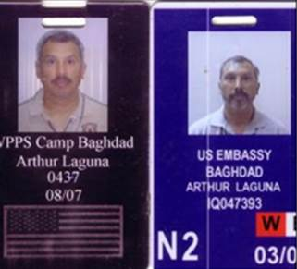
Entry Control Areas — Personnel
All personnel must wear a visible identification card
Revoke access when a staff member leaves the organization
Verify and authorize access for any external support services personnel
Entry Control Areas — Personnel
All personnel must wear a visible identification card
Revoke access when a staff member leaves the organization
Verify and authorize access for any external support services personnel
Source: DS/T/ATA

Slide 42
Entry Control Areas — Visitors
Ask person they are visiting to arrange access
Obtain permission prior to the day of visit
Be issued an identification card
Obtain a visitor card at reception desk
Be accompanied by an authorized person at all times
Entry Control Areas — Visitors
Ask person they are visiting to arrange access
Obtain permission prior to the day of visit
Be issued an identification card
Obtain a visitor card at reception desk
Be accompanied by an authorized person at all times

Slide 43
Secure Asset Locations (1 of 2)
Locate in interior of facility
Keep away from exterior windows
Do not use glass doors or windows for construction
Use metal or solid wood doors
Control access using electronic access control with capability to maintain a record of all entrants
Secure Asset Locations (1 of 2)
Locate in interior of facility
Keep away from exterior windows
Do not use glass doors or windows for construction
Use metal or solid wood doors
Control access using electronic access control with capability to maintain a record of all entrants

Slide 44

Secure Asset Locations (2 of 2)
Remove exterior room door key access hardware from the master key system
Control issuance of nonmaster keys
Install intruder detection system with uninterrupted power source
Do not include on floorplans and construct slab-to-slab
Secure Asset Locations (2 of 2)
Remove exterior room door key access hardware from the master key system
Control issuance of nonmaster keys
Install intruder detection system with uninterrupted power source
Do not include on floorplans and construct slab-to-slab
Source: Getty Images

Slide 45
Secure Asset Locations — Personnel
Only personnel with an ongoing business need should be given unescorted access
Remove names from card access system immediately when no longer required
Keep visitors to a minimum
Secure Asset Locations — Personnel
Only personnel with an ongoing business need should be given unescorted access
Remove names from card access system immediately when no longer required
Keep visitors to a minimum

Slide 46
Security Personnel
Control access
Conduct building searches
Perform patrol duties
Use the radio to communicate
Respond to an intrusion alarm
Security Personnel
Control access
Conduct building searches
Perform patrol duties
Use the radio to communicate
Respond to an intrusion alarm

Slide 47
Types of Policies in an SOP Manual
Refer To:
Workbook 11.3
Description of the facility site
Floor plan of the facility
Description and application of access controls for the facility
Security force responsibilities
Types of Policies
in an SOP Manual
Refer To:
Workbook 11.3
Description of the facility site
Floor plan of the facility
Description and application of access controls for the facility
Security force responsibilities

Slide 48
Policies and Standard Operational Procedures (1 of 2)
Refer To:
Workbook 11.3
Outline roles and responsibilities of response force personnel
Reflect general requirements of the lead security officer
Policies and Standard Operational Procedures (1 of 2)
Refer To:
Workbook 11.3
Outline roles and responsibilities of response force personnel
Reflect general requirements of the lead security officer

Slide 49
Policies and Standard Operational Procedures (2 of 2)
Refer To:
Workbook 11.3
Are reviewed annually with updates completed in a timely manner
Provide guidance on how and when to deploy specialized units
Policies and Standard Operational Procedures (2 of 2)
Refer To:
Workbook 11.3
Are reviewed annually with updates completed in a timely manner
Provide guidance on how and when to deploy specialized units

Slide 50

Effective Security Policies
Refer To:
Workbook 11.3
Simple introduction and purpose
Policy statement
Information about:
  Compliance measurement
  Sanctions for compliance failures
Source: Getty Images
Effective Security Policies
Refer To:
Workbook 11.3
Simple introduction and purpose
Policy statement
Information about:
  Compliance measurement
  Sanctions for compliance failures

Slide 51
Noncompliance of
Policies and Procedures
Refer To:
Workbook 11.3
If a facility fails an audit or inspection, sanctions can range from:
  Development of a corrective action plan
  Closure of the facility until the compliance issue is corrected
Noncompliance of
Policies and Procedures
Refer To:
Workbook 11.3
If a facility fails an audit or inspection, sanctions can range from:
  Development of a corrective action plan
  Closure of the facility until the compliance issue is corrected

Slide 52
Development of a
Compliance Program (1 of 2)
Refer To:
Workbook 11.3
Identify agency that possesses jurisdiction
Obtain data from past inspections and audits
Develop a self-audit plan
Conduct a self-assessment against criteria published
Development of a
Compliance Program (1 of 2)
Refer To:
Workbook 11.3
Identify agency that possesses jurisdiction
Obtain data from past inspections and audits
Develop a self-audit plan
Conduct a self-assessment against criteria published

Slide 53
Development of a
Compliance Program (2 of 2)
Refer To:
Workbook 11.3
Develop an action plan
Incorporate compliance measures from past audits
Development of a
Compliance Program
Refer To:
Workbook 11.3
Develop an action plan
Incorporate compliance measures from past audits

Slide 54

TeachBack Moment
What types of policies and procedures are needed to effectively protect critical infrastructure?
What types of policies should be included in a standard operating procedures manual?
TeachBack Moment
What types of policies and procedures are needed to effectively protect critical infrastructure?
What types of policies should be included in a standard operating procedures manual?

Slide 55
Policies and Procedures
Relating to Critical Incidents
This section will cover:
  Critical incidents definition
  Critical incident management plan
  Critical incident management plan process
Policies and Procedures
Relating to Critical Incidents
This section will cover:
  Critical incidents definition
  Critical incident management plan
  Critical incident management plan process

Slide 56
Critical Incident Definition
An event of unusual or severe nature that can cause:
  Loss of life or injury to citizens
  Damage to property
Critical incidents require extraordinary measures to protect lives and restore order
Policies and procedures provide guidance for effective response
Critical Incident Definition
An event of unusual or severe nature that can cause:
  Loss of life or injury to citizens
  Damage to property
Critical incidents require extraordinary measures to protect lives and restore order
Policies and procedures provide guidance for effective response

Slide 57
Discussion Questions
What are some examples of critical incidents?
What are some specific examples of critical incidents in your region?
Discussion Questions
What are some examples of critical incidents?
What are some specific examples of critical incidents in your region?

Slide 58
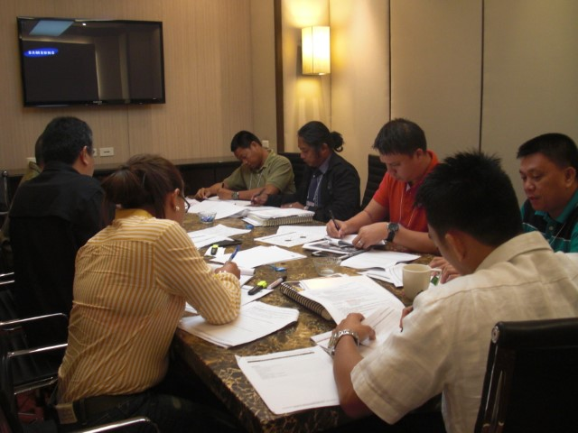
Critical Incident Management Plan
A standardized plan that outlines processes and procedures for coordination and control of responses to a terrorism event or natural disaster
Critical Incident Management Plan
A standardized plan that outlines processes and procedures for coordination and control of responses to a terrorism event or natural disaster
Source: DS/T/ATA

Slide 59
Discussion Questions
Does your agency have a critical incident management plan?
If so, how does the plan work?
Discussion Questions
Does your agency have a critical incident management plan?
If so, how does the plan work?

Slide 60

Principles of the Critical Incident Management Process (1 of 2)
Must be applied before, during, and after any incident
May require multiple jurisdiction and cross-functional agency involvement
Various responders must operate under the principles of flexibility and standardization to function as a unified team
Flexibility
Principles of the Critical Incident Management Process (1 of 2)
Must be applied before, during, and after any incident
May require multiple jurisdiction and cross-functional agency involvement
Various responders must operate under the principles of flexibility and standardization to function as a unified team
Standardization
Standardization
Flexibility

Slide 61
Principles of the Critical Incident Management Process (2 of 2)
The process provides:
  Consistent, flexible, and adjustable national framework of government and private entities working together to manage domestic incidents
  Standardized organizational structures:
    Incident command system
    Multiagency coordination systems
    Public emergency communication systems
Principles of the Critical Incident
Management Process (2 of 2)
The process provides:
  Consistent, flexible, and adjustable national framework of government and private entities working together to manage domestic incidents
  Standardized organizational structures:
    Incident command system
    Multiagency coordination systems
    Public emergency communication systems

Slide 62
Components of the Critical
Incident Management Process
Command and management structure
Joint operations
Resource and policy
Communications and information
After-actions reporting
Joint training exercises
Components of the Critical
Incident Management Process
Command and management structure
Joint operations
Resource and policy
Communications and information
After-actions reporting
Joint training exercises

Slide 63
Critical Incident
Management Process Phases
Phase 1: Prevention
Phase 2: Preparedness
Phase 3: Response
Phase 4: Recovery
Critical Incident
Management Process Phases
Phase 4: Recovery
Phase 1: Prevention
Phase 3: Response
Phase 2: Preparedness

Slide 64
Bomb Threat Management Plan (1 of 2)
This section will cover:
  Step 1: Designate management responsibilities
  Step 2: Define procedures for handling bomb threat calls
  Step 3: Determine procedures for evaluating bomb threat calls
Bomb Threat Management Plan (1 of 2)
This section will cover:
  Step 1: Designate management responsibilities
  Step 2: Define procedures for handling bomb threat calls
  Step 3: Determine procedures for evaluating bomb threat calls

Slide 65
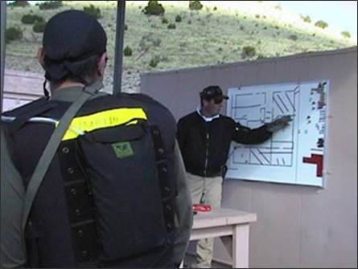
Bomb Threat Management Plan (2 of 2)
  Step 4: Identify an incident command post
  Step 5: Develop a search and evacuation plan
  Step 6: Establish a response procedure
Bomb Threat Management Plan (1 of 2)
  Step 4: Identify an incident command post
  Step 5: Develop a search and evacuation plan
  Step 6: Establish a response procedure
Source: DS/T/ATA

Slide 66
Discussion Questions
Does your agency have a bomb threat management plan?
If you have one, how does it work?
What benefits and deficiencies do you notice?
If your agency does not have one, how do you see one being helpful?
Discussion Questions
Does your agency have a bomb threat management plan?
If you have one, how does it work?
What benefits and deficiencies do you notice?
If your agency does not have one, how do you see one being helpful?

Slide 67
Step 1: Designate Management Responsibilities (1 of 4)
Incident commander | Alternate incident commander
Assess threat calls | Notify all operations supervisors of bomb threat
Order evacuation | Direct supervisors or floor wardens to initiate the response procedures
Supervise search and response to suspect objects
Determine when facility can be reentered
Step 1: Designate Management
Responsibilities (1 of 4)
Incident commander | Alternate incident commander
Assess threat calls | Notify all operations supervisors of bomb threat
Order evacuation | Direct supervisors or floor wardens to initiate the response procedures
Supervise search and response to suspect objects
Determine when facility can be reentered

Slide 68
Step 1: Designate Management Responsibilities (2 of 4)
Supervisor or floor warden | Runner
Notify employees of threat | Notify supervisors and management about threat
Supervise search or evacuation activities | Assist in securing location of suspect objects
 | Assign one to each shift to help with miscellaneous needs
Personnel who answer outside phone lines | Security and maintenance personnel assigned to search teams
Step 1: Designate Management
Responsibilities (2 of 4)
Supervisor or floor warden | Runner
Notify employees of threat | Notify supervisors and management about threat
Supervise search or evacuation activities | Assist in securing location of suspect objects
 | Assign one to each shift to help with miscellaneous needs
Personnel who answer outside phone lines | Security and maintenance personnel assigned to search teams

Slide 69

Step 1: Designate Management Responsibilities (3 of 4)
Refer To:
Handout 11.1
Purpose: to identify the basic roles and responsibilities of the personnel who are responsible for managing a bomb threat incident
  Duration: 15 minutes (10-activity; 5-debrief)
  Group composition: table groups
  Debrief: large-group discussion
Step 1: Designate Management Responsibilities (3 of 4)
Refer To:
Handout 11.1
Purpose: to identify the basic roles and responsibilities of the personnel who are responsible for managing a bomb threat incident
  Duration: 15 minutes (10-activity; 5-debrief)
  Group composition: table groups
  Debrief: large-group discussion

Slide 70

Step 1: Designate Management Responsibilities (4 of 4)
Communications network:
  Established through the chain of command
  Ensures employees are properly informed and supervised
  Mirrors existing management structure
  Ensures everyone is aware of their role
  Described when policy is developed
Step 1: Designate Management
Responsibilities (4 of 4)
Communications network:
  Established through the chain of command
  Ensures employees are properly informed and supervised
  Mirrors existing management structure
  Ensures everyone is aware of their role
  Described when policy is developed
Source: Getty Images

Slide 71
Step 2: Define Procedures for Bomb Threat Calls (1 of 3)
Refer To:
Workbook 11.4
Remain calm
Listen carefully to the caller’s message
Ask the caller to repeat the message
Record or write down every word the caller says
Step 2: Define Procedures for Bomb Threat Calls (1 of 3)
Refer To:
Workbook 11.4
Remain calm
Listen carefully to the caller’s message
Ask the caller to repeat the message
Record or write down every word the caller says

Slide 72
Step 2: Define Procedures for Bomb Threat Calls (2 of 3)
Refer To:
Workbook 11.4
Try to convince the caller to provide:
  Location of the device
  Time of detonation
Ask someone else to listen to the call
Keep the caller on phone as long as possible
Step 2: Define Procedures for Bomb Threat Calls (2 of 3)
Refer To:
Workbook 11.4
Try to convince the caller to provide:
  Location of the device
  Time of detonation
Ask someone else to listen to the call
Keep the caller on phone as long as possible

Slide 73
Step 2: Define Procedures for Bomb Threat Calls (3 of 3)
Refer To:
Workbook 11.4
Pay special attention to:
  The sound of the caller’s voice
  The caller’s dialect or use of language
  Background noises
Immediately report the situation to security
Complete a bomb threat checklist
Step 2: Define Procedures for Bomb Threat Calls (3 of 3)
Refer To:
Workbook 11.4
Pay special attention to:
  The sound of the caller’s voice
  The caller’s dialect or use of language
  Background noises
Immediately report the situation to security
Complete a bomb threat checklist

Slide 74
Discussion Question
What existing procedures do you have in place in your agency for managing bomb threat calls?
Discussion Question
What existing procedures do you have in place in your agency for managing bomb threat calls?

Slide 75
Step 3: Determine Procedures for Evaluating Bomb Threat Calls
Once the threat call is received and security is notified, the incident commander should:
  Debrief the person who received the call
  Let the recipient of the call describe the conversation in his or her own words
  Review the completed bomb threat checklist
Step 3: Determine Procedures
for Evaluating Bomb Threat Calls
Once the threat call is received and security is notified, the incident commander should:
  Debrief the person who received the call
  Let the recipient of the call describe the conversation in his or her own words
  Review the completed bomb threat checklist

Slide 76
How to Determine the
Authenticity of a Bomb Threat
Authentic bombers tend to:
  Repeat the threat message in a specific manner
  Provide detailed descriptions about the location of the device
The more information provided, the more likely threat is real
How to Determine the
Authenticity of a Bomb Threat
Authentic bombers tend to:
  Repeat the threat message in a specific manner
  Provide detailed descriptions about the location of the device
The more information provided, the more likely threat is real

Slide 77
Bomb Threat Decision Options (1 of 2)
Evacuate
Search
Ignore the threat
Do not base decisions solely on threat call’s credibility
Bomb Threat Decision Options (1 of 2)
Evacuate
Search
Ignore the threat
Do not base decisions solely on threat call’s credibility

Slide 78
Bomb Threat Decision Options (2 of 2)
The option chosen should be made in accordance with the bomb threat management plan
Guidelines for decisions about search and evacuation should be established by policy
Bomb Threat Decision Options (2 of 2)
The option chosen should be made in accordance with the bomb threat management plan
Guidelines for decisions about search and evacuation should be established by policy

Slide 79
Discussion Questions
What is the value of assessing potential threat credibility?
Should the building be evacuated or reoccupied before the time stated in the threat call?
What else should you plan for in addition to bomb threats?
Discussion Questions
What is the value of assessing potential threat credibility?
Should the building be evacuated or reoccupied before the time stated in the threat call?
What else should you plan for in addition to bomb threats?

Slide 80
Step 4: Determine an Incident Command Post (1 of 2)
Refer To:
Workbook 11.4
Bomb threat management plan should include an incident command post — the location from which the incident commander manages search and response activities
Location depends upon the type of search and response plan
Step 4: Determine an Incident Command Post (1 of 2)
Refer To:
Workbook 11.4
Bomb threat management plan should include an incident command post — the location from which the incident commander manages search and response activities
Location depends upon the type of search and response plan

Slide 81
Step 4: Determine an Incident Command Post (2 of 2)
Refer To:
Workbook 11.4
If an evacuation is required, relocate the incident command post to an alternate position outside of the building
To facilitate the mobility requirements of the incident command post, create a portable incident command post kit
Step 4: Determine an Incident Command Post (2 of 2)
Refer To:
Workbook 11.4
If an evacuation is required, relocate the incident command post to an alternate position outside of the building
To facilitate the mobility requirements of the incident command post, create a portable incident command post kit

Slide 82
Step 5: Develop a
Search and Evacuation Plan
Refer To:
Workbook 11.4
Primary search methods:
  Security team
  Employee work area
  Law enforcement assisted
Additional search guidance and search team safety points
Explosive device search procedures
Evacuation procedures
Step 5: Develop a
Search and Evacuation Plan
Refer To:
Workbook 11.4
Primary search methods:
  Security team
  Employee work area
  Law enforcement assisted
Additional search guidance and search team safety points
Explosive device search procedures
Evacuation procedures

Slide 83
Step 6: Establish a
Response Procedure (1 of 2)
Evacuate all employees from the danger area
Notify law enforcement
Secure danger area to prevent accidental intrusion
Brief bomb technicians about situation
Warn local authorities about any potential hazards
Step 6: Establish a
Response Procedure (1 of 2)
Evacuate all employees from the danger area
Notify law enforcement
Secure danger area to prevent accidental intrusion
Brief bomb technicians about situation
Warn local authorities about any potential hazards

Slide 84
Step 6: Establish a
Response Procedure (2 of 2)
Response procedures should:
  Include actions to take after the suspicious object has been removed from the site
  Consider any hazards resulting from disruption of safe process operations
  Provide guidelines for warning local authorities about any potential hazards
Step 6: Establish a
Response Procedure (2 of 2)
Response procedures should:
  Include actions to take after the suspicious object has been removed from the site
  Consider any hazards resulting from disruption of safe process operations
  Provide guidelines for warning local authorities about any potential hazards

Slide 85
Threaded Exercise Part 4 — Bomb Threat Management Policy
Refer To:
Workbook Part 4
Purpose: to create a bomb threat management policy for the National Ministries Building by answering a series of questions
  Duration: 30 minutes (20-exercise; 10-debrief)
  Group composition: table groups
  Debrief: large-group discussion
Threaded Exercise Part 4 —
Bomb Threat Management Policy
Refer To:
Workbook Part 4
Purpose: to create a bomb threat management policy for the National Ministries Building by answering a series of questions
  Duration: 30 minutes (20-exercise; 10-debrief)
  Group composition: table groups
  Debrief: large-group discussion

Slide 86
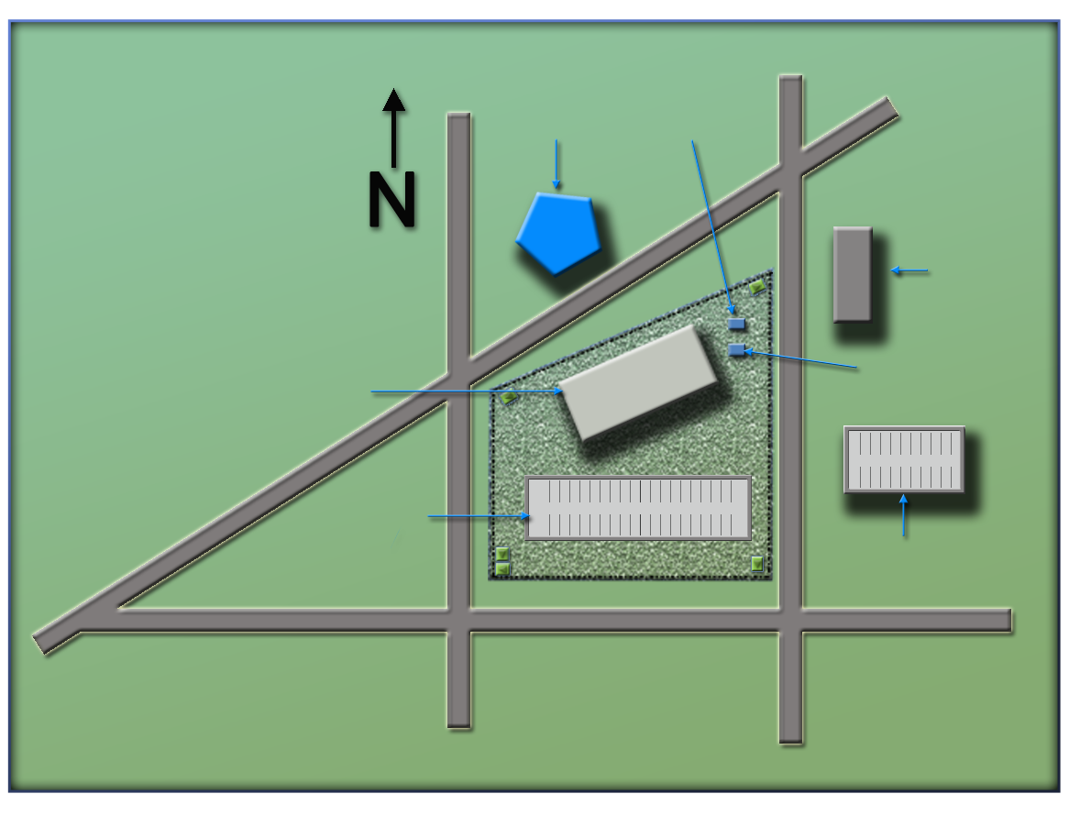
National Ministries
Building Complex Map
Refer To:
Workbook Part 4
(Ministry of Defense)
Ministry
of Defense
Security office
(Security office)
(Foreign embassy)
Foreign embassy
National Ministries
Building
Building generator
(National Ministries
Building)
National Avenue
(Building generator)
(National Avenue)
Parking lot
(Parking garage)
Parking garage
(Parking lot)
Judiciary Lane
(First Street)
(Judiciary Lane)
First Street
(Second Street)
Second Street
National Ministries
Building Complex Map
Refer To:
Workbook Part 4
(Ministry of Defense)
Ministry
of Defense
Security office
(Security office)
National Ministries
Building
(Foreign embassy)
Foreign embassy
(National Ministries
Building)
Building generator
National Avenue
Parking lot
(Building generator)
(National Avenue)
Parking garage
Judiciary Lane
(Parking lot)
(Parking garage)
(Judiciary Lane)
First Street
Second Street
(Second Street)
(First Street)

Slide 87

TeachBack Moment
How do policies and procedures help the effectiveness of response to a critical incident?
What elements should be included in a bomb threat management policy?
TeachBack Moment
How do policies and procedures help the effectiveness of response to a critical incident?
What elements should be included in a bomb threat management policy?

Slide 88
Module Summary
Policies and procedures relating to a physical protection system
Types of policies and procedures to protect critical infrastructure
Policies and procedures relating to critical incidents
Bomb threat management plan
Module Summary
Policies and procedures relating to a physical protection system
Types of policies and procedures to protect critical infrastructure
Policies and procedures relating to critical incidents
Bomb threat management plan

