Slide 1
Security Force Operations
Module 12

Slide 2
Module Objective
By the end of this module, you will be able to develop a security force response plan for the protection of critical infrastructure
Module Objective
By the end of this module, you will be able to develop a security force response plan for the protection of critical infrastructure

Slide 3
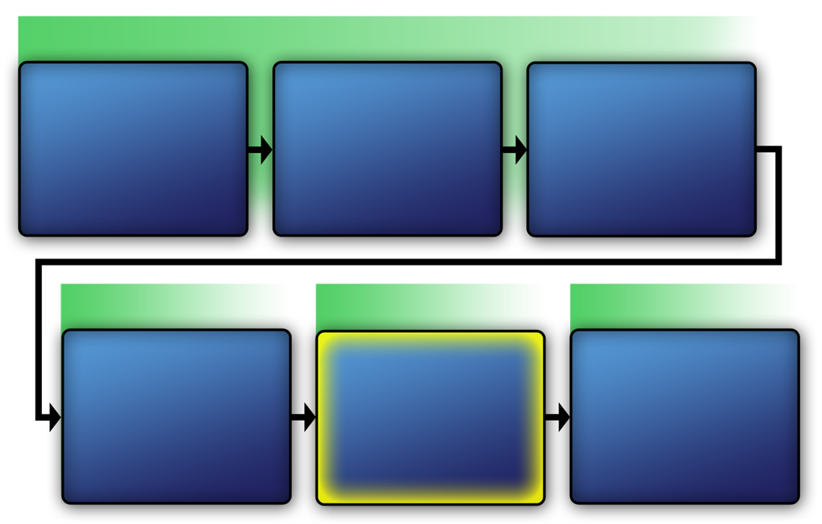
Physical Protection System
VAM Phase 1
Assess Critical Infrastructure Components
Module 5
Identify Critical Infrastructure Assets
Module 6
Identify Critical Infrastructure
Module 2
VAM Phase 2
VAM Phase 3
VAM Phase 4
Analyze the Threat
Modules 7-10
Identify
Security
Counter-
measures
Modules 11-14
Develop Operational Resilience
Module 15
Physical Protection System
VAM Phase 1
Identify Critical Infrastructure
Module 2
Assess Critical Infrastructure Components
Module 5
Identify Critical Infrastructure Assets
Module 6
VAM Phase 2
VAM Phase 2
VAM Phase 3
VAM Phase 4
Analyze the Threat
Modules 7-10
Identify
Security
Counter-
Measures
Modules 11-14
Develop Operational Resilience
Module 15

Slide 4
Physical Protection System —
Functional Relationships
Detection and assessment — a successful detection of an intruder would result in sending in a response force
Delay — once detected, the intruder must be delayed to allow time for the response force to arrive
Response — the response force will neutralize the intruder
Physical Protection System —
Functional Relationships
Detection and assessment — a successful detection of an intruder would result in sending in a response force
Delay — once detected, the intruder must be delayed to allow time for the response force to arrive
Response — the response force will neutralize the intruder

Slide 5

Intruder Action Timeline Activity
Refer To:
Workbook 12.1
Purpose: to organize intruder actions in the correct order
  Duration: 10 minutes (5-activity; 5-debrief)
  Group composition: individuals
  Debrief: large-group discussion
Intruder Action
Timeline Activity
Refer To:
Workbook 12.1
Purpose: to organize intruder actions in the correct order
  Duration: 10 minutes (5-activity; 5-debrief)
  Group composition: individuals
  Debrief: large-group discussion

Slide 6

Relationships between Functions (1 of 2)
Refer To:
Workbook 12.1
Begin
action
Task
complete
Intruder task time
Delay
PPS time required
First
alarm
Detect
Respond
Intruder
interrupted
Alarm assessed
Relationships between Functions (1 of 2)
Refer To:
Comparison:
Intruder timeline to PPS
Workbook 12.1
Begin
action
Intruder task time
Task
complete
First
alarm
Delay
PPS time required
Alarm assessed
Intruder
interrupted
Detect
Respond
Comparison: Intruder timeline to PPS

Slide 7
Relationships between Functions (2 of 2)
Refer To:
Workbook 12.1
Begin
action
Task
complete
Intruder task time
Delay
PPS Time Required
First
alarm
Alarm assessed
Intruder
interrupted
Detect
Respond
Relationships between Functions (2 of 2)
Refer To:
No interruption diagram
Workbook 12.1
Begin
action
Intruder task time
Task
complete
First
alarm
Delay
PPS time required
Alarm assessed
Intruder
interrupted
Detect
Respond
Relationships between Functions (2 of 2)
Refer to
Addendum 12.1
No interruption diagram

Slide 8
Detection and
Assessment Function (1 of 2)
Detection and assessment — the first function of the physical protection system
Detection without assessment is not detection
Detection and
Assessment Function (1 of 2)
Detection and assessment — the first function of the physical protection system
Detection without assessment is not detection

Slide 9
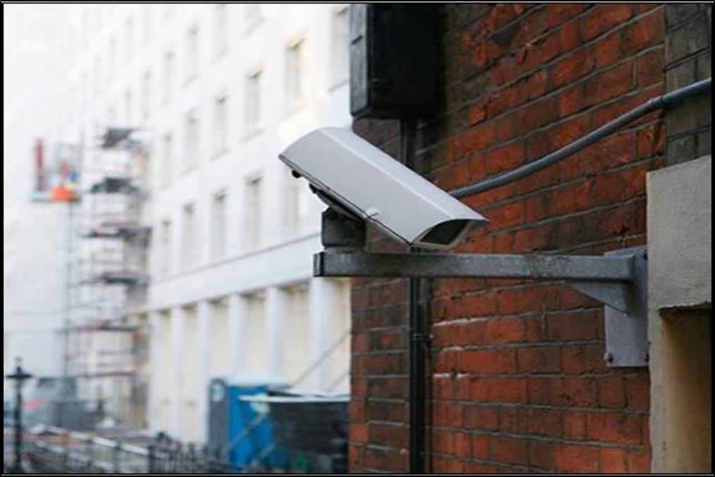
Detection and
Assessment Function (2 of 2)
This section will cover:
  Detection with electronic sensors
  Detection with entry control
  Detection with security force personnel
Detection and
Assessment Function (2 of 2)
This section will cover:
  Detection with electronic sensors
  Detection with entry control
  Detection with security force personnel
Source: Getty Images

Slide 10
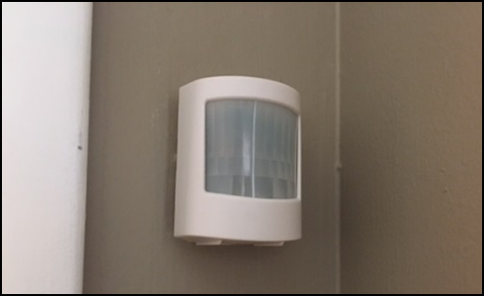
Detection with Electronic Sensors (1 of 2)
A sensor reacts to a stimulus and initiates an alarm
Sensor information is reported and displayed
A qualified person assesses information and judges the alarm to be either an attack, a nuisance alarm, or a false alarm
Detection with Electronic Sensors (1 of 2)
A sensor reacts to a stimulus and initiates an alarm
Sensor information is reported and displayed
A qualified person assesses information and judges the alarm to be either an attack, a nuisance alarm, or a false alarm
Source: Getty Images

Slide 11

Detection with Electronic Sensors (2 of 2)
Attack detection
Alarm signal initiated
Alarm reported
Alarm assessed
Sensor activated
Nuisance alarm–no detection
Detection with Electronic Sensors (2 of 2)
Attack detection
Sensor activated
Alarm signal initiated
Alarm reported
Alarm assessed
Nuisance alarm–no detection

Slide 12
Detection with Electronic
Sensors Example (1 of 2)
An intruder scales a fence that has a sensor attached
The sensor activation communicates electronically to the security control center
Detection with Electronic
Sensors Example (1 of 2)
An intruder scales a fence that has a sensor attached
The sensor activation communicates electronically to the security control center

Slide 13

Detection with Electronic
Sensors Example (2 of 2)
Closed-circuit television on the fence line transmits an image of the intruder to the security control center monitors
The security control center operator assesses the situation
The response is to send security force members to the area
Detection with Electronic
Sensors Example (2 of 2)
Closed-circuit television on the fence line transmits an image of the intruder to the security control center monitors
The security control center operator assesses the situation
The response is to send security force members to the area
Source: Getty Images

Slide 14

Detection with Entry Control (1 of 2)
Entry control:
  Allows authorized personnel and materials to enter the facility
  Detects and prevents attempted entry of unauthorized personnel and material
  Often conducted through use of technology
Detection with Entry Control (1 of 2)
Entry control:
  Allows authorized personnel and materials to enter the facility
  Detects and prevents attempted entry of unauthorized personnel and material
  Often conducted through use of technology
Source: Getty Images

Slide 15
Detection with Entry Control (2 of 2)
Effectiveness measured by:
  Throughput: number of authorized entries per time unit
  False acceptance rate: frequency of unauthorized persons allowed entry
  False rejection rate: frequency of authorized persons denied entry
Detection with Entry Control (2 of 2)
Effectiveness measured by:
  Throughput: number of authorized entries per time unit
  False acceptance rate: frequency of unauthorized persons allowed entry
  False rejection rate: frequency of authorized persons denied entry

Slide 16
Detection with Security Force
Personnel at fixed posts or on patrol may sense an intrusion
Using an effective assessment system, security personnel provide:
  Information about whether the alarm is valid
  Details about the cause of the alarm
Detection with Security Force
Personnel at fixed posts or on patrol may sense an intrusion
Using an effective assessment system, security personnel provide:
  Information about whether the alarm is valid
  Details about the cause of the alarm

Slide 17
Detection Function Effectiveness (1 of 2)
Three elements:
  Probability of sensing an alarm activation
  Time required for reporting and assessing an alarm
  Nuisance or false alarm rate
The shorter the time between sensor activation and alarm assessment the more the probability of detection increases
Detection Function Effectiveness (1 of 2)
Three elements:
  Probability of sensing an alarm activation
  Time required for reporting and assessing an alarm
  Nuisance or false alarm rate
The shorter the time between sensor activation and alarm assessment the more the probability of detection increases

Slide 18


Detection Function Effectiveness (2 of 2)
Detection Function Effectiveness (2 of 2)

Slide 19
Discussion Questions
What are some natural sources of nuisance alarms?
What are some industrial sources of nuisance alarms?
What are some sources for false alarms?
Discussion Questions
What are some natural sources of nuisance alarms?
What are some industrial sources of nuisance alarms?
What are some sources for false alarms?

Slide 20
Delay Function
Definition: the process of slowing down intruders’ progress by increasing the time it will take intruders to achieve their goal
Purpose: increase the time it takes intruders to achieve their goal
Delay Function
Definition: the process of slowing down intruders’ progress by increasing the time it will take intruders to achieve their goal
Purpose: increase the time it takes intruders to achieve their goal

Slide 21
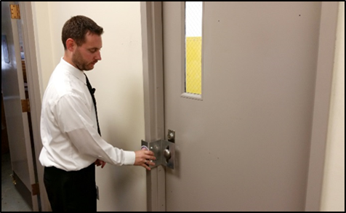
Delay Function Elements (1 of 2)
Barriers — walls, doors, and other solid structures between adversary and target
Locks — delay mechanisms within a barrier
Delay Function Elements ( 1 of 2)
Barriers — walls, doors, and other solid structures between adversary and target
Locks — delay mechanisms within a barrier
Source: US Air Force

Slide 22
Delay Function Elements (2 of 2)
Activated delays — introduction of chemical elements as a delay (pepper spray, gas, or smoke)
Personnel — security force members in fixed and well-protected positions
Delay Function Elements ( 2 of 2)
Activated delays — introduction of chemical elements as a delay (pepper spray, gas, or smoke)
Personnel — security force members in fixed and well-protected positions

Slide 23
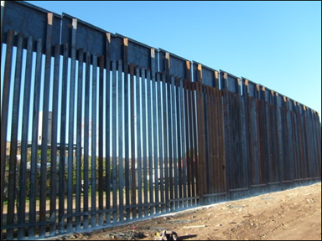
Delay Prior to Detection
Deterrent — barriers placed before detection
Forces intruders to consider another method
No value to the effectiveness of the physical protection system
Delay Prior to Detection
Deterrent — barriers placed before detection
Forces intruders to consider another method
No value to the effectiveness of the physical protection system
Source: DHS

Slide 24
Delay Function with
Physical Protection System
Barriers
Delay — provide obstacles to
increase intruder task time
Locks
Activated delays
Security force
Delay Function with
Physical Protection System
Delay — provide obstacles to
increase intruder task time
Barriers
Locks
Activated delays
Security force

Slide 25
Delay Function Example (1 of 2)
Refer To:
Workbook 12.1
An intruder scales a 2.5-meter fence and runs to the door of a critical infrastructure facility (2 minutes)
Once at the door, the intruder breaks into the facility and goes down a hallway to an asset storage area (2 minutes)
Delay Function
Example (1 of 2)
Refer To:
Workbook 12.1
An intruder scales a 2.5-meter fence and runs to the door of a critical infrastructure facility (2 minutes)
Once at the door, the intruder breaks into the facility and goes down a hallway to an asset storage area (2 minutes)

Slide 26
Delay Function Example (2 of 2)
Refer To:
Workbook 12.1
The intruder breaks into the asset storage area and steals critical information from the room (1.5 minutes)
The intruder proceeds out of the facility using the same entrance path (4 minutes)
Total time for intruder to complete task was 9.5 minutes
Delay Function
Example (2 of 2)
Refer To:
Workbook 12.1
The intruder breaks into the asset storage area and steals critical information from the room (1.5 minutes)
The intruder proceeds out of the facility using the same entrance path (4 minutes)
Total time for intruder to complete task was 9.5 minutes

Slide 27
Discussion Questions
What would happen if the intrusion sensor did not activate until the intruder reached the exterior door of the facility?
As Chief of Security, what actions could you implement to lengthen the delay time to allow your security force more time to respond?
Discussion Questions
What would happen if the intrusion sensor did not activate until the intruder reached the exterior door of the facility?
As Chief of Security, what actions could you implement to lengthen the delay time to allow your security force more time to respond?

Slide 28
Response Function Section
This section will cover:
  Definition and success
  Responding personnel
  Contingency planning
  Communication
  Interruption
  Neutralization
Response Function Section
This section will cover:
  Definition and success
  Responding personnel
  Contingency planning
  Communication
  Interruption
  Neutralization

Slide 29
Response Function Definition
The actions taken by the security force to prevent intruder success
Response Function Definition
The actions taken by the security force to prevent intruder success

Slide 30
Response Function Success
Established components:
  Prearranged tactical plans
  Communication devices
  Realistic training
Communication of accurate information and deployment of security force
Response Function Success
Established components:
  Prearranged tactical plans
  Communication devices
  Realistic training
Communication of accurate information and deployment of security force

Slide 31
Responding Personnel
Depending on magnitude of attack, other responding personnel may include:
  Contract security force members
  Local and regional law enforcement, fire protection, and medical responders
  Government agencies, in some cases
Responding Personnel
Depending on magnitude of attack, other responding personnel may include:
  Contract security force members
  Local and regional law enforcement, fire protection, and medical responders
  Government agencies, in some cases

Slide 32
Contingency Planning Definition
A method to develop well-documented procedures for:
  Identifying potential targets
  Responding to potential threats
  Interacting with external agencies
  Determining level of use-of-force for various situations
Contingency Planning Definition
A method to develop well-documented procedures for:
  Identifying potential targets
  Responding to potential threats
  Interacting with external agencies
  Determining level of use-of-force for various situations

Slide 33
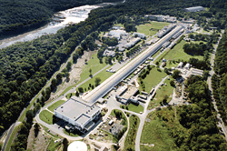
Contingency Planning Purpose
Provides procedures for responding personnel to evaluate the situation
Allows:
  Identification and evaluation of potential threats and intruder routes
  Creation of tactical plans for response
  Planning for training exercises
Contingency Planning Purpose
Provides procedures for responding personnel to evaluate the situation
Allows:
  Identification and evaluation of potential threats and intruder routes
  Creation of tactical plans for response
  Planning for training exercises
Source: US NAVY

Slide 34

Communication (1 of 3)
Critical component of response function
Information must be transferred with speed and accuracy
Messages to security force must include:
  Information on intruder actions
  Instructions for deployment
Communication (1 of 3)
Critical component of response function
Information must be transferred with speed and accuracy
Messages to security force must include:
  Information on intruder actions
  Instructions for deployment
Source: Getty Images

Slide 35
Communication (2 of 3)
Effectiveness is measured on time and accuracy
Time varies based on method of communication
Probability of correct and current data being transmitted increases after the initial response
Communication (2 of 3)
Effectiveness is measured on time and accuracy
Time varies based on method of communication
Probability of correct and current data being transmitted increases after the initial response

Slide 36
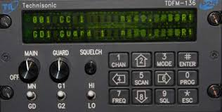
Communication (3 of 3)
Most commonly used method is a two-way or frequency modulation clear-voice radio
Two-way radios can be heard or jammed by intruders
To guard against intruder communication attacks, plan for the use of alternative communication methods or technologies
Communication (3 of 3)
Most commonly used method is a two-way or frequency modulation clear-voice radio
Two-way radios can be heard or jammed by intruders
To guard against intruder communication attacks, plan for the use of alternative communication methods or technologies
Source: Civil Air Patrol

Slide 37
Interruption Response
Interruption: the successful arrival of the security force at an appropriate location and in sufficient numbers to confront intruder(s)
Using protected paths increases chances of successful interruption
Interruption Response
Interruption: the successful arrival of the security force at an appropriate location and in sufficient numbers to confront intruder(s)
Using protected paths increases chances of successful interruption

Slide 38
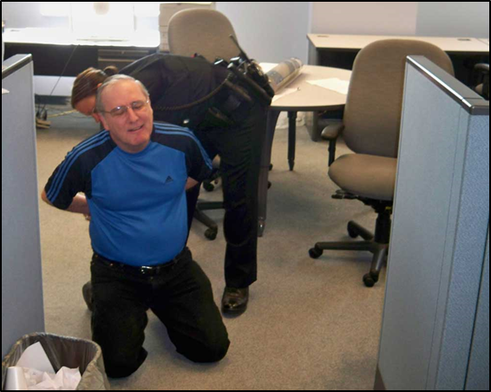
Neutralization Response
Neutralization: the point at which intruders’ actions are stopped and intruders are no longer able to fight against the security force
Force-on-force training beneficial but not typically necessary at industrial facilities
Neutralization Response
Neutralization: the point at which intruders’ actions are stopped and intruders are no longer able to fight against the security force
Force-on-force training beneficial but not typically necessary at industrial facilities
Source: US ARMY

Slide 39
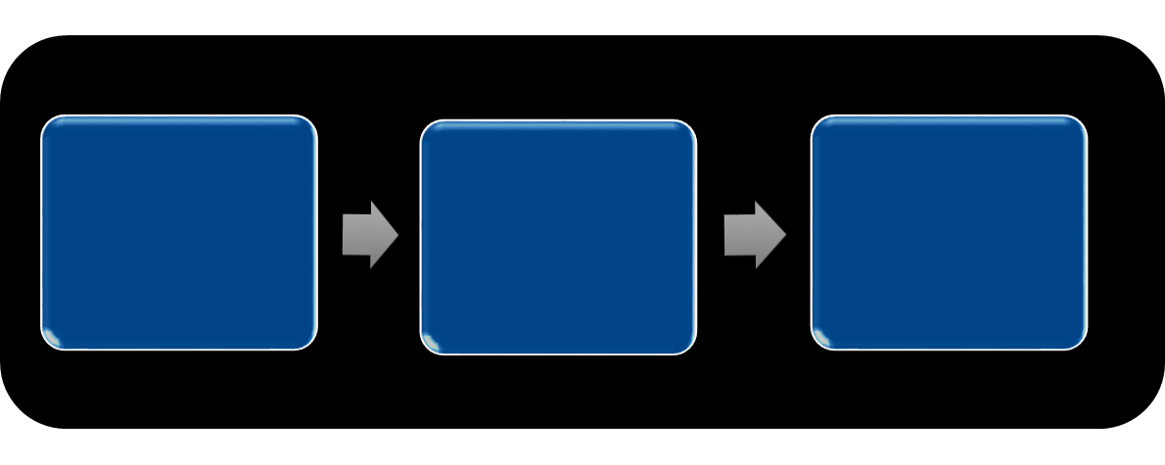
Response Function of the
Physical Protection System
Communicate information to security force
Deploy security force
Interrupt and neutralize intruder attempt
Response Function of the
Physical Protection System
Communicate information to security force
Deploy security force
Interrupt and neutralize intruder attempt

Slide 40
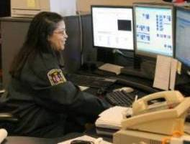
Response Function Example (1 of 2)
The security control center operator receives notice of an alarm activation and transmits the location over the radio to a responding security force member
Response Function Example (1 of 2)
The security control center operator receives notice of an alarm activation and transmits the location over the radio to a responding security force member
Source: FairfaxVA.GOV

Slide 41

Response Function Example (2 of 2)
The member responds to the designated area and stands by in a defensive posture to wait for the intruder
The intruder arrives and is interrupted and neutralized by the security force member
Response Function Example (2 of 2)
The member responds to the designated area and stands by in a defensive posture to wait for the intruder
The intruder arrives and is interrupted and neutralized by the security force member
Source: PasedenaCA.GOV

Slide 42
Discussion Question
Based on this response example, what type of events could have caused this scenario to be less than a desired outcome?
Discussion Question
Based on this response example, what type of events could have caused this scenario to be less than a desired outcome?

Slide 43

TeachBack Moment
What are the functional relationships between detection and assessment, delay, and response?
How do the terms interruption and neutralization apply to security force effect?
TeachBack Moment
What are the functional relationships between detection and assessment, delay, and response?
How do the terms interruption and neutralization apply to security force effect?

Slide 44
Primary Elements of
Security Force Effectiveness
This section will cover:
  Selection of security force members
  Initial and continuous training
  Deployment of equipment
  Appropriate supervision
Primary Elements of
Security Force Effectiveness
This section will cover:
  Selection of security force members
  Initial and continuous training
  Deployment of equipment
  Appropriate supervision

Slide 45
Selection of Security Force Members —
Pre-Employment
Background checks
Medical exams
Candidate testing and oral interview
Selection of Security Force Members —
Pre-Employment
Background checks
Medical exams
Candidate testing and oral interview

Slide 46

Selection of Security Force
Members — Desirable Qualities
Refer To:
Workbook 12.2
Integrity and honesty
Alertness
Judgment
Confidence
Physical fitness
Tactfulness
Self-control
Source: US AIR FORCE
Selection of Security Force
Members — Desirable Qualities
Refer To:
Workbook 12.2
Integrity and honesty
Alertness
Judgment
Confidence
Physical fitness
Tactfulness
Self-control

Slide 47
Selection of Security Force Members —
Important Considerations
Mental attitude and quality of job performance are critical
Assign only the most reliable, responsible, and trustworthy members to the assignments requiring access to sensitive information
Conduct follow-up investigations to ensure behavior is above reproach
Selection of Security Force Members —
Important Considerations
Mental attitude and quality of job performance are critical
Assign only the most reliable, responsible, and trustworthy members to the assignments requiring access to sensitive information
Conduct follow-up investigations to ensure behavior is above reproach

Slide 48
Discussion Questions (1 of 2)
What provisions do you have in place to ensure that your critical infrastructure security force or security force remains in good physical condition?
What are the advantages of periodic physical-conditioning assessments and the benefits of a strong, healthy security force? Are there any disadvantages?
Discussion Questions (1 of 2)
What provisions do you have in place to ensure that your critical infrastructure security force or security force remains in good physical condition?
What are the advantages of periodic physical-conditioning assessments and the benefits of a strong, healthy security force? Are there any disadvantages?

Slide 49
Discussion Questions (2 of 2)
What background checks are performed on your security force personnel?
Is it a requirement to conduct periodic background updates, especially for personnel securing critical areas? Why or why not?
Discussion Questions (2 of 2)
What background checks are performed on your security force personnel?
Is it a requirement to conduct periodic background updates, especially for personnel securing critical areas? Why or why not?

Slide 50
Initial and Continuous Training
Entry-level skills training — various skills
Assignment of coach — ensures recruits gain insight from veteran members
Annual update training — legal updates, new policies, and procedures
Specialized training — dependent upon security force placement
Initial and Continuous Training
Entry-level skills training — various skills
Assignment of coach — ensures recruits gain insight from veteran members
Annual update training — legal updates, new policies, and procedures
Specialized training — dependent upon security force placement

Slide 51
Deployment of Equipment
Equipment requirements must address security force needs
Inadequate equipment can be detrimental to protecting critical infrastructure
Deployment of Equipment
Equipment requirements must address security force needs
Inadequate equipment can be detrimental to protecting critical infrastructure

Slide 52
Appropriate Supervision
Competent in security force job skills
Experienced in the field
Sufficient number of supervisors
Supervisor development and training
Appropriate Supervision
Competent in security force job skills
Experienced in the field
Sufficient number of supervisors
Supervisor development and training

Slide 53
Inappropriate Supervision
Common causes:
  Lack of qualified, trained, experienced personnel
  Poor documentation
Common deficiencies:
  Overworked or inattentive supervisors
  Lack of coordination with others
  Failure to develop emergency tactical skills
Inappropriate Supervision
Common causes:
  Lack of qualified, trained, experienced personnel
  Poor documentation
Common deficiencies:
  Overworked or inattentive supervisors
  Lack of coordination with others
  Failure to develop emergency tactical skills

Slide 54
Discussion Questions
In addition to the supervision issues identified, are there any others that you may have experienced?
What tactics could you use to counter these deficiencies or prevent them in the first place?
Discussion Questions
In addition to the supervision issues identified, are there any others that you may have experienced?
What tactics could you use to counter these deficiencies or prevent them in the first place?

Slide 55
Develop a Security Force Response Plan
Purpose: to define the processes necessary to enable the security force to successfully accomplish its mission
Content is primarily for emergency response procedures
Plan should be clear, concise, and current
Develop a Security Force Response Plan
Purpose: to define the processes necessary to enable the security force to successfully accomplish its mission
Content is primarily for emergency response procedures
Plan should be clear, concise, and current

Slide 56
Security Force
Response Plan Format
Refer To:
Workbook 12.3
Title
References
Definitions and abbreviations
Purpose
Guidance
Reporting requirements
Security Force
Response Plan Format
Refer To:
Workbook 12.3
Title
References
Definitions and abbreviations
Purpose
Guidance
Reporting requirements

Slide 57

TeachBack Moment
What are the primary elements that contribute to the effectiveness of a security force?
What are the components that should be included in a security force response plan?
TeachBack Moment
What are the primary elements that contribute to the effectiveness of a security force?
What are the components that should be included in a security force response plan?

Slide 58

Threaded Exercise Part 5 — National Ministries Building
Refer To:
Workbook Part 5
Purpose: to develop a security force response plan
  Duration: 60 minutes (30-exercise; 20-presentations; 10-debrief)
  Group composition: table groups
  Debrief: team presentations; facilitator feedback
Threaded Exercise Part 5 — National Ministries Building
Refer To:
Workbook Part 5
Purpose: to develop a security force response plan
  Duration: 60 minutes (30-exercise; 20-presentations; 10-debrief)
  Group composition: table groups
  Debrief: team presentations; facilitator feedback

Slide 59
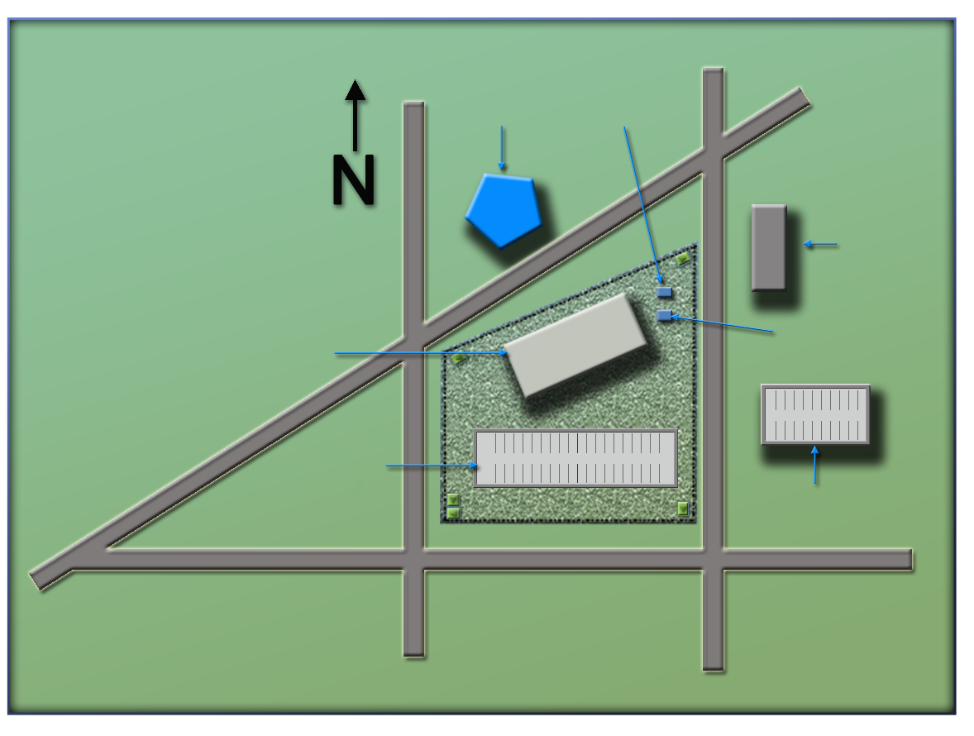
National Ministries
Building Complex Map
Refer To:
Workbook Part 4
(Ministry of Defense)
Ministry
of Defense
Security office
(Security office)
(Foreign embassy)
Foreign embassy
National Ministries
Building
Building generator
(National Ministries
Building)
National Avenue
(Building generator)
(National Avenue)
Parking lot
(Parking garage)
Parking garage
(Parking lot)
Judiciary Lane
(Judiciary Lane)
(First Street)
(Second Street)
First Street
Second Street
National Ministries
Building Complex Map
Refer To:
Workbook Part 4
(Ministry of Defense)
Ministry
of Defense
Security office
(Security office)
National Ministries
Building
(Foreign embassy)
Foreign embassy
(National Ministries
Building)
Building generator
National Avenue
Parking lot
(Building generator)
(National Avenue)
Parking garage
Judiciary Lane
(Parking lot)
(Parking garage)
(Judiciary Lane)
First Street
Second Street
(Second Street)
(First Street)

Slide 60
Module Summary
Relationships between functions
Primary elements of security force effectiveness
Develop a security force response plan
Module Summary
Relationships between functions
Primary elements of security force effectiveness
Develop a security force response plan

