Slide 1
Security Technology
Module 13

Slide 2
Module Objective
By the end of this module, you will be able to develop a security technology plan for the protection of critical infrastructure
Module Objective
By the end of this module, you will be able to develop a security technology plan for the protection of critical infrastructure

Slide 3
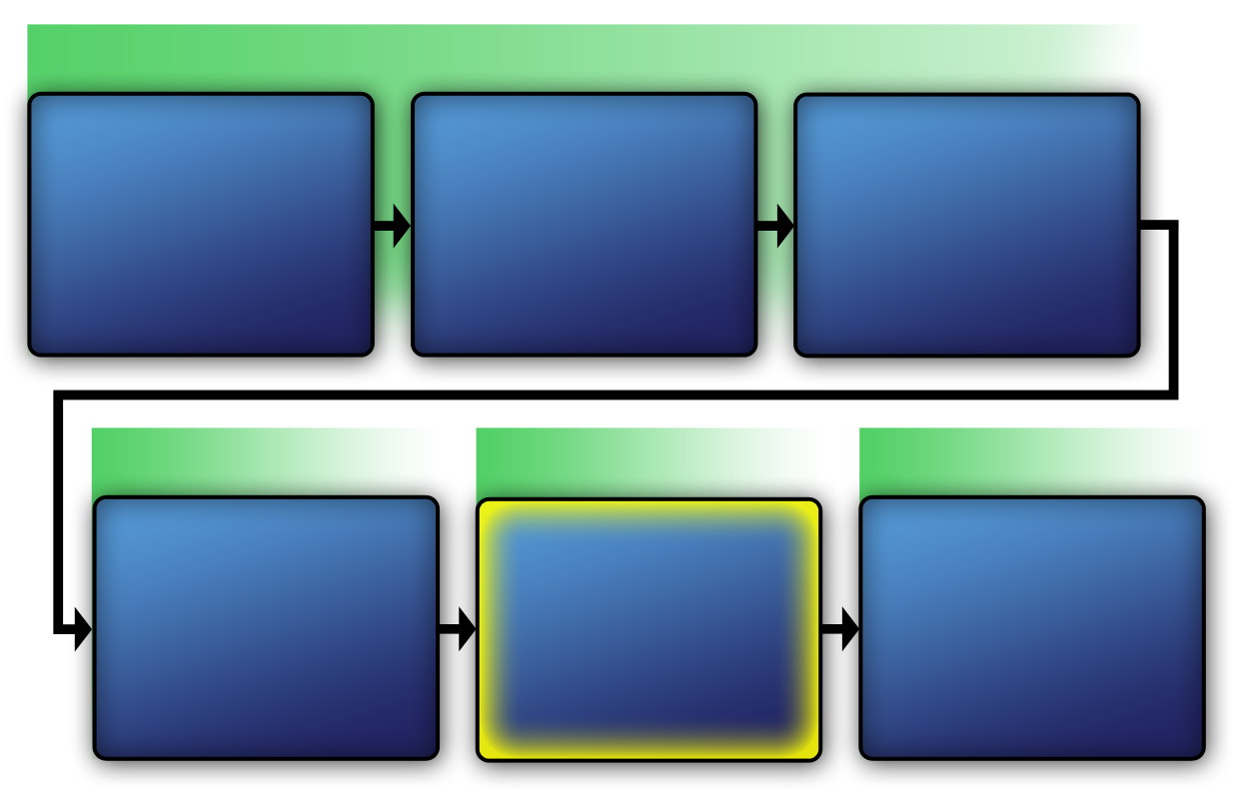
Physical Protection System
VAM Phase 1
Identify Critical Infrastructure
Module 2
Assess Critical Infrastructure Components
Module 5
Identify Critical Infrastructure Assets
Module 6
VAM Phase 2
VAM Phase 3
VAM Phase 4
Analyze the Threat
Modules 7–10
Identify Security Counter-measures Modules 11–14
Develop
Operational Resilience
Module 15
Physical Protection System
VAM Phase 1
Identify Critical Infrastructure
Module 2
Assess Critical Infrastructure Components
Module 5
Identify Critical Infrastructure Assets
Module 6
VAM Phase 2
VAM Phase 2
VAM Phase 3
VAM Phase 4
Analyze the Threat
Modules 7-10
Identify
Security
Counter-
Measures
Modules 11-14
Develop Operational Resilience
Module 15

Slide 4

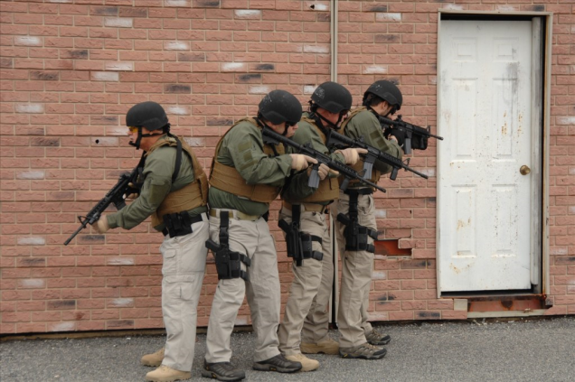
Characteristics of a
Physical Protection System
Refer To:
Workbook 13.1
Protection-in-depth
Minimum consequences of component failure
Balanced protection
Characteristics of a
Physical Protection System
Refer To:
Workbook 13.1
Protection-in-depth
Minimum consequences of component failure
Balanced protection
Source: DS/T/ATA

Slide 5
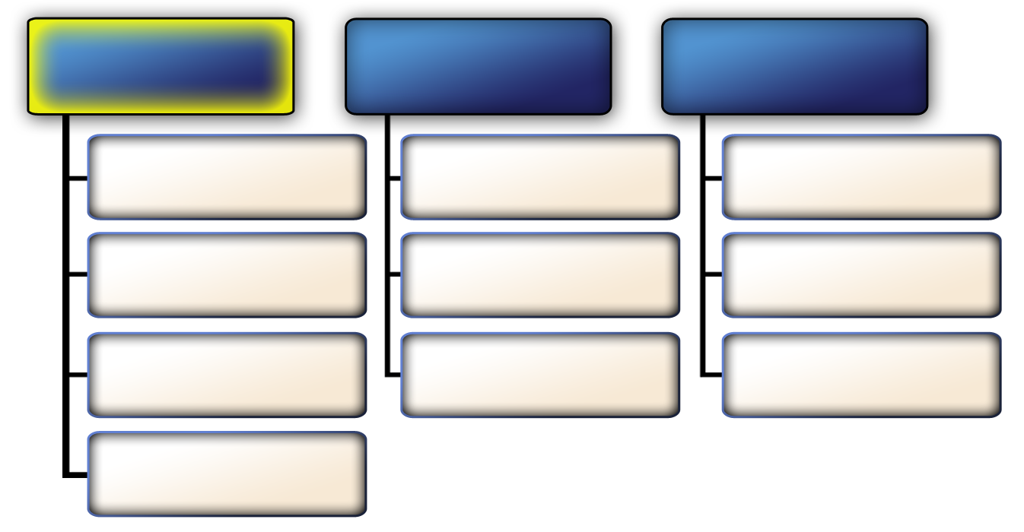
Primary Physical Protection System Functions — Detection and Assessment
Detection and assessment
Delay
Response
Intrusion Sensing
Passive Barriers
Communicate to
Security Force
Alarm Communication and Display
Deployable Barriers
Deploy Security Force
Alarm Assessment
Personnel or Security Force
Interrupt Adversary Attempt
Entry Control System
Primary Physical Protection System Functions — Detection and Assessment
Detection and assessment
Delay
Response
Intrusion Sensing
Passive Barriers
Communicate to
Security Force
Alarm Communication and Display
Deployable Barriers
Deploy Security Force
Alarm Assessment
Personnel or Security Force
Interrupt Adversary Attempt
Entry Control System

Slide 6
Intrusion Detection Systems (1 of 2)
Designed to detect unauthorized persons or vehicles attempting to gain access to a protected critical asset
Intended to supplement security forces, not replace them
Intrusion Detection Systems (1 of 2)
Designed to detect unauthorized persons or vehicles attempting to gain access to a protected critical asset
Intended to supplement security forces, not replace them

Slide 7
Intrusion Detection Systems (2 of 2)
Consist of the following components working together:
  Exterior and interior intrusion sensors
  Video alarm assessment
  Entry control and alarm communication
Intrusion Detection Systems (2 of 2)
Consist of the following components working together:
  Exterior and interior intrusion sensors
  Video alarm assessment
  Entry control and alarm communication
Source: FEMA

Slide 8
Performance Characteristics
This section will cover:
  Probability of detection
  Vulnerabilities to defeat
Performance Characteristics
This section will cover:
  Probability of detection
  Vulnerabilities to defeat

Slide 9
Probability of Detection (1 of 2)
The likelihood that an intrusion detection system senses an actual threat or attack
The design of the physical protection system should specify the detection criteria required or expected of a sensor or sensor system
Probability of Detection (1 of 2)
The likelihood that an intrusion detection system senses an actual threat or attack
The design of the physical protection system should specify the detection criteria required or expected of a sensor or sensor system

Slide 10
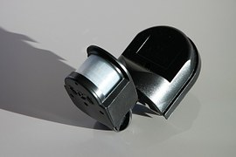
Probability of Detection (2 of 2)
Factors that may influence the probability of detection for a specific sensor:
  Target to be detected
  Sensor hardware design
  Installation conditions
  Sensitivity adjustment
  Weather conditions
  Condition of the equipment
Probability of Detection (2 of 2)
Factors that may influence the probability of detection for a specific sensor:
  Target to be detected
  Sensor hardware design
  Installation conditions
  Sensitivity adjustment
  Weather conditions
  Condition of the equipment
Source: Pixabay

Slide 11
Vulnerabilities to Defeat
Bypassing — going around a sensor’s detection zone
Spoofing — passing through a sensor’s normal detection zone without triggering the alarm
Vulnerabilities to Defeat
Bypassing — going around a sensor’s detection zone
Spoofing — passing through a sensor’s normal detection zone without triggering the alarm

Slide 12
Discussion Question
Drawing from your own experiences, what are some examples of bypassing and spoofing?
Discussion Question
Drawing from your own experiences, what are some examples of bypassing and spoofing?

Slide 13

Intrusion Sensor Application
Refer To:
Workbook 13.2
Must determine how sensors should be used in the protected area
Application modes are different for exterior sensors and interior sensors
Classified as:
  Passive or active
  Covert or visible
Intrusion Sensor Application
Refer To:
Workbook 13.2
Must determine how sensors should be used in the protected area
Application modes are different for exterior sensors and interior sensors
Classified as:
  Passive or active
  Covert or visible

Slide 14
Discussion Questions (1 of 2)
Refer To:
Workbook 13.2
How can pressure or seismic sensors be defeated?
How can magnetic field sensors be defeated?
How can ported coaxial cable sensors be defeated?
How can fiber-optic cable sensors be defeated?
Discussion
Questions (1 of 2)
Refer To:
Workbook 13.2
How can pressure or seismic sensors be defeated?
How can magnetic field sensors be defeated?
How can ported coaxial cable sensors be defeated?
How can fiber-optic cable sensors be defeated?

Slide 15
Discussion Questions (2 of 2)
Refer To:
Workbook 13.2
How can fence-disturbance sensors be defeated?
How can sensor fences be defeated?
How can a sensor fence be designed to deter tunneling (digging under)?
Discussion
Questions (2 of 2)
Refer To:
Workbook 13.2
How can fence-disturbance sensors be defeated?
How can sensor fences be defeated?
How can a sensor fence be designed to deter tunneling (digging under)?

Slide 16
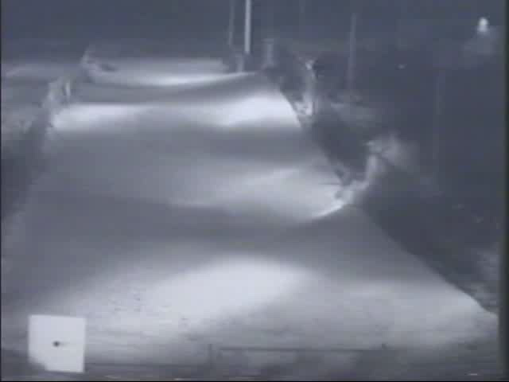
Application Modes for Exterior Sensors
Refer To:
Workbook 13.2
Application Modes
for Exterior Sensors
Refer To:
Workbook 13.2

Slide 17
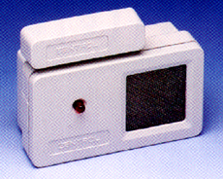
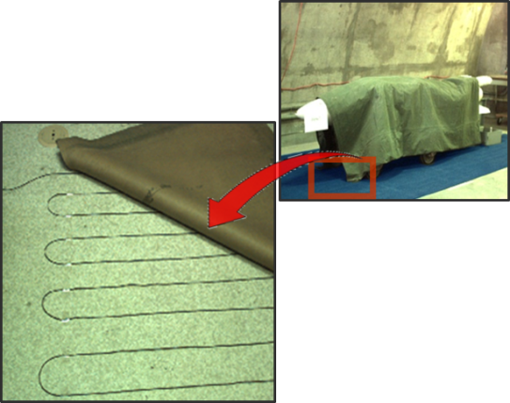
Application Modes for Interior Sensors
Refer To:
Workbook 13.2
Boundary-penetration sensors
Interior motion sensors
Proximity sensors
Source: DS/T/ATA
Application Modes
for Interior Sensors
Refer To:
Source: DS/T/ATA
Workbook 13.2
Boundary-penetration sensors
Interior motion sensors
Proximity sensors

Slide 18
Discussion Questions (1 of 2)
Refer To:
Workbook 13.2
How can vibration sensors be defeated?
How can electromechanical sensors be defeated?
How can interior active infrared sensors be defeated?
Discussion
Questions (1 of 2)
Refer To:
Workbook 13.2
How can vibration sensors be defeated?
How can electromechanical sensors be defeated?
How can interior active infrared sensors be defeated?

Slide 19
Discussion Questions (2 of 2)
Refer To:
Workbook 13.2
How can monostatic microwave sensors be defeated?
How can video motion detector sensors be defeated?
How can you defeat pressure sensors?
Discussion
Questions (2 of 2)
Refer To:
Workbook 13.2
How can monostatic microwave sensors be defeated?
How can video motion detector sensors be defeated?
How can you defeat pressure sensors?

Slide 20
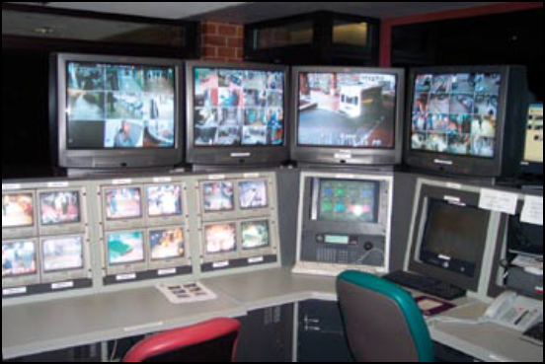
Alarm Communication and Display Systems (1 of 2)
Provide security personnel with rapid response capability
Perform two critical tasks:
  Transport alarm and assessment information to a central point
  Provide information to the security control center operator
Alarm Communication
and Display Systems (1 of 2)
Provide security personnel with rapid response capability
Perform two critical tasks:
  Transport alarm and assessment information to a central point
  Provide information to the security control center operator
Source: FEMA

Slide 21
Alarm Communication and Display Systems (2 of 2)
Five subsystems:
  Communications
  Line supervisions and security
  Information handling
  Control display and alarm assessment
  Off-line functions
Subsystems enable operators to respond appropriately
EMERGENCY PHONE
Alarm Communication
and Display Systems (2 of 2)
Five subsystems:
  Communications
  Line supervisions and security
  Information handling
  Control display and alarm assessment
  Off-line functions
Subsystems enable operators to respond appropriately
Source: FEMA
EMERGENCY PHONE

Slide 22
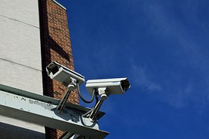

Alarm Communication and
Display System Characteristics
Fast reporting time
Secure from attack
Durable
Backup capable
User friendly
Source: Pixabay
Alarm Communication and
Display System Characteristics
Source: Pixabay
Fast reporting time
Secure from attack
Durable
Backup capable
User friendly

Slide 23
Alarm Assessment
Purpose:
  Determines the cause of an alarm
  Provides additional information for security force
Provided through:
  Closed-circuit television coverage of each zone
  Visual checks by personnel
Closed-circuit television may provide assessment and surveillance
Alarm Assessment
Purpose:
  Determines the cause of an alarm
  Provides additional information for security force
Provided through:
  Closed-circuit television coverage of each zone
  Visual checks by personnel
Closed-circuit television may provide assessment and surveillance

Slide 24
Discussion Question
When would security force members need to perform an alarm assessment?
Discussion Question
When would security force members need to perform an alarm assessment?

Slide 25
Alarm Assessment Components (1 of 3)
Camera, lens, and mount
Lighting system
Transmission system
Video switching equipment
Recorder, monitor, and controller
Alarm Assessment Components (1 of 3)
Camera, lens, and mount
Lighting system
Transmission system
Video switching equipment
Recorder, monitor, and controller

Slide 26

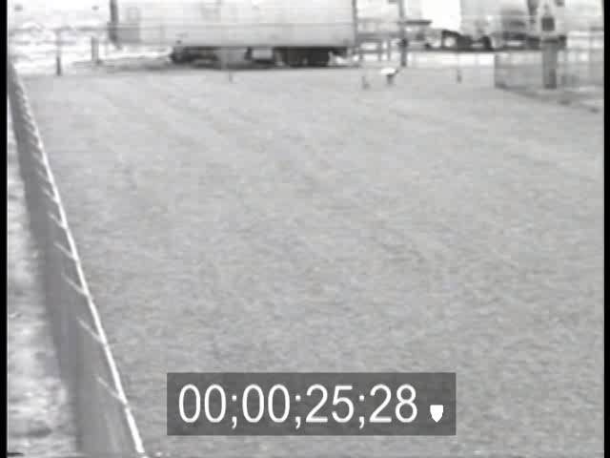
Alarm Assessment
Components (2 of 3)
Alarm Assessment
Components (2 of 3)

Slide 27
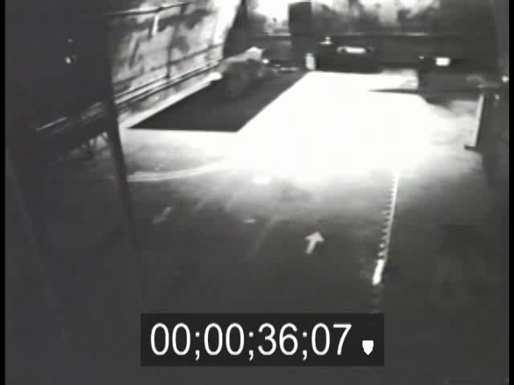
Alarm Assessment
Components (3 of 3)
Alarm Assessment
Components (3 of 3)

Slide 28
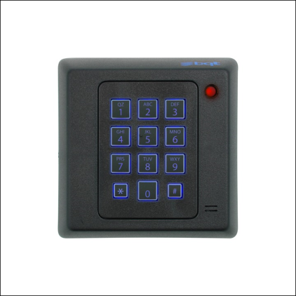
Entry Control Systems (1 of 2)
Purposes:
  Permit entry and exit to authorized personnel only
  Detect and prevent entry or exit of contraband material
  Provide information to the security force
Located at a facility’s perimeter or interior
Entry Control Systems (1 of 2)
Purposes:
  Permit entry and exit to authorized personnel only
  Detect and prevent entry or exit of contraband material
  Provide information to the security force
Located at a facility’s perimeter or interior
Source: Pixabay

Slide 29
Entry Control Systems (2 of 2)
Performance is measured according to:
  Flow rate — the measure of the time it takes for an authorized person or material to successfully pass an entry or exit point
  Error rate — the percentage that a specific entry control technique or process falsely rejects an authorized person or falsely accepts an unauthorized person
Entry Control Systems (2 of 2)
Performance is measured according to:
  Flow rate — the measure of the time it takes for an authorized person or material to successfully pass an entry or exit point
  Error rate — the percentage that a specific entry control technique or process falsely rejects an authorized person or falsely accepts an unauthorized person

Slide 30
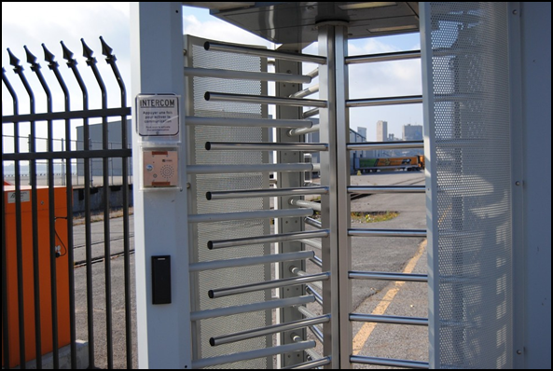
Entry Control Systems Features (1 of 2)
Prevents bypass
Allows observation by security force members
Protects the security force member
Performs access and material control
Blocks passage until access and material control are complete
Entry Control Systems Features (1 of 2)
Prevents bypass
Allows observation by security force members
Protects the security force member
Performs access and material control
Blocks passage until access and material control are complete
Source: Pixabay

Slide 31

Entry Control Systems Features (2 of 2)
Provides secondary inspection for those who cannot pass automated inspection
Accommodates maximum flow of vehicles and people
Provides central alarm station surveillance
Allows facility entry and exit
Entry Control Systems Features (2 of 2)
Provides secondary inspection for those who cannot pass automated inspection
Accommodates maximum flow of vehicles and people
Provides central alarm station surveillance
Allows facility entry and exit
Source: Public Domain Pictures

Slide 32
Entry Control Systems Categories
This section will cover:
  Personnel entry control systems
  Contraband detection systems
  Locks
Entry Control Systems Categories
This section will cover:
  Personnel entry control systems
  Contraband detection systems
  Locks

Slide 33
Personnel Entry Control Systems (1 of 2)
Verify the authorization of individuals seeking entry to a controlled area based upon whether the person seeking entry:
  Knows a valid personal identification number
  Carries valid credentials
  Possesses physical characteristics that match database information
Combinations of systems fortify protection
Personnel Entry Control Systems (1 of 2)
Verify the authorization of individuals seeking entry to a controlled area based upon whether the person seeking entry:
  Knows a valid personal identification number
  Carries valid credentials
  Possesses physical characteristics that match database information
Combinations of systems fortify protection

Slide 34


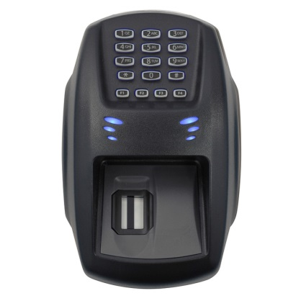
Personnel Entry Control Systems (2 of 2)
Source: Pixabay
Source: Bing
Source: Pixabay
Personnel Entry Control Systems (2 of 2)

Slide 35

Contraband Detection
Examining personnel, materials, and vehicles to detect unauthorized items
  Metal detectors
  Package searches
  Explosive detectors
Contraband Detection
Examining personnel, materials, and vehicles to detect unauthorized items
  Metal detectors
  Package searches
  Explosive detectors
Source: US TSA

Slide 36
Locks
Used with other protection measures, such as security force checks and sensors
Two major components:
  Fastening device —secures the door in the closed or locked position
  Coded mechanism — allows the movement of the bolt or latch to the unlocked position
Locks
Used with other protection measures, such as security force checks and sensors
Two major components:
  Fastening device —secures the door in the closed or locked position
  Coded mechanism — allows the movement of the bolt or latch to the unlocked position

Slide 37

TeachBack Moment
What are the three characteristics of an effective physical protection system as they apply to technology?
What are the performance characteristics of intrusion sensor systems?
TeachBack Moment
What are the three characteristics of an effective physical protection system as they apply to technology?
What are the performance characteristics of intrusion sensor systems?

Slide 38
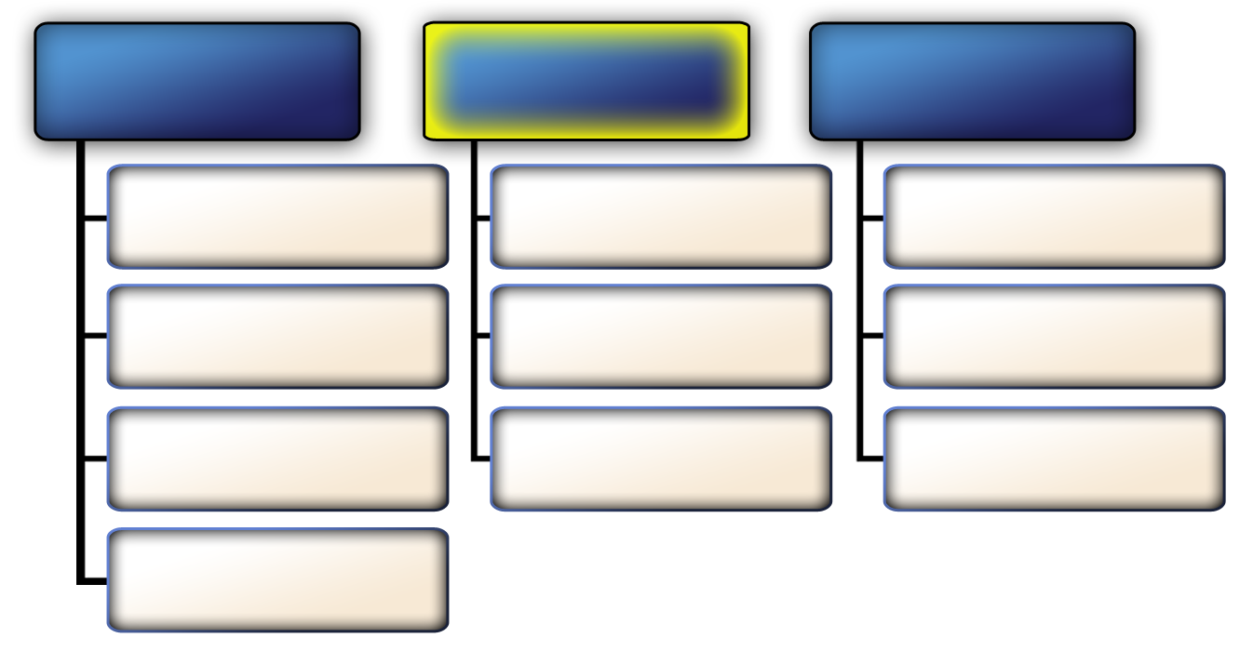
Primary Physical Protection
System Functions — Delay (1 of 3)
Detection and Assessment
Delay
Response
Intrusion Sensing
Passive Barriers
Communicate to Security Force
Alarm Communication and Display
Deployable Barriers
Deploy Security Force
Alarm Assessment
Personnel or
Security Force
Interrupt Adversary Attempt
Entry Control System
Primary Physical Protection
System Functions — Delay (1 of 3)
Detection and assessment
Delay
Response
Intrusion Sensing
Passive Barriers
Communicate to
Security Force
Alarm Communication and Display
Deployable Barriers
Deploy Security Force
Alarm Assessment
Personnel or Security Force
Interrupt Adversary Attempt
Entry Control System

Slide 39
Primary Physical Protection
System Functions — Delay (2 of 3)
Purpose: increase the time it takes for a terrorist to carry out an attack by placing obstacles along the intended path to the target
Performance measure: time
  Critical element of system effectiveness
  Depends on barrier and penetration time
  Detection systems and barriers should be adjacent
Primary Physical Protection
System Functions — Delay (2 of 3)
Purpose: increase the time it takes for a terrorist to carry out an attack by placing obstacles along the intended path to the target
Performance measure: time
  Critical element of system effectiveness
  Depends on barrier and penetration time
  Detection systems and barriers should be adjacent

Slide 40
Primary Physical Protection
System Functions — Delay (3 of 3)
Passive barriers (fixed)
Deployable barriers (operable)
Personnel or security force
Primary Physical Protection
System Functions — Delay (3 of 3)
Passive barriers (fixed)
Deployable barriers (operable)
Personnel or security force

Slide 41
Passive Barriers
Remain in place at all times
Delay an attacker from completing the attack objective
Are divided into two categories:
  Perimeter
  Structural
Passive Barriers
Remain in place at all times
Delay an attacker from completing the attack objective
Are divided into two categories:
  Perimeter
  Structural

Slide 42
Passive Barriers — Perimeter
Purpose: prevent unauthorized entry
Function: form the outermost protective layer of the physical protection system
Types: fences, gates, vehicle barriers, and natural barriers
Passive Barriers — Perimeter
Purpose: prevent unauthorized entry
Function: form the outermost protective layer of the physical protection system
Types: fences, gates, vehicle barriers, and natural barriers

Slide 43
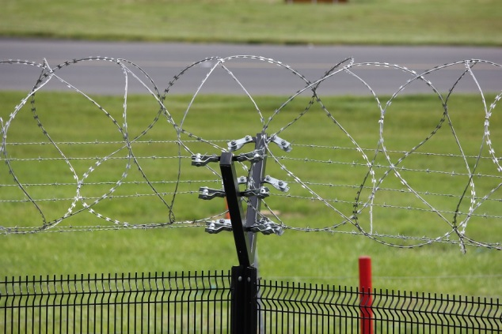
Fences (1 of 2)
Common perimeter barriers
Not always a strong deterrent but provide a visible legal boundary and warning
Can increase delay time and allow response force time to interrupt and neutralize the intruder closer to the point of alarm
Fences (1 of 2)
Common perimeter barriers
Not always a strong deterrent but provide a visible legal boundary and warning
Can increase delay time and allow response force time to interrupt and neutralize the intruder closer to the point of alarm
Source: Pixabay

Slide 44
Discussion Question
How could you strengthen perimeter fence use and increase delay time?
Discussion Question
How could you strengthen perimeter fence use and increase delay time?

Slide 45

Fences (2 of 2)
Fences (2 of 2)

Slide 46
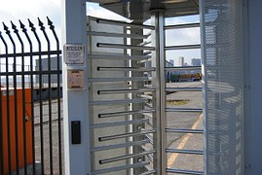
Gates (1 of 2)
Function:
  Establish specific points of entry and exit to an area defined by fences and walls
  Limit the flow of pedestrian or vehicular traffic and establish a controlled traffic pattern
Gates (1 of 2)
Function:
  Establish specific points of entry and exit to an area defined by fences and walls
  Limit the flow of pedestrian or vehicular traffic and establish a controlled traffic pattern
Source: Pixabay

Slide 47
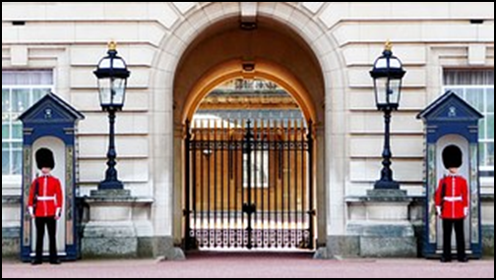
Gates (2 of 2)
Easy to defeat if they have:
  Weak hinges, locks, and latches
  Driveways positioned directly in front of the gate (make ramming by vehicle easier)
Gates (2 of 2)
Easy to defeat if they have:
  Weak hinges, locks, and latches
  Driveways positioned directly in front of the gate (make ramming by vehicle easier)
Source: Pixabay

Slide 48
Discussion Question
How could you strengthen perimeter gate use and increase delay time?
Discussion Question
How could you strengthen perimeter gate use and increase delay time?

Slide 49
Vehicle Barriers (1 of 3)
Function: restrict and control entry
Design considerations:
  Define the threat that the barrier system is intended to stop
  Define the asset and determine area to be protected
  Examine site-specific conditions
Vehicle Barriers (1 of 3)
Function: restrict and control entry
Design considerations:
  Define the threat that the barrier system is intended to stop
  Define the asset and determine area to be protected
  Examine site-specific conditions

Slide 50
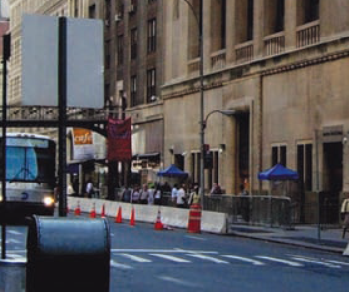
Vehicle Barriers (2 of 3)
Install vehicle barriers that are difficult to defeat in areas that cannot be monitored continuously
Source: FEMA
Vehicle Barriers (2 of 3)
Install vehicle barriers that are difficult to defeat in areas that cannot be monitored continuously

Slide 51
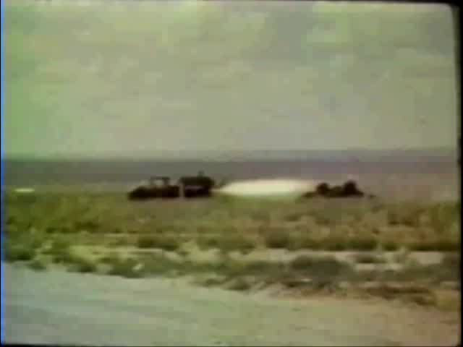
Vehicle Barriers (3 of 3)
Vehicle Barriers (3 of 3)

Slide 52
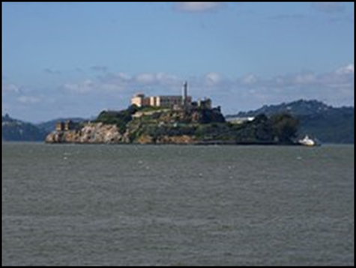
Natural Barriers
Water
Vegetation
Ditches or trenches
Hard-to-access terrain
Source: Pixabay
Natural Barriers
Water
Vegetation
Ditches or trenches
Hard-to-access terrain

Slide 53
Discussion Question
What examples can you provide of natural barriers for critical infrastructure facilities in your country?
Discussion Question
What examples can you provide of natural barriers for critical infrastructure facilities in your country?

Slide 54
Passive Barriers — Structural
Refer To:
Workbook 13.3
Walls
Doors
Windows and utility ports
Roofs and floors
Passive Barriers — Structural
Refer To:
Workbook 13.3
Walls
Doors
Windows and utility ports
Roofs and floors

Slide 55
Discussion Questions
How can using two or more concrete walls in a series increase delay time?
How can you reinforce doors to increase penetration resistance?
How can you increase window penetration resistance?
Why do floors offer more penetration resistance than roofs?
Discussion Questions
How can using two or more concrete walls in a series increase delay time?
How can you reinforce doors to increase penetration resistance?
How can you increase window penetration resistance?
Why do floors offer more penetration resistance than roofs?

Slide 56
Deployable Barriers
Deployed:
  When threat level is high
  Very close to the protected asset
Operate using two types:
  Active — activated on command
  Passive — activated automatically
Allow security force time to respond to threat
Deployable Barriers
Deployed:
  When threat level is high
  Very close to the protected asset
Operate using two types:
  Active — activated on command
  Passive — activated automatically
Allow security force time to respond to threat
Source: FEMA

Slide 57
Discussion Questions
Why are deployable barriers typically deployed very close to the protected asset?
What advantage does a passive deployable barrier system have compared to an active deployable barrier system?
Discussion Questions
Why are deployable barriers typically deployed very close to the protected asset?
What advantage does a passive deployable barrier system have compared to an active deployable barrier system?

Slide 58
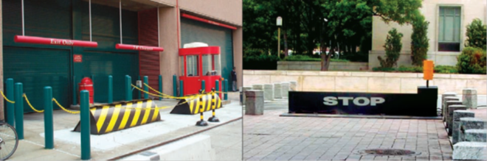
Bollards and Rising Wedge Barriers
Bollards — fixed or retractable often used in high-traffic entry and exit lanes
Rising wedges — retractable and can be raised or lowered
Wedge barriers
Bollards and Rising Wedge Barriers
Bollards — fixed or retractable often used in high-traffic entry and exit lanes
Rising wedges — retractable and can be raised or lowered
Source: FEMA
Wedge barriers
Bollards
Bollards

Slide 59
Personnel or Security Force as Barriers
Can serve as delay barriers if security force members:
  Hold fixed positions
  Are well-protected and well-trained
  Are properly equipped
  Have clear communication protocols
Personnel or Security Force as Barriers
Can serve as delay barriers if security force members:
  Hold fixed positions
  Are well-protected and well-trained
  Are properly equipped
  Have clear communication protocols

Slide 60
Discussion Question
What other factors affect security force’s ability to serve as an effective delay barrier?
Discussion Question
What other factors affect security force’s ability to serve as an effective delay barrier?

Slide 61
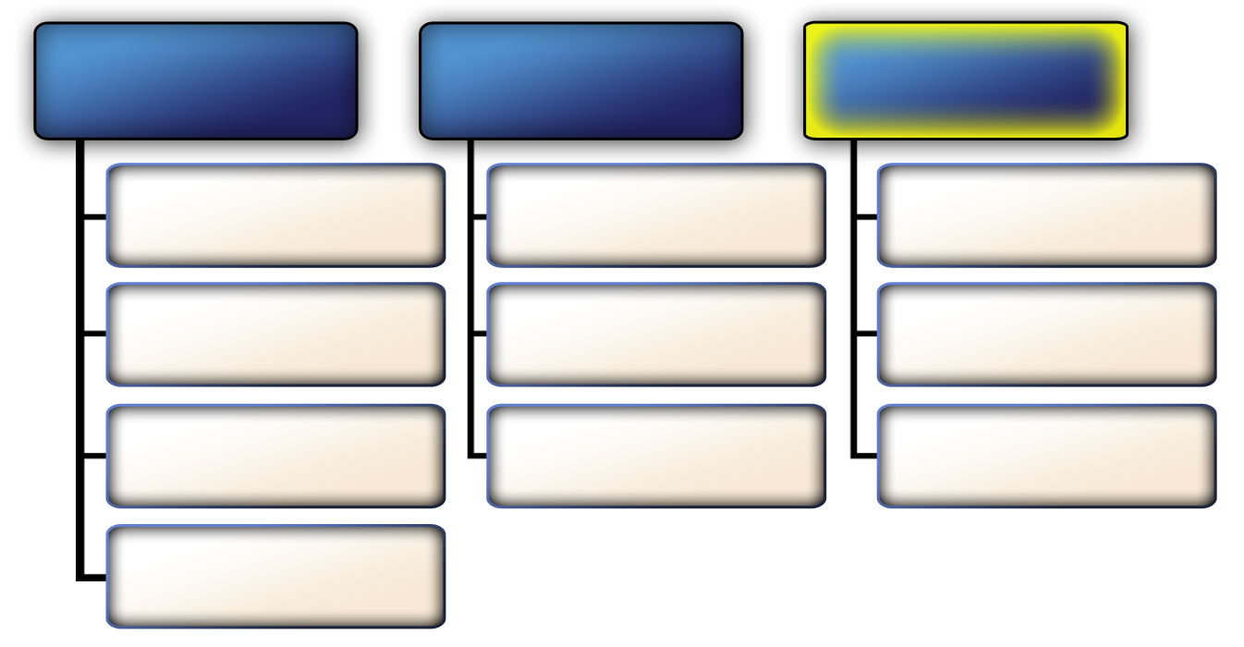
Primary Physical Protection
System Functions — Response (1 of 2)
Detection and Assessment
Delay
Response
Intrusion Sensing
Passive Barriers
Communicate to Security Force
Alarm Communication
and Display
Deployable Barriers
Deploy Security Force
Alarm Assessment
Personnel or
Security Force
Interrupt
Adversary Attempt
Entry Control System
Primary Physical Protection
System Functions — Response (1 of 2)
Detection and assessment
Delay
Response
Intrusion Sensing
Passive Barriers
Communicate to
Security Force
Alarm Communication and Display
Deployable Barriers
Deploy Security Force
Alarm Assessment
Personnel or Security Force
Interrupt Adversary Attempt
Entry Control System

Slide 62

Primary Physical Protection
System Functions — Response (2 of 2)
Communicate information to security force
Deploy security force
Interrupt terrorist activity
Primary Physical Protection
System Functions — Response (2 of 2)
Communicate information to security force
Deploy security force
Interrupt terrorist activity

Slide 63
Communicate Information to Security Force (1 of 2)
Frequency modulation or two-way radio is the most common method to communicate with the security force
Advantages include:
  Allow rapid reporting and deployment
  Easy to operate
  Efficient
  Inexpensive
Communicate Information
to Security Force (1 of 2)
Frequency modulation or two-way radio is the most common method to communicate with the security force
Advantages include:
  Allow rapid reporting and deployment
  Easy to operate
  Efficient
  Inexpensive

Slide 64

Communicate Information to Security Force (2 of 2)
Disadvantages include:
  Range limitation (overcome by the use of repeaters and multiple-receive systems)
  Vulnerability to eavesdropping, deceptive messages, and jamming (overcome by a spread-system or frequency-hopping communication system)
Communicate Information
to Security Force (2 of 2)
Disadvantages include:
  Range limitation (overcome by the use of repeaters and multiple-receive systems)
  Vulnerability to eavesdropping, deceptive messages, and jamming (overcome by a spread-system or frequency-hopping communication system)
Source: Pixabay

Slide 65
Deploy Security Force
Responding personnel
Contingency planning
Communications
Interruption and neutralization
Deploy Security Force
Responding personnel
Contingency planning
Communications
Interruption and neutralization

Slide 66
Threaded Exercise Part 6 — National Ministries Building
Refer To:
Workbook Part 6
Purpose: to develop a security technology plan for the protection of the National Ministries Building
  Duration: 60 minutes (40-exercise; 20-debrief)
  Group composition: table groups
  Debrief: presentation and discussion
Threaded Exercise Part 6 — National Ministries Building
Refer To:
Workbook Part 6
Purpose: to develop a security technology plan for the protection of the National Ministries Building
  Duration: 60 minutes (40-exercise; 20-debrief)
  Group composition: table groups
  Debrief: presentation and discussion

Slide 67
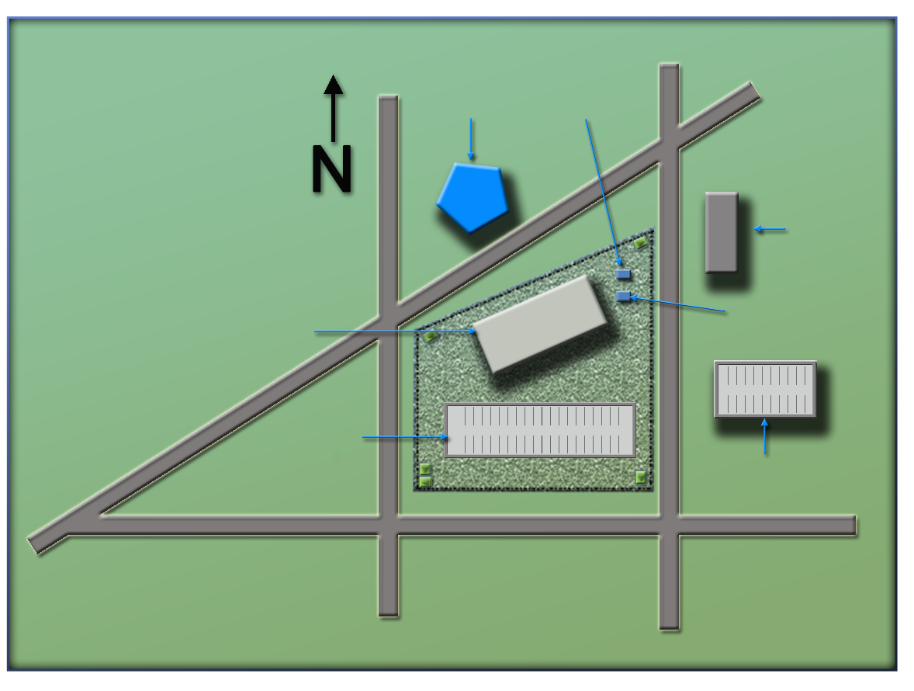
National Ministries
Building Complex Map
Refer To:
Workbook Part 6
(Ministry of Defense)
Ministry
of Defense
Security office
(Security office)
(Foreign Embassy)
Foreign embassy
(National Ministries
Building)
National Ministries
Building
Building generator
National Avenue
(Building generator)
(National Avenue)
Parking lot
Parking garage
(Parking lot)
(Parking garage)
Judiciary Lane
(Judiciary Lane)
(Second Street)
(First Street)
First Street
Second Street
National Ministries
Building Complex Map
Refer To:
Workbook Part 6
(Ministry of Defense)
Ministry
of Defense
Security office
(Security office)
National Ministries
Building
(Foreign embassy)
Foreign embassy
(National Ministries
Building)
Building generator
National Avenue
Parking lot
(Building generator)
(National Avenue)
Parking garage
Judiciary Lane
(Parking lot)
(Parking garage)
(Judiciary Lane)
First Street
Second Street
(Second Street)
(First Street)

Slide 68
Module Summary
Characteristics of a physical protection system
Primary physical protection system functions — detection and assessment
Primary physical protection system functions — delay
Primary physical protection system functions — response
Module Summary
Characteristics of a physical protection system
Primary physical protection system functions — detection and assessment
Primary physical protection system functions — delay
Primary physical protection system functions — response

