Slide 1
Security Inspection and Validation
Module 14

Slide 2
Module Objective
By the end of this module, you will be able to describe how to develop a security inspection and validation program
Module Objective
By the end of this module, you will be able to describe how to develop a security inspection and validation program

Slide 3
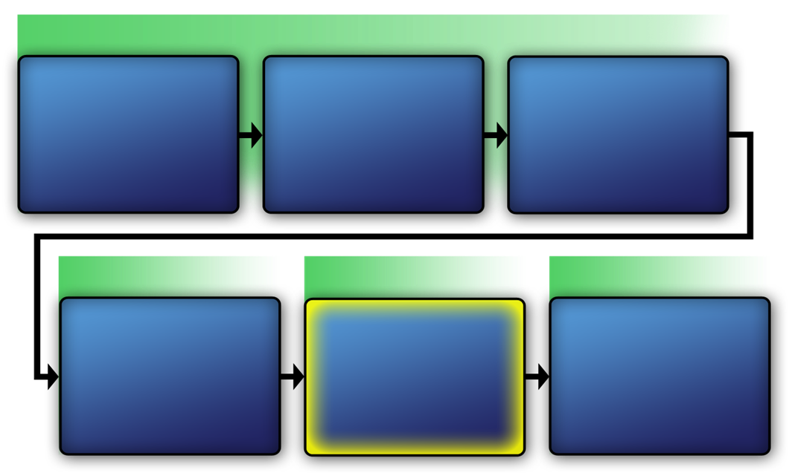
Physical Protection System
VAM Phase 1
Identify Critical Infrastructure
Module 2
Assess Critical Infrastructure Components
Module 5
Identify Critical Infrastructure Assets
Module 6
VAM Phase 2
VAM Phase 3
VAM Phase 4
Analyze the
Threat
Modules 7–10
Identify Security Counter-measures
Modules 11–14
Develop Operational
Resilience
Module 15
Physical Protection System
VAM Phase 1
Identify Critical Infrastructure
Module 2
Assess Critical Infrastructure Components
Module 5
Identify Critical Infrastructure Assets
Module 6
VAM Phase 2
VAM Phase 2
VAM Phase 3
VAM Phase 4
Analyze the Threat
Modules 7-10
Identify
Security
Counter-
Measures
Modules 11-14
Develop Operational Resilience
Module 15

Slide 4
Purpose of a Security
Inspection and Validation Program
Provides management with a means to evaluate the effectiveness of an existing physical protection system
Evaluates all aspects of the critical infrastructure’s assets including personnel, processes, equipment, and information
Purpose of a Security
Inspection and Validation Program
Provides management with a means to evaluate the effectiveness of an existing physical protection system
Evaluates all aspects of the critical infrastructure’s assets including personnel, processes, equipment, and information

Slide 5
Discussion Questions
Have evaluators ever come to your agency to conduct an inspection of security?
  If so, what did they do?
  What questions did they ask?
  What types of documents did they review?
Discussion Questions
Have evaluators ever come to your agency to conduct an inspection of security?
  If so, what did they do?
  What questions did they ask?
  What types of documents did they review?

Slide 6
Elements of a Security
Inspection and Validation Program
This section will cover:
  Introduction
  Reference list
  Definitions list
  How to conduct the program
  Responsibilities of senior managers
Elements of a Security
Inspection and Validation Program
This section will cover:
  Introduction
  Reference list
  Definitions list
  How to conduct the program
  Responsibilities of senior managers

Slide 7
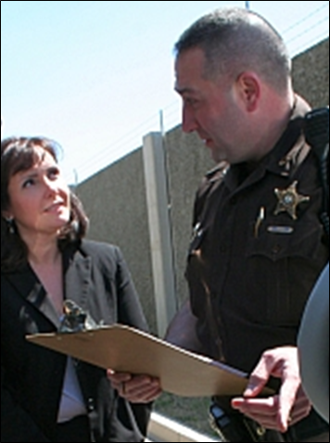
Introduction
States the purpose of the inspection
Explains to whom the information applies
Source: alexandriava.gov
Introduction
States the purpose of the inspection
Explains to whom the information applies

Slide 8

Reference List
Cites all sources used to formulate the security inspection and validation program
Includes regulations, policies, and procedures
Allows evaluators to easily locate documentation
Reference List
Cites all sources used to formulate the security inspection and validation program
Includes regulations, policies, and procedures
Allows evaluators to easily locate documentation
Source: Getty Images

Slide 9
Discussion Question
What types of policies and procedures can you use to formulate a security inspection and validation program?
Discussion Question
What types of policies and procedures can you use to formulate a security inspection and validation program?

Slide 10
Definitions List
Provides comprehensive list of unfamiliar terms or acronyms
Helps ensure all evaluators understand all terms
Clarifies how terms are used within context of a security inspection and validation program
Definitions List
Provides comprehensive list of unfamiliar terms or acronyms
Helps ensure all evaluators understand all terms
Clarifies how terms are used within context of a security inspection and validation program

Slide 11
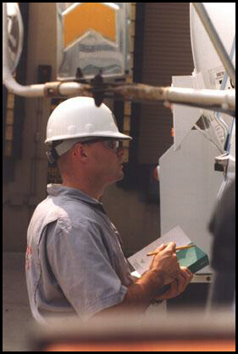
Conducting Inspections
Includes a detailed description of how inspections should be conducted
Should include the following roles:
  Team leader
  Technical writer or editor
  Subject matter experts
Conducting Inspections
Includes a detailed description of how inspections should be conducted
Should include the following roles:
  Team leader
  Technical writer or editor
  Subject matter experts
Source: DOT.GOV

Slide 12
Conducting Inspections —
Team Leader (1 of 2)
Meet with representatives from critical infrastructure
Determine required skill set for team and selecting members
Establish activity schedules
Conduct team meetings
Conducting Inspections —
Team Leader (1 of 2)
Meet with representatives from critical infrastructure
Determine required skill set for team and selecting members
Establish activity schedules
Conduct team meetings

Slide 13
Conducting Inspections —
Team Leader (2 of 2)
Monitor the progress of team assignments
Gather information required to complete security inspection and validation process
Coordinate all activities with representatives
Ensure all required briefings and reports are written
Conducting Inspections —
Team Leader (2 of 2)
Monitor the progress of team assignments
Gather information required to complete security inspection and validation process
Coordinate all activities with representatives
Ensure all required briefings and reports are written

Slide 14
Conducting Inspections —
Technical Writer (1 of 2)
Ensure the current required report format is used in written report
Attend meetings and maintain a record of the decisions made and actions to be taken
Ensure the report is properly classified and marked in accordance with specific guidelines
Conducting Inspections —
Technical Writer (1 of 2)
Ensure the current required report format is used in written report
Attend meetings and maintain a record of the decisions made and actions to be taken
Ensure the report is properly classified and marked in accordance with specific guidelines

Slide 15

Conducting Inspections —
Technical Writer (2 of 2)
Review data collected with the security inspection and validation team
Collect facility data and organize it into reference files for use
Ensure that the appropriate individuals review all documentation for classification purposes
Conducting Inspections —
Technical Writer (2 of 2)
Review data collected with the security inspection and validation team
Collect facility data and organize it into reference files for use
Ensure that the appropriate individuals review all documentation for classification purposes
Source: BLS.GOV

Slide 16
Conducting Inspections —
Subject Matter Expert (1 of 2)
Collect security inspection and validation data based on area of expertise
Research documentation of past performance and identify what changes, if any, have occurred
Conducting Inspections —
Subject Matter Expert (1 of 2)
Collect security inspection and validation data based on area of expertise
Research documentation of past performance and identify what changes, if any, have occurred

Slide 17
Conducting Inspections —
Subject Matter Expert (2 of 2)
Coordinate activities with site safety and security personnel prior to conducting any performance testing or site visits
Attend scheduled meetings and provide adequate documentation to the team leader and technical writer
Conducting Inspections —
Subject Matter Expert (2 of 2)
Coordinate activities with site safety and security personnel prior to conducting any performance testing or site visits
Attend scheduled meetings and provide adequate documentation to the team leader and technical writer

Slide 18
Senior Management Responsibilities
Address observations and findings of the security inspection and validation program:
  What to do after the security inspection and validation is completed
  Specify which positions are responsible for which corrective actions
Senior Management Responsibilities
Address observations and findings of the security inspection and validation program:
  What to do after the security inspection and validation is completed
  Specify which positions are responsible for which corrective actions

Slide 19
Documenting Elements in
Standard Operating Procedures
Creates a comprehensive plan by documenting all elements in standard operating procedures manual
Promotes consistency and accuracy for the security inspection and validation team
Documenting Elements in
Standard Operating Procedures
Creates a comprehensive plan by documenting all elements in standard operating procedures manual
Promotes consistency and accuracy for the security inspection and validation team

Slide 20

Security Inspection and
Validation Program Directive (1 of 2)
Refer To:
Workbook 14.1
A written order for implementing and conducting the program
Provides information for:
  Reason for the order
  Manner in which the inspection will be conducted
  Required format for findings and observations
  Description of corrective action plan
Security Inspection and
Validation Program Directive (1 of 2)
Refer To:
Workbook 14.1
A written order for implementing and conducting the program
Provides information for:
  Reason for the order
  Manner in which the inspection will be conducted
  Required format for findings and observations
  Description of corrective action plan

Slide 21

Security Inspection and
Validation Program Directive (2 of 2)
Refer To:
Workbook 14.1
Discussion questions:
  What is the purpose of this program?
  How many references were considered for this program?
  What would initiate a program update?
  What responsibilities are assigned to the critical infrastructure security manager?
Security Inspection and
Validation Program Directive (2 of 2)
Refer To:
Workbook 14.1
Discussion questions:
  What is the purpose of this program?
  How many references were considered for this program?
  What would initiate a program update?
  What responsibilities are assigned to the critical infrastructure security manager?

Slide 22
Phases of the Security
Inspection and Validation Program
This section will cover:
  Phase 1: Inspection planning
  Phase 2: Conducting inspection
  Phase 3: Close-out
Phases of the Security
Inspection and Validation Program
This section will cover:
  Phase 1: Inspection planning
  Phase 2: Conducting inspection
  Phase 3: Close-out

Slide 23
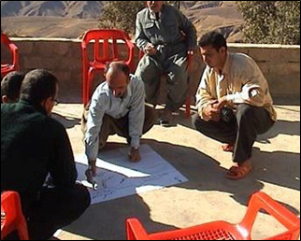
Phase 1: Inspection Planning (1 of 2)
Gather and review primary documents
Identify records and other documents that will be reviewed on-site
Identify assets associated with the critical infrastructure
Phase 1: Inspection Planning (1 of 2)
Gather and review primary documents
Identify records and other documents that will be reviewed on-site
Identify assets associated with the critical infrastructure
Source: DS/T/ATA

Slide 24
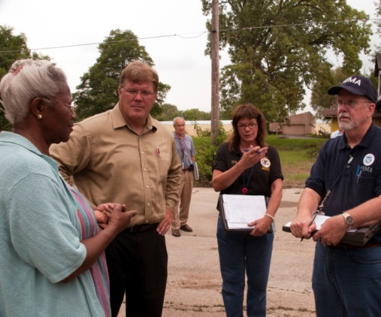
Phase 1: Inspection Planning (2 of 2)
Familiarize team members with the site
Determine the extent of the inspection
Identify essential personnel to be interviewed
Identify systems performance tests
Phase 1: Inspection Planning (2 of 2)
Familiarize team members with the site
Determine the extent of the inspection
Identify essential personnel to be interviewed
Identify systems performance tests
Source: FEMA

Slide 25
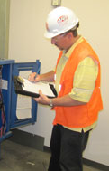
Phase 2: Conducting the Inspection
Conduct data collection and analysis
Review all pertinent records and documents
Interview essential personnel
Tour facility and observe employees
Conduct limited scope performance testing
Phase 2: Conducting the Inspection
Conduct data collection and analysis
Review all pertinent records and documents
Interview essential personnel
Tour facility and observe employees
Conduct limited scope performance testing
Source: RI.GOV

Slide 26

Security Inspection and Validation Checklists (1 of 2)
Refer To:
Workbook 14.2
Quick reference and can be used by anyone on the security inspection and validation team
Can provide pass or fail information for the report
Security Inspection and Validation Checklists (1 of 2)
Refer To:
Workbook 14.2
Quick reference and can be used by anyone on the security inspection and validation team
Can provide pass or fail information for the report

Slide 27
Security Inspection and Validation Checklists (2 of 2)
Refer To:
Workbook 14.2
Used to assess each of the following areas:
  Policies and procedures
  Technology
  Ability to delay access
  Security force
Security Inspection and Validation Checklists (2 of 2)
Refer To:
Workbook 14.2
Used to assess each of the following areas:
  Policies and procedures
  Technology
  Ability to delay access
  Security force

Slide 28
Limited Scope
Performance Testing Purpose
Ensure procedures are being followed as directed
Verify that variances are documented
Confirm that the physical protection system is operating as expected
Limited Scope
Performance Testing Purpose
Ensure procedures are being followed as directed
Verify that variances are documented
Confirm that the physical protection system is operating as expected

Slide 29
Limited Scope
Performance Testing Classes
Refer To:
Workbook 14.3
Operability tests
Performance tests
Post-maintenance tests
Whole system and limited scope tests
Evaluation tests
Limited Scope
Performance Testing Classes
Refer To:
Workbook 14.3
Operability tests
Performance tests
Post-maintenance tests
Whole system and limited scope tests
Evaluation tests

Slide 30
Limited Scope
Performance Testing Results
Recorded and later analyzed
Used to assign a rating of the physical protection system
Limited Scope
Performance Testing Results
Recorded and later analyzed
Used to assign a rating of the physical protection system

Slide 31
Limited Scope Performance Testing Rating System
Refer To:
Workbook 14.3
Satisfactory
Marginal
Unsatisfactory
Marginal
Satisfactory
Unsatisfactory
Limited Scope Performance Testing Rating System
Refer To:
Workbook 14.3
Satisfactory
Marginal
Unsatisfactory
Satisfactory
Marginal
Unsatisfactory

Slide 32

Phase 3: Close-Out
Goals:
  Identify findings and observations
  Discuss the effect on the critical infrastructure
  Assign a rating
Present findings
Create a report
Phase 3: Close-Out
Goals:
  Identify findings and observations
  Discuss the effect on the critical infrastructure
  Assign a rating
Present findings
Create a report
Source: Getty Images

Slide 33
Security Inspection and Validation Report (1 of 2)
Refer To:
Workbook 14.4
Executive summary
Introduction
Security inspection and validation methodology
System assessment
Security Inspection and Validation Report (1 of 2)
Refer To:
Workbook 14.4
Executive summary
Introduction
Security inspection and validation methodology
System assessment

Slide 34
Security Inspection and Validation Report (2 of 2)
Refer To:
Workbook 14.4
Performance testing requirements
Recommendations
Conclusions
References
Security Inspection and Validation Report (2 of 2)
Refer To:
Workbook 14.4
Performance testing requirements
Recommendations
Conclusions
References

Slide 35
Threaded Exercise—National Ministries Building Part 7 (1 of 2)
Refer To:
Threaded Exercise Workbook Part 7
Purpose: to develop a security inspection and validation checklist for the National Ministries Building
  Duration: 60 minutes (45-exercise;15-debrief)
  Group composition: table groups
  Debrief: large-group discussion
Threaded Exercise—National Ministries Building Part 7 (1 of 2)
Refer To:
Threaded Exercise Workbook Part 7
Purpose: to develop a security inspection and validation checklist for the National Ministries Building
  Duration: 60 minutes (45-exercise;15-debrief)
  Group composition: table groups
  Debrief: large-group discussion

Slide 36
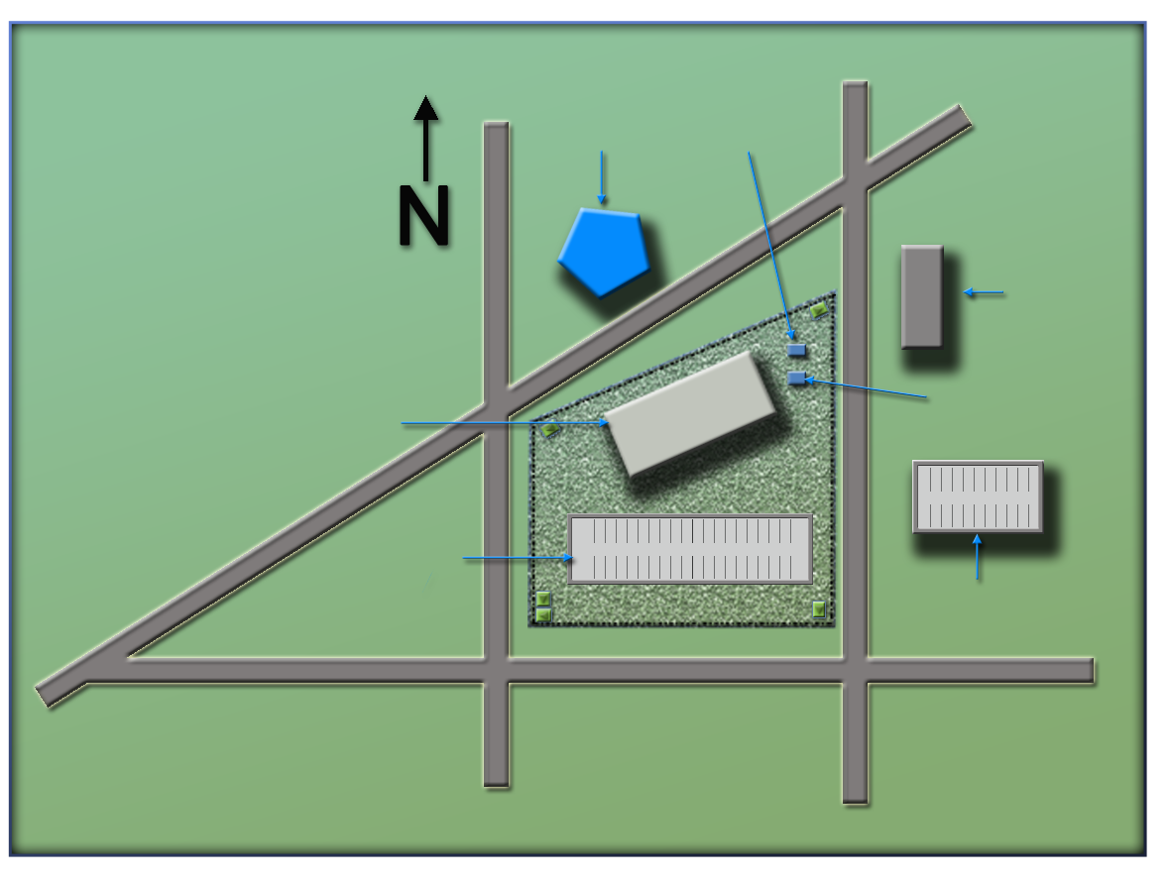
Threaded Exercise—National Ministries Building Part 7 (2 of 2)
Refer To:
Threaded Exercise Workbook Part 7
(Ministry of Defense)
Ministry
of Defense
Security office
(Security office)
(Foreign Embassy)
Foreign embassy
National Ministries
Building
(National Ministries
Building)
Building generator
National Avenue
(Building generator)
(National Avenue)
Parking lot
(Parking garage)
Parking garage
(Parking lot)
Judiciary Lane
(Judiciary Lane)
(Second Street)
(First Street)
First Street
Second Street
Threaded Exercise—National Ministries Building Part 7 (2 of 2)
Refer To:
Threaded Exercise Workbook Part 7
(Ministry of Defense)
Ministry
of Defense
Security office
(Security office)
National Ministries
Building
(Foreign embassy)
Foreign embassy
(National Ministries
Building)
Building generator
National Avenue
Parking lot
(Building generator)
(National Avenue)
Parking garage
Judiciary Lane
(Parking lot)
(Parking garage)
(Judiciary Lane)
First Street
Second Street
(Second Street)
(First Street)

Slide 37

TeachBack Moment
What are elements of the security inspection and validation program?
What are the three phases of a security inspection and validation program?
TeachBack Moment
What are elements of the security inspection and validation program?
What are the three phases of a security inspection and validation program?

Slide 38
Module Summary
Purpose of a security inspection and validation program
Elements of a security inspection and validation program
Phases of the security inspection and validation program
Module Summary
Purpose of a security inspection and validation program
Elements of a security inspection and validation program
Phases of the security inspection and validation program

