Slide 1
Operational Resilience
Module 15

Slide 2
Module Objective
By the end of this module, you will be able to describe how to apply operational resilience strategies for your country after a terrorist attack, natural disaster, or other threat
Module Objective
By the end of this module, you will be able to describe how to apply operational resilience strategies for your country after a terrorist attack, natural disaster, or other threat

Slide 3
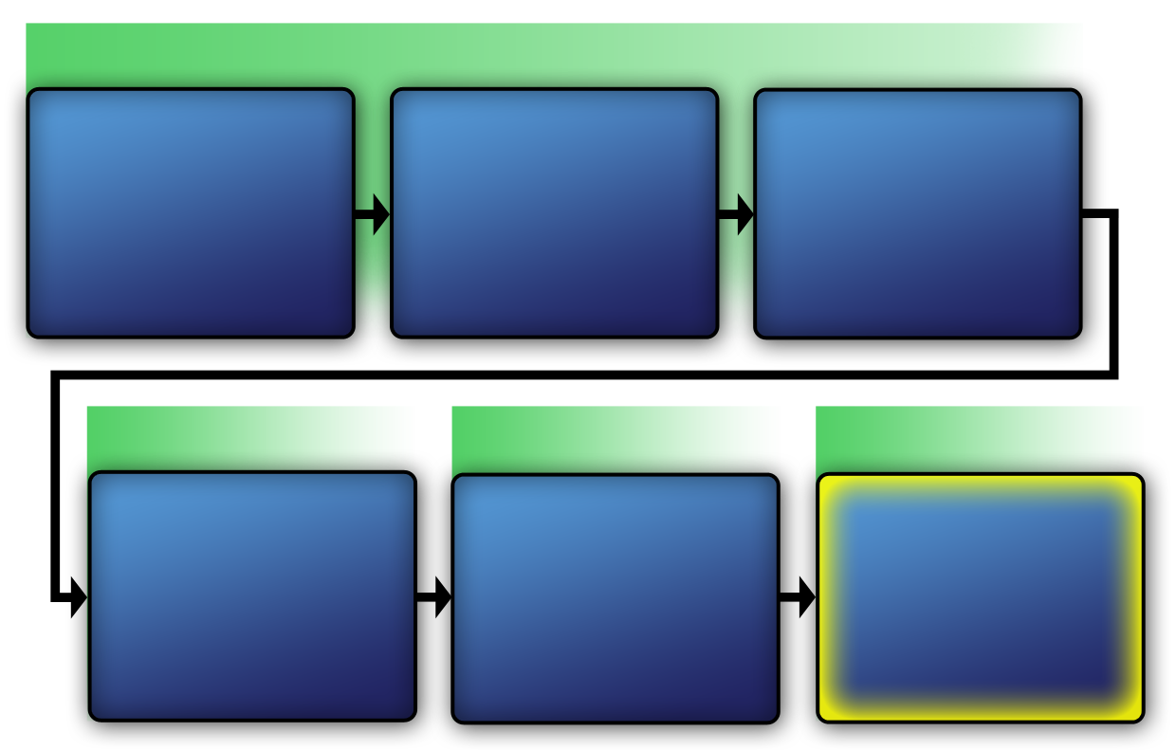
Course Map Diagram
VAM Phase 1
Identify Critical Infrastructure
Module 2
Assess Critical Infrastructure Components
Module 5
Identify Critical Infrastructure Assets
Module 6
VAM Phase 2
VAM Phase 3
VAM Phase 4
Analyze the Threat
Modules 7–10
Identify Security Counter-measures Modules 11–14
Develop Operational
Resilience
Module 15
Course Map Diagram
VAM Phase 1
Identify Critical Infrastructure
Module 2
Assess Critical Infrastructure Components
Module 5
Identify Critical Infrastructure Assets
Module 6
VAM Phase 2
VAM Phase 2
VAM Phase 3
VAM Phase 4
Analyze the Threat
Modules 7-10
Identify
Security
Counter-
Measures
Modules 11-14
Develop Operational Resilience
Module 15

Slide 4
Terms Related to
Critical Infrastructure Resilience
Resilience — to prepare and adapt, withstand and recover rapidly
Collaboration — to work together to achieve shared goals
Protection — the capabilities necessary to secure the homeland
Terms Related to
Critical Infrastructure Resilience
Resilience — to prepare and adapt, withstand and recover rapidly
Collaboration — to work together to achieve shared goals
Protection — the capabilities necessary to secure the homeland

Slide 5
Resilience in Your Country (1 of 2)
What strategies does your country currently have for resilience?
What types of capabilities does your country have to protect against threats and natural disasters?
Resilience in Your Country (1 of 2)
What strategies does your country currently have for resilience?
What types of capabilities does your country have to protect against threats and natural disasters?

Slide 6
Resilience in Your Country (2 of 2)
What type of preparations for resilience has your country made?
Based on your country’s past experience, how long has it taken to return to operational status?
Resilience in Your Country (2 of 2)
What type of preparations for resilience has your country made?
Based on your country’s past experience, how long has it taken to return to operational status?

Slide 7
Critical Infrastructure Security and Resilience Policy Example
High-level national directive to serve as a template for other sectors; may include:
  Introduction
  Policies
  Roles and responsibilities
  Strategic imperatives
  Innovations and research and development
  Actions to implement the directive
Critical Infrastructure Security
and Resilience Policy Example
High-level national directive to serve as a template for other sectors; may include:
  Introduction
  Policies
  Roles and responsibilities
  Strategic imperatives
  Innovations and research and development
  Actions to implement the directive

Slide 8
Critical Infrastructure
Security Introduction (1 of 3)
Requires coordinated efforts
Includes both physical space, cyberspace, and multinational ownership
Requires managing risk and determining effective strategies for resilience
Helps rapid recovery
Critical Infrastructure
Security Introduction (1 of 3)
Requires coordinated efforts
Includes both physical space, cyberspace, and multinational ownership
Requires managing risk and determining effective strategies for resilience
Helps rapid recovery

Slide 9
Critical Infrastructure
Security Introduction (2 of 3)
Phase 1: Prevention
Phase 2: Preparedness
Phase 3: Response
Phase 4: Recovery
Requires security systems integration across:
Critical Infrastructure
Security Introduction (2 of 3)
Phase 4: Recovery
Phase 1: Prevention
Phase 3: Response
Phase 2: Preparedness

Slide 10
Critical Infrastructure
Security Introduction (3 of 3)
Requires all stakeholders to share policies and action
Compels national governments to strengthen internal security and resilience
Critical Infrastructure
Security Introduction (3 of 3)
Requires all stakeholders to share policies and action
Compels national governments to strengthen internal security and resilience

Slide 11
Critical Infrastructure
Resilience Policies (1 of 2)
Governments and stakeholders work to:
  Take proactive steps to manage risk
  Consider all hazards to security, economy, health, and safety
  Integrate policies to reflect interdependencies
  Identify critical energy and communication systems
  Protect all information in compliance with law
Critical Infrastructure
Resilience Policies (1 of 2)
Governments and stakeholders work to:
  Take proactive steps to manage risk
  Consider all hazards to security, economy, health, and safety
  Integrate policies to reflect interdependencies
  Identify critical energy and communication systems
  Protect all information in compliance with law

Slide 12
Critical Infrastructure
Resilience Policies (2 of 2)
Reduce vulnerabilities
Minimize consequences
Identify and disrupt threats
Hasten response and recovery efforts
Critical Infrastructure
Resilience Policies (2 of 2)
Reduce vulnerabilities
Minimize consequences
Identify and disrupt threats
Hasten response and recovery efforts

Slide 13
Roles and Responsibilities (1 of 2)
Minister or secretary of national security and resilience organization:
  Provide high-level strategic guidance
  Promote and coordinate national unity
  Evaluate national capabilities and analyze threats
  Identify security and resilience functions
  Develop a national plan and report effectiveness
Roles and Responsibilities (1 of 2)
Minister or secretary of national security and resilience organization:
  Provide high-level strategic guidance
  Promote and coordinate national unity
  Evaluate national capabilities and analyze threats
  Identify security and resilience functions
  Develop a national plan and report effectiveness

Slide 14
Roles and Responsibilities (2 of 2)
Sector-specific agencies:
  Unique characteristics, operating models, and risk profiles
  Institutional knowledge and specialized expertise
  Knowledge of specific recovery and resilience needs
Roles and Responsibilities (2 of 2)
Sector-specific agencies:
  Unique characteristics, operating models, and risk profiles
  Institutional knowledge and specialized expertise
  Knowledge of specific recovery and resilience needs

Slide 15

Roles and Responsibilities of Other Stakeholders
Finance and contracts division
Human resources division
Information technology division
Legal division
Operational area specialists
Security operations team
Roles and Responsibilities
of Other Stakeholders
Finance and contracts division
Human resources division
Information technology division
Legal division
Operational area specialists
Security operations team
Source: Ready.gov

Slide 16
Three Strategic Imperatives (1 of 3)
Refine and clarify functional relationships across the government to advance the national unity of effort to strengthen critical infrastructure security and resilience:
    Guided by a national plan
    Informed by expertise, experience, capabilities, and responsibilities of all stakeholders
Three Strategic Imperatives (1 of 3)
Refine and clarify functional relationships across the government to advance the national unity of effort to strengthen critical infrastructure security and resilience:
    Guided by a national plan
    Informed by expertise, experience, capabilities, and responsibilities of all stakeholders

Slide 17
Three Strategic Imperatives (2 of 3)
Enable efficient information exchange by identifying baseline data and systems requirements for the government:
    Timely exchange
    Situational awareness capability
    System requirements
    Respect of privacy and civil liberties
Three Strategic Imperatives (2 of 3)
Enable efficient information exchange by identifying baseline data and systems requirements for the government:
    Timely exchange
    Situational awareness capability
    System requirements
    Respect of privacy and civil liberties

Slide 18

Three Strategic Imperatives (3 of 3)
Implement an integration and analysis function to inform planning and operational decisions regarding critical infrastructure
Three Strategic Imperatives (3 of 3)
Source: Getty Images
Implement an integration and analysis function to inform planning and operational decisions regarding critical infrastructure

Slide 19
Innovation and
Research and Development (1 of 2)
Align research and development activities
Research innovations in construction and cybersecurity methods
Enhance research on various scenario responses
Innovation and
Research and Development
Align research and development activities
Research innovations in construction and cybersecurity methods
Enhance research on various scenario responses
Facilitate incentives for investments in designs
Prioritize efforts to implement critical infrastructure security and resilience policies

Slide 20
Innovation and
Research and Development (2 of 2)
Facilitate incentives for investments in designs
Prioritize efforts to implement critical infrastructure security and resilience policies
Innovation and
Research and Development
Align research and development activities
Research innovations in construction and cybersecurity methods
Enhance research on various scenario responses
Facilitate incentives for investments in designs
Prioritize efforts to implement critical infrastructure security and resilience policies

Slide 21
Planning for Resilience
Adequacy and deficiency
Timely recovery
Policy applies across all sectors
Each sector responsible for implementing in their area
Planning for Resilience
Adequacy and deficiency
Timely recovery
Policy applies across all sectors
Each sector responsible for implementing in their area

Slide 22
Gap Analysis Process (1 of 2)
The steps that security managers use to compare the actual performance of an existing physical protection system with its potential performance
  Does the system design meet requirements?
  Does the system meet expected outcomes?
Gap Analysis Process (1 of 2)
The steps that security managers use to compare the actual performance of an existing physical protection system with its potential performance
  Does the system design meet requirements?
  Does the system meet expected outcomes?

Slide 23
Gap Analysis (2 of 2)
Step 1: Determine expected standard requirements
Step 2: Assess existing performance levels
Step 3: Identify gaps
Step 4: Define risk management plan
1
2
3
4
Determine
Assess
Identify
Define
Gap Analysis (2 of 2)
Step 1: Determine expected standard requirements
Step 2: Assess existing performance levels
Step 3: Identify gaps
Step 4: Define risk management plan
Determine
Assess
Identify
Define

Slide 24
Step 1: Determine Expected
Standard Requirements
Identify the performance requirements and expectations for a specific security countermeasure
1
2
3
4
Determine
Assess
Identify
Define
Step 1: Determine Expected
Standard Requirements
Identify the performance requirements and expectations for a specific security countermeasure
Determine
Assess
Identify
Define

Slide 25
Step 2: Assess Existing
Performance Levels
Decide how the existing performance levels will be measured
1
2
3
4
Determine
Assess
Identify
Define
Step 2: Assess Existing
Performance Levels
Decide how the existing performance levels will be measured
Determine
Assess
Identify
Define

Slide 26
Step 3: Identify Gaps
Determine what areas (risks) do not meet the pre-established performance standards or expectations
1
2
3
4
Determine
Assess
Identify
Define
Step 3: Identify Gaps
Determine what areas (risks) do not meet the pre-established performance standards or expectations
Determine
Assess
Identify
Define

Slide 27
Step 4: Define Risk Management Plan
Determine the best countermeasures to manage the risks
1
2
3
4
Determine
Assess
Identify
Define
Step 4: Define Risk Management Plan
Determine the best countermeasures to manage the risks
Determine
Assess
Identify
Define

Slide 28

Gap Analysis
Process Scenario Activity
Refer To:
Handout 15.1
Purpose: to identify the steps of the gap analysis process in a given scenario
  Duration: 40 minutes (30-actvity; 10-discussion)
  Group composition: table groups
  Debrief: large-group discussion
Gap Analysis
Process Scenario Activity
Refer To:
Handout 15.1
Purpose: to identify the steps of the gap analysis process in a given scenario
  Duration: 40 minutes (30-actvity; 10-discussion)
  Group composition: table groups
  Debrief: large-group discussion

Slide 29
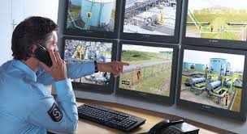
Proposed Security Countermeasures
Formulate how the proposed countermeasures will resolve the gap
Prioritize the recommendations from security inspection and validation report:
  Importance and vulnerability
  Greatest risks are highest priority
Proposed Security Countermeasures
Formulate how the proposed countermeasures will resolve the gap
Prioritize the recommendations from security inspection and validation report:
  Importance and vulnerability
  Greatest risks are highest priority
Source: atg.sd.gov

Slide 30
Discussion Questions
In your experience, which type of security countermeasure is the most consistently well planned and budgeted? Why?
In your experience, which type of security countermeasure is the least planned and budgeted? Why?
Discussion Questions
In your experience, which type of security countermeasure is the most consistently well planned and budgeted? Why?
In your experience, which type of security countermeasure is the least planned and budgeted? Why?

Slide 31
Develop National Resilience Plan (1 of 2)
National security and resilience organization and minister must develop the national plan that each sector will use as a model
Integrate:
  Prevention
  Preparedness
  Response
  Recovery
Develop National Resilience Plan (1 of 2)
National security and resilience organization and minister must develop the national plan that each sector will use as a model
Integrate:
  Prevention
  Preparedness
  Response
  Recovery

Slide 32
Develop National Resilience Plan (2 of 2)
Stakeholders, government agencies, and advisory groups must coordinate together to:
  Assess gaps in current conditions
  Evaluate effectiveness of current practices
  Develop expected outcomes and performance relative to resilience
  Prepare plan of prioritized recommendations for high-level national policies, procedures, and actions
Develop National Resilience Plan (2 of 2)
Stakeholders, government agencies, and advisory groups must coordinate together to:
  Assess gaps in current conditions
  Evaluate effectiveness of current practices
  Develop expected outcomes and performance relative to resilience
  Prepare plan of prioritized recommendations for high-level national policies, procedures, and actions

Slide 33

TeachBack Moment
What are the definitions of resilience, collaboration, and protection as they relate to critical infrastructure resilience?
What are the important elements of a critical infrastructure security and resilience directive?
What are the necessary actions to develop an operational resilience plan?
TeachBack Moment
What are the definitions of resilience, collaboration, and protection as they relate to critical infrastructure resilience?
What are the important elements of a critical infrastructure security and resilience directive?
What are the necessary actions to develop an operational resilience plan?

Slide 34

Threaded Exercise — National Ministries Building Part 8
Refer To:
Threaded Exercise Workbook Part 8
Purpose: to present four main points of an operational resilience plan statement that includes recommended security countermeasures for a given scenario
  Duration: 70 minutes (40-preparation; 30-debrief)
  Group composition: table groups
  Debrief: group presentations and facilitator feedback
Threaded Exercise — National Ministries Building Part 8
Refer To:
Threaded Exercise Workbook Part 8
Purpose: to present four main points of an operational resilience plan statement that includes recommended security countermeasures for a given scenario
  Duration: 70 minutes (40-preparation; 30-debrief)
  Group composition: table groups
  Debrief: group presentations and facilitator feedback

Slide 35
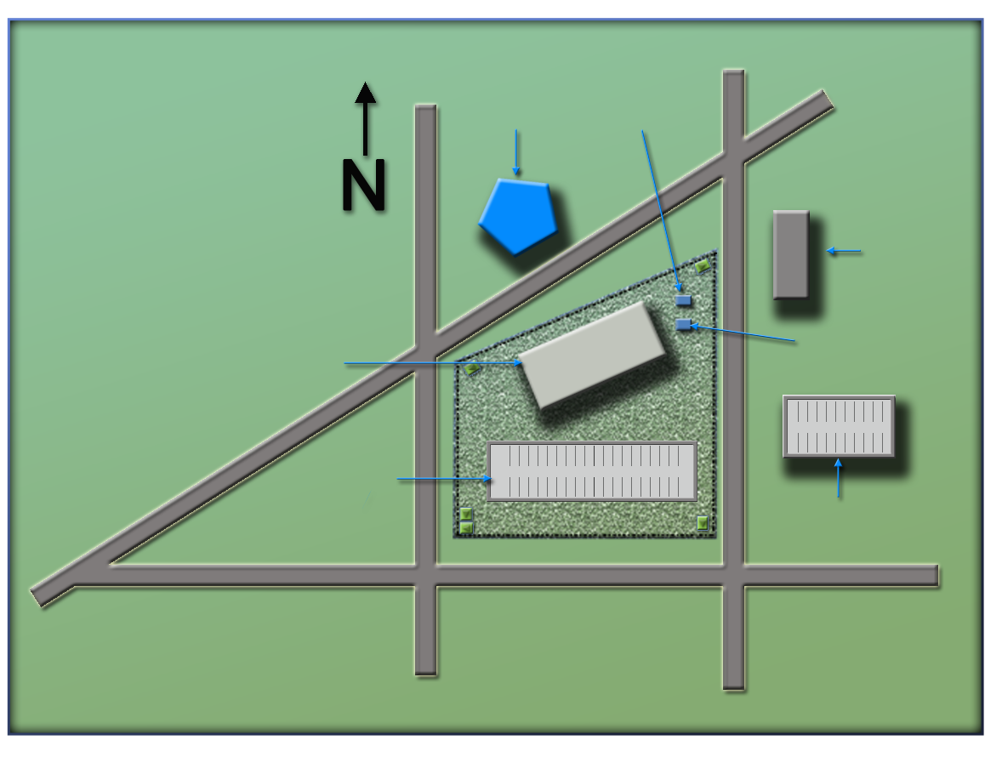
National Ministries
Building Complex Map
Refer To:
Threaded Exercise Workbook Part 8
(Ministry of Defense)
Ministry
of Defense
Security office
(Security office)
(Foreign Embassy)
Foreign embassy
(National Ministries
Building)
National Ministries
Building
Building generator
National Avenue
(Building generator)
(National Avenue)
Parking lot
Parking garage
(Parking lot)
(Parking garage)
Judiciary Lane
(Judiciary Lane)
(First Street)
First Street
(Second Street)
National Ministries
Building Complex Map
Refer To:
Second Street
Threaded Exercise Workbook Part 8
(Ministry of Defense)
Ministry
of Defense
Security office
(Security office)
National Ministries
Building
(Foreign embassy)
Foreign embassy
(National Ministries
Building)
Building generator
National Avenue
Parking lot
(Building generator)
(National Avenue)
Parking garage
Judiciary Lane
(Parking lot)
(Parking garage)
(Judiciary Lane)
First Street
Second Street
(Second Street)
(First Street)

Slide 36
Module Summary
Critical infrastructure resilience
Critical infrastructure security and resilience directive example
Planning for resilience
Module Summary
Critical infrastructure resilience
Critical infrastructure security and resilience directive example
Planning for resilience

