Slide 1
Summary and Evaluation
Module 17

Slide 2
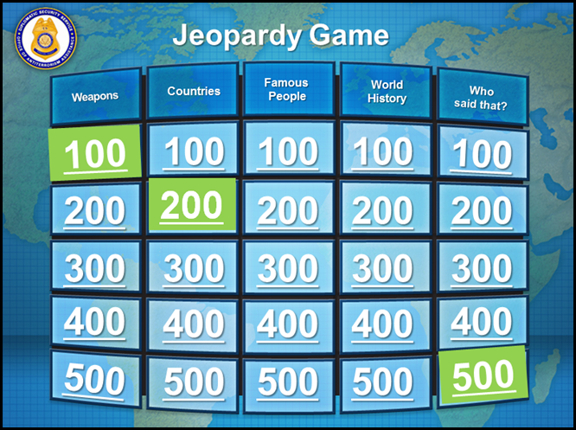
Jeopardy Game Review
Overview
  Participate in the game of Jeopardy to review course content
Time
  60 minutes
Source: DS/T/ATA
Jeopardy Game Review
Overview
  Participate in the game of Jeopardy to review course content
Time
  60 minutes

Slide 3

Course Expectations and Next Steps
How well did this course meet your expectations?
How do you plan to use what you learned?
Source: Getty Images
Course Expectations and Next Steps
Course Expectations and Next Steps
How well did this course meet your expectations?
How do you plan to use what you learned?

Slide 4


Post-Course Knowledge Survey
Refer To:
Handout 17.1
Overview
  Complete the post-course knowledge survey
Time
  As needed
Source: Getty Images
Post-Course Knowledge Survey
Post-Course
Knowledge Survey
Refer To:
Handout 17.1
Overview
  Complete the post-course knowledge survey
Time
  As needed
Notes:
4
Module 17
Investigative Information Management

Slide 5
Participant Critique of Training
Refer To:
Critique Form
Overview
  Complete the participant critique of training
Time
  As needed
Source: Getty Images
Participant Critique of Training
Participant
Critique of Training
Refer To:
Critique Form
Overview
  Complete the participant critique of training
Time
  As needed
Notes:
5
Module 17
Investigative Information Management

Slide 6

Commencement Ceremony
Commencement Ceremony

