Slide 1
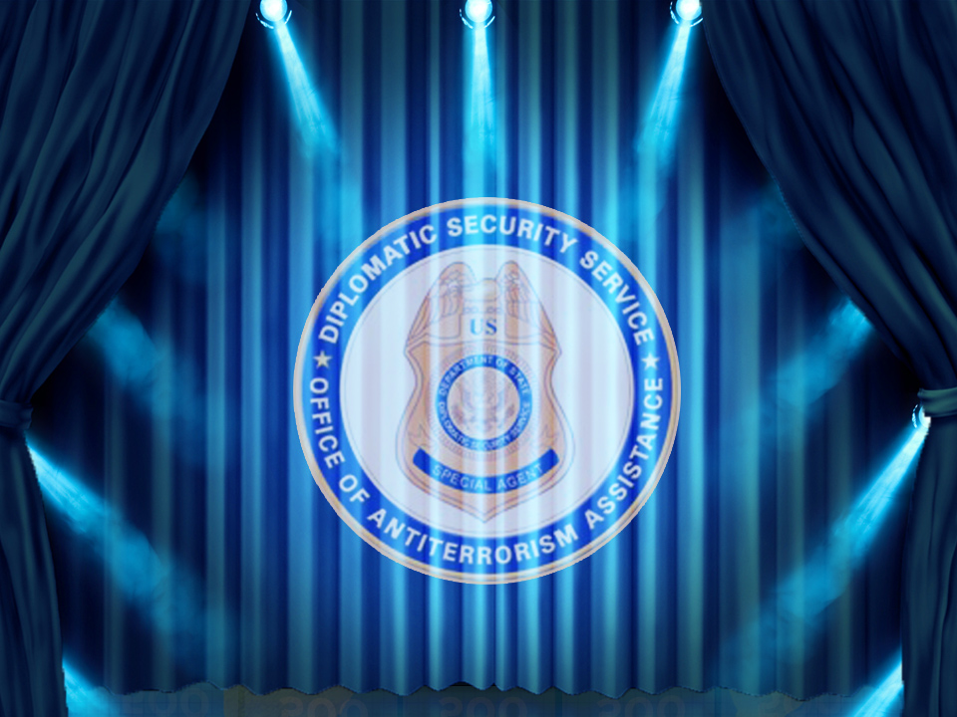


Slide 2

Critical Infrastructure
Miscellaneous
Surveillance and Security
Threats
Technology & Operations
100
100
100
100
100
200
200
200
200
200
300
300
300
300
300
400
400
400
400
400
500
500
500
500
500

Slide 3



Critical Infrastructure - 100
An assessment of a given critical infrastructure consists of ________________.
The evaluation of functional components
(Module 5)
Notes:
Module 5, Objective 1, Slide 6, Knowledge Survey Question 1

Slide 4
Critical Infrastructure - 200
During a critical infrastructure assessment,
a “data call” refers to:
Requesting information about the site
prior to the site visit
(Module 5)
Notes:
Module 5, Objective 2, Slide 33, Knowledge Survey Question 4

Slide 5
Critical Infrastructure - 300
What is the third function of a physical protection system?
Response
(Module 2)
Notes:
Module 2, Objective 4, Slide 51, Knowledge Survey Question 2

Slide 6
Critical Infrastructure - 400
What should occur in Phase 4 of the vulnerability analysis for a physical protection system?
  Conducting a gap analysis
  (Module 2)
Notes:
Module 2, Objective 6, Slide 65, No Corresponding Knowledge Survey Question

Slide 7
Critical Infrastructure - 500
What are the four categories of
critical assets?
  People, information, equipment, and processes
  (Module 2)
Notes:
Module 2, Objective 3, Slide 20, Knowledge Survey Question 3

Slide 8
Miscellaneous - 100
Any observed behavior that could indicate terrorism or terrorism-related crime is considered _______________.
            Suspicious activity
            (Module 4)
Notes:
Module 4, Objective 1, Slide 4, No Corresponding Knowledge Survey Question

Slide 9
Miscellaneous - 200
When law enforcement agencies and the community and organizations they serve work together for the purpose of developing solutions to problems and increasing trust in law enforcement, it is known as community ____________________.
Partnership
(Module 4)
Notes:
Module 4, Objective 2, Slide 15, Knowledge Survey Question 5

Slide 10
Miscellaneous - 300
Identifying all _________________ is necessary before conducting an asset analysis.
Critical assets
(Module 6)
Notes:
Module 6, Objective 1, Slide 8, Knowledge Survey Question 6

Slide 11
Miscellaneous - 400
What is any circumstance or event with the potential to adversely affect an information system via unauthorized access, destruction, disclosure, modification of information, or denial of service?
Cyberthreat
(Module 7)
Notes:
Module 7, Objective 1, Slide 3, Knowledge Survey Question 8

Slide 12
Daily
Double!

Slide 13
Miscellaneous - 500
Since it is not possible or practical to protect all critical infrastructure assets, you must:
Prioritize protection for assets according to their importance
(Module 6)
Notes:
Module 6, Objective 2, Slide 11, Knowledge Survey Question 7

Slide 14
Surveillance and Security - 100
As terrorist organizations prepare to launch an attack against a critical infrastructure site, ________________ can be the weak link in the preparation process.
Surveillance
(Module 8)
Notes:
Module 8, Objective 4, Slide 15, Knowledge Survey Question 10

Slide 15
Surveillance and Security - 200
What is the most effective security
measure against a vehicle-borne
improvised explosive device?
Distance
(Module 9)
Notes:
Module 9, Objective 2, Slide 38, Knowledge Survey Question 13

Slide 16
Surveillance and Security - 300
Unusual activities, such as taking quick photos of a site using a cell phone, can be an indicator of:
Hostile surveillance
(Module 8)
Notes:
Module 8, Objective 4, Slide 18, Knowledge Survey Question 11

Slide 17
Daily
Double!

Slide 18
Surveillance and Security - 400
Which type of IED currently poses the most destructive threat to a critical infrastructure?
Vehicle-borne IEDs (VBIEDs)
(Module 9)
Notes:
Module 9, Objective 2, Slide 39, Knowledge Survey Question 14

Slide 19
Surveillance and Security - 500
What are the three elements of
resilience planning?
Robustness, resourcefulness,
and rapid recovery
(Module 7)
Notes:
Module 7, Objective 3, Slide 25, Knowledge Survey Question 9

Slide 20
Threats - 100
What is the overall purpose of a threat analysis statement?
Gather intelligence information on one or more threats
(Module 10)
Notes:
Module 10, Objective 1, Slide 4, Knowledge Survey Question 14

Slide 21
Threats - 200
In a physical protection system, what is detection?
A process in which an alarm sensor activates due to an intrusion, a nuisance alarm,
or false alarm
(Module 12)
Notes:
Module 12, Objective 1, Slide 17, No Corresponding Knowledge Survey Question

Slide 22
Threats - 300
When a bomb threat is received, the decision options are to search, evacuate, or ignore the threat. What should this response decision be based on?
Previously defined policies and procedures
(Module 11)
Notes:
Module 11, Objective 4, Slide 74, No Corresponding Knowledge Survey Question

Slide 23
Threats - 400
What are the four primary elements
that contribute to the effectiveness of a security force?
Appropriate supervision, selection of
security force members, initial and continuous training, and deployment of adequate equipment
(Module 12)
Notes:
Module 12, Objective 2, Slide 44, Knowledge Survey Question 17

Slide 24
Threats - 500
What is the purpose of having written procedures pertaining to critical infrastructure security?
Provide consistent security force response
(Module 11)
Notes:
Module 11, Objective 1, Slide 8, Knowledge Survey Question 15

Slide 25
Daily
Double!

Slide 26
Technology & Operations - 100
What is the function of a passive sensor?
It detects some type of energy emitted
by the intruder
(Module 13)
Notes:
Module 13, Objective 2, Slide 13, Knowledge Survey Question 18

Slide 27
Technology & Operations - 200
What is a written order for implementing and conducting a security inspection and validation program?
Security inspection and validation
program directive
(Module 14)
Notes:
Module 14, Objective 2, Slide 20, No Corresponding Knowledge Survey Question

Slide 28
Technology & Operations - 300
What is the name of the phase of the security inspection validation when you identify assets associated with the critical infrastructure?
Phase 1: Inspection planning
(Module 14)
Notes:
Module 14, Objective 3, Slide 23, Knowledge Survey Question 19

Slide 29
Technology & Operations - 400
Which of the following is a management tool used to compare the actual performance of an existing physical protection system with its potential performance?
Gap analysis
(Module 15)
Notes:
Module 15, Objective 3, Slide 21, No Corresponding Knowledge Survey Question

Slide 30
Technology & Operations - 500
What are the steps of the gap
analysis process?
Determine expected standard requirements
Assess existing performance levels
Identify gaps
Define risk management plan
(Module 15)
Notes:
Module 15, Objective 3, Slide 25, Knowledge Survey Question 20

