Slide 1
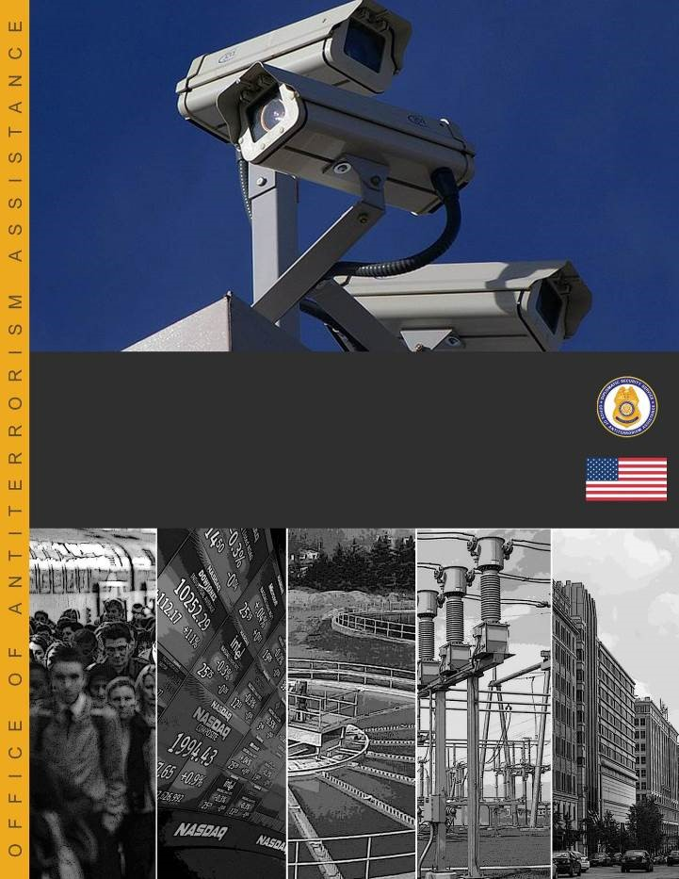
Facilitator Answer Key
July 2016—v4.00
Critical Infrastructure and Security Resilience
Threaded Exercise Workbook

